Slide 1

Statements – Noughts & Crosses
In this game two teams of students try to get three Os or Xs in a row.
Students can complete as many questions as possible and then
be given the opportunity to answer for their team.
Otherwise, questions can be chosen in turns, or directed by the teacher.
An answer sheet for the teacher, and handouts, are included.
Click/Touch ‘X’ or ‘O’ according to which team gets the answer correct.

Slide 2


Statements

Slide 3




£500
£620.50
£255
Transaction | Credit | Debit | Balance
Salary | 200
Salary | 250 |  | ?
Transaction | Credit | Debit | Balance
Transfer | 143.45
Interest | 6.92
Elec. |  | 56.72 | ?
Transaction | Credit | Debit | Balance
ATM |  | 70
Tax |  | 92 | ?
£213.47
£862.16
£373
Transaction | Credit | Debit | Balance
Internet |  | 45.61
Hamsford |  | 2.99
Deposit | 55 |  | ?
Transaction | Credit | Debit | Balance
Refund | 22
Tax Bill |  | 1403
Upay.com | 215.40 |  | ?
Transaction | Credit | Debit | Balance
Wages | 512.50
IO.com |  | 29.99
Max LTD |  | 56 | ?
£672
£1205.88
£800
Transaction | Credit | Debit | Balance
Wage | 451
Mort. |  | 722 | ?
Transaction | Credit | Debit | Balance
Fees |  | 22.50
Wages | 1340
XTR Inc |  | 8.75 | ?
Transaction | Credit | Debit | Balance
ATM |  | 160
Salary | 610 |  | ?

Slide 4
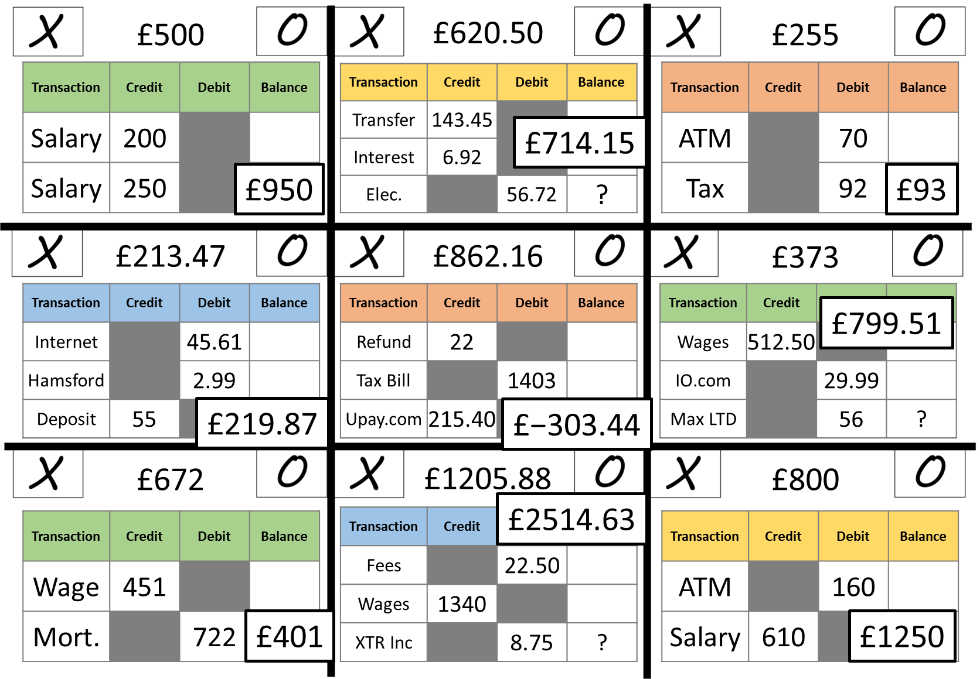
Teacher’s Answer Sheet

Slide 5
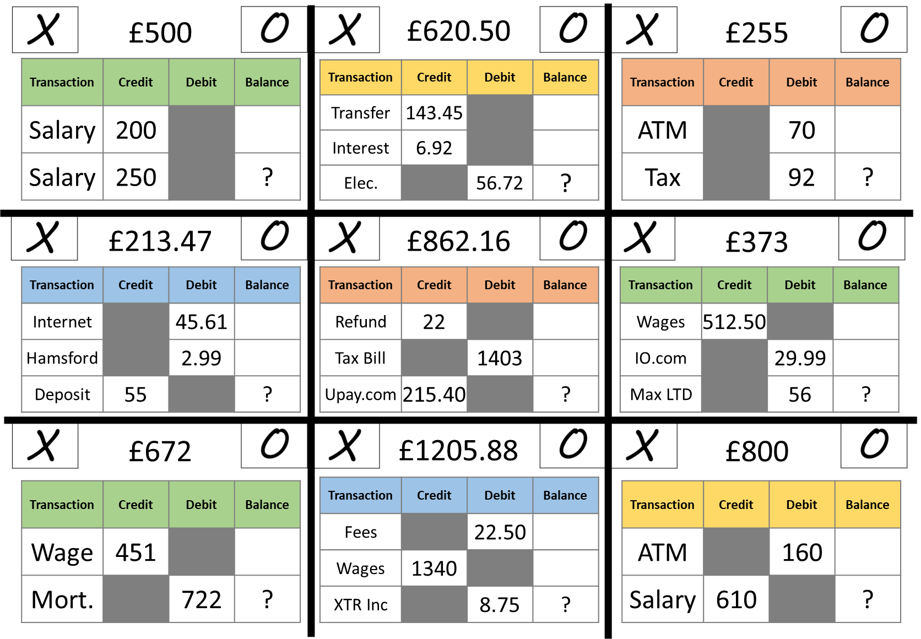

Slide 6
Questions?
Comments?
Suggestions?
…or have you found a mistake!?
Any feedback would be appreciated ☺.
Please feel free to email:
tom@goteachmaths.co.uk

