Slide 1

Project Jukebox
Presented by - Aman Pandey
Guided by – Mr. Vaibhav Diwan
Mrs. Pushpa

Slide 2
CONTENT
Objective
Database Section
Step by Step Flow
Flow Chart
Coding Section
Code Overview
6(i). Package Overview
Beanpackage Overview
Exception
Dao Package Overview
AudioPlayer

Slide 3

Objective of the Project
To create a Jukebox that can -:
1) Play Songs
2) Create Playlist , Retrieve Existing Playlist
3) Add songs In the Playlist
4) Perform Different tasks While Playing song
i) Pause ii) Resume iii) Stop song iv) Restart v) Skip

Slide 4
DATABASE SECTION
What is Database?
Database is used to Store Information in a Tabular Form.
Databases are used for storing, maintaining and accessing any sort of data. They collect information on people, places or things. That information is gathered in one place so that it can be observed and analyzed

Slide 5
Step by Step Flow.
Step 1 : Create 1 Database using MySql, Which can store different tables According to requirement .
Step 2 : Create 3 Tables
1. For Storing songs.
2. To store Newly Created Playlist Id and Name.
3. To Store playlistId and songId.

Slide 6
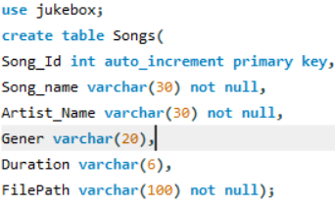
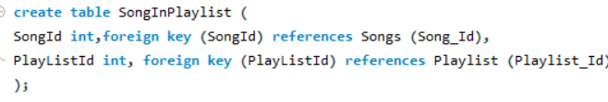
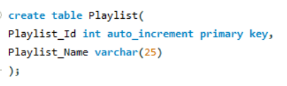
To Create SongsInPlaylist Table
To Create Songs Table
After Creating the table You can Insert the Values in the Table.
After inserting values, We have to Use Java to Create Playlist and to Play song and do other Operations.
To create Playlist Table

Slide 7
Jukebox Database
Song Name
Songs
PlayList
SongsInPlaylist
Genre
Artist Name
Filepath
Playlist ID
Playlist ID
SongID
PlayList Name
Primary Key
Foreign Key
Duration
SongID
Flow Chart
Primary Key

Slide 8


Primary Key -:
Primary Key is a constraint Uniquely identifies each row in a data table.
Foreign Key -:
A foreign key is a field in a table that refers to the primary Key of another table. It Links 2 or more Tables.
Foreign Key
SongInPlaylist Table
Playlist Table

Slide 9
Coding Section
In the coding section we use java Language as a Programming language.
To retrieves the data from the database, and to add data in the database.
Operation we need to perform in this coding Section.
1) Retrieve song Table from the database.
2) Add Playlist in the PlayList table of the Database.
3) Add song in the Playlist, User need to select the Playlist Id.
4) Delete Playlist from the Playlist Table.

Slide 10
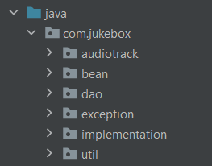
CODE EXPLANATION
To write the code more efficiently we are using one IDE(integrated development environment) “IntelliJ”.
Inside this IDE we have created one project Named Jukebox .
Inside this Jukebox project we have created some Packages in the package section so that our project looks
pretty clear to the observer.
Now, we have to Identify classes inside these Packages.
These Packages contains different classes according to requirement.

Slide 11
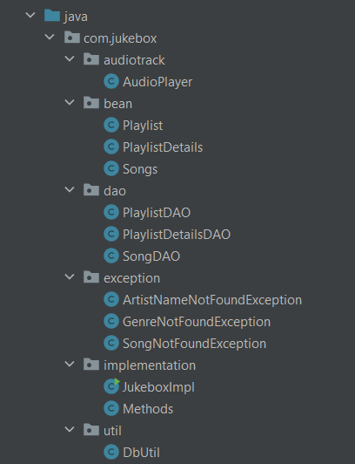
CLASSES
Classes are not real world entity it is just a blueprints from which Objects are created.
A class is a group of different types of attribute and Behaviours.
As, you can see in the image, that we have created some packages and inside those packages we have created some classes which consist some methods and attributes.

Slide 12
bean Package
Songs
Bean package contains 3 classes
Playlist
Playlist Details
dao Package
SongsDAO
Dao package contains 3 classes
PlaylistDAO
PlaylistDetailsDAO

Slide 13
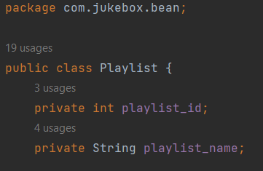
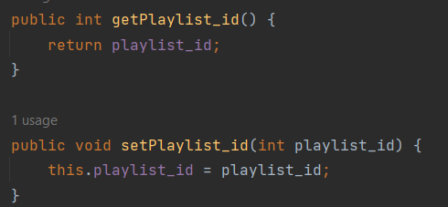
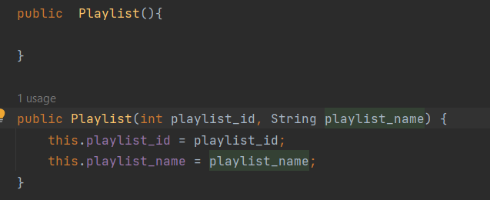
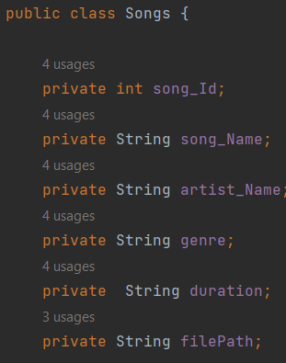
Bean Package Classes Overview
Playlist Class
This playlist class is having 2 private instance Variable (playlist_Id, playlist_Name).
So, Whenever the Attributes are Private, then to access them in different package or class we have to use getters and setters method.
Songs Class
This Songs class is having 6 private instance Variable (song_Id, song_Name, artist_Name, genre, duration, Filepath).
Playlist Details Class
This class having 2 variable 1)Playlist_Id 2) Song_Id

Slide 14
Dao Package Overview
SongDAO Class Overview
This method connects to the database by executing sql query and return the data present in Song table as a List.
getAllSongs
displaySongs
This method takes the list as a argument and print that list in console in a specific way.
searchBy
By using this searchBy method we can search the Artist name, Song-Name, Genre. I have use Like command of sql for this . And returns List of type song.
songToPlay
This songToPlay method provide the filePath of the songs to the audio File.

Slide 15
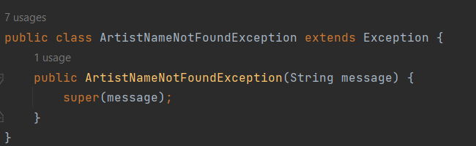
Exceptions
Exception is like unwanted error that can occur during the Run time of the program. To handle those exception we use Try & catch Blocks so that Our Normal flow of the program doesn’t disturb.
In previous slide we have a searchBy method that method is going to throws some User defined Exceptions.
ArtistNotFoundException
Super Class
SongNotFoundException
GenreNotFoundException

Slide 16
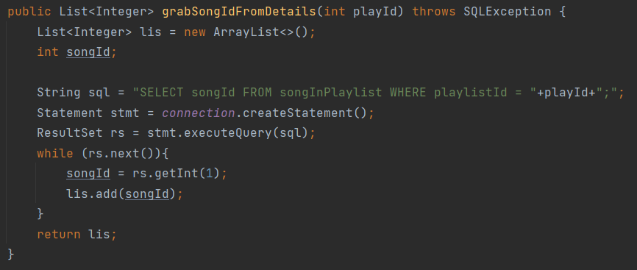
PlaylistDetailsDAO Class
addSongInPlaylist
This addSongsInPlaylist method take 2 args (SongId, PlaylistId) after performing all the required operation in the block it returns a String.
songInPlaylist
This method is going to take a List of integer type from the grabSongId method and returns a list of songs.
grabSongId
This grabSongId method is taking an argument playid as an input from the user and returns a list of Integer type.

Slide 17
PlaylistDAO
This method takes a String name as a parameter, and checks whether the name exist or not and returns a Boolean value(True, False).
playlistExist
This method takes a string as a parameter and helps us in creating playlist and add song in playlist
createPlaylist
This method takes a Playlist object as a parameter, so that we can access the Playlist class and returns a String.
deletePlaylist
getAllDetails
This method returns a List of Playlist
displayPlaylist
This method displays the list on the console

Slide 18
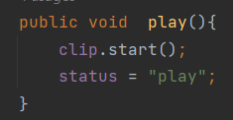
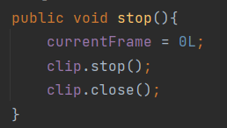
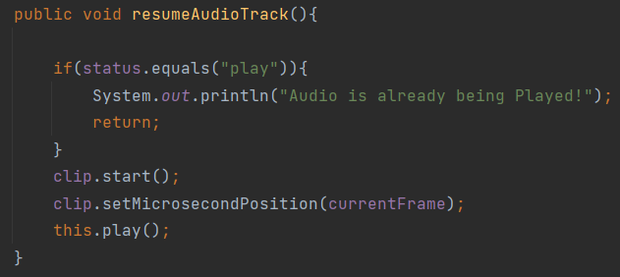
audioTrack Package
AudioPalyer
This Audio Player class Perform different tasks.
Play
Pause
Resume
Restart
Stop
Shuffle
Skip/Jump

Slide 19
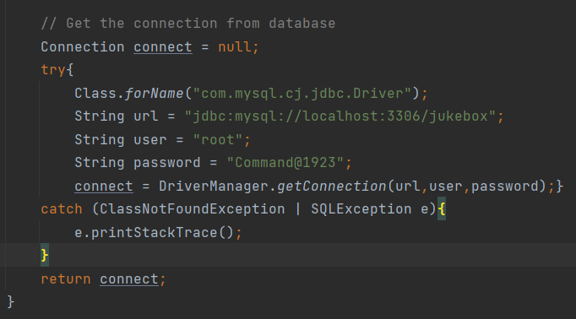
Establishing Connection

Slide 20
Thank You.

