Slide 1
Analysis of a Specific StartUp
StartUp Chosen: TurtleMint
Name : Aman Patni
Roll Number: 103120080

Slide 2
When is a Company called as a StartUp ?
According to the Ministry of Commerce and Industry, an entity that is registered as a private limited company as defined in the Companies Act, 2013 or registered as a partnership firm under section 59 of the partnership act, 1932 of a limited liability company under the LLP Act of 2008 in India is called a startup if:
Its period of existence from the date of incorporation is less than 10 years,
Its annual turnover does not exceed Rs 100 crore in a financial year.
It is working towards innovation, development, improvement of products or processes or services.
Or, if it is a scalable business model with a high potential for employment generation or wealth creation.
Source

Slide 3

Insurtech platform Turtlemint has onboarded Mahendra Singh Dhoni as its brand ambassador.

Slide 4
Company Overview
Founded Year 2015
Location Mumbai, India
Company StageSeries E
Total Funding $250M
Last Funding Round $120M, Series E, Apr 29, 2022
Valuation $780M as on May 30, 2022
Annual Revenue $7.95M as on Dec 31, 2020
Employee Count 2,433 as on Mar 31, 2022
Similar Cos. Policybazaar, NerdWallet, Turtlemint, Meilleurtaux
Source

Slide 5
What Problem does TurtleMint Solve?
95% of insurance in India is sold through an in-person consultancy because insurance fundamentally is a complex product. Consumers find it difficult to make a decision themselves, hence rely on an expert / in-person consultancy, eg financial advisors to help guide their purchase.
It was in the strength of this understanding where Turtlemint founders, Anand Prabhudesai & Dhirendra Mahyavanshi, saw an opportunity. Instead of using technology to change how people buy insurance, they chose to radically challenge how it is sold. Not by cutting out the middle man but by empowering them.
Turtlemint created a tech platform designed to help financial advisors to distribute insurance to their community of customers. The platform instantly made it simpler for financial advisors to match each customer with the best product & to close the deal with the burden of endless paperwork. Source

Slide 6

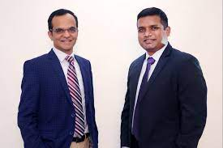
Present TurtleMint
Turtlemint is an online insurance platform that identifies and purchases appropriate insurance policies for consumers. It aims to “demystify” insurance by explaining the jargon in a simple way and providing smart tools to help a user make the right choice. From search to purchase, the entire process can be completed online in just a few clicks.The company offers car insurance, bike insurance, health insurance, and term life insurance.

Slide 7
Financial Statement Analysis of TurtleMint
From the Official Website we can get the Financial Statement of FY2020 and from other Open Sources from the Internet we can get Financial Data of FY2021.
Click Here for Document of FY2020
Click here for Comparision of FY2020 and FY 2021

Slide 8
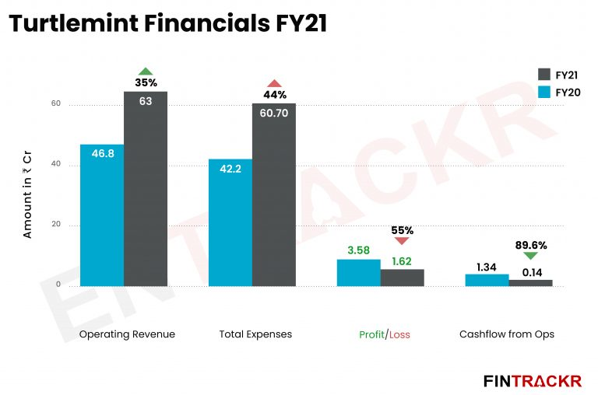

Slide 9
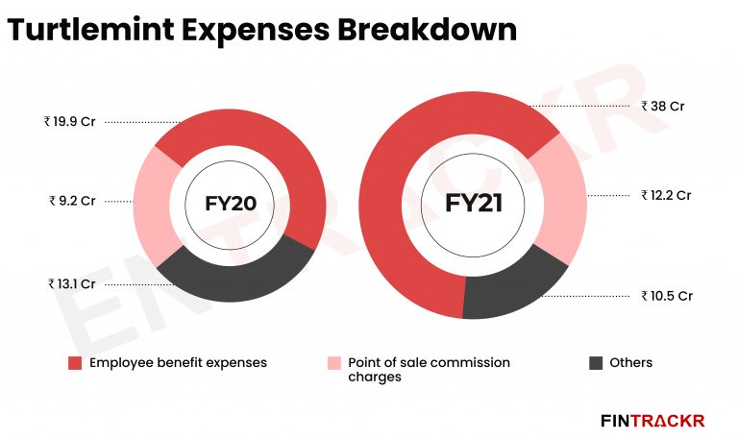

Slide 10
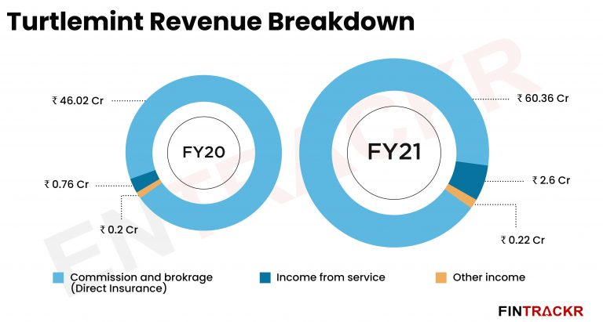

Slide 11
Inferences From above Analysis
Due to the reduction in profit, Turtlemint’s cash flow from operations fell to Rs 14 lakh in the last fiscal (FY21) which stood at Rs 1.34 crore in FY20. On a unit level, the company spent 0.96 paise to make a rupee of operating income in FY21.
Despite the pandemic, Turtlemint’s operating revenue grew in FY21, which is in line with the global climate as demand for insurance policies (especially those related to health) increased multifold in FY21, owing to the COVID-19 pandemic.
Even though the company’s profit fell in the fiscal, it managed to remain in the green which is a good sign for the eight-year-old company.

Slide 12
Acquisitions By TurtleMint
Turtlemint has acquired IOPhysics Systems on Nov 16, 2021.
IOPhysics Systems is a Pune-based cloud data analytics company.
Reasoning for the acquisition: As Turtlemint went into its next phase of growth, data science and data engineering have become critical focus areas.

Slide 13
Investors of the Company
The Company has around 16 investors till date.
Sequoia Capital, Amansa Capital, Jungle Ventures, Blume Ventures, American Family Ventures, MassMutual Ventures, GGV Capital Nexus Venture Partners, Vitruvian Partners, Marshall Wace are few names available openly on the internet.
Turtlemint raised $120 million in a round led by Amansa Capital, Jungle Ventures and Nexus Venture Partners recently in this year in Series E funding.

Slide 14
The Stakeholders and Founders of the StartUp
Turtlemint Founders
Anand Prabhudesai, Co-Founder
Dhirendra Mahyavanshi, Co-Founder
Kunal Shah, Co-Founder
Turtlemint Board Members
Anand Prabhudesai, Director
Nalinkumar Mahyavanshi, Director
Ravi Ganapathy, Nominee Director

Slide 15
How is TurtleMint Different From its Competitors
While rivals such as Paytm and Policybazaar sell insurance directly to customers, Turtlemint offers online training to insurance agents in smaller cities and towns, helping them sell coverage to consumers. Nearly 75% of the startup’s business comes from outside the country’s 30 biggest cities. It offers its service in six major Indian languages, including Hindi, Kannada and Tamil.
One of the first things that Turtlemint did after proving its Minimum Viable Product(MVP), was to digitise the journey of getting on boarded on the platform. Through their platform they digitised the process of training, licensing, verification, and more. As a result, advisors were able to download the Turtlemint app, go through the regulatory requirement, and complete the process in a faster, efficient manner, and start selling in an efficient manner.

Slide 16
How Did it Gain Control over its Audience?
India is a low trust market economy. One doesn’t join communities or brands or any cause about which you don’t know. Solving for trust at early stage of your business is critical for expansion.
Turtlemint solved the trust and awareness issue in their ways:
Power users became influencers- In markets where Turtlemint already had presence, their power users started spreading the message and the company was able to grow organically through WOM and references.
Promotions & events- In addition to digital promotion, Turtlemint hosted a packed calendar of intimate, on-ground events at which the team set about converting advisors into users, users into power users & power users into vocal champions.
Endorsements- Getting the big insurers on board was equally and if not more important. These would instantly lend Turtlemint credibility & show financial advisors that they could now access a broader range of products and the big brands also served as a secondary endorsement for Turtlemint.

Slide 17
Speculation of the Company Future
#ActiveHoJaao
Insurance, one of the most traditional and highly regulated industries in India. Despite being a massive $280Bn industry, it has achieved only a tiny fraction of its potential with only 4% of the population having an insurance cover to date (global average 6%).
With Strong and Skilled Founders and trustworthy Backing of Investors , Becoming a Unicorn is Just the matter of time for the StartUp.
InsurTech in Emerging Country can help Solve the expertise barrier and Accessibility Barrier for the common population of the Nation.
Being a Tech Company, It also has a lot of potential to further expand in the globe and solve its Objective.

Slide 18
Note:
The data is sourced from the Internet from reputed Website.
More Data available on the net, but requires special access which I don’t have.
Data provided have a possibility of not being precise, as observed some sites show different data for same data point.
Thank You !

