Slide 1


NAME- SWEETY KUMARI
STUDENT CODE- BWU/BBA/23/104
SECTION-”B”
COURSE CODE- BBA20002
COURSE NAME – BUSINESS COMMUNICATION

Slide 2

EXPLAIN ELEMENTS
,PROCESS AND PRINCIPLES OF COMMUNICATION

Slide 3
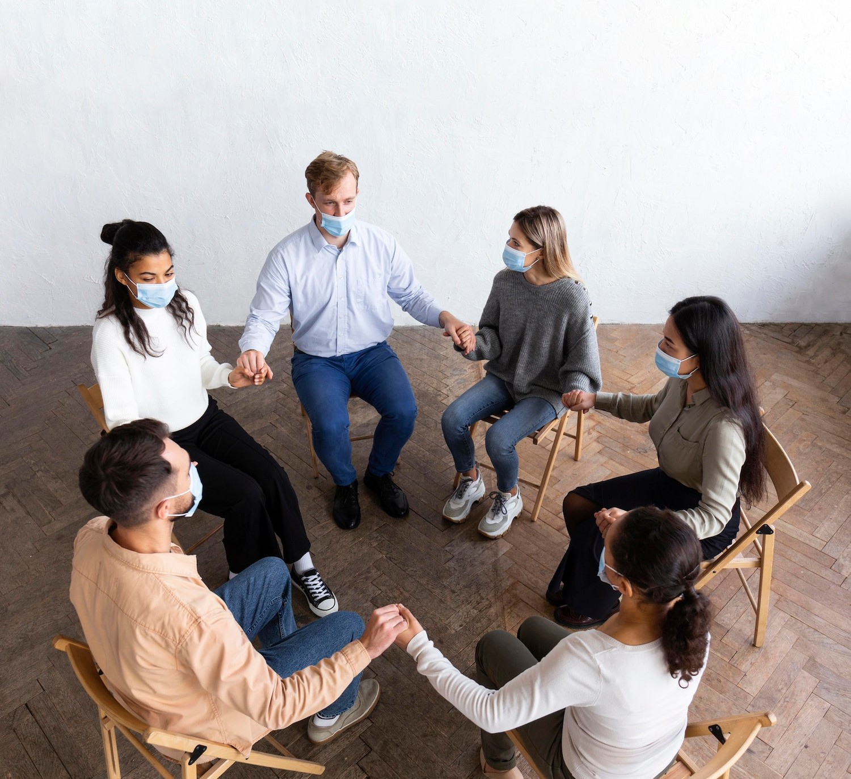





INTRODUCTION
This presentation will the
, , and of communication. We will delve into the
various aspects of verbal and non- verbal communication, as well as the role of in modern
communication.

Slide 4
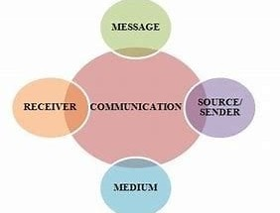





ELEMENTS OF COMMUNICATION
Communication involves the
, , , and
. Understanding these
,
elements is crucial for e ective communication in any context, whether interpersonal, organizational, or mass communication.

Slide 5
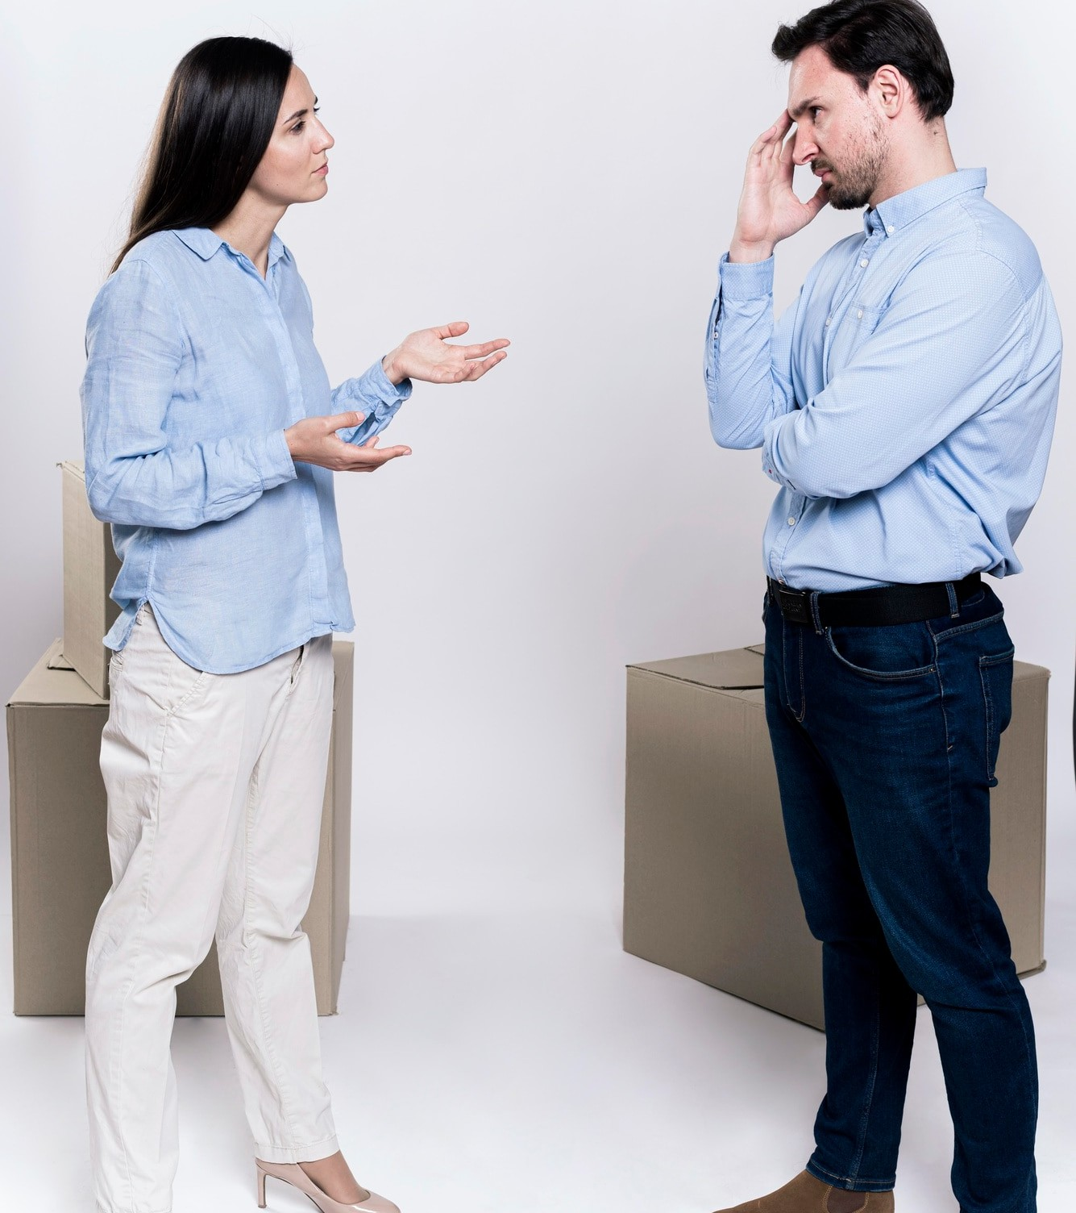
VERBAL VS. NON-VERBAL COMMUNICATION
Verbal communication involves spoken or written words, while non-verbal communication includes Body language, facial expression, and Gestures. Both forms play a vital role in conveying messages accurately and effectively.
,

Slide 6


COMMUNICATION PROCESS
Encoding
Decoding
The sender organizes their thoughts and translates them into a message using words, gestures, or other forms of communication.
The receiver interprets the message, drawing on their own experiences and understanding to make sense of the information.
1
2
3
Transmission
The message is conveyed through a channel, such as speech, email, or body language, to the receiver.

Slide 7

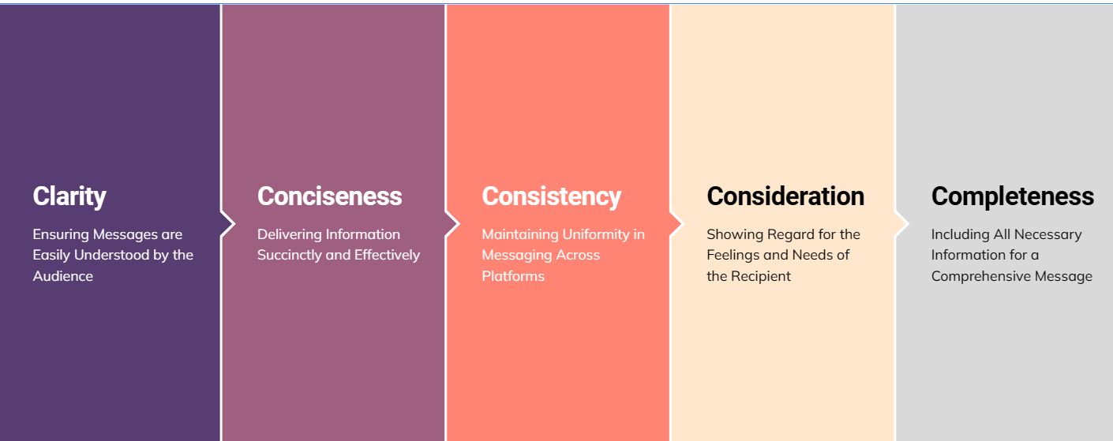
PRINCIPLES OF EFFECTIVE COMMUNICATION
Effective communication is guided by principles such as clarity, conciseness, consistency, consideration and completeness. Adhering to these principles enhances the quality of communication and minimizes misunderstandings.

Slide 8

ROLE OF TECHNOLOGY IN COMMUNICATION
Technology has revolutionized communication through various platforms such as email, social media, and video conferencing. It has facilitated global connectivity and transformed the way individuals and organizations interact.

Slide 9
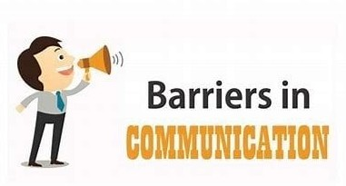
BARRIERS TO EFFECTIVE COMMUNICATION
Barriers such as language barriers, cultural differences, physical barriers, and psychological barriers can hinder effective communication. Understanding and addressing these barriers is essential for successful communication.

Slide 10
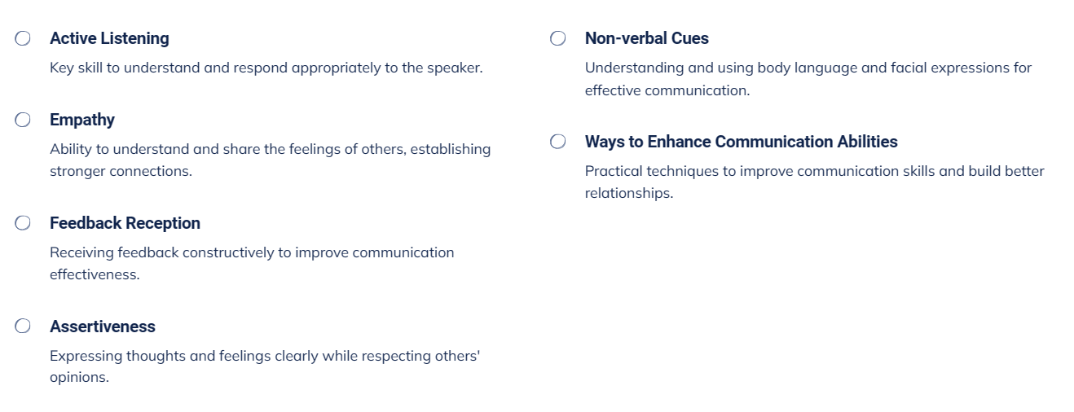
Mastering Effective Communication Skills

Slide 11
CONCLUSION
Effective communication is a cornerstone of success in personal, professional, and societal interactions. By understanding the elements, processes, and principles of communication, individuals can enhance their ability to convey and receive messages accurately and meaningfully.

Slide 12

Thanks!
Do you have any questions?

