Slide 1
HACKTOBERFEST HACK DAY 2026 · AI FOR OPEN SOURCE
psf/requests
Handoff
515
What do we lose when a maintainer leaves, and what should we do before they go?
people have contributed code
3
people hold most of the code knowledge (truck factor)
1
Measure
2
Explain
3
Verify
Live demo: handoff-mu-mauve.vercel.app
Notes:
Open with the hook: requests has 515 contributors, but if just 3 key people left, more than half its files would have no remaining expert. That's the truck factor. Handoff answers one question: if a specific maintainer leaves, which code loses its last expert, and what should the team do before they go? It does three things: measure who knows what from Git history, explain the risky code with a local AI model, and verify every claim the AI makes.

Slide 2
THE PROBLEM
Knowledge leaves with people
!
Contributor counts hide it
Handoff gives a team three answers
Hundreds of names, but most made one-off changes.
Impact numbers How bad is it?
1
13 files lose their only expert; truck factor 3 → 2
!
Teams find out too late
When a bug lands in code nobody left can explain.
Ranked code Where does it hurt most?
2
Folders ranked by risk, with a suggested successor
!
“Please write docs” doesn't work
Nobody knows what to document, or for whom.
Knowledge-transfer plan What do we do now?
3
What the code does, its traps, questions to ask, tasks
Notes:
Knowledge in open source is concentrated in a few people, and contributor counts hide that. Projects find out only after someone leaves. Handoff gives three layers of answer: how serious the departure is (impact numbers), where it hurts most (ranked folders with a successor), and what to do about it (a knowledge-transfer plan with questions to ask the person while they are still around).

Slide 3
HOW IT WORKS
Math decides, AI explains, code checks
Git history
Analysis
AI explains
Checker
KT plan
Every commit: who, when, which files
Who knows what, and what's lost. Pure math, no AI.
A local model writes notes on the risky code
Drops every claim it can't trace to evidence
Cited plan + web page
Reproducible
Right job for the AI
Measurable trust
Risk comes from math, so it can't be hallucinated.
LLMs are good at explaining, bad at judging what matters.
The checker turns “trust the AI” into a number.
The two halves meet in one file (analysis.json), so they were built in parallel by two people.
Notes:
The most important slide for Q&A. The analysis half uses math on Git history to decide what is at risk, with no AI, so results are repeatable. The generation half asks a local AI model to explain the risky code, but only from evidence we hand it, and a checker written in ordinary code removes claims whose citation doesn't point to that evidence. The halves only meet in one JSON file.

Slide 4
PART 1 · FINDING THE EXPERTS
Who knows what, and what's lost
Three signals → one expertise score per file
13
Created it
Changed it often
Others edited it
+
+
−
files lose their only expert
Degree of Authorship, from published research. A high enough score makes you an author (expert).
100% → 65%
If Kenneth Reitz leaves psf/requests:
files that still have an expert
models.py
ORPHANED
only Kenneth knows it
3 → 2
compat.py
AT RISK
Kenneth and Nate know it
truck factor
_types.py
SAFE
only Nate knows it
Then folders are ranked by how much important code (size, imports, recent work) loses its expert.
Notes:
Git shows three behaviours that track knowledge: creating a file, changing it often, and other people changing it afterwards (which makes your knowledge stale). The Degree of Authorship formula (Fritz et al.; Avelino et al.) combines them into a score; above a threshold you count as an author, i.e. an expert. Remove the leaver: files where they were the only expert are orphaned; files where someone else also knows them are at risk. Coverage is the share of files that still have an expert; the truck factor is how many people can leave before more than half the files have none. Folders are then ranked by importance (40% size, 40% how many files import it, 20% the leaver's recent work; our own weights), and each gets a successor: the best person who has worked on it and committed in the last 12 months. We clean the history first: bots and 100+-file commits don't count, renames keep history, and one person's emails are merged.

Slide 5
PART 2 · THE KNOWLEDGE-TRANSFER PLAN
Every claim must show its proof
Evidence pack
AI notes, each claim cited
Checker
Cited plan
81 / 94
“Reverting the max_retries change caused issues”
claims verified on the requests plan. The rest were dropped.
KEPT
commit 23d8522 was in the evidence
“LookupDict is at structures.py line 91”
DROPPED
never shown: the class is really at line 96
“Why is the urllib3 version check so complex?”
ASKED
intent isn't in the evidence, so it's asked
Verified = correctly cited, not guaranteed true. Every claim links to its line on GitHub.
Local, open model: code never leaves the laptop.
Notes:
For each risky file we build an evidence pack: the code outline with line numbers, the leaver's commit messages, their TODO/FIXME/HACK comments and their fix/revert commits. A local model (qwen2.5-coder 7B via Ollama) writes notes where every claim must cite a line or commit. A checker in plain Python drops claims whose citation wasn't in the evidence; when intent isn't in the evidence the model must ask a question instead. On requests, 81 of 94 claims were kept. We picked the model by measuring: Qwen 86% vs Gemma 63%, because Gemma got line numbers wrong. Be honest: verified means the citation is real, not that every sentence is right; that's why every claim is one click from its source. The plan then gives, per folder: what it does, how to work in it, rules not to break, known landmines, questions to ask before they leave, and handoff tasks.

Slide 6
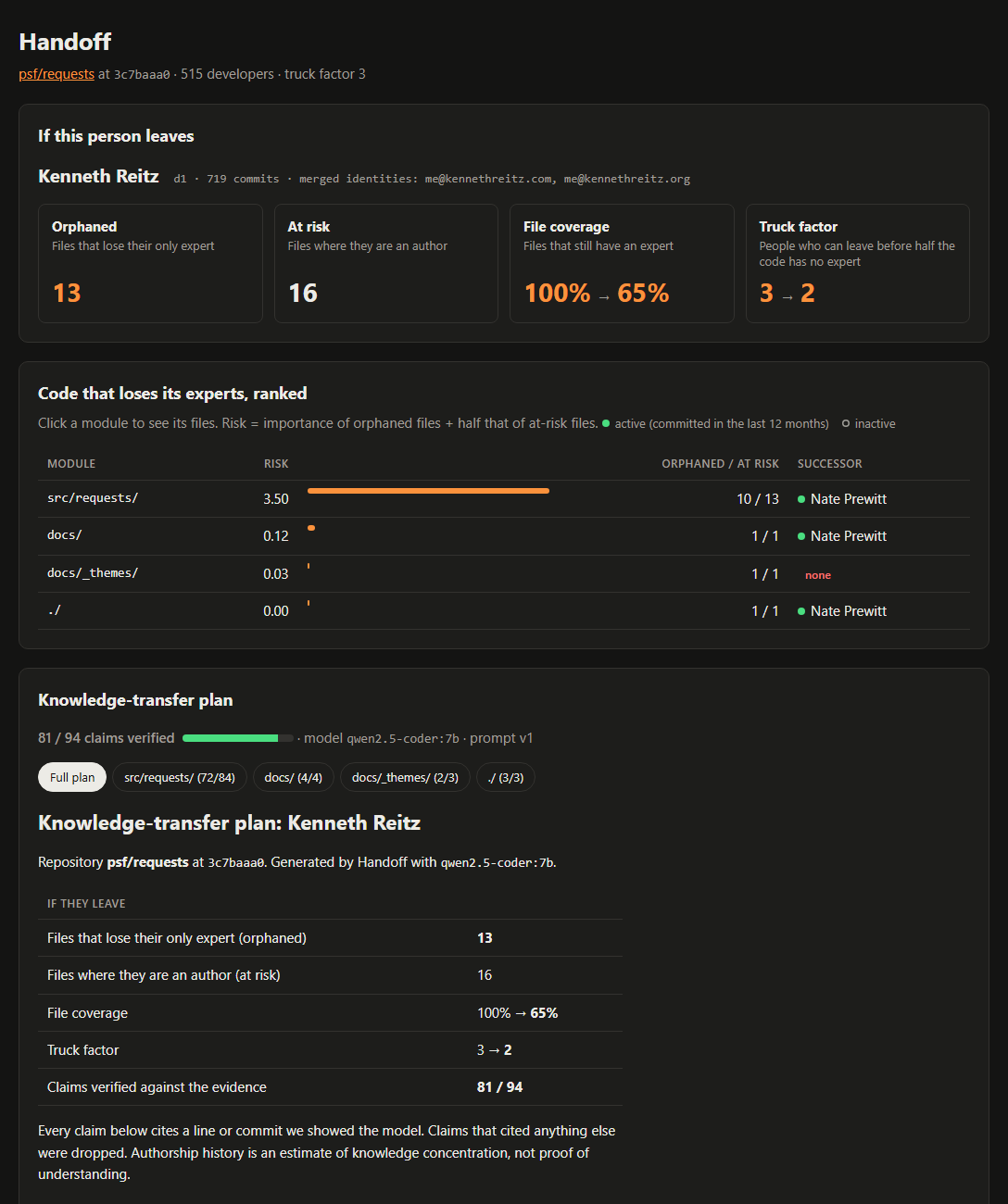
SEE IT WORKING
From a GitHub URL to a cited plan
Demo page · live on Vercel
Impact, ranked folders, heatmap and the plan with clickable citations, for 3 sample repos. Read-only; needs no GPU.
Try it: handoff-mu-mauve.vercel.app
Handoff Studio · any repo, locally
• Paste any GitHub URL: it clones and analyses
• Pick who leaves, see the impact instantly
• Generate with a live progress bar; stop and resume
• Top 5 / 10 / all files per folder; delete runs
Notes:
Live demo for judges: https://handoff-mu-mauve.vercel.app/ (switch repos with the picker, or add ?repo=typer). It is a static site on Vercel serving saved results for psf/requests, pallets/click and fastapi/typer; generation is not hosted because it runs a local model on a GPU and code never leaves the machine. Two front ends. The demo page (handoff serve, or the Vercel site) shows saved results and needs no GPU. Handoff Studio (python -m handoff.studio) runs the whole flow on any repo from the browser: clone, pick who leaves, generate the plan with progress, limit files per folder to save time, stop and resume (finished files are cached), and delete runs. Active developers get a filled dot, inactive ones a hollow grey dot. A full plan for requests takes about 2.5 minutes on a laptop GPU.

Slide 7
BEING HONEST
What's proven, what's ours, what's next
From published research
Our documented choices
Limits we state openly
• Expertise score (DOA)
DOA = 3.293 + 1.098·FA + 0.164·DL
− 0.321·ln(1 + AC)
FA created it · DL own · AC others' commits
Fritz et al., ICSE 2010 · ACM TOSEM 2014
• Expert rule
normalised DOA > 0.75 and DOA ≥ 3.293
• Truck factor
remove top experts until < 50% covered
both: Avelino et al., ICPC 2016
• Importance weights
40% size · 40% files importing it
20% leaver's commits, last 12 months
• Folder risk
orphaned ×1 + at-risk ×0.5 · top 5 folders
• Successor
active in last 12 months · highest total DOA
• Filters
no bots · no commits over 100 files
source code only (no vendor or build)
• Git history isn't understanding
• Verified ≠ guaranteed true
• Python gets the most detail
Handoff finds the code only one person understands, and turns their departure into a checked, cited plan.
Try it: handoff-mu-mauve.vercel.app Next: GitHub Action · Co-authored-by · CODEOWNERS check MIT · runs locally
Notes:
Close by being honest. REFERENCES: (1) T. Fritz, J. Ou, G. C. Murphy, E. Murphy-Hill, 'A degree-of-knowledge model to capture source code familiarity', ICSE 2010, pp. 385-394. (2) T. Fritz, G. C. Murphy, E. Murphy-Hill, J. Ou, E. Hill, 'Degree-of-knowledge: modeling a developer's knowledge of code', ACM TOSEM 23(2), 2014. These define the Degree-of-Authorship formula and its coefficients (3.293, 1.098, 0.164, -0.321). (3) G. Avelino, L. Passos, A. Hora, M. T. Valente, 'A novel approach for estimating truck factors', ICPC 2016: they normalised DOA, set the expert thresholds (normalised DOA > 0.75 and DOA >= 3.293, tuned against git-blame) and defined the greedy truck-factor algorithm, tested on 133 GitHub projects. Importance = 40% file size (lines of code) + 40% fan-in (how many other files import it) + 20% the leaver's commits to it in the last 12 months, each scaled 0-1 within the repo. Folder risk = sum of importance of orphaned files (x1) plus at-risk files someone else also knows (x0.5); the top 5 folders go on to the KT plan. Successor = among developers other than the leaver who committed in the 12 months before the repo's latest commit, the one with the highest summed normalised DOA over the folder's files; 'none' if nobody qualifies. Filters: bot accounts (dependabot, renovate, github-actions, [bot] ...) and commits touching more than 100 files are never credited (the 100 is configurable with --bulk-limit); only source-code files that still exist count, skipping vendor/, node_modules/, dist/, build/, minified and generated files. All of these are our own documented choices, not from research. Limits: Git history isn't understanding, verified isn't guaranteed true, Python gets the richest evidence.
Q&A CHEAT SHEET
- Why not git blame? Blame is a snapshot: it loses renames, credits whoever reformatted last, and forgets the creator.
- How do you stop the AI making things up? It only sees evidence we pick; every claim needs a citation; a checker drops the rest (81/94 kept).
- Why a small local model? Open-weight, free, private (code never leaves the laptop), ~2.5 min per plan.
- Where do the numbers come from? Expertise and truck factor: published research. Importance weights: our choice.
- What if the GPU fails in the demo? Results are cached; the demo page needs no GPU.
- 500+ contributors but only 4 developers? Only source-code files count; one-line list edits aren't code expertise.
- More commits but not the top expert? Expertise is per file and goes stale when others rewrite your code.
- Why is the successor sometimes 'none'? Nobody active in the last 12 months has worked on that folder.
- Is risk between 0 and 1? No: it adds up importance across a folder's files; compare within one repo.
- Why top 5 folders? Time (each file is a model call) and focus; risk is usually concentrated.
- Why a successor per folder? Teams own areas, not files; per-file signals are too thin.
- Other languages? Yes, with less detail: the history math is language-agnostic; imports are Python-only.
- Does it post to GitHub? Never; it writes local files for a human to review.

