Slide 1



SliceMatic
MVP Live Demo
Validated, file-based digital ordering system — built to spec, running live.
Slicematic Application
Group 3
Mouli Murakambattu · Shaik Mohammed Pasha · Aman Sharma · Saurabh Sekhar · Sushant Kumar
FDE Academy · PizzaFlow Applied Project · 30 June 2026
Notes:
Hello everyone, we are Group 3. Today, we are excited to present the MVP Live Demo for the SliceMatic PizzaFlow project. What you are about to see is a fully validated, digital ordering system that we built strictly to spec, and it is currently running live in production.

Slide 2







WHAT WE BUILT
The MVP in one minute
A guided, fully-validated pizza ordering flow that prices every order deterministically and persists it in a parseable log — no manual math, no crashes, every order captured.
8 / 8
100%
All
0
Edge cases handled
Zero unhandled crashes
Bills computed by one deterministic engine
Order appended to a parseable log
Code changes to swap the menu files
How it works under the hood
Menu loaded at runtime from 3 .txt files (Base · Pizza · Topping) — defensively parsed, never hardcoded.
Pricing engine runs 6 fixed steps: unit price → subtotal → 10% discount at qty ≥ 5 → 18% GST on the post-discount total → payable.
Completed orders are appended to orders_log.txt, pipe-separated, one block each — ready for AOV, peak-hour & break-even analysis.
SliceMatic · PizzaFlow MVP Demo
2
Notes:
To summarize our MVP in one minute: We built a guided pizza ordering flow that handles all edge cases and prices every order with 100% mathematical accuracy. Under the hood, nothing is hardcoded. Our menu loads dynamically from text files, our pricing engine follows a strict 6-step deterministic calculation, and every completed order is safely persisted into a parseable log.

Slide 3





DEMO WALKTHROUGH
The order journey — what you'll see
Six guided steps from launch to a confirmed, saved order. Every step validates input and loops back on anything invalid.
1
2
3
Customer intake
Menu selection
Quantity
Name + phone, validated
Base · Pizza · Topping by number
1–10; 10% off at qty ≥ 5
4
5
6
Itemised bill
Payment
Saved & confirmed
Engine computes discount + GST
Cash / Card / UPI + confirm
Appended to orders_log.txt
SliceMatic · PizzaFlow MVP Demo
3
Notes:
We will now walk you through the customer journey. It consists of six guided steps: Customer Intake, Menu Selection, Quantity, Itemised Bill, Payment, and Confirmation. At every single step, our system validates the user's input to ensure the business never receives bad data.

Slide 4


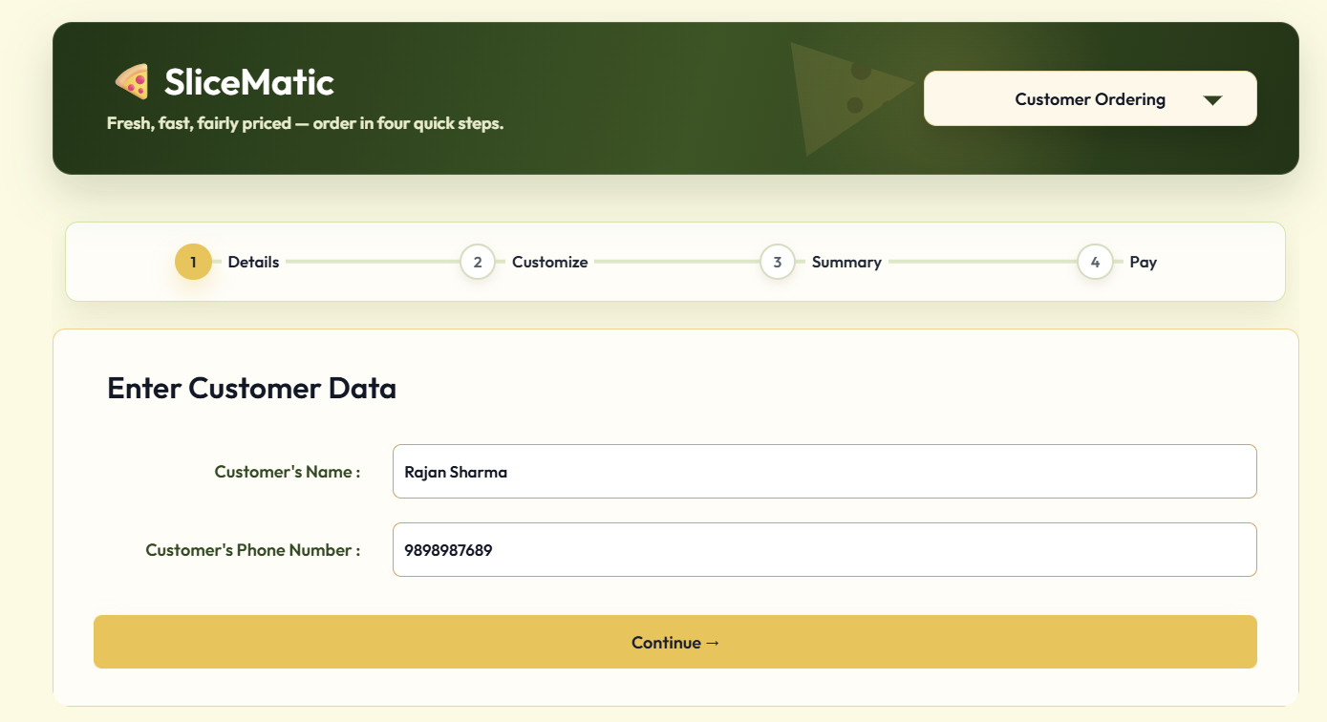


STEP 1 · CUSTOMER INTAKE
Name & phone — validated on entry
Name alphabets & spaces only, 2–40 characters.
moulsai2296-pizzaflow-v2.hf.space
Phone exactly 10 digits, must start with 6, 7, 8 or 9.
Session timestamp logged the moment the order starts.
Rejected input gets a specific message, then re-prompts.
Screenshot
Name + phone entry screen (try a valid name & 10-digit number)
1
SliceMatic · PizzaFlow MVP Demo
4
Notes:
Step 1 is Customer Intake. We don't just accept any text; the name is validated for characters, and the phone number must be exactly 10 digits starting with an Indian mobile prefix (6 through 9). The exact timestamp of the session is logged instantly.

Slide 5
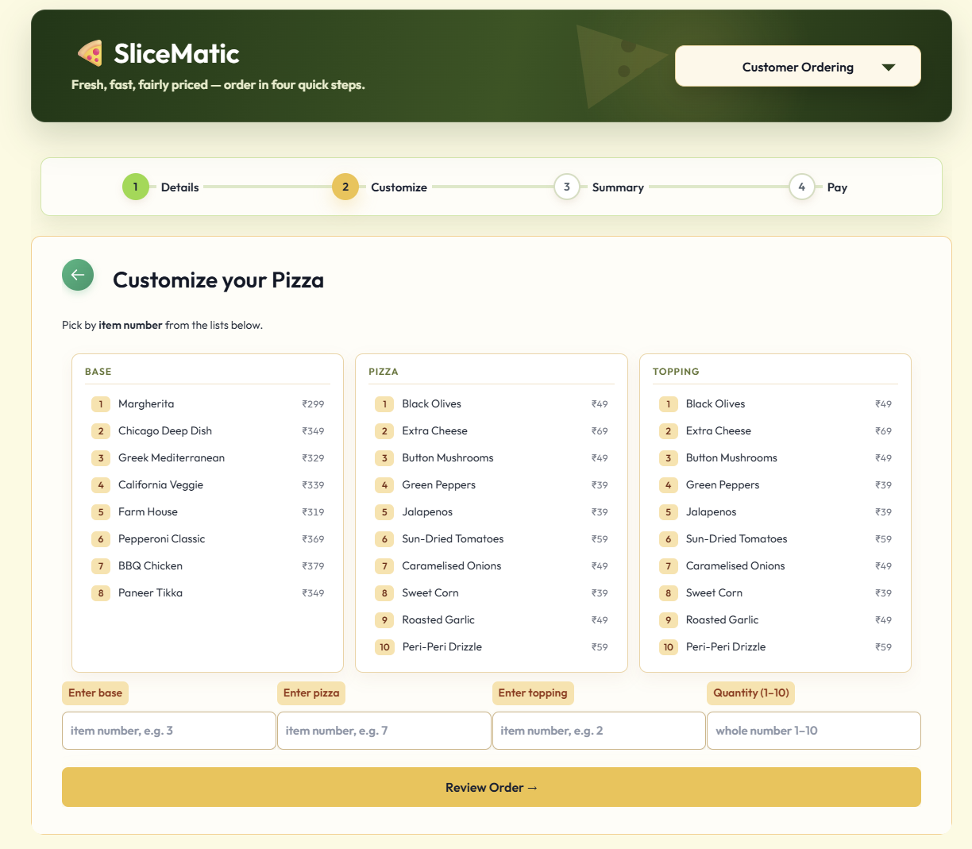
STEP 2 · MENU SELECTION
Pick base, pizza & topping — by number
Loaded live from 3 .txt files — names & prices in INR.
moulsai2296-pizzaflow-v2.hf.space
One of each a Base, a Pizza and a Topping per order.
Select by number only valid in-range numbers accepted.
No hardcoding edit the file → new menu, zero code change.
Screenshot
Menu screen showing Base / Pizza / Topping numbered lists
2
SliceMatic · PizzaFlow MVP Demo
5
Notes:
"Step 2 is Menu Selection. The user picks their Base, Pizza, and Topping. Because we built this dynamically, the app reads directly from our menu files. If the owner updates a price in the text file, this UI updates automatically—no code changes required."

Slide 6
STEP 3 · QUANTITY
Quantity 1–10 — discount auto-triggers
moulsai2296-pizzaflow-v2.hf.space
Integer 1–10 rejects 0, 11, negatives, floats & text.
Capacity cap max 10 pizzas per order, with an explanation.
10% discount applies automatically at quantity ≥ 5.
Screenshot
Quantity prompt (enter 5 to trigger the 10% discount)
3
SliceMatic · PizzaFlow MVP Demo
6
Notes:
"Step 3 asks for Quantity. We cap orders at 10 pizzas to manage capacity. More importantly, this is where our business logic kicks in automatically: if a customer orders 5 or more pizzas, the system seamlessly triggers a 10% discount."

Slide 7
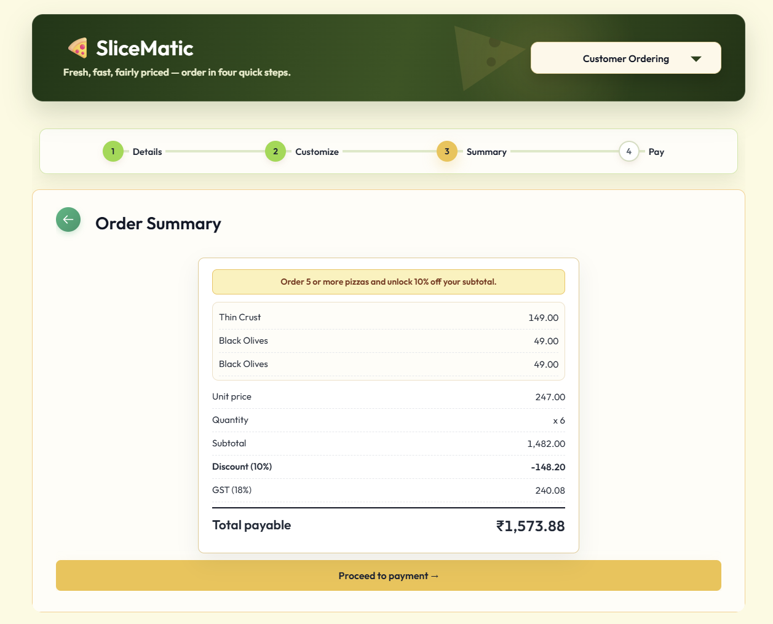
STEP 4 · ITEMISED BILL
The bill — every rupee accounted for
Itemised Base + Pizza + Topping, qty, unit price, subtotal.
moulsai2296-pizzaflow-v2.hf.space
Discount line 10% shown when quantity ≥ 5.
GST @ 18% charged on the post-discount taxable amount.
Final payable rounded to 2 decimals, INR on every line.
Screenshot
Itemised bill: unit price, subtotal, discount, GST, total
4
SliceMatic · PizzaFlow MVP Demo
7
Notes:
"Step 4 generates the Itemised Bill. Transparency is key. The customer sees exactly how the cost is broken down—the unit price, the subtotal, the applied discount, and the 18% GST which is strictly calculated on the post-discount taxable amount. Every rupee is accounted for."

Slide 8
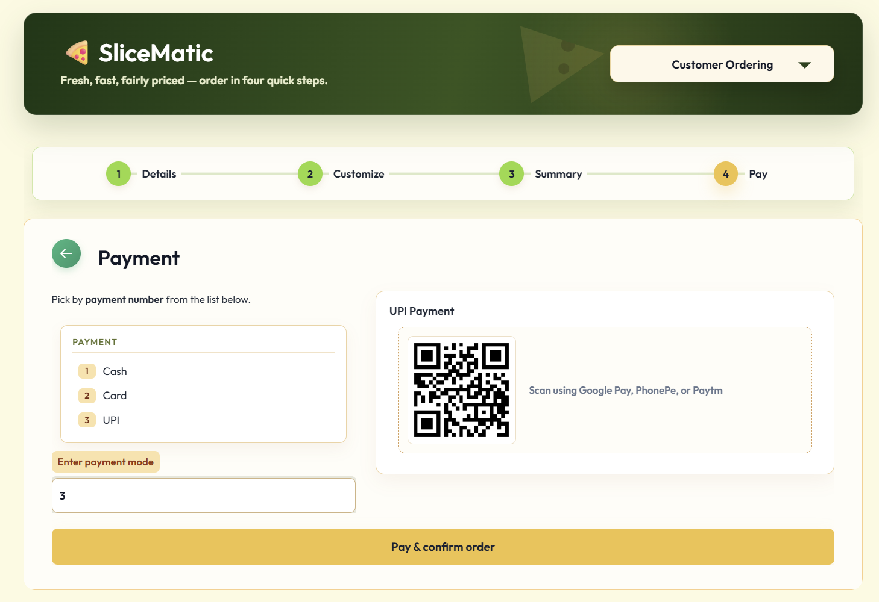
STEP 5 · PAYMENT
Payment mode & confirmation
Three modes Cash, Card or UPI — exactly these.
moulsai2296-pizzaflow-v2.hf.space
Confirmation a mode-appropriate confirmation is shown.
Invalid mode rejected and re-prompted to retry.
MVP scope selection + confirm (no live gateway yet).
Screenshot
Payment selection — Cash / Card / UPI + confirmation message
5
SliceMatic · PizzaFlow MVP Demo
8
Notes:
"Steps 5 and 6 handle Payment and Confirmation. The customer selects Cash, Card, or UPI. Once confirmed, they receive a success message, and in the background, this order is immediately appended to our orders_log.txt file. It's saved, secured, and ready for business analysis."

Slide 9
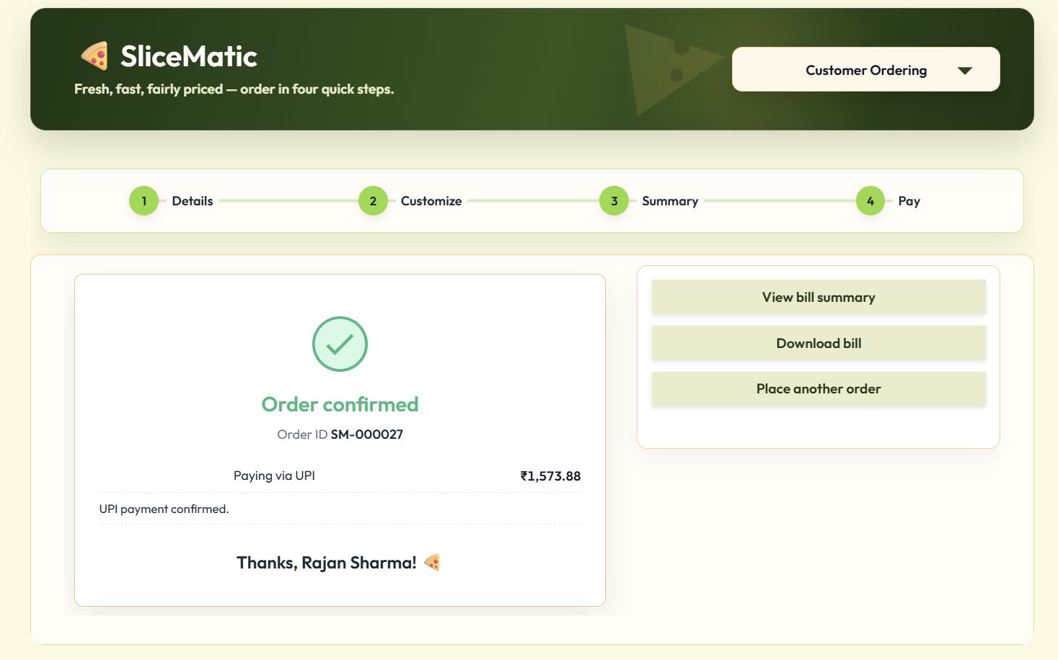
STEP 6 · SAVED & CONFIRMED
Order confirmed — and persisted
Confirmed the customer sees a clear success message.
moulsai2296-pizzaflow-v2.hf.space
Appended the order is written to orders_log.txt.
Parseable pipe-separated, one block per order.
Analysable this log is the raw input for Part B economics.
Screenshot
Order-confirmed screen after a successful order
6
SliceMatic · PizzaFlow MVP Demo
9
Notes:
"Steps 5 and 6 handle Payment and Confirmation. The customer selects Cash, Card, or UPI. Once confirmed, they receive a success message, and in the background, this order is immediately appended to our orders_log.txt file. It's saved, secured, and ready for business analysis."

Slide 10
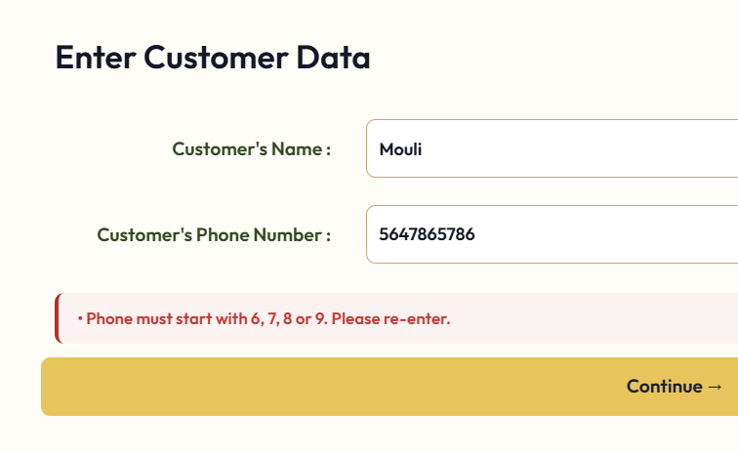
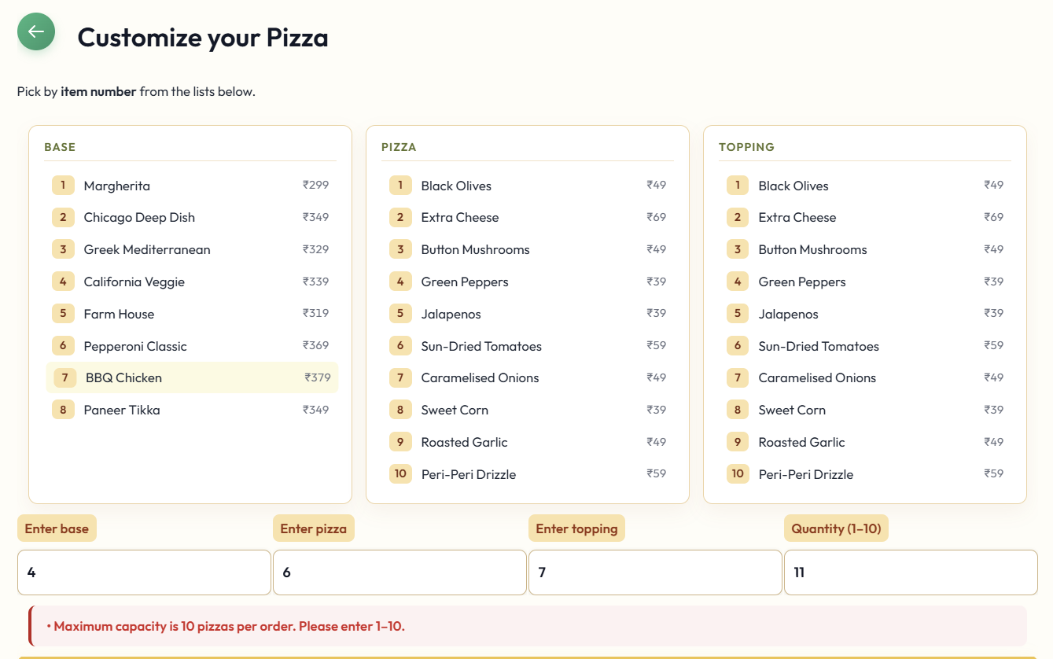
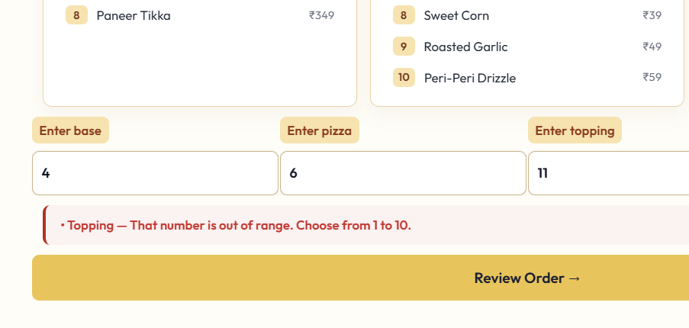
ROBUSTNESS
Validation & edge cases — live proof
The grader will throw bad input at this. Here's the system refusing to break — every rejection is specific and re-prompts.
moulsai2296-pizzaflow-v2.hf.space
moulsai2296-pizzaflow-v2.hf.space
moulsai2296-pizzaflow-v2.hf.space
Screenshot
Screenshot
Screenshot
Error: Phone starts with 1
Error: Quantity = 11
Error: Item number out of range
Phone starts with 1
Quantity = 11
Item number out of range
"Must be 10 digits & start with 6/7/8/9."
"Enter an integer between 1 and 10."
"Pick a valid number from the list."
SliceMatic · PizzaFlow MVP Demo
10
Notes:
"A prototype only works if you use it perfectly; a production app survives the real world. We actively tested our system against edge cases. If you enter an 11-digit phone number, request 15 pizzas, or pick a menu item that doesn't exist, the system refuses to crash. It intercepts the error, gives the user a specific warning, and reprompts them."

Slide 11
PERSISTENCE
Every order, captured — orders_log.txt
This is the data the business has never had. Each completed order is one parseable block.
orders_log.txt
Fields recorded per order
SM-000027 | 2026-06-23 19:42:10 | Rajan Sharma | 9876543210 |
Cheese Burst | BBQ Chicken | Extra Cheese |
677.00 | 5 | 3385.00 | 338.50 | 548.37 |
3594.87 | UPI
SM-000026 | 2026-06-23 19:55:02 | Aman S | 8123456780 |
Thin Crust | Margherita | Jalapenos |
397.00 | 2 | 794.00 | 0.00 | 142.92 |
936.92 | Cash
order_id
timestamp
name
phone
base
pizza
topping
unit price
quantity
subtotal
discount
GST
final total
payment mode
Pipe-separated · one block per order · blank line between — machine-parseable.
SliceMatic · PizzaFlow MVP Demo
11
Notes:
"This brings us to Persistence. Every order is captured in a pipe-separated log. This is the exact data structure we needed to fuel our Part B economics analysis. You can see here exactly how the data is structured: completely machine-parseable and clean."

Slide 12
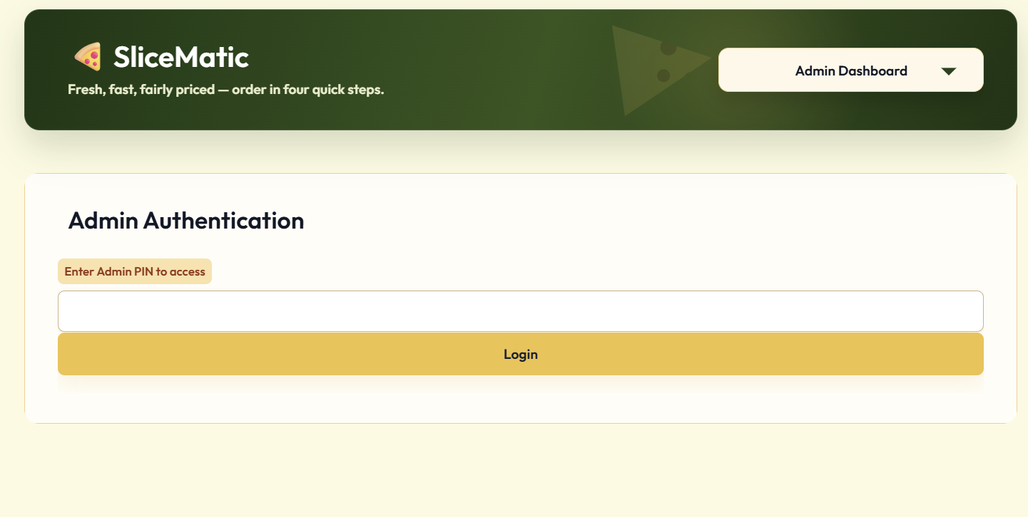



BEYOND THE MVP SCOPE · DELIVERED EARLY
The owner console — PIN-gated admin
The PRD parked admin for Stage 3. We shipped it now — a PIN-protected console behind the order screen's dropdown gives the owner full control and visibility.
moulsai2296-pizzaflow-v2.hf.space
Menu control add / edit items & prices
Discount rules set % and the qty threshold
Analytics dashboard top sellers & combinations
Screenshot
Admin dropdown + PIN entry screen
Order-log export full history, downloadable
PIN-gated — owner enters a 6-digit PIN to enter the console.
SliceMatic · PizzaFlow MVP Demo
12
Notes:
"Now, we’d like to show you something we delivered ahead of schedule. The PRD originally parked the Admin Console for Stage 3, but we built a PIN-gated owner console today. The owner can log in and literally edit the menu, change prices, or adjust the 10% discount threshold on the fly without ever calling a developer."

Slide 13
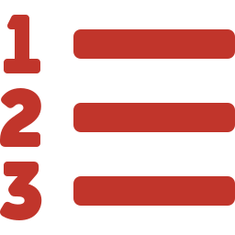
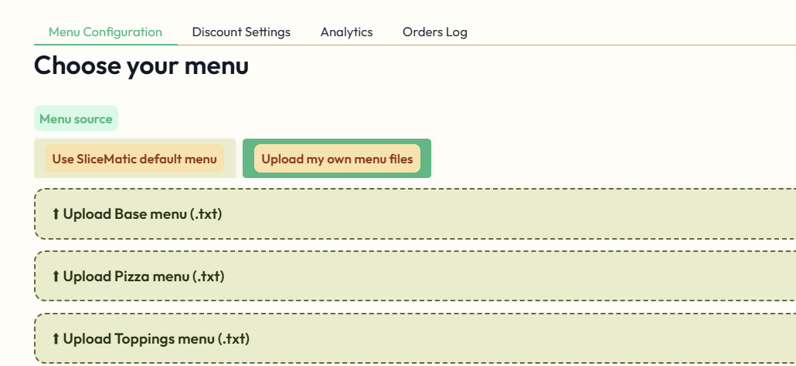


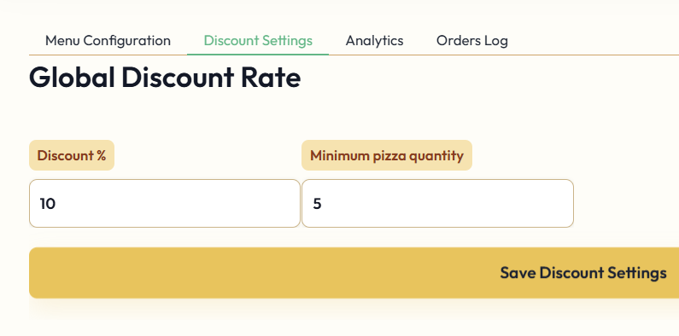
ADMIN · MENU & PRICING
Owner controls the menu & the discount
Edit the menu add, rename or re-price any base, pizza or topping — no developer, no redeploy.
moulsai2296-pizzaflow-v2.hf.space
Set the discount % the owner chooses the bulk-discount rate (e.g. 10%).
Set the threshold choose the quantity at which the discount kicks in (e.g. ≥ 5).
Screenshot
Engine stays deterministic changes flow straight into the same pricing engine.
Admin menu editor + discount % and quantity-threshold controls
SliceMatic · PizzaFlow MVP Demo
13
Notes:
"Now, we’d like to show you something we delivered ahead of schedule. The PRD originally parked the Admin Console for Stage 3, but we built a PIN-gated owner console today. The owner can log in and literally edit the menu, change prices, or adjust the 10% discount threshold on the fly without ever calling a developer."

Slide 14
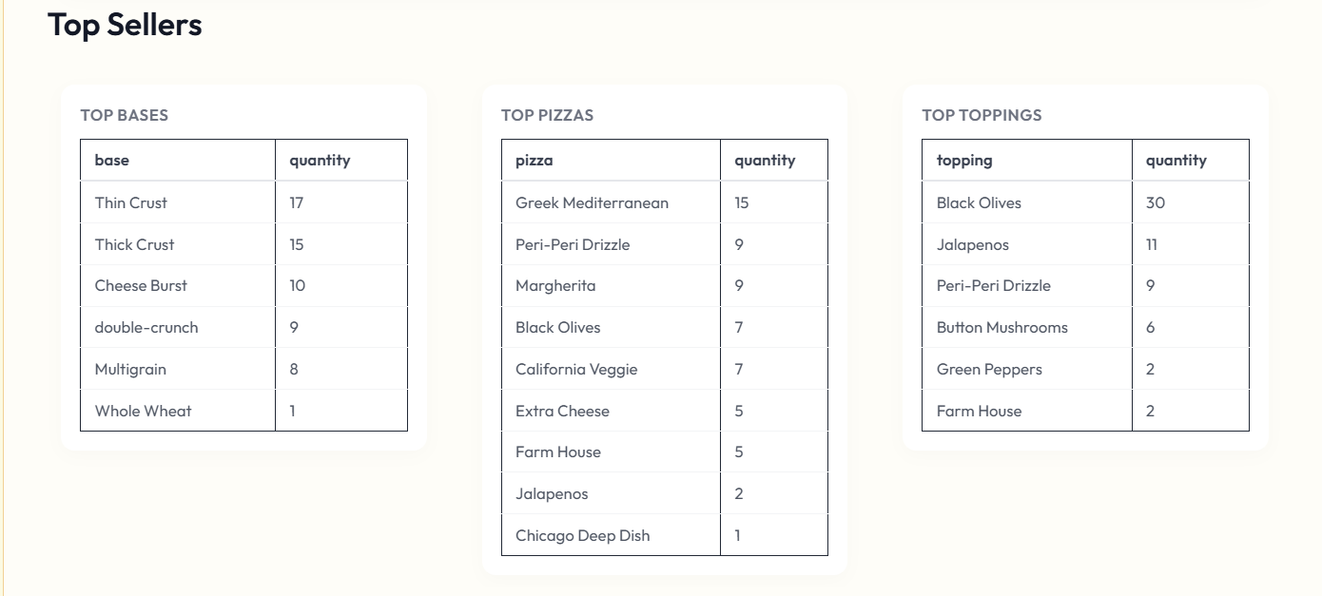
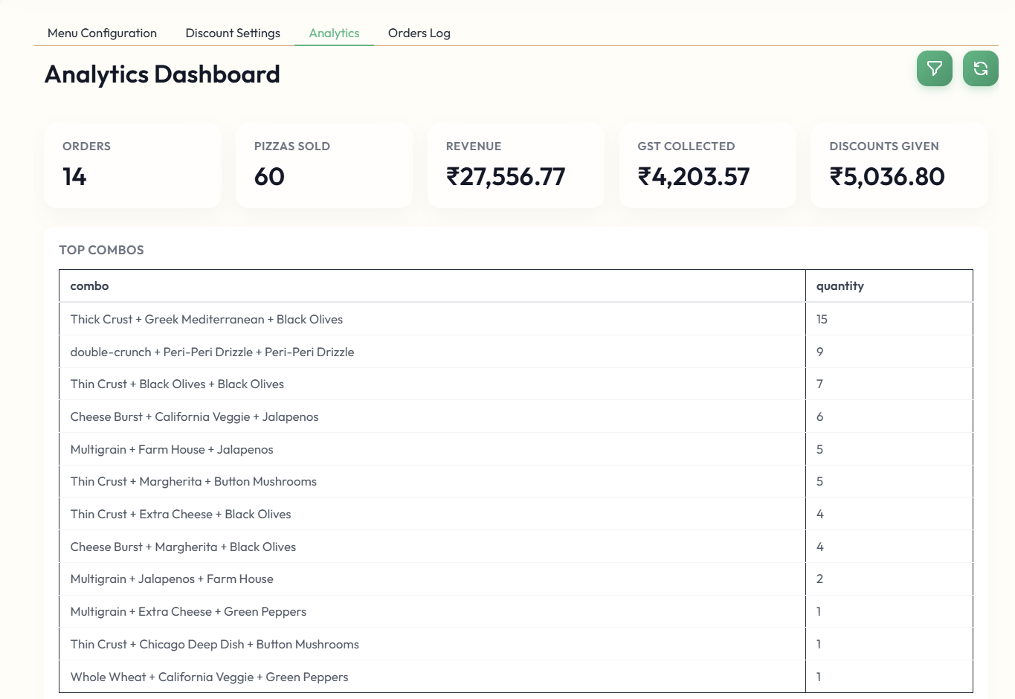
ADMIN · ANALYTICS
The dashboard the owner never had
The order log, turned into decisions — what sells, and what sells together.
Top-selling items — rank the menu by volume to promote winners and retire laggards.
Top combinations — the base+pizza+topping baskets that drive AOV; fuels upsell prompts.
SliceMatic · PizzaFlow MVP Demo
14
Notes:
"Within that same console, the owner gets a real-time Analytics Dashboard. They can see their top-selling items and best combinations. Furthermore, they can view the entire order history and download it with one click for GST filing or accounting."

Slide 15
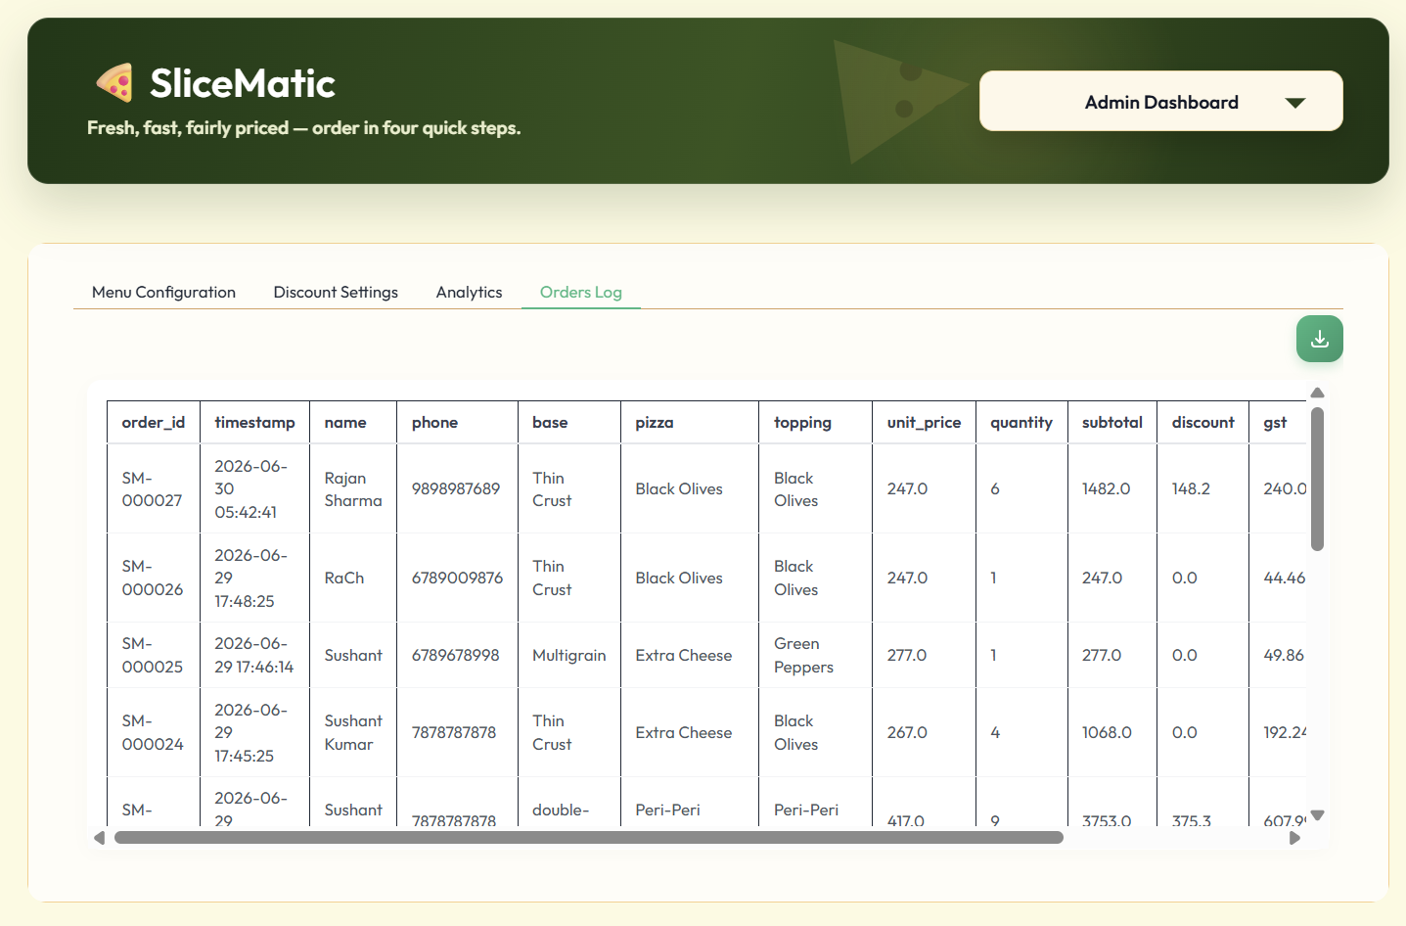


ADMIN · ORDER LOG
Every order — viewable & downloadable
Full order history the complete log rendered as a clean table in the console.
moulsai2296-pizzaflow-v2.hf.space
One-click download export the orders for accounting, GST filing or analysis.
Owner-only behind the PIN — customers never see it.
Screenshot
Decision-ready the same data behind every Part B metric.
Admin order-log table with the download button
SliceMatic · PizzaFlow MVP Demo
15
Notes:
"Within that same console, the owner gets a real-time Analytics Dashboard. They can see their top-selling items and best combinations. Furthermore, they can view the entire order history and download it with one click for GST filing or accounting."

Slide 16
WHY THE NUMBERS ARE TRUSTWORTHY
Pricing engine — the worked example, verified
One deterministic path, six steps, same result every time. This is the client's reference order — the app reproduces it to the paisa.
Base — Cheese Burst
₹229.00
THE SIX STEPS
Pizza — BBQ Chicken
₹379.00
1
Unit price = Base + Pizza + Topping
Topping — Extra Cheese
₹69.00
2
Subtotal = Unit price × Quantity
Unit price
₹677.00
Subtotal (× qty 5)
₹3,385.00
3
Discount = 10% if Qty ≥ 5, else ₹0
Discount — 10% (qty ≥ 5)
− ₹338.50
4
Taxable = Subtotal − Discount
Taxable amount
₹3,046.50
5
GST = 18% of Taxable amount
GST @ 18%
₹548.37
Total payable
₹3,594.87
6
Total = Taxable + GST
SliceMatic · PizzaFlow MVP Demo
16
Notes:
"We want to emphasize why our financial numbers are trustworthy. We took the exact reference order from the assignment brief—a Cheese Burst BBQ Chicken pizza with Extra Cheese at quantity 5—and ran it through our engine. Our system hits the exact same paisa. The 10% discount and 18% GST are calculated deterministically every single time."

Slide 17

ACCOUNTABILITY
PRD promise → delivered
Every Stage 2 commitment from our PRD, mapped to what's running in the MVP.
Requirement | What we promised | Status
Customer intake | Name 2–40 alpha; phone 10-digit 6/7/8/9 | ✓ Delivered
Menu loading | From 3 .txt files, no hardcoding | ✓ Delivered
Item selection | Base + Pizza + Topping by number | ✓ Delivered
Quantity + discount | Integer 1–10; 10% off at qty ≥ 5 | ✓ Delivered
Pricing engine | 6-step deterministic; 18% GST post-discount | ✓ Delivered
Itemised bill | Structured table, totals marked | ✓ Delivered
Payment | Cash / Card / UPI + confirmation | ✓ Delivered
Persistence | Parseable orders_log.txt, one block/order | ✓ Delivered
Robustness | All 8 edge cases, zero crashes | ✓ Delivered
Delivered ahead of plan: admin menu & discount control, analytics dashboard and order-log export — all originally Stage 3.
SliceMatic · PizzaFlow MVP Demo
17
Notes:
"In terms of accountability, every commitment we made in our Stage 2 PRD has been successfully delivered and mapped to the MVP, plus the Admin tools which we delivered an entire stage early."

Slide 18

PRODUCTION READINESS
How we know it's ready to ship
Two lenses — the engineering pipeline that ships it safely, and the product validation that proves it's correct.
Software & engineering
Product & features
Automated CI/CD — GitHub Actions tests every PR and blocks on any failure.
100% PRD traceability — every shipped feature maps to a documented requirement.
Zero-touch deploys — approved code ships to Hugging Face with no human in the loop.
Edge-case validation — the UI blocks invalid input and impossible discounts.
Environment parity — Docker makes local and production exactly identical.
Validated economics — the pricing engine aligns with the GST and margin models.
Fault tolerance — a persistent storage volume protects data across restarts.
End-to-end verified — the full lifecycle works — landing page to owner dashboard.
SliceMatic · PizzaFlow MVP Demo
18
Notes:
"We know we are ready to ship. From an engineering perspective, we use GitHub Actions for automated CI/CD and Docker for environment parity. From a product perspective, every feature traces back to the PRD, edge cases are locked down, and the economics are validated. This is a production-grade system."

Slide 19


ROADMAP
What's next — Stage 3
The MVP's structured log is the foundation everything next is built on.
STAGE 3
STAGE 3
STAGE 3
Full Stack Platform
Conversational AI ordering
Growth & intelligence
Web UI (next.js) replaces the CLI flow
Supabase Postgres + Auth
Concurrency-safe writes + managed backups
Deployment on Versel and Railway
Tables: Users, Roles, Orders, Messages, Sessions
Natural-language orders via OpenRouter
Menu-grounded extraction
Pricing stays deterministic
Input and Output Guardrails
AI observability to make decisions on improvements
Demand forecasting
Recommendations during order
Improve in Real time analytics for Admin
Multi-persona support (User, Staff, Admin)
SliceMatic · PizzaFlow MVP Demo
19
Notes:
"Looking ahead to Stage 3, we will upgrade our file-based logging to a Supabase Postgres database. We will also introduce Conversational AI ordering using natural language, backed by our deterministic pricing engine to ensure accuracy."

Slide 20
Try it yourself — it's live.
Place a real order in the MVP right now.
Slicematic Application
Thank you — Group 3
Mouli Murakambattu · Shaik Mohammed Pasha · Aman Sharma · Saurabh Sekhar · Sushant Kumar
Notes:
"Our MVP is currently live on Hugging Face Spaces. We invite you to visit the link and place a real order yourself. Thank you from Group 3!"

