Slide 1

EDITABLE HD BRAND KIT
RichPay Fincorp
Fixed master logo + expanded colour palette + editable branding tools + HD visual mockups.
LOGO • COLOUR • SOCIAL • APP • WEBSITE • STATIONERY • SIGNAGE • OUTDOOR • BRAND COLLATERAL

Slide 2
01
Fixed master logo
This deck uses the latest navy + gold RichPay logo exactly as provided in the approved image direction.
R FOR RICHPAY
GROWTH BARS
SUPPORT BRIDGE
TRUST & SECURITY
Strong, bold and ownable brand identity.
Progress, financial movement and prosperity.
A helping bridge between today and payday.
Navy-led institutional finance confidence.

Slide 3

02
Logo lockups and editable placement system
The logo artwork is inserted in high resolution and can be moved, resized and placed across all templates.
PRIMARY ON LIGHT
CONTROLLED USE ON DARK

Slide 4
03
Colour palette: Primary + optional digital extensions
Navy + gold remains the master identity. Blue + green is added as a secondary social/digital palette.
Deep Navy
Warm Gold
Light Gold
Charcoal
#071F3D
#C69A45
#E8C27A
#333333
Master brand
Premium accent
Soft accent
Copy / documents
Royal Blue
Sky Blue
Finance Green
Mint Green
#2560EB
#38BDF8
#16A34A
#22C55E
Optional digital
Optional UI
Optional growth
Optional social
Usage: Use navy/gold for main brand recognition. Use blue/green only for Instagram, campaign variations, charts, highlights, UI states and digital accents.

Slide 5
04
Typography and brand tonality
A modern NBFC should sound reassuring, simple and premium — not loud or desperate.
PRIMARY FONT
BODY FONT
APTOS DISPLAY
APTOS / CLEAN SANS
Your Salary is Coming. We Can Help You Bridge the Gap.
Use short, transparent, low-pressure copy. RichPay should feel like a responsible financial bridge for salaried professionals.
Helpful
Transparent
Responsible
Modern
Human

Slide 6
05
Editable Instagram profile + 3×3 grid
Profile, highlights and posts are built as editable PPT objects with the correct logo inserted.
SALARY BRIDGE
EMERGENCY LOAN
QUICK APPROVAL
richpay_fincorp
128 Posts 18.7K Followers 96 Following
RichPay Fincorp Emergency financial bridge for salaried professionals. Apply responsibly.
HOW IT WORKS
TRUSTED SUPPORT
FLEXIBLE TENURE
About
Loans
FAQs
Trust
FAQ FRIDAY
CLEAR TERMS
APPLY ONLINE

Slide 7
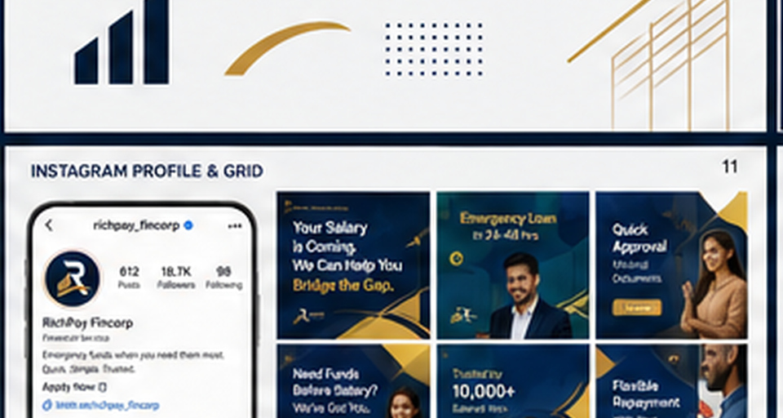
06
HD Instagram visual mockup
High-resolution visual reference for the actual social-media look.

Slide 8
07
Editable website homepage layout
Editable wireframe using the fixed logo and RichPay brand colours.
Home
About Us
Our Loans
How It Works
Why RichPay
Contact
Apply Now
EMERGENCY FUNDS, WHEN YOU NEED THEM MOST
Your Salary is Coming. We Can Help You Bridge the Gap.
Apply Now
How It Works
Quick Approval
Short Tenure
Secure & Trusted
For Salaried
Minimal documents
Until payday
Privacy first
Designed for you

Slide 9
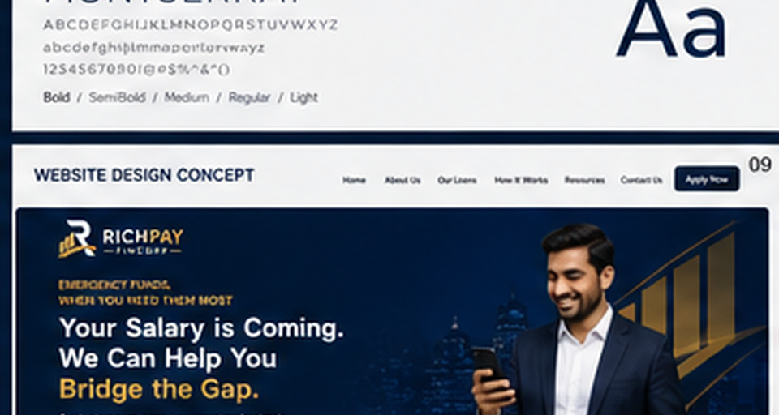
08
HD website look and feel
High-resolution visual reference for the brand-led website experience.

Slide 10

09
Editable app icon + mobile screens
Native editable app UI concept plus inserted fixed logo.
LOGIN
ELIGIBILITY
SUMMARY
Welcome Back!
₹50,000
Repayment Plan
APP ICON
Continue
Continue
Continue

Slide 11
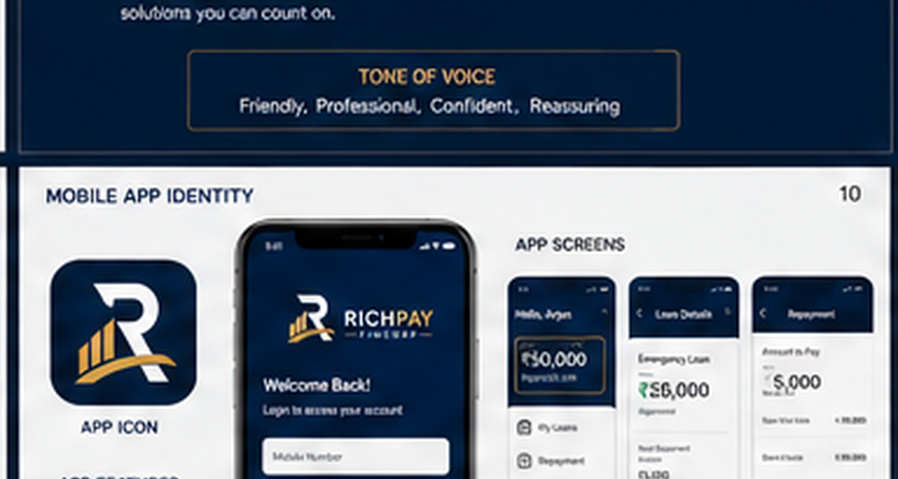
10
HD app visual mockup
High-resolution app identity and UI reference.

Slide 12
11
Editable stationery kit
Visiting card, notebook, pen, letterhead, envelope and employee ID templates.
RICHPAY
PEN
YOUR NAME
Designation +91 98XX XXX XXX name@richpay.example
RICHPAY
EMPLOYEE ID NAME ROLE
Date: To: Subject: Editable letterhead body copy.
NOTEBOOK

Slide 13
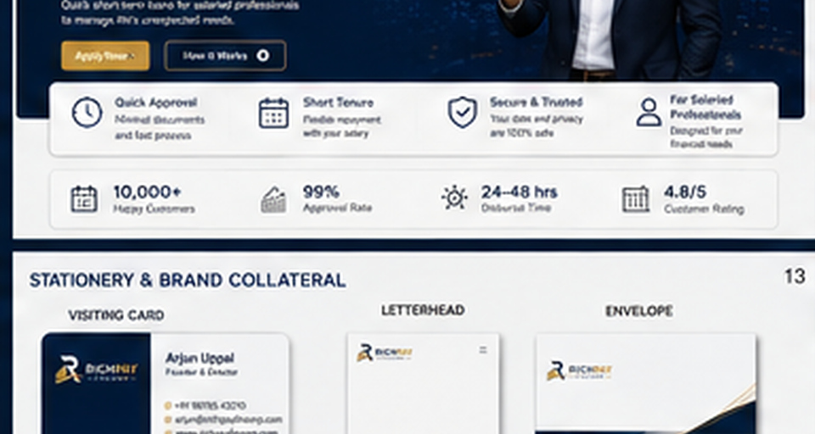
12
HD stationery and brand collateral mockup
High-resolution visual reference for visiting cards, notebook, pen, letterhead and ID collateral.

Slide 14
13
Editable office board and building signage
Editable signboard layouts showing logo placement on office boards and branch fascia.
OFFICE BOARD ON BUILDING
BRANCH ENTRANCE
RECEPTION / OFFICE WALL

Slide 15
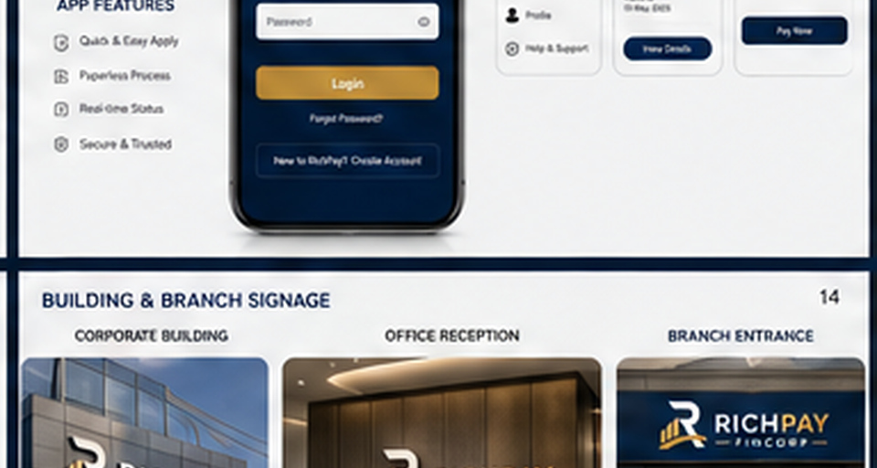
14
HD building, entrance and branch mockups
High-resolution visual reference for physical brand presence.

Slide 16
15
Editable marketing and outdoor advertising
Banner, hoarding and bus-stop layouts with editable copy, CTAs and logo placement.
Your Salary is Coming. Bridge the Gap.
Your Salary is Coming. Bridge the Gap.
Your Salary is Coming. Bridge the Gap.
Apply Now
HOARDING
Apply Now
Apply Now
STREET BANNER
BUS STOP

Slide 17
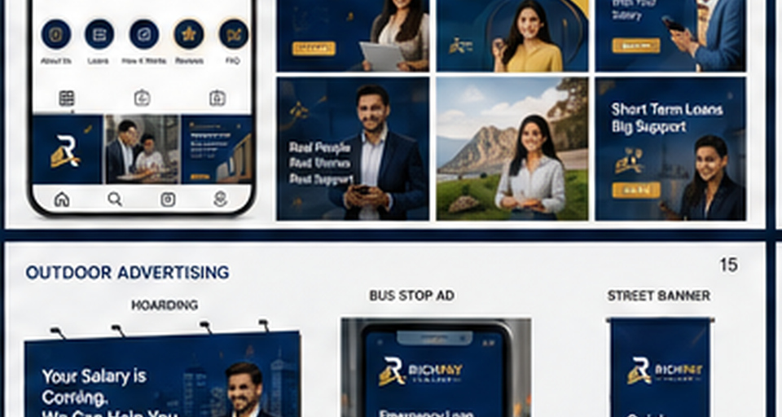
16
HD advertising visual mockup
High-resolution banner, billboard and street advertising reference.

Slide 18
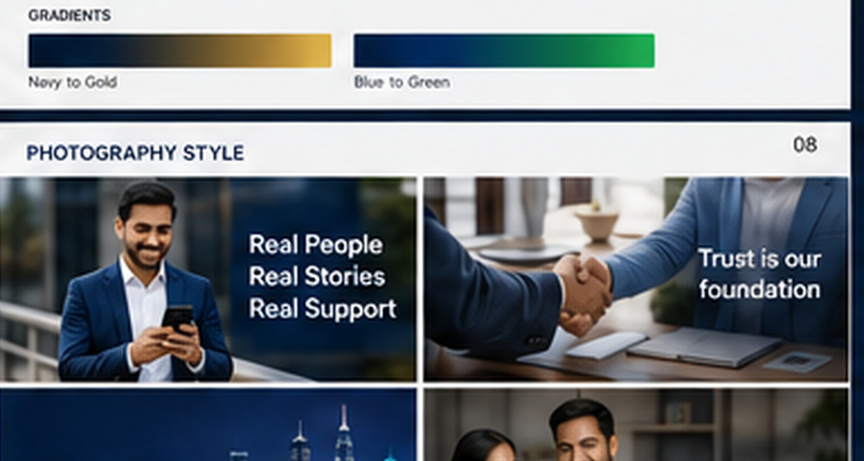
17
HD photography direction
Use real salaried professionals, authentic office/home situations and aspirational but believable visuals.

Slide 19
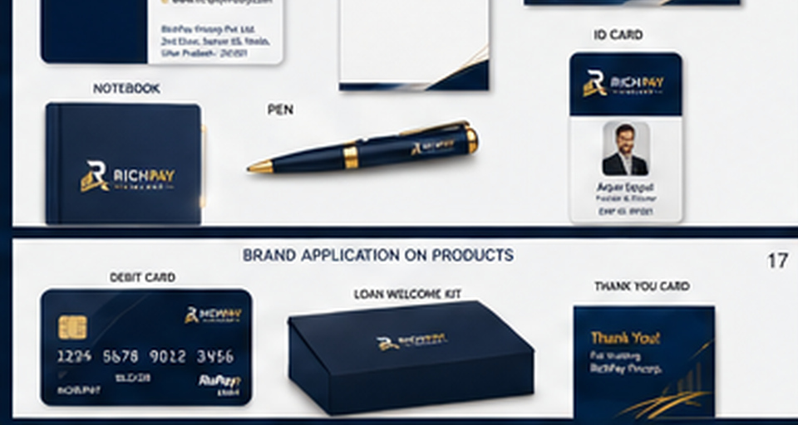
18
HD product and customer collateral
Card, welcome kit and customer-facing collateral visual reference.

Slide 20
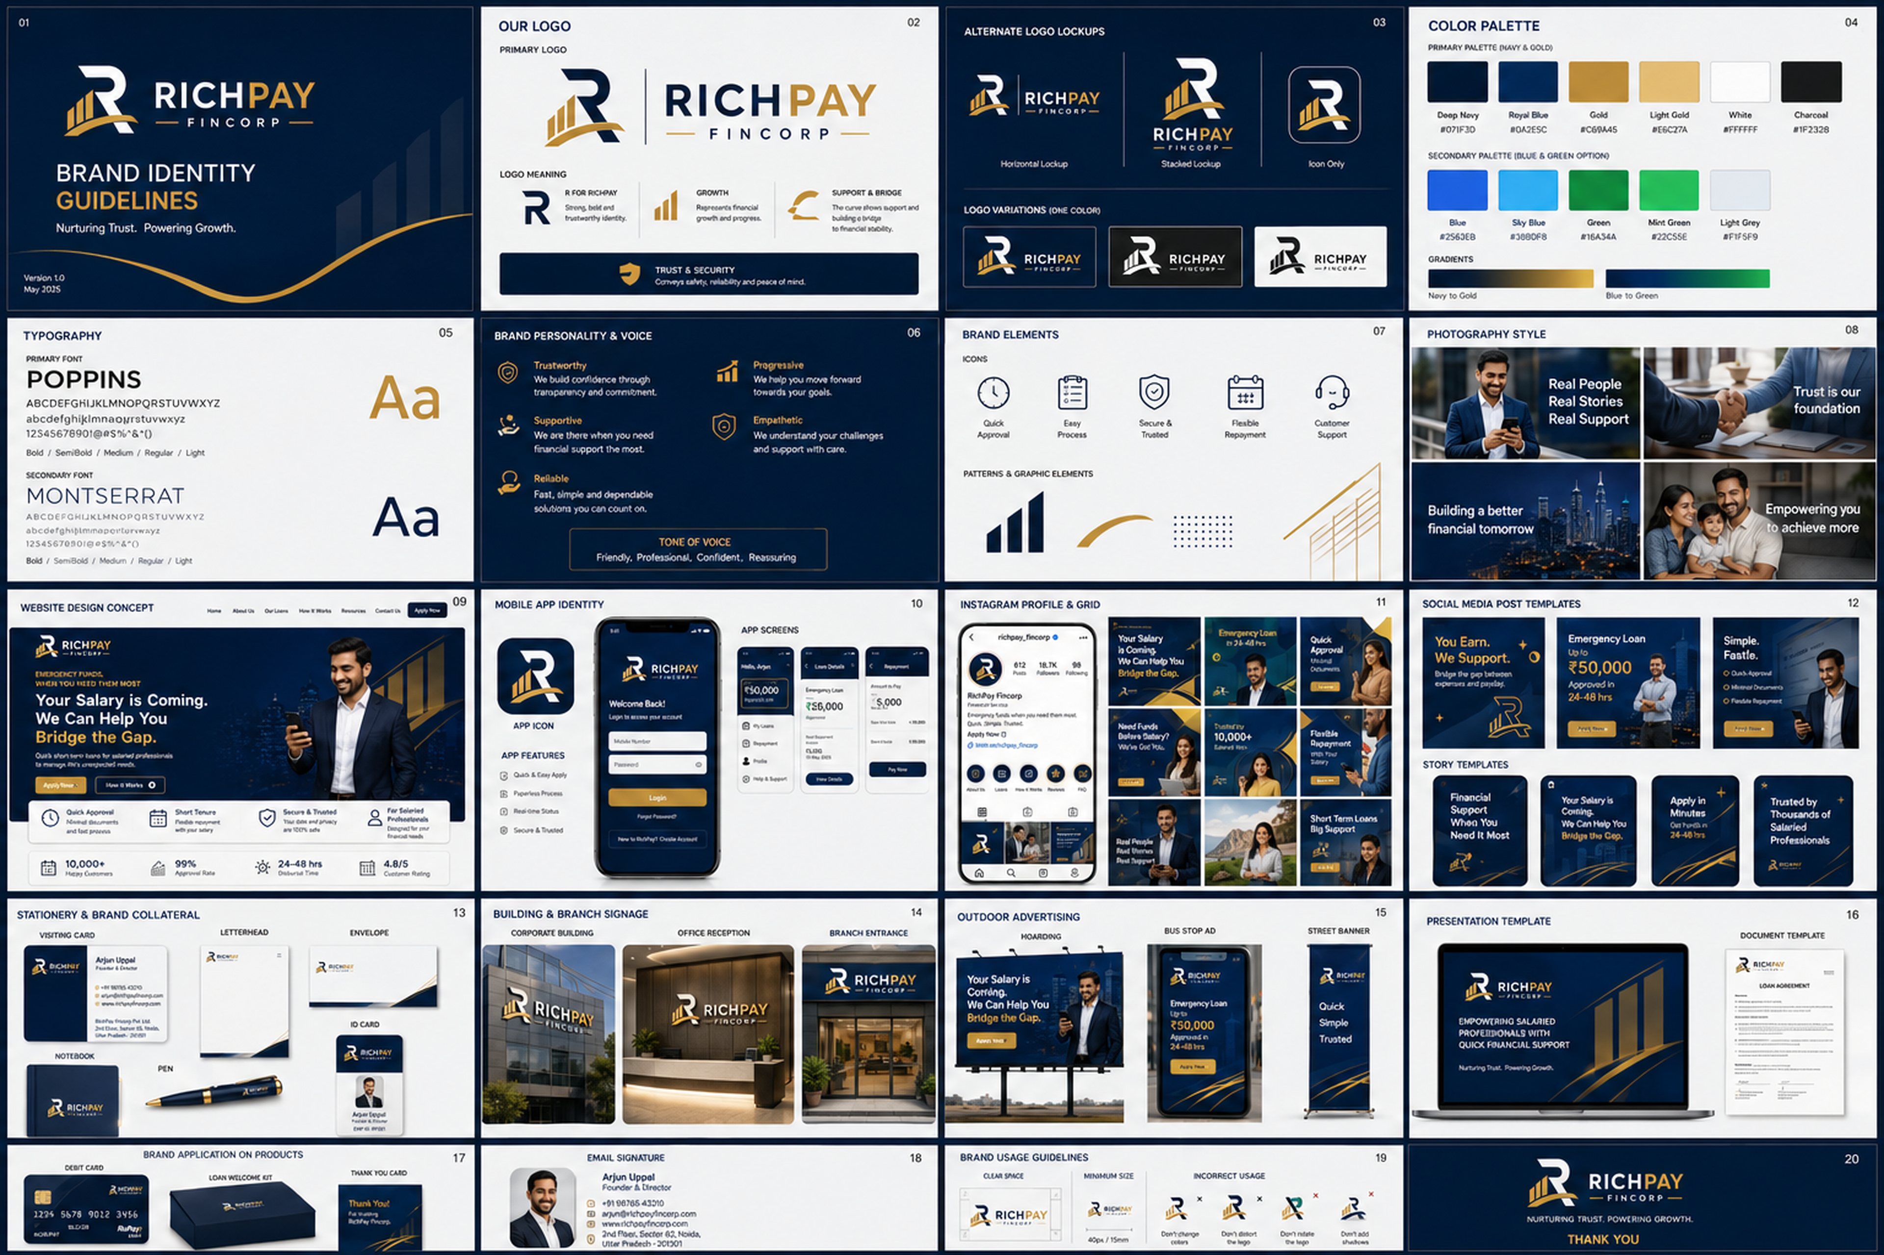
19
Complete 360° HD brand application board
Single reference board showing logo, social, app, web, stationery, signage, ads and collateral.

Slide 21
20
Brand usage rules
✓
Use the fixed navy + gold master logo as the official identity.
✓
Use blue + green only as optional digital, Instagram, UI and campaign accents.
✓
Do not integrate the Indian rupee symbol into the logo.
✓
Keep gold limited and premium — do not overuse it.
✓
Keep financial communication clear, transparent and responsible.
✓
Use the HD mockups as visual references and editable slides for layout adaptation.

Slide 22
EDITABLE HD BRAND KIT
Correct logo • Primary navy/gold palette • Secondary blue/green palette • Editable tools • HD visual mockups

