Slide 1
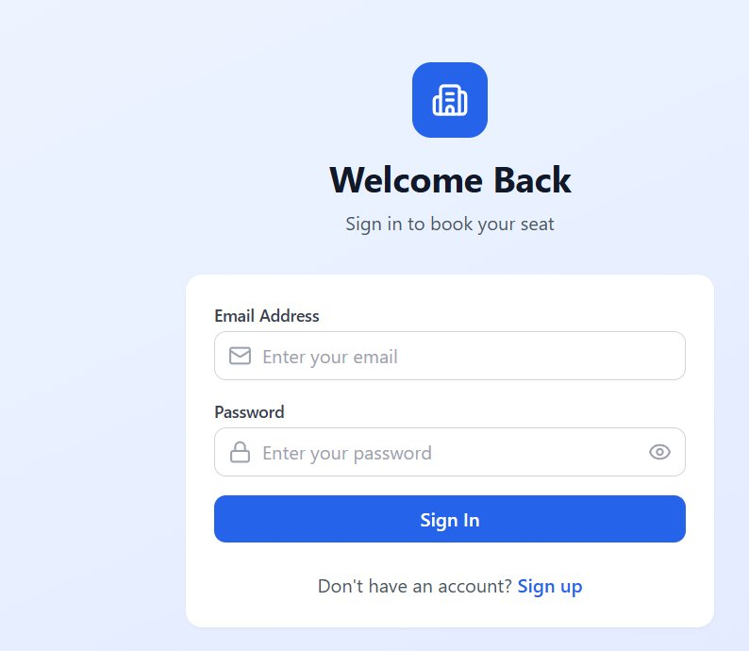
🏢
SeatBooking
Project Output Showcase
Smart Hybrid Office Seat Allocation System
MERN Stack · React + Express + MongoDB + Node
Login & Auth
Dashboard
Book a Seat
Week View
My Bookings
Floor Plan
11 screens · Full CRUD · Real-time seat state

Slide 2
01 · Login & Authentication
JWT-based auth
🔒 Email + Password sign-in
✅ Protected routes via middleware
🔑 JWT token on success
📋 Role: Employee (batch-aware)
👤 Sign-up flow included
⚡ Token stored in localStorage
🔐 Password visibility toggle
🚫 Invalid credentials blocked
🏢 Batch & Squad auto-assigned
🎨 Clean minimal design

Slide 3
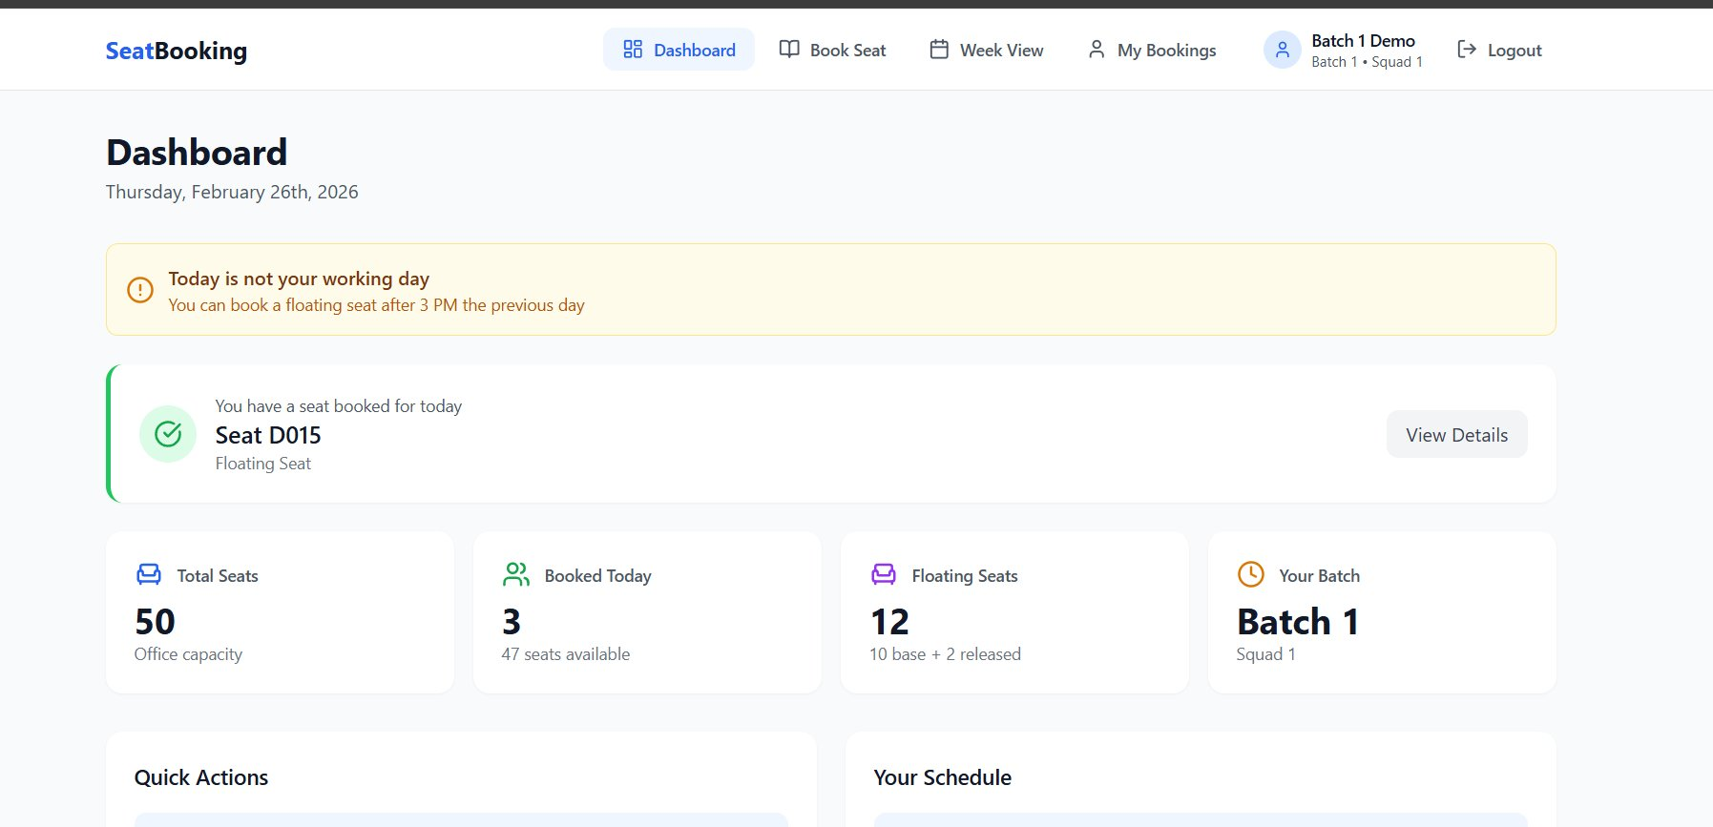
02 · Dashboard — Live Overview
Today's status at a glance
⚠️ Batch status banner (not working day)
✅ Today's booked seat (D015 Floating)
📊 Live seat stats (50 / 3 / 12)
📅 Your batch schedule display
Real-time stats: Total Seats · Booked Today · Floating Pool · Your Batch

Slide 4
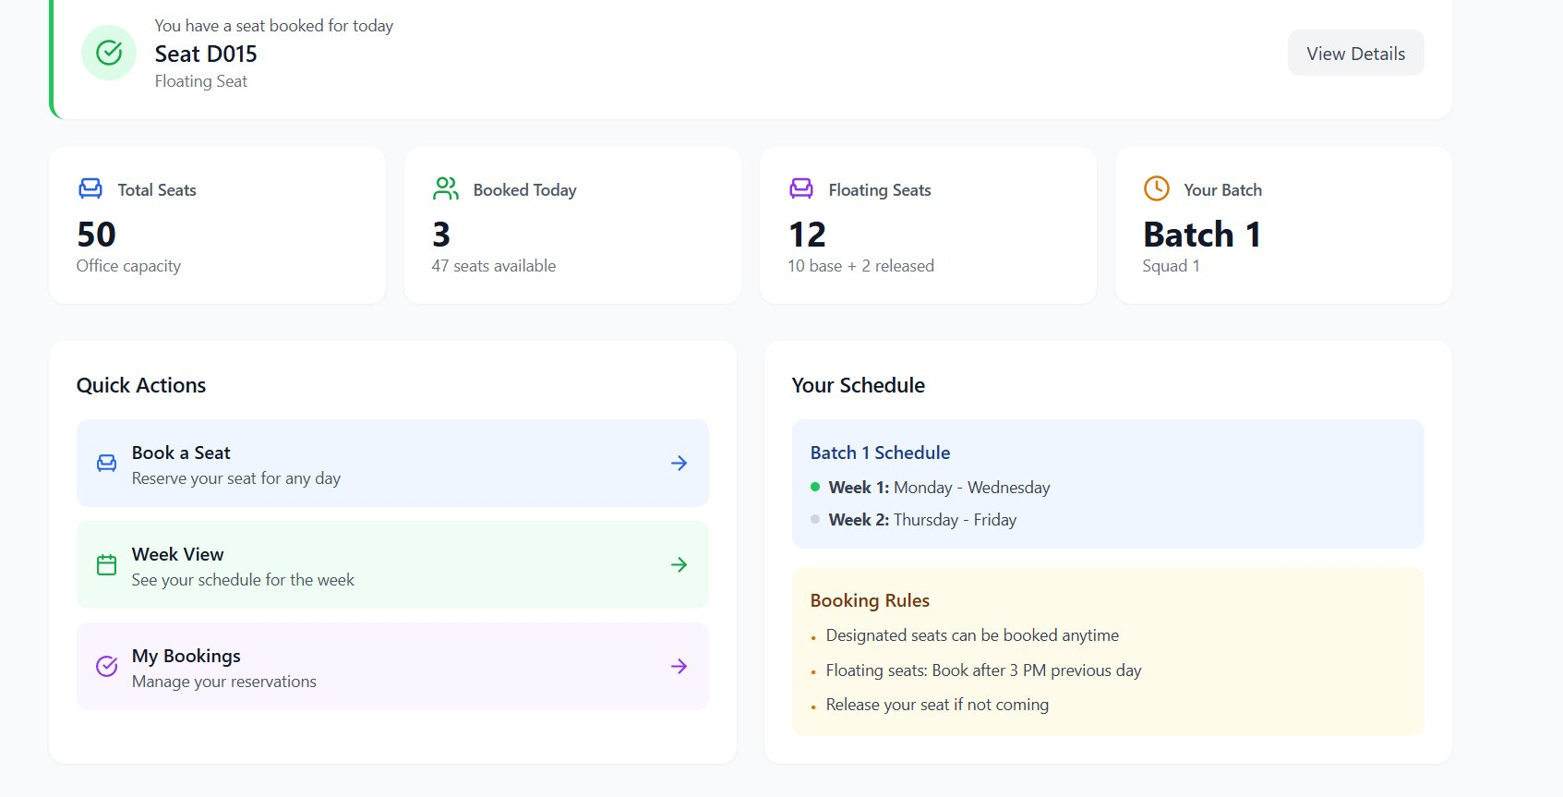
02 · Dashboard — Quick Actions & Schedule
Navigation hub
📖 Book a Seat quick action
📅 Week View quick link
📋 My Bookings quick link
📌 Batch 1 schedule card
Booking Rules shown inline: Designated anytime · Floating after 3 PM · Release if not coming

Slide 5
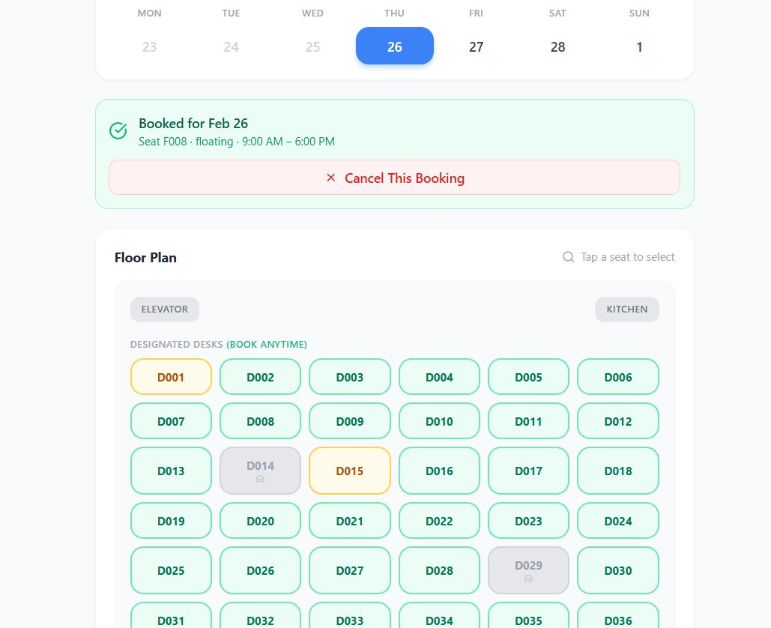
03 · Book a Seat — Floor Plan View
Visual desk selection
🟡 My Designated Desk
🟢 Floating Available
⬜ Designated (others)
❌ Cancel Booking
🔵 Selected Seat

Slide 6
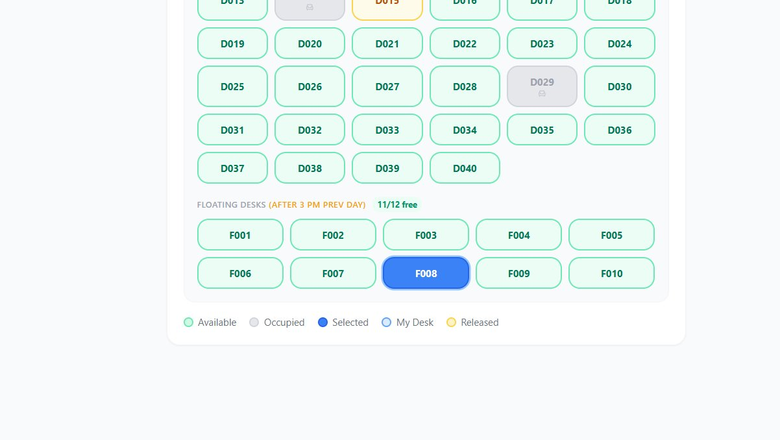
03 · Floor Plan — Floating Desk Pool
Dynamic buffer seats (F001–F010+)
🌊 FLOATING DESKS section — 11/12 free (10 base + 1 released)
🔵 F008 selected (currently booked by user)

Slide 7
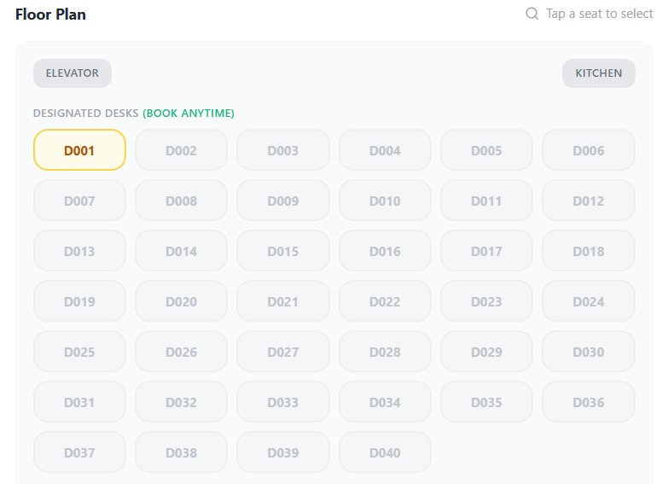
03 · Floor Plan — Designated Desks Grid
D001–D040 with book-anytime rule
🟡 D001 — My designated desk (yellow border)
⬜ D002–D040 — Other team members' desks
🔒 Occupied desks show lock icon (not bookable)
📌 "BOOK ANYTIME" label on designated section

Slide 8
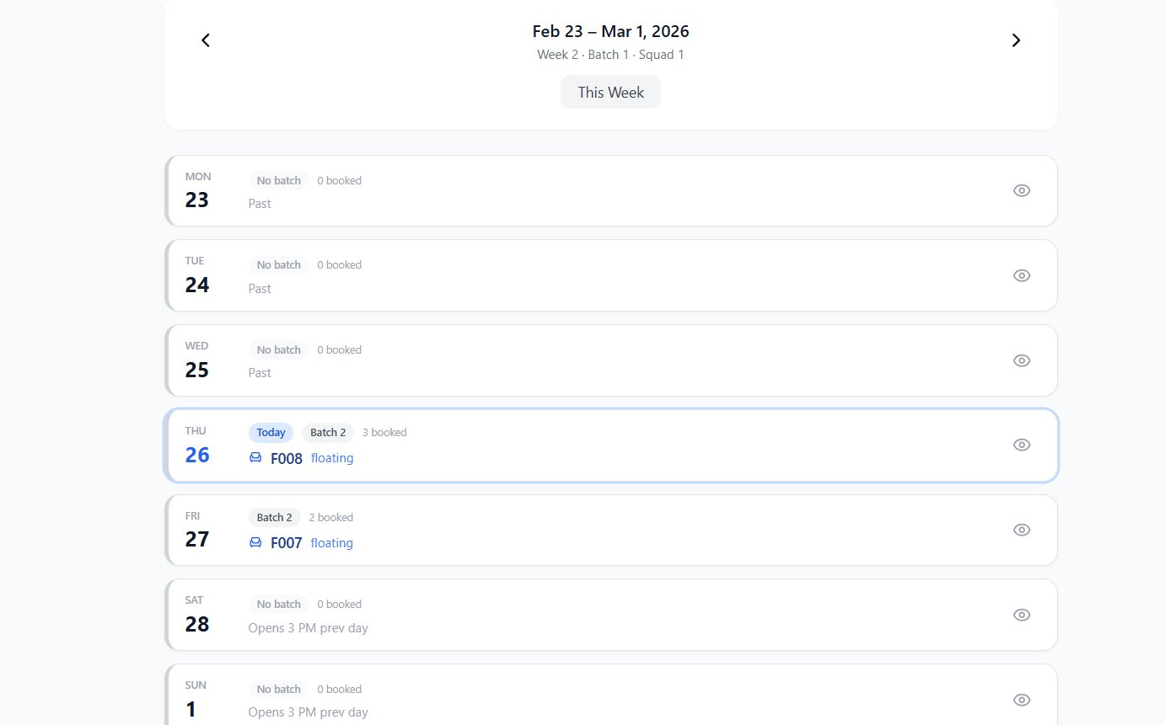
04 · Week View — 7-Day Schedule
Batch-aware calendar with booking status
📅 Week navigation
← → buttons to move between weeks
📍 Today highlighted
Thursday Feb 26 in bold blue pill
✅ Booked seats shown
F008 floating shown under Thu 26
🏷️ Batch labels
Batch 2 badge per working day
⏳ Past days greyed
Mon–Wed shown as 'Past'
🔓 Future days
'Opens 3 PM prev day' info shown

Slide 9
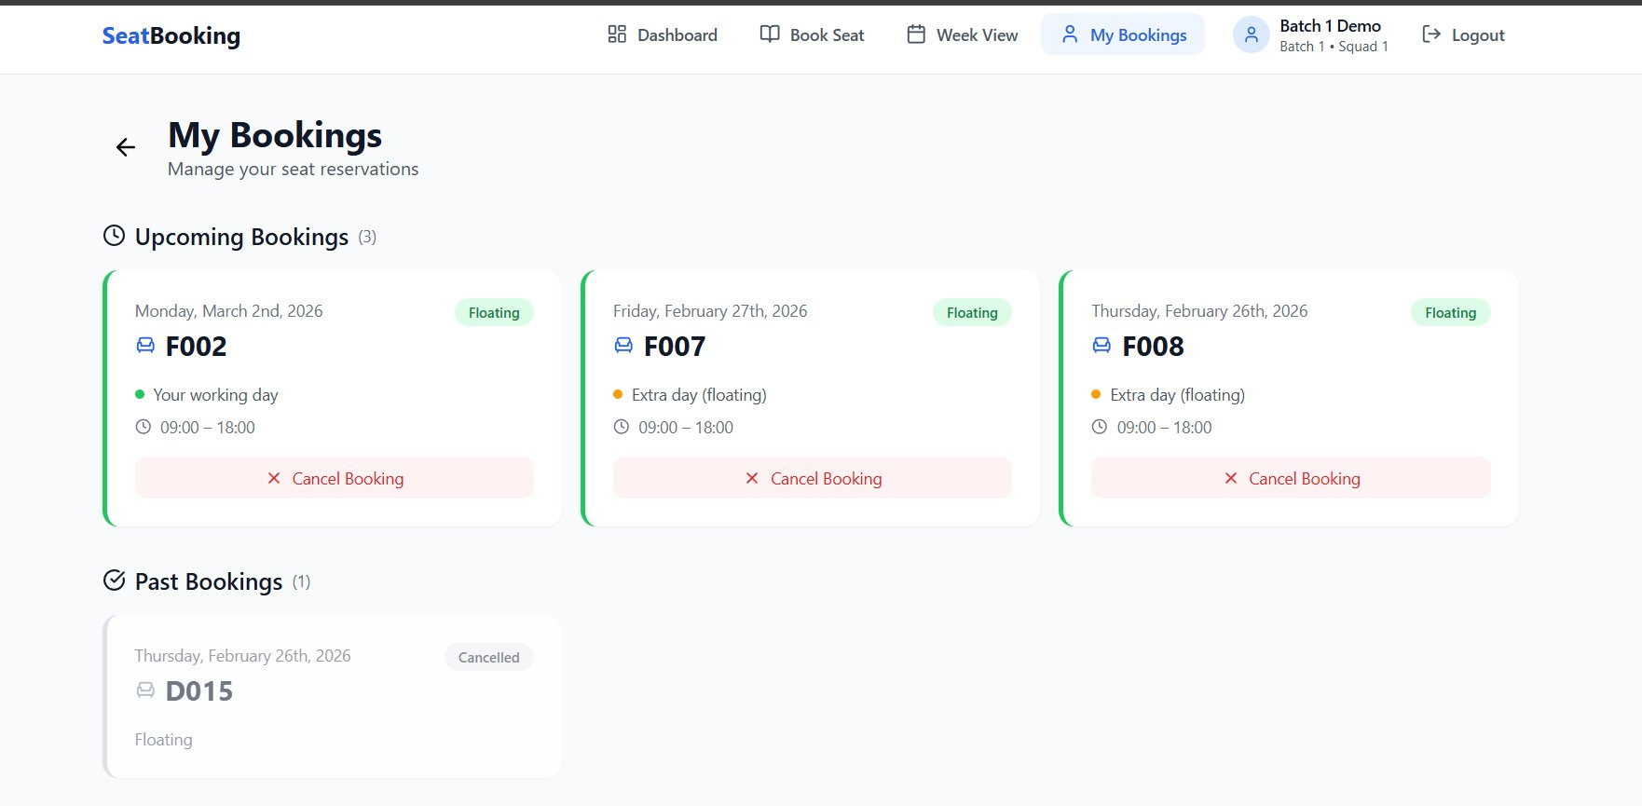
05 · My Bookings — Manage Reservations
Upcoming + past booking history
🟢 Upcoming Bookings (3)
🔵 Floating badge on each card
🟡 'Your working day' indicator
⬜ Past bookings / Cancelled
Cancel Booking button visible on each card · D015 shown as Cancelled in past bookings

Slide 10
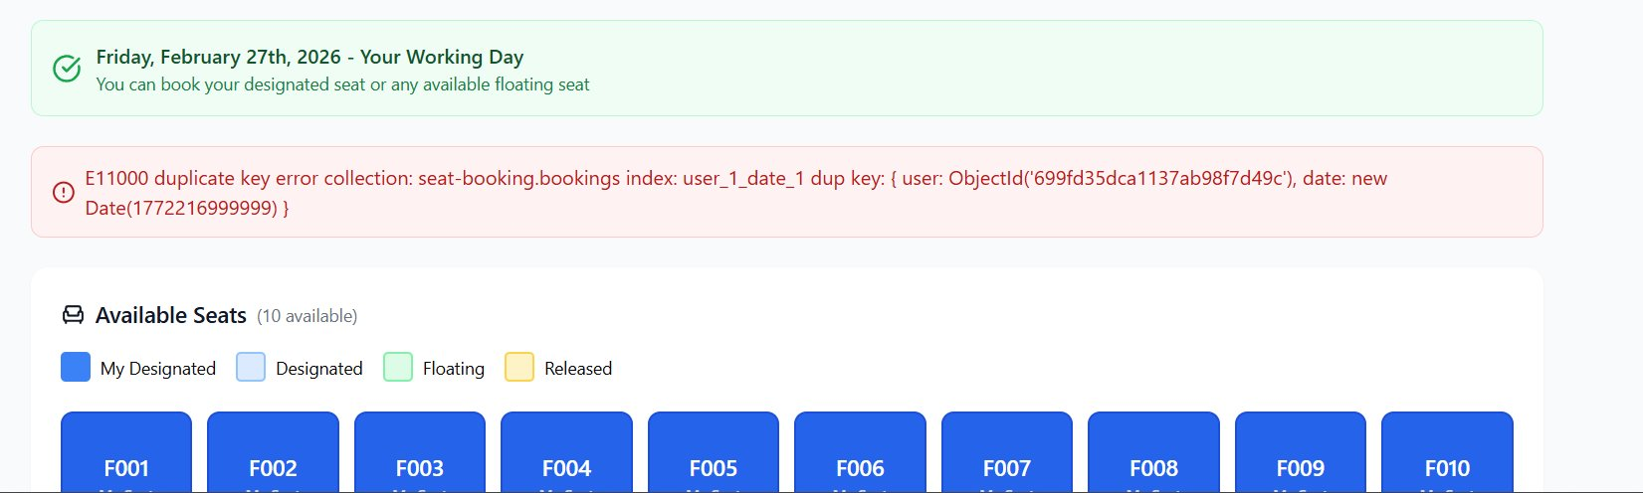
06 · Validation & Error Handling
Duplicate booking prevention in action
🚫 E11000 Duplicate Key Error
✅ Working Day Banner
💺 Available Seats Counter
MongoDB compound unique index (user + date) fires when same user tries to book twice on same day — caught at DB level.
Green banner confirms 'Your Working Day' — user can book designated OR floating seat with appropriate time rules.
Live '10 available' count shown. Color-coded legend: My Designated · Designated · Floating · Released seats.

Slide 11
07 · Full App Flow — All Screens
End-to-end user journey
1. Login
2. Dashboard
3. Book Seat
4. Week View
5. My Bookings
Login → Dashboard → Book a Seat → Week View → My Bookings → Cancel / Release

Slide 12
🏢
SeatBooking
Smart Hybrid Office Seat Allocation — Project Complete
✅ Login & JWT Auth
✅ Dashboard with Live Stats
✅ Designated + Floating Seats
✅ 3 PM Time-Gate Enforced
✅ Week View Calendar
✅ My Bookings + Cancel
✅ Dynamic Seat Pool
✅ Duplicate Booking Prevention
React · Express · MongoDB · Node.js · MERN Stack

