Slide 1


Emotion Detection and Recognition via Text
Aman Kumar Singla
15116007
Sanyam Rajpal
15116051
Under the guidance of
Dr. Debashis Ghosh
(Professor, ECE, IIT Roorkee)

Slide 2


Content
Objective
Dataset Processing
Word Embedding
Training Techniques
Architecture
Results
Conclusion and Future

Slide 3
Objective
Develop deep learning model which can recognise multiple emotions from the text.
Achieving the same on dataset having sarcastic comments.

Slide 4
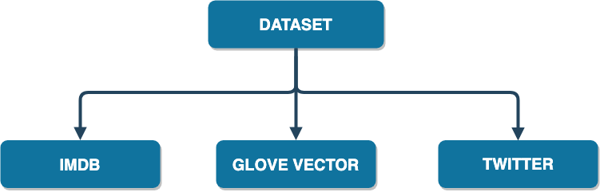
Datasets

Slide 5
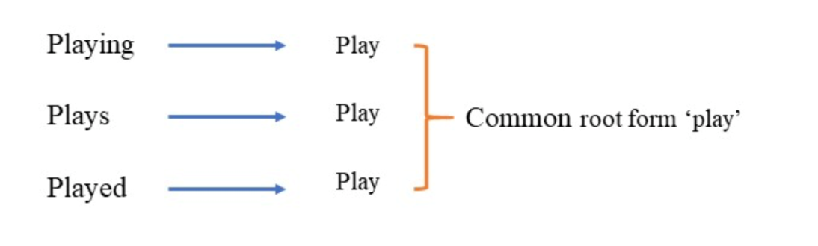
Data Preprocessing
Stemming
Lemmatisation
Go, Went ,Gone,Going
Go

Slide 6
Data Preprocessing
3. POS Tagging
I want play piano
(Preposition) (Verb) (Verb) (Noun)
4. POS Tagging
James Cameron filmed part of Avatar in New Zealand
James Cameron: DIRECTOR
Avatar: FILM
New Zealand: LOCATION

Slide 7
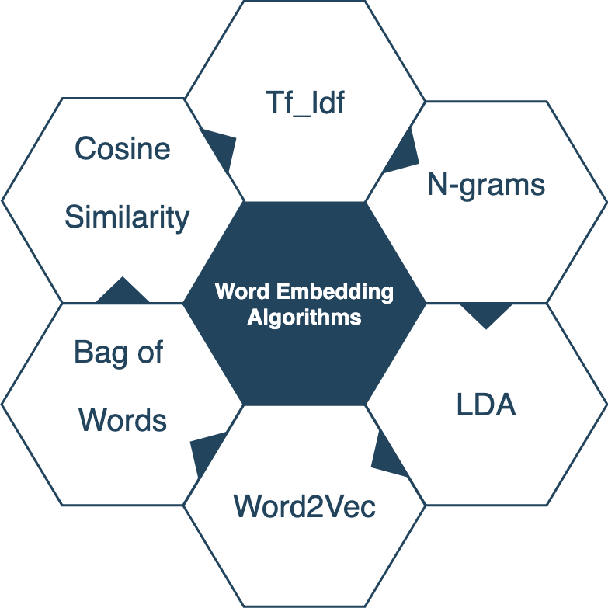
Word Embeddings

Slide 8
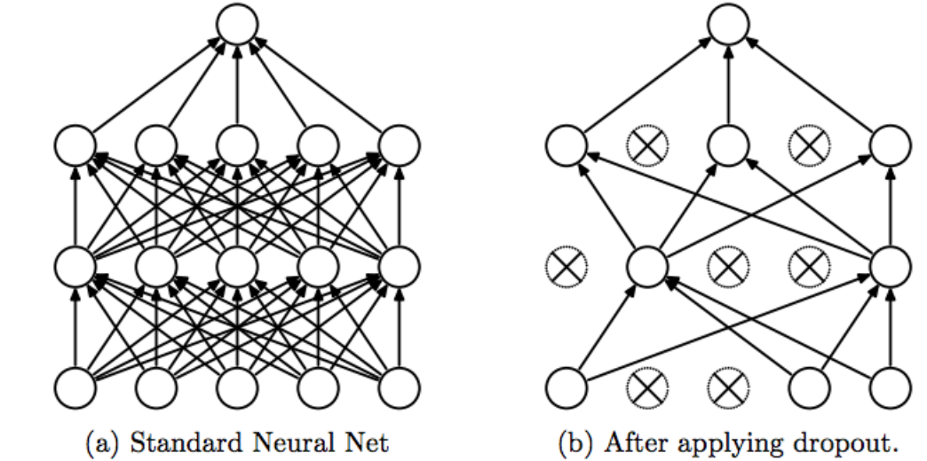
Training Techniques
Dropout

Slide 9
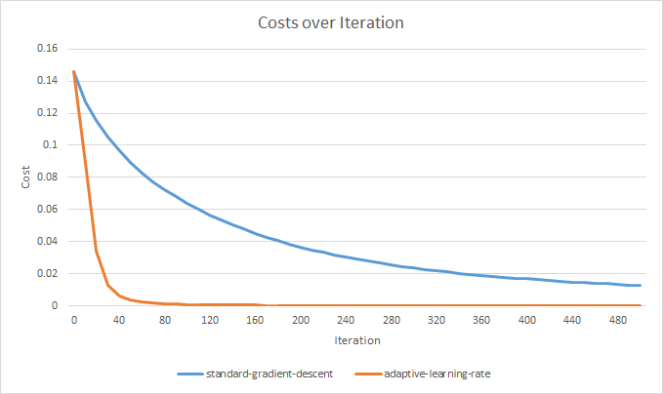
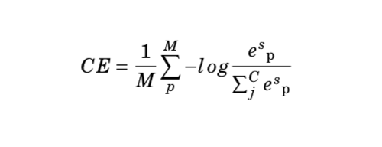
Training Techniques
Adaptive Learning Rate
Categorical Cross-entropy

Slide 10
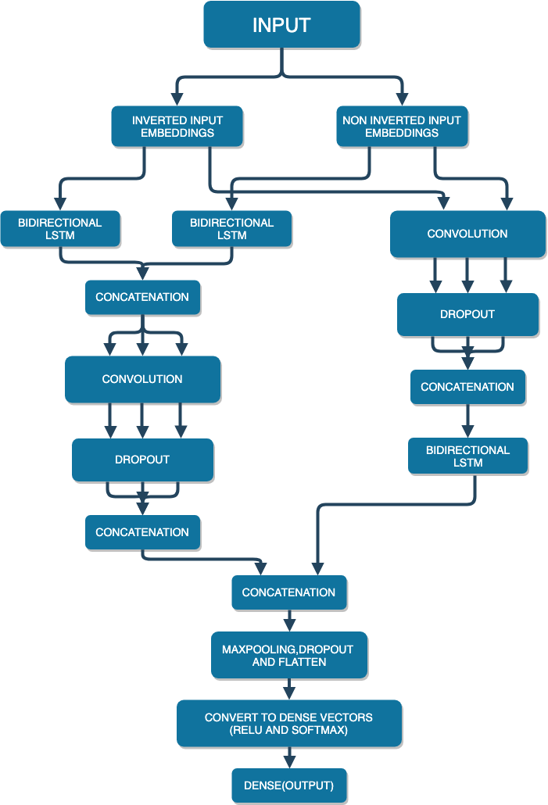
Architecture
Part I
Part II
Part III
Part IV

Slide 11
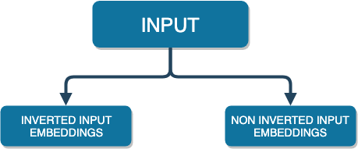
Architecture Part I

Slide 12
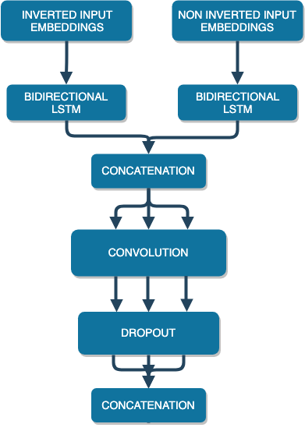
Architecture Part II

Slide 13
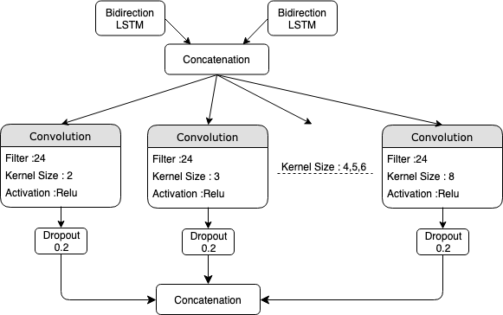
Architecture Part II

Slide 14
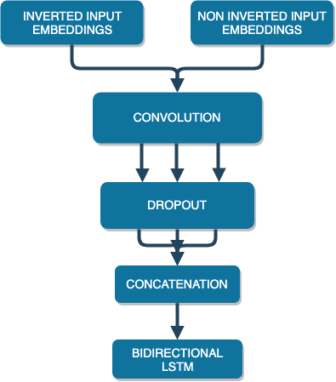
Architecture Part III

Slide 15
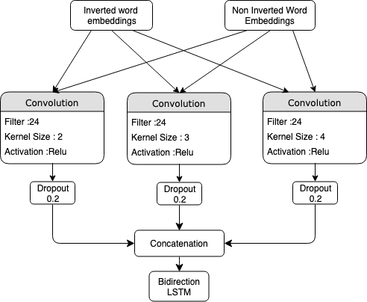
Architecture Part III

Slide 16
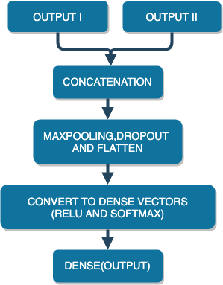
Architecture Part IV

Slide 17

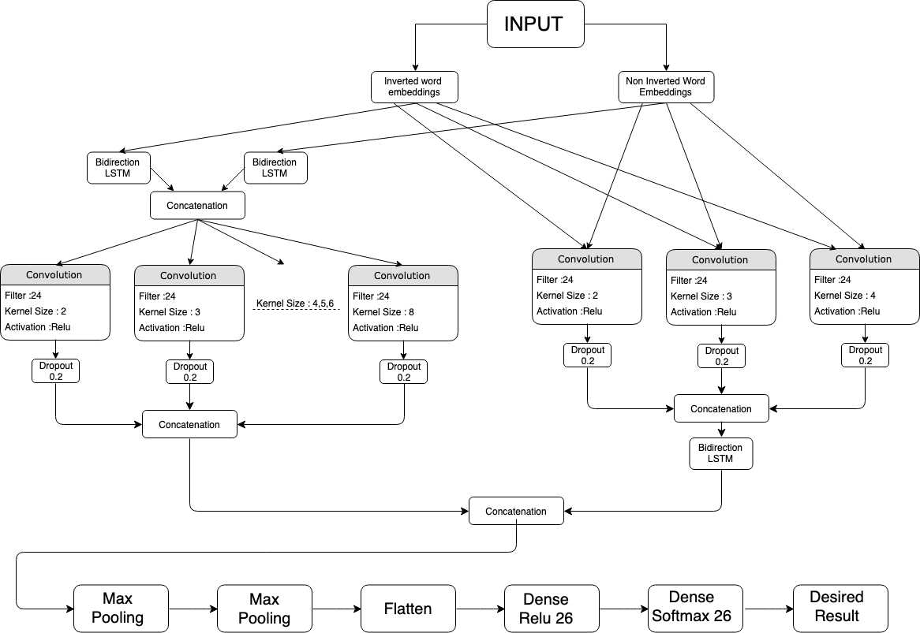
Architecture

Slide 18
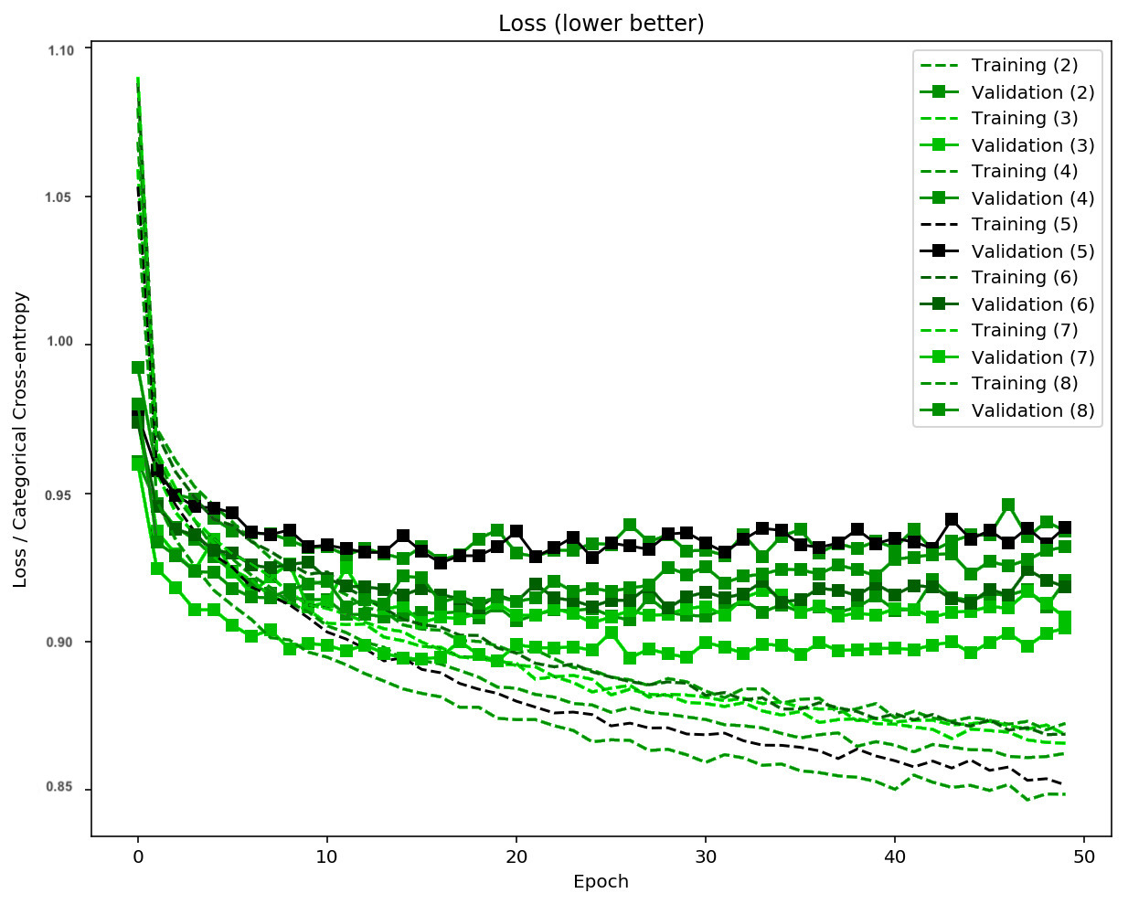
Results
Training loss decreasing -> model is learning

Slide 19
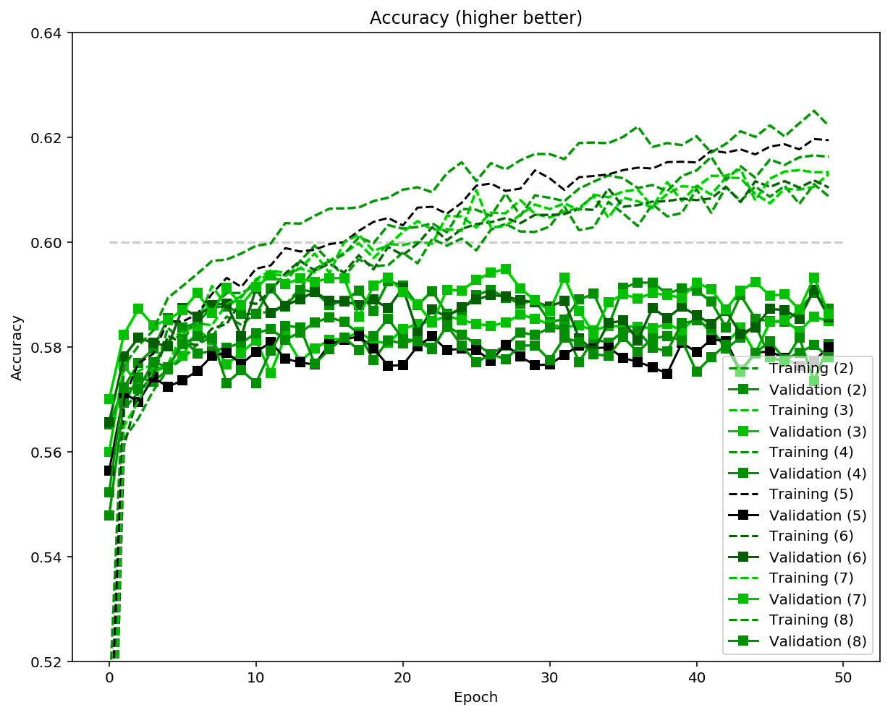
Results
Training accuracy increasing -> model is learning

Slide 20
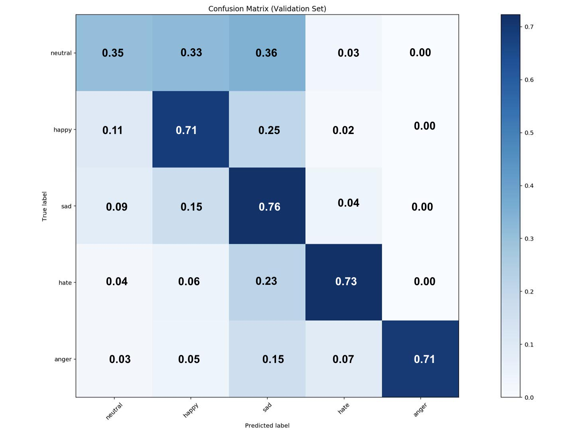
Results

Slide 21
Results
S.No | Architecture | Accuracy(%)
1 | RNN 2 Emotions | 86.01
2 | Faster RNN 2 Emotions | 85.18
3 | CNN 2 Emotions | 85.28
4 | CNN 5 Emotions | 87.15
5 | LSTM 5 Emotions | 62.29

Slide 22
Conclusion
We managed to get good accuracy on binary and multiple(5) emotions recognition.
We performed the same on dataset comprising of Sarcastic comments.

Slide 23
Future Work
Recognising emotion of incomplete sentences.
Characterize feeling to greater extents, say -2 to 2.
Considering punctuation marks while recognizing emotions.

Slide 24
References
W. E.-H. H. H. Shaheen, Shadi and S. Elbassuoni, “Emotion recognition from text based on automatically generated rules,” Data Mining Workshop ICDMW, vol. pp. 383-392, 2014.
S. K. N. J. Jain, Vinay Kumar and P. Verma, “A novel approach to track public emotions related to epidemics in multilingual data,” International Conference and Youth School Information Technology and Nanotechnology, vol. 101 No. 10, pp. 104503–1‚Äì104503–22, 2016.

Slide 25
References
K. R. L. Jin Wang, Liang Yu and X. Zhang, “Dimensional sentiment analysis using a regional cnn-lstm model,” Annual Meeting of the Association for Computational Linguistics, 2016.
X. W. Tao Chena Rui feng Xuab, Yulan Hec, “Improving sentiment analysis via sentence type classification using bilstm-crf and cnn,” Annual Meeting of the Association for Computational Linguistics, vol. 36, pp. 1559–1564, 2017.

Slide 26
Thank You

