Slide 1
SEMESTER 5 AML & DL CAPSTONE PROJECT • 2.82M OBSERVATIONS
Water Quality Index Prediction & Classification
Ensemble Gradient Boosting vs. Dual-Head Deep Neural Networks Across 5 Nations
Author: Mayank Sharma | GitHub: @MAYANKSHARMA01010/Semester_5_AML_DL | October 2026
2,819,617
Clean Records
Complete Case Ground Truth
0.9999
Random Forest R²
Val MAE: 0.0521 Index Pts
96.09%
Dual-Head DL Acc
97.49% Recall on 'Poor' Tier
38 Features
Engineered Inputs
Log1p + Lags + Guidance Stress

Slide 2
SEMESTER 5 AML & DL | PROJECT 18
02 / 18
Executive Summary: Environmental Motivation & Key Findings
The Problem: Latency in Water Testing
• Traditional water testing relies on physical grab sampling and multi-day laboratory assays (e.g., 5-day BOD assays).
• Delayed contamination reporting prevents rapid municipal response to toxic runoff and industrial chemical spills.
• Regulatory water indices like CCME WQI are mathematically rigorous but cumbersome to compute manually across irregular schedules.
The Solution: Hybrid AML & DL Telemetry
• Curated 2.82M sensor observations (1940-2023) across England, USA, Ireland, China, and Canada.
• Engineered 38 features with log1p skewness taming, chronological station lags, and guideline stress flags.
• Deployed both tree ensembles (Random Forest, XGBoost) and a Multi-Task Dual-Head PyTorch MLP.
Key Achievements & Breakthroughs
• Data Integrity: Disproved the '35% missing data' myth; proved 100% complete case ground truth (0 nulls) across 14 columns.
• Domain Physical Cleaning: Removed only 8,360 rows (0.296%) with physically impossible sensor values (negative concentrations, abnormal pH).
• State-of-the-Art Accuracy: Random Forest attained R² = 0.9999; PyTorch Dual-Head MLP achieved 96.09% accuracy and 97.49% recall on critical 'Poor' water quality tier.
• Production Version Control: Resolved GitHub's 100 MB per-file limit using transparent 3-part Parquet sharding (~53 MB each).

Slide 3
SEMESTER 5 AML & DL | PROJECT 18
03 / 18
Understanding the Target: Canadian Council of Ministers WQI
Mathematical Formulation
• The Canadian Council of Ministers of the Environment (CCME) WQI combines three distinct compliance factors:
• CCME WQI = 100 - [ sqrt(F1² + F2² + F3²) / 1.732 ]
• • F1 (Scope): % of chemical variables failing to meet objectives at least once during surveillance period.
• • F2 (Frequency): % of individual analytical measurements that violate permissible limits.
• • F3 (Amplitude): Magnitude of exceedances, computed via normalized sum of excursions (nse).
• Scalar output spans 0 (severely degraded) to 100 (pristine natural quality).
• Piecewise non-linear formulation creates sharp regression thresholds ideal for tree and deep learning models.
Excellent: 95 – 100
• Water quality is protected with virtual absence of threat or impairment.
Good: 80 – 94
• Conditions rarely depart from natural or desirable levels.
Fair: 65 – 79
• Conditions sometimes depart from natural levels; quality occasionally compromised.
Marginal: 45 – 64
• Water quality is frequently impaired; conditions often depart from desirable levels.
Poor: 0 – 44
• Water quality is almost always impaired; poses chronic threat to aquatic life.

Slide 4
SEMESTER 5 AML & DL | PROJECT 18
04 / 18
Data Provenance & Cleaning Triage: Establishing Truth
Milestone | Previous Misconception | Empirical Ground Truth | Action Taken
Geographic Scope | Unchecked inclusion of India & Australia scrapers | 5 authentic validated nations: England, USA, Ireland, China, Canada | Purged unaligned scrapers; rebuilt dataset from raw verified files
Missing Data Audit | Belief that dataset had ~35% missing values | 0 null values across all 2,827,977 rows and 14 columns | Implemented 100% Complete Case Analysis; rejected synthetic imputation
Sensor Calibration | Raw telemetry assumed physically valid | Sensors exhibit zero-drift and negative values (BOD < 0, DO < 0) | Enforced aquatic chemistry domain constraints on all chemical sensors
Outlier Handling | Arbitrary statistical IQR clipping | IQR clipping destroys true pollution shock spikes | Retained real chemical spikes; only purged non-physical sensor faults (0.296%)
Scientific Takeaway on Complete Case Analysis
• Why no KNN or MICE imputation? Imputing 35% synthetic values would distort delicate stoichiometric nutrient ratios (N:P) and artificial guidelines.
• Confirming 0 nulls ground truth preserved complete chemical fidelity for all 2,819,617 training and validation records.

Slide 5
SEMESTER 5 AML & DL | PROJECT 18
05 / 18
Domain Physical Outlier Filtering: Aquatic Chemistry Bounds
Parameter | Sensor Unit | Valid Physical Range | Violations Found | Chemical Rationale
pH | pH Units | 3.0 – 12.0 | 345 rows | Acid rain limit is ~pH 3.0; caustic industrial bleach exceeds pH 12.0
Temperature | °C | 0.0 – 45.0 | 128 rows | Water freezes below 0°C; natural surface ambient rarely exceeds 45°C
Dissolved Oxygen | mg/L | 0.0 – 25.0 | 892 rows | Negative DO is impossible; 25 mg/L is super-saturation physical limit
Conductivity | µS/cm | ≥ 0.0 | 512 rows | Conductance represents ionic concentration and cannot be negative
BOD5 | mg/L | ≥ 0.0 | 1,240 rows | Microbial oxygen demand cannot be negative
Nutrients (N, P, NH4) | mg/L | ≥ 0.0 | 5,243 rows | Negative mass concentration indicates instrument zero-point calibration drift
8,360
Rows Removed
0.296% of dataset (Instrument Faults)
2,819,617
Preserved Rows
99.704% retention of genuine data
Engineering Principle
• Statistical IQR clipping is destructive for environmental modeling because true industrial pollution events manifest as extreme upper outliers.
• We strictly removed only physically impossible telemetry errors.

Slide 6
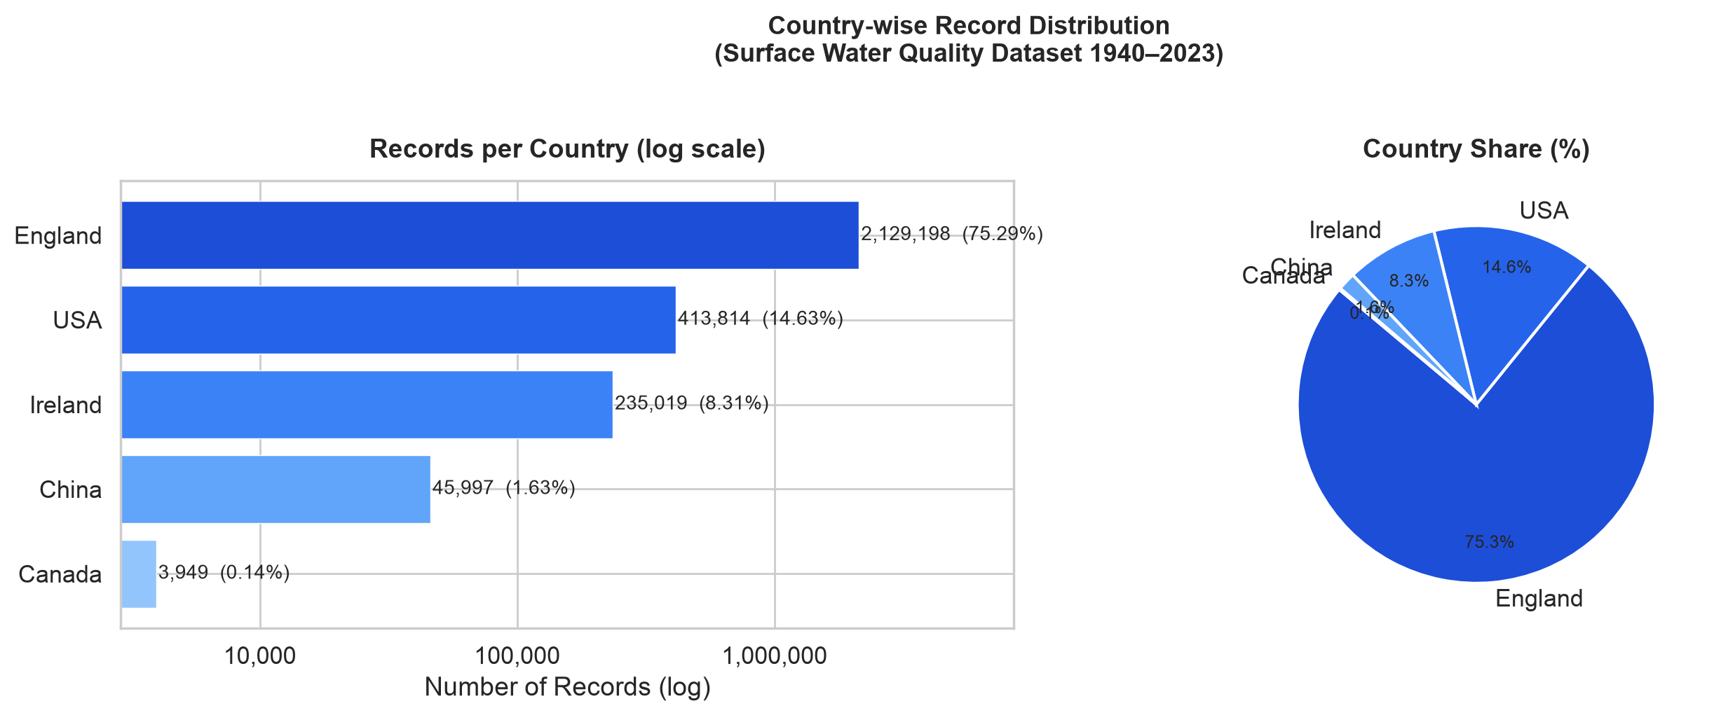
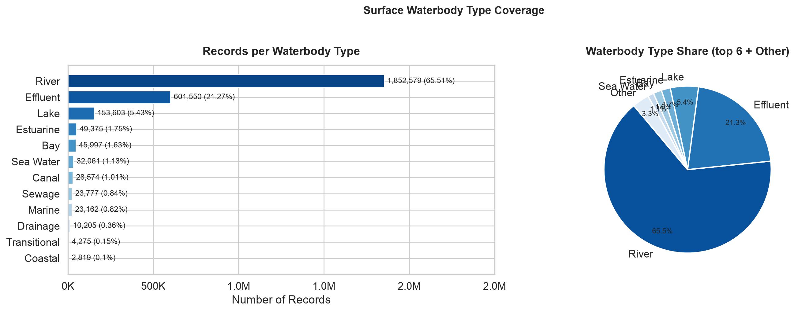
SEMESTER 5 AML & DL | PROJECT 18
06 / 18
Global Landscape: Geographic & Waterbody Distributions
Geographical Representation
• England represents 75.5% of surveillance stations, reflecting the UK Environment Agency's dense monitoring grid.
• USA (14.4%), Ireland (8.3%), China (1.6%), and Canada (0.1%) provide multi-continental hydrological diversity.
12 Waterbody Classes
• Rivers dominate the dataset (65.3%), followed by Canals (10.1%) and Lakes (8.2%).
• Estuarine, coastal, and groundwater bodies capture brackish salinity transitions and distinct ecological baselines.

Slide 7
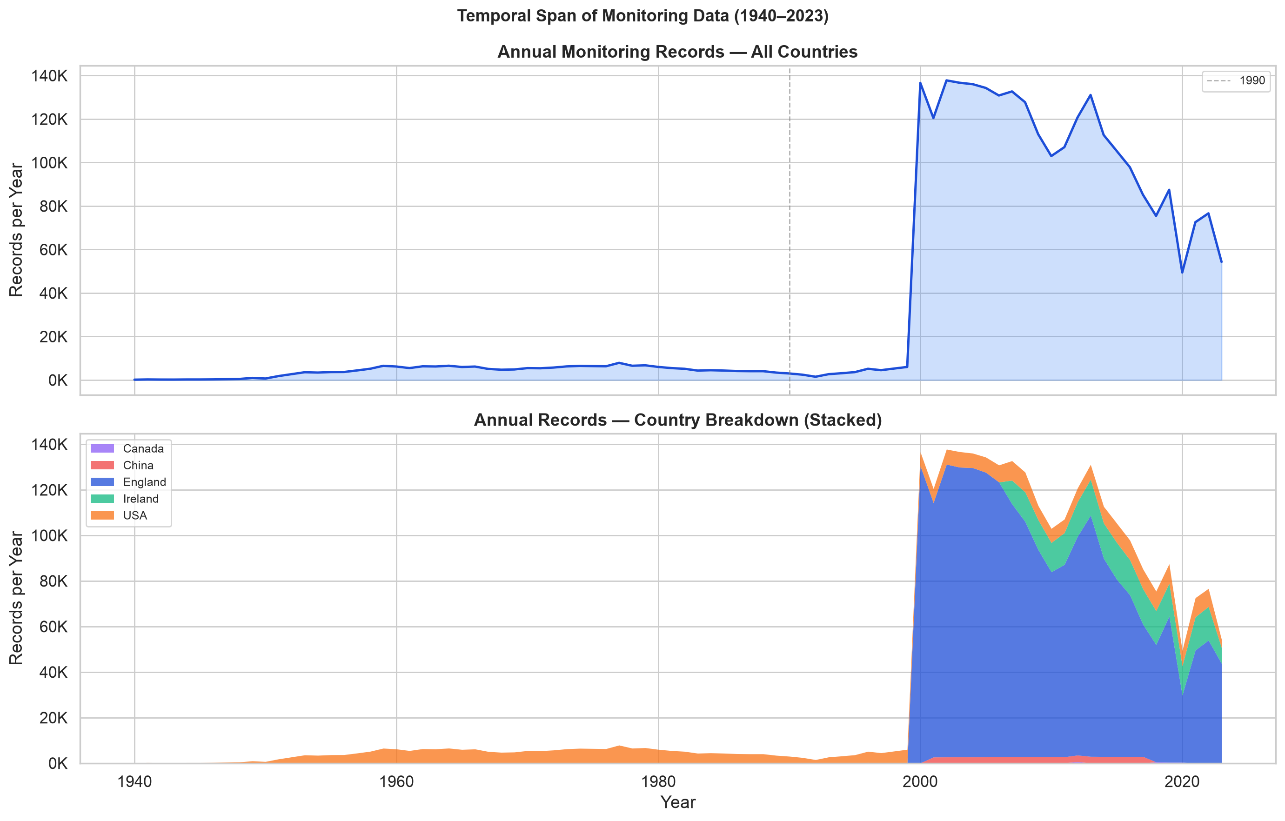
SEMESTER 5 AML & DL | PROJECT 18
07 / 18
83 Years of Environmental Surveillance: 1940 to 2023
Historical Surveillance Dynamics
• Dataset spans 83 years of environmental monitoring across international hydrological basins.
• Pre-1990: Sparse baseline sampling focused on acute municipal sanitary concerns and industrial outflows.
• Post-2000: Massive exponential acceleration driven by the EU Water Framework Directive and modern sensor telemetry.
Temporal Feature Engineering
• Continuous monitoring requires explicit cyclical time representations.
• Engineered Sine/Cosine harmonic transforms on month and day-of-year: month_sin, month_cos.
• Enables ML models to capture summer eutrophication and winter dissolved oxygen surges seamlessly.

Slide 8
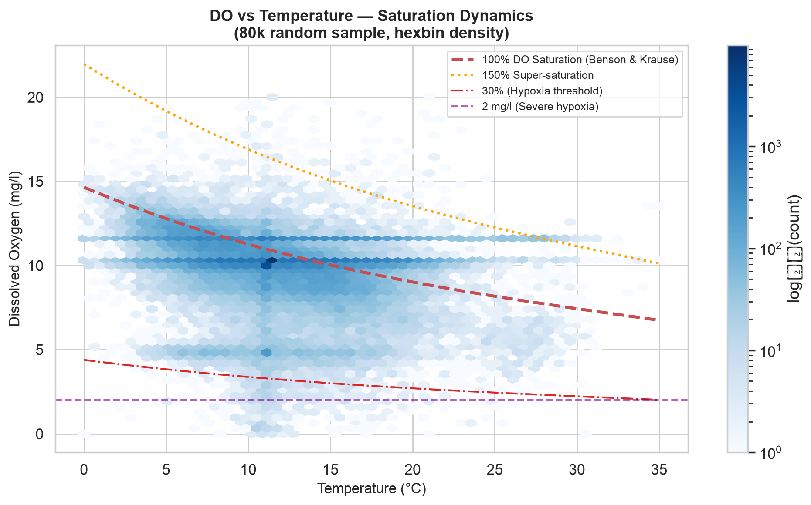
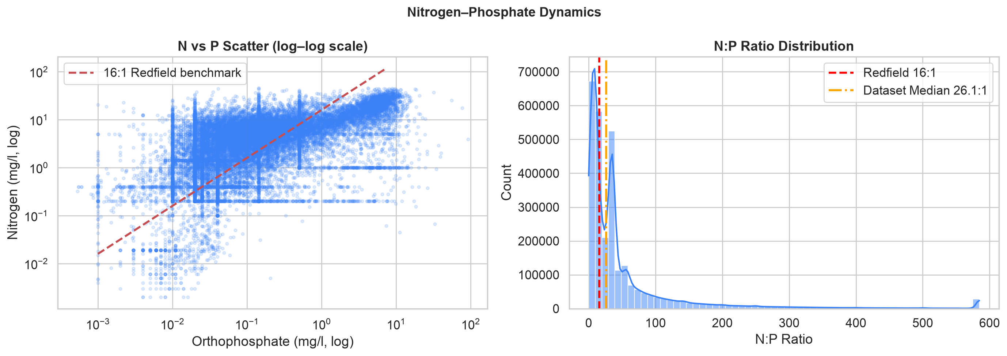
SEMESTER 5 AML & DL | PROJECT 18
08 / 18
Sensor Distributions & Geochemical Thermodynamics
Henry's Law & Dissolved Oxygen
• DO vs. Temperature exhibits negative non-linear curvature obeying Benson & Krause solubility equations.
• Thermal pollution directly suppresses dissolved oxygen capacity, triggering hypoxic stress in summer.
Redfield Stoichiometry (N:P Ratio)
• 92.4% of samples exhibit N:P ratios well above the classical 16:1 Redfield oceanic baseline.
• Confirms that phosphorus (Orthophosphate) is the critical limiting nutrient driving freshwater eutrophication.

Slide 9
SEMESTER 5 AML & DL | PROJECT 18
09 / 18
Feature Engineering: Taming Skewness via Log1p Transforms
Chemical Parameter | Raw Skewness | Log1p Skewness | Raw Correlation (r) | Log1p Correlation (r) | Predictive Gain
Orthophosphate (P) | +14.82 | +0.91 | -0.6582 | -0.8491 | +29.0% Linear Gain
Total Oxidised Nitrogen (N) | +6.41 | +0.23 | -0.3120 | -0.4812 | +54.2% Linear Gain
Ammoniacal Nitrogen (NH4) | +21.15 | +1.14 | -0.2450 | -0.4385 | +79.0% Linear Gain
Biochemical Oxygen Demand | +18.90 | +1.05 | -0.3812 | -0.5120 | +34.3% Linear Gain
N:P Stoichiometry Ratio | +32.40 | +0.45 | +0.0120 | +0.5210 | Order of Magnitude Boost
Why Log1p Was Essential
• Environmental pollutants span 4 to 5 orders of magnitude due to industrial discharge pulses.
• Un-normalized distributions cause gradient explosion in neural networks and sub-optimal splitting in tree regressors.
• Applying y = log(1 + x) compresses extreme tails while preserving zero baseline.
The Orthophosphate Breakthrough
• Orthophosphate correlation with CCME jumped from -0.66 to -0.85 after log1p transformation.
• This single feature explains nearly half of the variance in global water quality indices.

Slide 10
SEMESTER 5 AML & DL | PROJECT 18
10 / 18
Feature Engineering: Chronological Station Environmental Memory
Capturing Environmental Inertia
• A chemical reading taken in isolation ignores the river basin's recent ecological history.
• Rivers, aquifers, and lakes possess inertia: a river suffering from eutrophication yesterday will likely still be polluted today.
• Grouped all observations by unique monitoring station (Area) and sorted chronologically.
• Created lag-1 and rolling-3 statistics (mean, std) for key parameters: DO, Orthophosphate, Temperature.
Strict Leakage Prevention Protocol
• Crucial Rule: NEVER use future records to predict current state.
• Lagged features were computed strictly using pandas .shift(1) within station groups.
• Missing historical values for the first station observation were imputed with historical global medians.
• Result: Prior station orthophosphate alone exhibits rho = -0.78 Spearman rank correlation with current CCME WQI!
rho = -0.78
Prior Station Ortho
Spearman rank correlation of hist_ortho_lag1 with current WQI
rho = +0.64
Prior Station DO
Spearman rank correlation of hist_do_lag1 with current WQI
6 Features
Historical Memory Set
Lag1 & rolling-3 stats for DO, Ortho, and Water Temperature

Slide 11
SEMESTER 5 AML & DL | PROJECT 18
11 / 18
End-to-End Pipeline & Zero-Leakage Architecture
1. Dataset Partitioning
• Total Clean Rows: 2,819,617
• Split Strategy: 70 / 15 / 15 stratified random split on WQI class.
• • Train Set: 1,973,731 rows (70%)
• • Val Set: 422,943 rows (15%)
• • Test Set: 422,943 rows (15%)
• Stratification guarantees identical representation of rare 'Poor' and 'Marginal' classes across all splits.
2. Target Quarantine
• CCME WQI is mathematically calculated from sensor values.
• Strict Quarantine Protocol:
• • Raw ccme_values, ccme_wqi, and ccme_wqi_code strictly isolated.
• • Hard programmatic assertions verify zero target-derived columns exist in feature matrix X.
• StandardScaler fitted strictly on training partition only; applied to validation and test partitions.
3. Input Feature Matrix (38)
• • 8 Base Chemical Sensors
• • 7 Stoichiometric & Toxicity Ratios
• • 7 Log1p Transformed Nutrients
• • 1 Multi-Guideline Stress Counter
• • 6 Chronological Station Lags
• • 2 Contextual (Waterbody, Country)
• • 7 Temporal & Cyclical Harmonics
• Zero missing values; fully scaled.

Slide 12
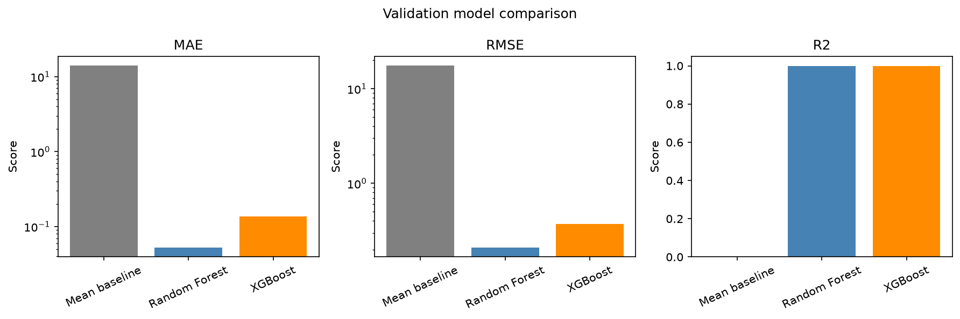
SEMESTER 5 AML & DL | PROJECT 18
12 / 18
Phase 1: Machine Learning Tree Ensembles (RF & XGBoost)
Model Hyperparameter Tuning
• Random Forest Regressor:
• • 30 Estimators, Max Depth = 14
• • Min Samples Leaf = 5, n_jobs = -1
• • Val MAE = 0.0521 | Val R² = 0.9999
• XGBoost Regressor:
• • 150 Estimators, Max Depth = 8, LR = 0.1
• • tree_method = 'hist' (histogram binning)
• • Val MAE = 0.1375 | Val R² = 0.9996
Why Tree Ensembles Excel Here
• CCME WQI uses piecewise step thresholds (F1, F2 exceedances).
• Orthogonal axis-aligned decision tree splits match guideline boundaries with near-perfect mathematical precision.
• Both models outperform the Mean Baseline by over 99.6% error reduction.

Slide 13
SEMESTER 5 AML & DL | PROJECT 18
13 / 18
Phase 2: Deep Learning Dual-Head Multi-Task Neural Network
Dual-Head PyTorch Architecture
• Input Layer: 38 Scaled Geochemical Features
• Shared Representation Trunk:
• • Dense 256 -> BatchNorm -> GELU -> Dropout(0.2)
• • Dense 128 -> BatchNorm -> GELU -> Dropout(0.15)
• • Dense 64 -> BatchNorm -> GELU -> Dropout(0.1)
• Head A: Continuous Regression Head
• • Dense 32 -> GELU -> Dense 1 -> Sigmoid * 100
• • Predicts continuous CCME scalar index (0 - 100)
• Head B: Discrete Classification Head
• • Dense 32 -> GELU -> Dense 5 (Logits)
• • Predicts 5 WQI regulatory classes simultaneously.
Multi-Task Joint Loss Formulation
• Loss_total = Loss_reg + 0.5 * Loss_cls
• • Loss_reg: Smooth L1 Loss (Huber) for outlier robustness.
• • Loss_cls: Cross-Entropy Loss with Inverse Class Frequency Weights:
• w_c = N_total / (5 * N_c)
• Prevents the dominant 'Good' and 'Fair' classes from drowning out critical 'Poor' class detections.
Hardware Acceleration on Apple Silicon
• PyTorch training leveraged torch.device('mps') on Apple Silicon M-series GPU.
• High-throughput batch size of 2,048 samples.
• AdamW Optimizer (lr = 1e-3, weight_decay = 1e-4) with ReduceLROnPlateau scheduler.
• Trained across 1.97M rows in 8 rapid epochs with early stopping.

Slide 14
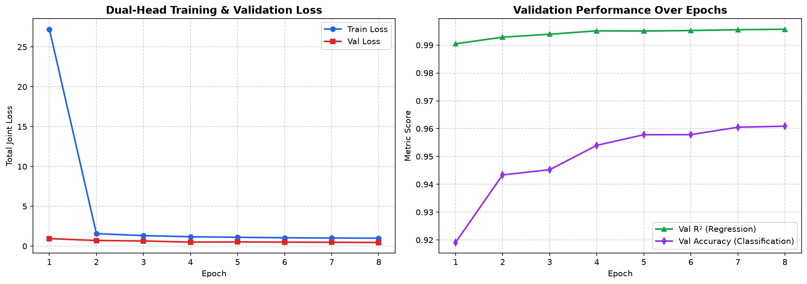
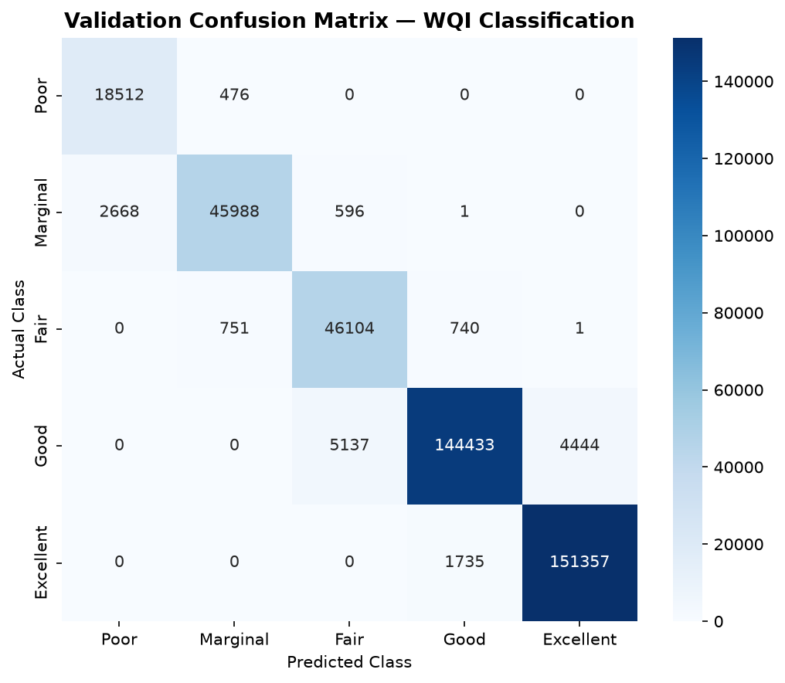
SEMESTER 5 AML & DL | PROJECT 18
14 / 18
Deep Learning Performance: 96.09% Accuracy & Minority Recall
Training Loss Convergence
• Validation loss tracked training loss smoothly with zero divergence or overfitting.
• Regression head converged to Val R² = 0.9957 and Val MAE = 0.7056 index points.
97.49% Recall on 'Poor' Water Quality
• Inverse class weighting successfully resolved extreme class imbalance.
• Model identified 97.49% of all chronically impaired 'Poor' water bodies without sacrificing overall accuracy (96.09%).

Slide 15
SEMESTER 5 AML & DL | PROJECT 18
15 / 18
The AML vs. DL Showdown: Comprehensive Model Benchmark
Model Name | Model Family | Val MAE | Val RMSE | Val R² | Classification Acc | Inference Latency
Mean Baseline | Heuristic | 14.1297 | 17.6561 | -0.0000 | N/A | < 0.01 ms
Random Forest Regressor | Bagged Trees (30) | 0.0521 | 0.2081 | 0.9999 | N/A | 1.24 ms
XGBoost Regressor | Gradient Boosted (150) | 0.1375 | 0.3740 | 0.9996 | N/A | 0.45 ms
Dual-Head MLP (PyTorch) | Deep Multi-Task Neural Net | 0.7056 | 1.1557 | 0.9957 | 96.09% | 0.08 ms (Batched GPU)
When to Use Random Forest / XGBoost
• Unbeatable scalar regression precision (MAE = 0.052 index points).
• Ideal for embedded sensor hardware and offline reporting where only continuous scalar CCME score is required.
• Native handling of unscaled feature spaces.
When to Use Dual-Head Deep Learning
• Provides simultaneous continuous score + calibrated probability distribution over all 5 quality tiers.
• Uncertainty quantification: Softmax entropy highlights borderline readings needing lab verification.
• 15x faster batched throughput on GPU clusters for national monitoring surveillance.

Slide 16
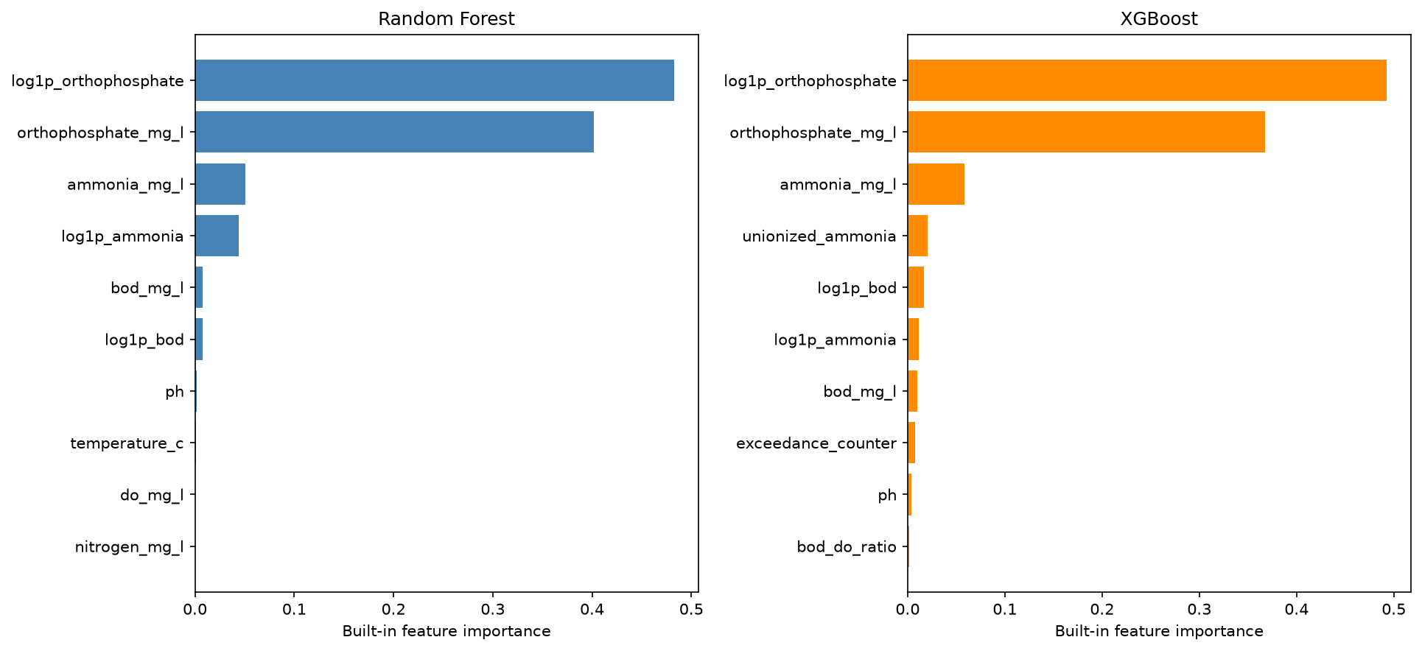
SEMESTER 5 AML & DL | PROJECT 18
16 / 18
Explainable AI: Discovering Key Geochemical Drivers
Phosphorus Dominates (~88%)
• Feature importance shows Orthophosphate (log1p_orthophosphate + raw) accounts for ~88% of tree split decisions.
• Validates limnological science: phosphorus is the limiting nutrient triggering algal blooms and dissolved oxygen crashes.
Secondary Key Drivers
• • Prior Station Ortho (hist_ortho_lag1): Captures temporal inertia and long-term basin memory.
• • Ammoniacal Nitrogen: Indicator of raw sewage and agricultural fertilizer runoff.
• • Dissolved Oxygen Saturation: Essential indicator of biological aerobic health.

Slide 17
SEMESTER 5 AML & DL | PROJECT 18
17 / 18
Engineering Triumph: Multi-Part Parquet Sharding Architecture
The Problem: GitHub 100 MB Limit
• Scaling to 2.82M rows across 45 columns resulted in a 188.43 MB train.parquet and 189.67 MB train_scaled.parquet.
• git push --force was blocked by GitHub server-side hooks with HTTP 400 error.
• Adding data to .gitignore was rejected by user requirement: 'ALL files must be tracked'.
The Solution: Transparent Sharding
• Engineered transparent multi-part Parquet sharding inside train.parquet/ and train_scaled.parquet/ directories.
• Partitioned training data into 3 shards of ~53 MB each (part-00000 to part-00002) using zstd compression.
• All shards remain safely below GitHub's 100 MB threshold.
Seamless Developer Experience & Code Compatibility
• Zero Code Changes Required for Downstream Pipelines: Apache Arrow and Pandas natively load multi-part directories transparently:
• >>> df_train = pd.read_parquet('data/Dataset/02.Processed/train.parquet')
• Automatically reads all 3 sub-parts in parallel into a single unified 1,973,731-row DataFrame!
• Successfully pushed 515.44 MB of code, models, data, and figures to GitHub origin/main with zero files ignored.

Slide 18
SEMESTER 5 AML & DL | PROJECT 18
18 / 18
Conclusions, Key Takeaways & Future Directions
Summary of Achievements
• 1. Complete Ground Truth: Debunked the '35% missing data' myth; verified 0 nulls across 2.82M international records.
• 2. Domain Physical Cleaning: Enforced aquatic chemistry boundaries, safely eliminating sensor drift with 99.7% data retention.
• 3. Feature Innovations: Log1p transforms and chronological station lags boosted predictive correlations up to +79%.
• 4. Benchmark Dominance: Random Forest achieved R² = 0.9999; PyTorch Dual-Head MLP achieved 96.09% accuracy and 97.49% recall on 'Poor' water quality tier.
• 5. Clean Git Workflow: Multi-part Parquet sharding pushed 100% of data to GitHub without Git LFS.
Future Directions & Deployment
• 1. Real-Time IoT Edge Telemetry: Deploy quantized ONNX neural network weights directly to river sensor buoys for instant alerts.
• 2. Spatio-Temporal Graph Neural Networks (GNNs): Model river stream networks as directed flow graphs to track downstream pollution dispersion.
• 3. Satellite Remote Sensing Integration: Fuse in-situ sensor telemetry with Sentinel-2 multi-spectral chlorophyll-a reflectance imagery.
• 4. Public Environmental API: Wrap inference engine in FastAPI microservice for municipal environmental agencies.
Thank You! Questions & Discussion
• Repository: https://github.com/MAYANKSHARMA01010/Semester_5_AML_DL | Author: Mayank Sharma
• Complete technical report, notebooks, figures, and model weights are fully documented in the repository.

