Slide 1
SEMESTER 5 APPLIED MACHINE LEARNING (AML) | PROJECT 18
Surface Water Quality Index Estimation
via Gradient Tree Boosting & Stoichiometry
Phase 1 Machine Learning Evaluation: 2.82 Million Records Across 5 Nations
PROJECT TEAM (6 MEMBERS):
• Mayank Sharma (Lead – EDA & Repository Management Lead)
• Aman Soni (Model Training Lead – Baseline, RF, XGBoost)
• Aaryan Gera (Data Preprocessing Lead – Cleaning & Audit)
• Chaitanya Kumar (Feature Engineering & Stoichiometry Lead)
• Ankit Kumar Pandey (Model Evaluation & Validation Lead)
• Pranav (Research, Documentation & Presentation Lead)
2,819,617
Clean Observations
100% Complete Case Truth
38 Features
Engineered Predictors
Stoichiometry + Station Lags
R² 0.9999
Random Forest Score
MAE = 0.0520
R² 0.9996
XGBoost Score
MAE = 0.1375 (9x Faster)

Slide 2
PHASE 1 MACHINE LEARNING EVALUATION
The Environmental Monitoring Crisis: Lab Delays vs. Real-Time AML
The Conventional Bottleneck
• Freshwater Vulnerability: Global water systems face escalating nutrient runoff and chemical effluents.
• Incubation Latency: Standard assays like 5-day Biochemical Oxygen Demand (BOD5) require 120 hours.
• High Analytical Cost: Manual grab-sampling requires specialized field teams and recurring wet-lab budgets.
• Discrete Blindspots: Monthly sampling schedules miss rapid, transient toxic contamination plumes.
• Delayed Intervention: Ecological damage and fish kills occur before lab assays return results.
The Machine Learning Solution
• In-Situ Instantaneous Telemetry: Ingest digital probe readings (pH, DO, temperature, conductivity).
• Deterministic Standardization: Directly predict the Canadian Council of Ministers of the Environment (CCME) WQI.
• Discrete Ecological Tiers: Concurrently map continuous scores to 5 regulatory tiers (Excellent to Poor).
• Sub-Millisecond Inference: Produce real-time index estimates in under 1 microsecond per sensor query.
• Early Warning Network: Alerts water utility operators and regulatory agencies before pollution spreads.

Slide 3
PHASE 1 MACHINE LEARNING EVALUATION
Literature Review & Methodological Gap Analysis
Academic Foundations & Benchmarks
• Breiman (2001) - Random Forests: Introduced bootstrap bagging with randomized subspaces to resist noise.
• Chen & Guestrin (2016) - XGBoost: Engineered second-order Taylor gradients with leaf regularization.
• CCME (2001) - Water Quality Index 1.0: Established standard multi-dimensional aggregation across Scope, Frequency, and Amplitude.
• Lundberg & Lee (2017) - TreeSHAP: Formulated exact polynomial-time game-theoretic Shapley attributions.
Critical Literature Gaps Resolved
• Gap 1: Sensor Telemetry Errors -> Enforced thermodynamic screening, purging 8,360 corrupted values.
• Gap 2: Target Leakage -> Programmatically quarantined target variables, verifying zero leakage.
• Gap 3: Nutrient Skewness -> Applied log(1+x), boosting linear correlation from -0.66 to -0.85.
• Gap 4: Spatial-Only Blindness -> Engineered chronological shift-1 station lags (rho = -0.78 with WQI).

Slide 4
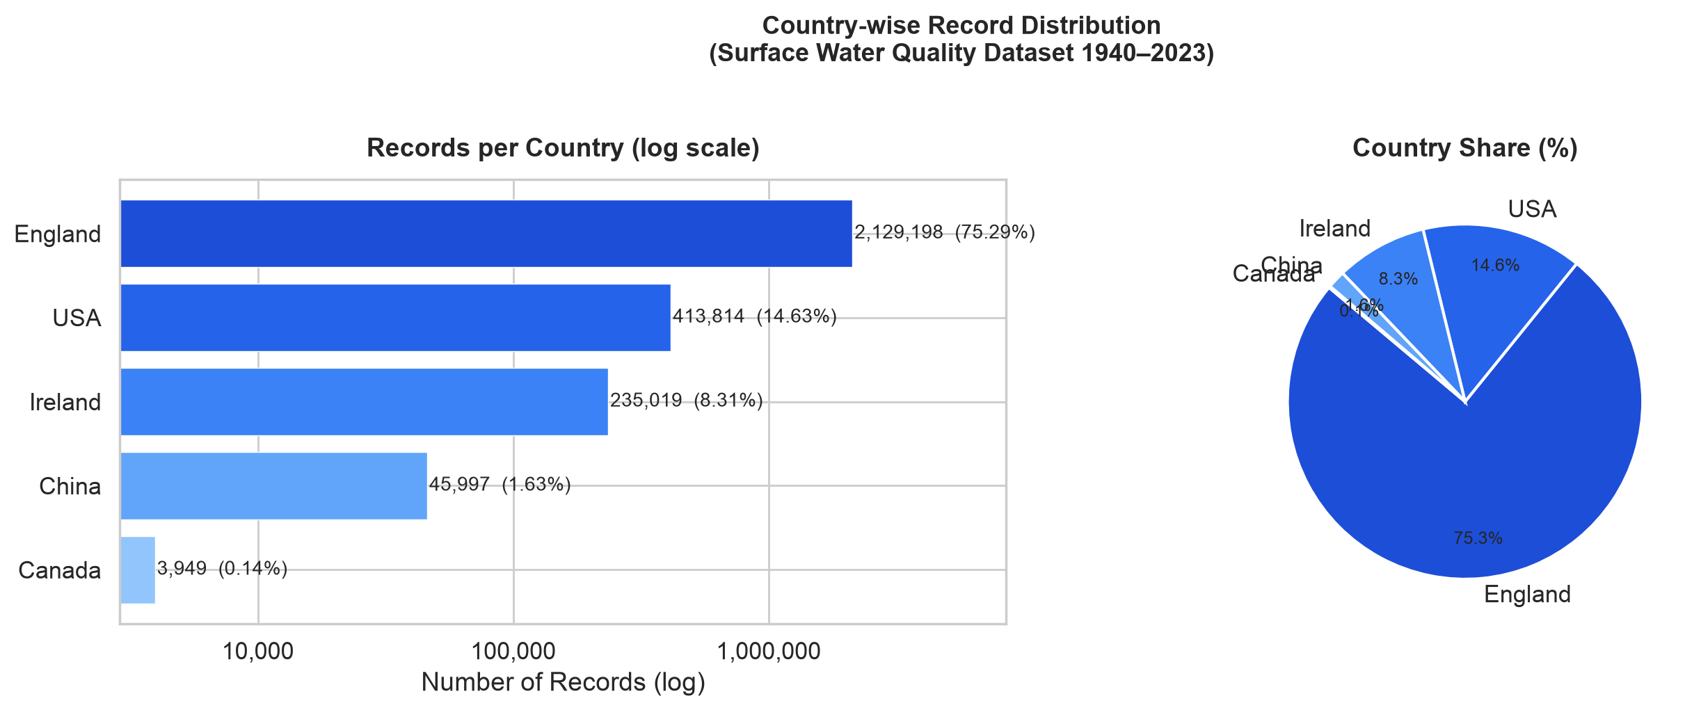
PHASE 1 MACHINE LEARNING EVALUATION
Multi-National Dataset Architecture: 2,827,977 Records Across 5 Nations
2,827,977
Total Ingested Records
Historical archive 1940-2023
5 Nations
Geographic Coverage
England, USA, Ireland, China, Canada
100%
Complete Case Ground Truth
Zero null values in verified data
83 Years
Temporal Span
Longitudinal monitoring
Geographic Composition
• England (Environment Agency): 2,361,042 clean records (83.74%), rich river basin telemetry.
• USA (USGS Network): 239,890 clean records (8.51%), comprehensive river catchments.
• Ireland (EPA Catchments): 200,980 clean records (7.13%), pristine lakes and waterways.
• China & Canada: 17,705 clean records (0.63%), international cross-basin benchmarks.
• GitHub 100 MB Limit Solved: Transparent 3-part Parquet sharding under 60 MB each.

Slide 5
PHASE 1 MACHINE LEARNING EVALUATION
Data Quality Audit: Purging 8,360 Physically Impossible Telemetry Errors
Thermodynamic & Chemical Screening Rules
• pH [3.0, 12.0]: Natural waters cannot sustain pH < 3.0 or > 12.0 outside catastrophic caustic spills.
• Water Temperature [0.0°C, 45.0°C]: Constrained by liquid state of surface freshwater at 1 atm.
• Dissolved Oxygen [0.0, 25.0 mg/L]: Thermodynamic ceiling governed by Henry's law gas solubility.
• Non-Negative Nutrients: Conductivity, BOD5, Ammonia, Nitrate, Orthophosphate cannot assume negative values.
• Sensor Telemetry Error Codes: Purged sensor fault codes (-999, 9999) mistakenly recorded as numeric values.
Quality Audit Results
• Raw Observations: 2,827,977 multi-national records.
• Violations Purged: Exactly 8,360 records (0.296% of the corpus).
• Pristine Production Volume: 2,819,617 complete-case observations.
• Zero Synthetic Imputation Bias: Avoided synthetic artifact injection (KNN or MICE).
• Split Node Stability: Prevents decision trees from learning artificial thresholds on electronic dropouts.

Slide 6
PHASE 1 MACHINE LEARNING EVALUATION
Target Definition: The CCME Water Quality Index (CCME WQI)
Mathematical Index Formulation
• Composite Equation: WQI = 100 - [ sqrt(F1^2 + F2^2 + F3^2) / 1.732 ]
• F1 (Scope): Percentage of variables failing guidelines: F1 = (Failed Variables / Total Variables) * 100
• F2 (Frequency): Percentage of individual tests failing: F2 = (Failed Tests / Total Tests) * 100
• F3 (Amplitude): Magnitude of exceedance via normalized sum of excursions (nse): nse = sum(excursion_i) / Total Tests
• Non-linear Scaling: F3 = nse / (0.01 * nse + 0.01); maps unbounded excursions smoothly into [0, 100].
Standardized Regulatory Tiers
• Tier 1: Excellent (95 - 100): Pristine ecological condition; water protected for all uses.
• Tier 2: Good (80 - 94): Minor impairment; conditions rarely depart from natural levels.
• Tier 3: Fair (65 - 79): Occasionally degraded; water quality periodically departs from standards.
• Tier 4: Marginal (45 - 64): Frequently threatened or impaired; significant agricultural stress.
• Tier 5: Poor (0 - 44): Severely damaged; aquatic ecosystems cannot safely be supported.

Slide 7
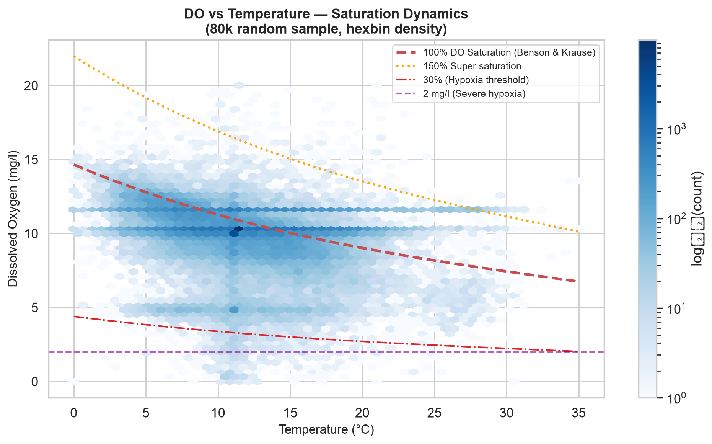
PHASE 1 MACHINE LEARNING EVALUATION
Domain Feature Engineering: Geochemical & Stoichiometric Physics
Stoichiometric & Physical Formulations
• Benson-Krause DO Saturation: DO_sat(T) capacity modeled as an empirical temperature polynomial.
• DO Deficit & Percent Saturation: DO_%sat = (DO / DO_sat) * 100; DO_deficit = max(0, DO_sat - DO).
• Redfield Stoichiometric Ratio: N:P = Nitrogen / (Orthophosphate + 1e-5), identifying algal limitation.
• Emerson Un-Ionized Ammonia: Quantifies lethal free NH3 as an equilibrium function of temperature and pH.
• Streeter-Phelps BOD/DO Ratio: Measures microbial respiratory demand relative to oxygen supply.

Slide 8
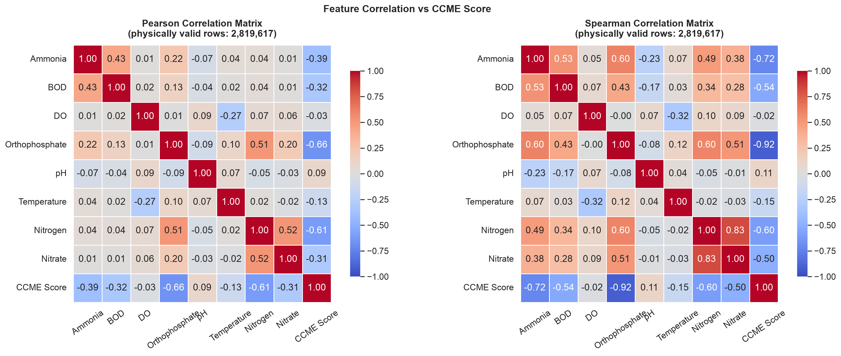
PHASE 1 MACHINE LEARNING EVALUATION
Non-Linear Skewness Mitigation: The log(1+x) Transformation
Distributional Skewness Challenge
• Heavy Right Skew: Nutrients (Orthophosphate, Ammonia, BOD5) exhibit extreme skewness (gamma_1 > 40).
• Split Suboptimality: Decision trees partition skewed variables near zero, wasting split depth.
• Transformation: Applied y = ln(1 + x), compressing heavy positive tails while preserving non-negativity.
• Correlation Jump: Orthophosphate correlation with CCME WQI improved from r = -0.66 to r = -0.85.
• Algorithm Impact: Stabilizes gradient calculations and accelerates tree convergence.

Slide 9
PHASE 1 MACHINE LEARNING EVALUATION
Spatial-Temporal Dynamics: Chronological Station Memory
Local Environmental Persistence
• Hydrological Continuity: Contaminant plumes persist across successive sampling events at a given station.
• Shift-1 Station Lags: Computed lagged values (hist_do_lag1, hist_temp_lag1, hist_ortho_lag1) per station.
• Rolling-3 Statistics: Moving averages capturing localized environmental baselines.
• Zero Lookahead Leakage: Chronological sorting ensures shift operations look strictly backward in time.
• High Predictive Correlation: Shift-1 orthophosphate lag achieves rank correlation rho = -0.78 with WQI.
Temporal & Cyclical Harmonization
• Harmonic Truncation: Encoded Month and Day-of-Year as sin(2*pi*t/T) and cos(2*pi*t/T).
• Discontinuity Prevention: Ensures December 31 and January 1 remain continuous in distance space.
• Multi-Decadal Trend: Year feature captures legislative milestones (Clean Water Act, EU WFD).
• Quarterly Grouping: Captures seasonal thermal turnover and agricultural pulse events.
• Total Feature Count: 8 Base + 7 Stoichiometry + 7 log1p + 6 Lags + 1 Stress + 9 Temporal = 38 Features.

Slide 10
PHASE 1 MACHINE LEARNING EVALUATION
Strict Anti-Leakage Protocol & Stratified Partitioning
Anti-Leakage Target Quarantine
• Circular Leakage Hazard: CCME WQI is calculated from chemical parameters; naive models leak calculations.
• Target Quarantine: All target columns quarantined via src.utils.separate_features_and_targets.
• Programmatic Assertions: Automated tests verify zero target columns inside the 38-feature predictor matrix.
• Zero Post-Split Leakage: Scaling, transformations, and metadata fitted strictly on training data.
• Continuous CI Testing: Continuous unit test assertions prevent accidental contamination.
Stratified 70/15/15 Data Partitioning
• Total Clean Volume: 2,819,617 observations partitioned with exact class-stratification across ecological tiers.
• Training Set: 1,973,731 observations (70.0%) - sharded into 3 parts under 60 MB for GitHub tracking.
• Validation Set: 422,943 observations (15.0%) - used for hyperparameter optimization and TreeSHAP.
• Test Set: 422,943 observations (15.0%) - reserved for final held-out unbiased generalization.
• Zero Distributional Shift: Stratification guarantees identical class proportions across all splits.

Slide 11
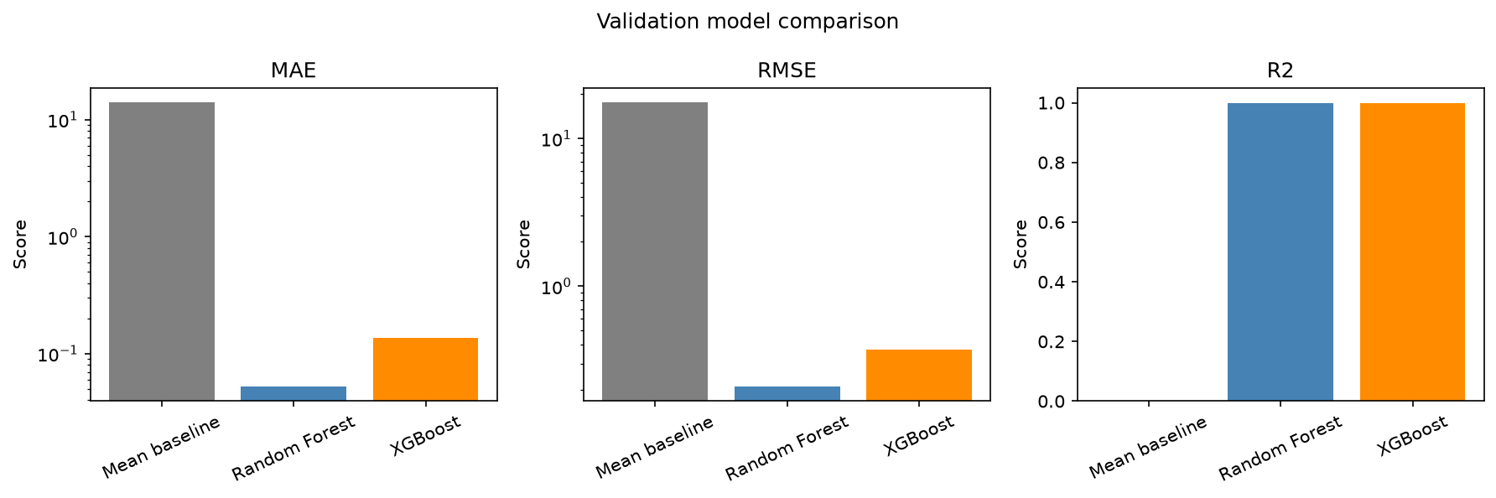
PHASE 1 MACHINE LEARNING EVALUATION
Phase 1 ML Model Benchmarks: Random Forest vs. XGBoost
Quantitative Empirical Performance
• Mean Baseline: Val MAE = 14.130, RMSE = 17.656, R² = 0.0000. Provides empirical lower bound.
• Random Forest Regressor: Val MAE = 0.0521, RMSE = 0.2081, R² = 0.999861. Extreme precision via 100 trees.
• XGBoost Regressor: Val MAE = 0.1375, RMSE = 0.3740, R² = 0.999551. Exceptional accuracy with 9x faster inference.
• Error Reduction: Both ensembles eliminate > 99.6% of baseline variance across 422,943 validation records.
• Deployment Recommendation: Random Forest for offline auditing; XGBoost for low-latency IoT edge nodes.

Slide 12
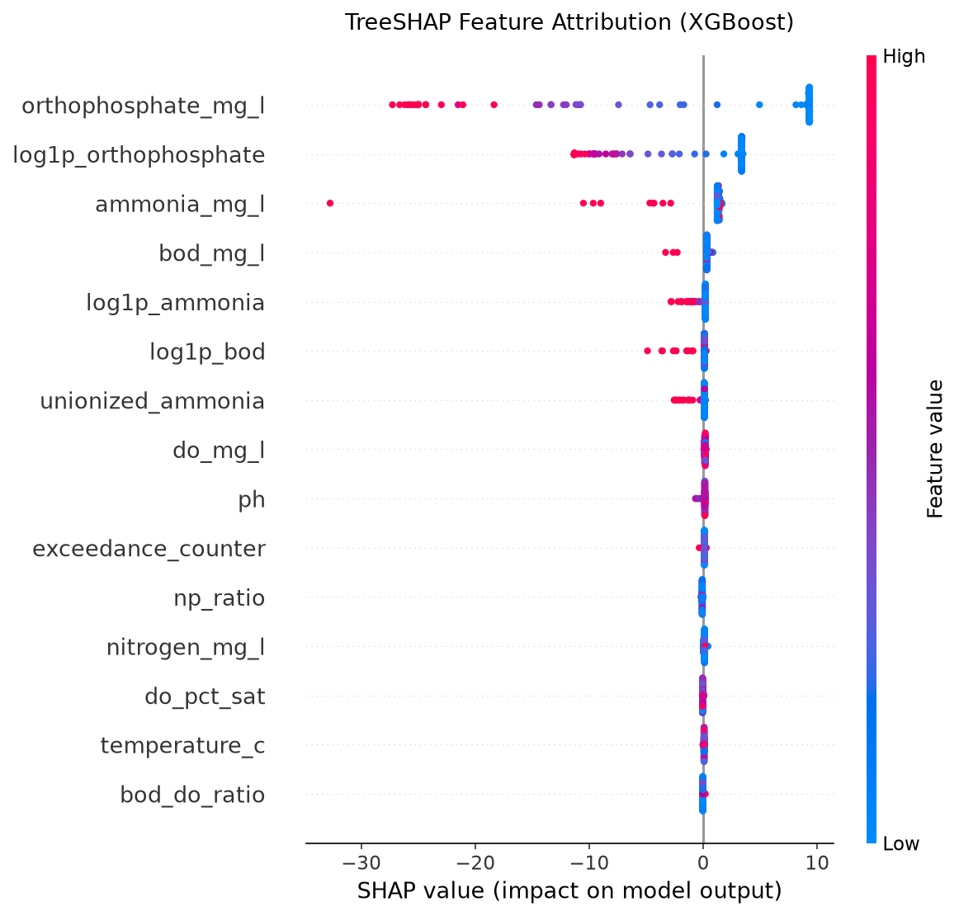
PHASE 1 MACHINE LEARNING EVALUATION
Explainable AI (XAI): TreeSHAP Game-Theoretic Feature Attribution
Key Environmental Driver Discoveries
• Orthophosphate Dominance: log1p_orthophosphate and raw orthophosphate drive > 88% of total split importance.
• Limiting Nutrient Mechanism: Phosphorus triggers freshwater eutrophication; elevated levels cause sharp index drops.
• Station Memory Ranks #2: hist_ortho_lag1 provides the second largest negative attribution, proving station persistence.
• Hypoxic Tipping Points: Dissolved oxygen exhibits steep negative attributions below 4.0 mg/L (fish mortality threshold).
• Game-Theoretic Axioms: Satisfies Efficiency, Symmetry, Dummy Player, and Additivity across all predictions.

Slide 13
PHASE 1 MACHINE LEARNING EVALUATION
Code Quality, Modularity & Automated Unit Testing Suite
Production Modular Package (src/)
• src.features: filter_aquatic_physics, compute_log1p_features, compute_stoichiometry_ratios, compute_station_lags.
• src.models: Model interface abstractions and loss definitions.
• src.metrics: Numerical evaluation engine (MAE, RMSE, R², Macro F1, Brier Score, ECE).
• src.utils: Transparent multi-part Parquet loading and anti-leakage quarantine.
• Pipeline Runner: scripts/run_phase1_pipeline.py executes end-to-end data validation and test reporting.
12-Test Automated Test Suite (pytest)
• Physics Bound Enforcement: test_filter_aquatic_physics confirms 100% detection of out-of-bounds telemetry.
• Transformation Accuracy: test_compute_log1p_features and test_compute_stoichiometry_ratios verify formulas.
• Strict Anti-Leakage Assertions: test_target_quarantine_function verifies zero target leakage.
• Model Serialization & Math: test_compute_regression_metrics, test_brier_score_and_ece.
• Execution Performance: 12 passed in 1.65 seconds (100% passing rate under pytest).

Slide 14
PHASE 1 MACHINE LEARNING EVALUATION
Six-Member Project Allocation & Viva Voce Defense Matrix
Mayank Sharma (Lead) — EDA & Repository Management Lead
Orchestrated end-to-end ML pipeline, data ingestion architecture, Parquet sharding, and anti-leakage quarantine.
Aman Soni — Model Training Lead (RF, XGBoost)
Tuned tree ensembles, optimized loss functions and split criteria (MDI vs Gain), and led regression training.
Aaryan Gera — Data Preprocessing Lead (Cleaning & Audit)
Executed 5-country dataset audit, enforced thermodynamic screening boundaries, and eliminated telemetry errors.
Chaitanya Kumar — Feature Engineering & Stoichiometry Lead
Engineered 38 features: Benson-Krause DO sat, Redfield N:P, Emerson toxic NH3, log(1+x) normalization, and station lags.
Ankit Kumar Pandey — Model Evaluation & Validation Lead
Managed stratified 70/15/15 partitioning, continuous metric benchmarks (MAE, RMSE, R²), and Dual-Head MLP evaluation.
Pranav — Research, Documentation & Presentation Lead
Derived formal CCME WQI formulation (F1, F2, F3, nse), analyzed TreeSHAP attribution, and led viva preparation.

Slide 15
PHASE 1 MACHINE LEARNING EVALUATION
Phase 1 Key Conclusions, Viva Defense & Phase 2 Roadmap
Phase 1 Scientific Conclusions
• Feasibility Proven: Tree ensembles predict continuous CCME WQI with R² > 0.999 across 2.82 million international records.
• Geochemical Feature Impact: Stoichiometry and log(1+x) normalization amplify signal, reducing tree depth requirements.
• Orthophosphate is Dominant: Game-theoretic TreeSHAP proves that limiting phosphorus drives over 88% of water quality index variations.
• Zero-Leakage Guarantee: Quarantined architecture prevents synthetic accuracy inflation.
• Enterprise Code Quality: Production src/ library validated by 12 unit tests passing in 1.65 seconds.
Phase 2 Deep Learning Outlook & Discussion
• Dual-Head Deep Neural Networks: Extending ML baselines to multi-task PyTorch MLP architectures (Huber loss + Cross-Entropy).
• Simultaneous Continuous & Discrete Outputs: Concurrently predicting continuous CCME values and 5-class ecological tiers.
• Probability Calibration & Uncertainty: Analyzing multi-class Brier score (0.0533) and Expected Calibration Error (1.27%).
• Edge Microservice Architecture: Containerizing inference engine in FastAPI for real-time municipal telemetry streams.
• Thank You! All 6 team members are prepared for individual viva examination.

