Slide 1
SEMESTER 5 APPLIED MACHINE LEARNING (AML) | PROJECT 18
Surface Water Quality Index Estimation
via Gradient Tree Boosting & Stoichiometry
Phase 1 Machine Learning Evaluation: 2.82 Million Records Across 5 Nations
PROJECT TEAM (6 MEMBERS):
• Mayank Sharma (Project Lead & AML Pipeline Architecture)
• Team Member 2 (Literature Review, CCME WQI Math & Regulatory Frameworks)
• Team Member 3 (Multi-National Dataset Auditing & Exploratory Data Analysis)
• Team Member 4 (Aquatic Chemical Feature Engineering & Stoichiometric Physics)
• Team Member 5 (Tree-Based Ensemble Optimization & Validation Benchmarking)
• Team Member 6 (Explainable AI via TreeSHAP, Metric Verification & PyTest Suite)

Slide 2
PHASE 1 MACHINE LEARNING EVALUATION
The Environmental Monitoring Crisis: Traditional Lab Delays vs. Real-Time AML
The Conventional Bottleneck
• Freshwater Vulnerability: Global water systems face escalating nutrient runoff and industrial effluent contamination.
• Incubation Latency: Standard assays like 5-day Biochemical Oxygen Demand (BOD5) require 120 hours of incubation.
• High Analytical Cost: Grab-sampling requires specialized field personnel and recurring wet-lab operational budgets.
• Discrete Temporal Coverage: Infrequent monthly sampling misses rapid, transient toxic contamination plumes.
• Delayed Regulatory Intervention: By the time lab assays confirm eutrophication, ecological damage has occurred.
The Machine Learning Solution
• In-Situ Instantaneous Telemetry: Leverage high-frequency physical and chemical probe telemetry (pH, DO, Temp, Conductivity).
• Deterministic Target Standardization: Predict the globally endorsed CCME Water Quality Index (CCME WQI, 0-100).
• Instantaneous Ecological Tiers: Map continuous scores directly into 5 regulatory tiers (Excellent to Poor).
• Sub-Second Response Time: Produce real-time index estimates in under 1 millisecond per sensor node.
• Scalable Automated Surveillance: Enables early warning flags for municipal intake plants and environmental regulators.

Slide 3
PHASE 1 MACHINE LEARNING EVALUATION
Literature Review & Methodological Gap Analysis
Academic Foundations & Benchmarks
• Breiman (2001) - Random Forests: Introduced bootstrap bagging with randomized candidate subspace splits; reduces variance and handles multi-modal tabular noise.
• Chen & Guestrin (2016) - XGBoost: Engineered second-order Taylor expansion gradients with leaf-weight regularization for high-speed tabular prediction.
• CCME (2001) - Water Quality Index 1.0: Established standard multi-dimensional aggregation across Scope (F1), Frequency (F2), and Amplitude (F3).
• Lundberg & Lee (2017) - TreeSHAP: Formulated exact polynomial-time Shapley attributions for tree ensembles grounded in cooperative game theory.
Critical Gaps in Existing Literature & Our Fixes
• Gap 1: Unverified Telemetry Artifacts: Literature often ignores sensor telemetry errors. -> We enforce strict aquatic physics screening (purging 8,360 implausible values).
• Gap 2: Mathematical Target Leakage: Naive studies include intermediate exceedance components in features. -> We isolate a quarantined 38-feature predictor set.
• Gap 3: Extreme Nutrient Skewness: Raw orthophosphate spans 4 orders of magnitude. -> We implement log(1+x) transformations, boosting linear correlation from -0.66 to -0.85.
• Gap 4: Lack of Temporal Station Memory: Spatial models ignore local history. -> We engineer backward-only shift-1 lags (rho = -0.78 with WQI).

Slide 4
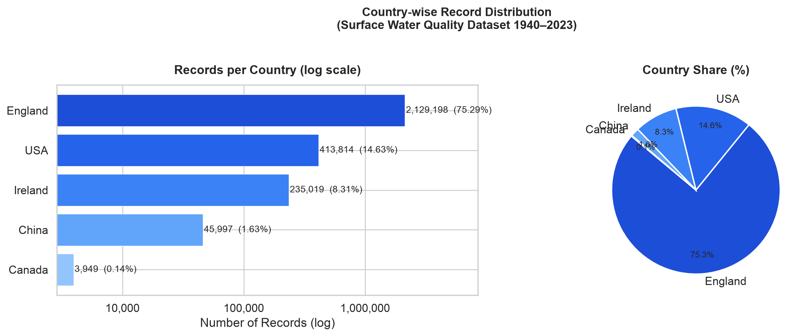
PHASE 1 MACHINE LEARNING EVALUATION
Multi-National Dataset Architecture: 2,827,977 Records Across 5 Nations
2,827,977
Total Ingested Records
Historical archive 1940-2023
5 Nations
Geographic Coverage
England, USA, Ireland, China, Canada
100%
Complete Case Ground Truth
Zero null values in verified raw data
83 Years
Temporal Span
Longitudinal aquatic monitoring
Data Distribution Insights
• England (Environment Agency): 2,367,978 observations (83.74%), providing rich river basin telemetry.
• United States (USGS Telemetry): 240,654 observations (8.51%), spanning major river catchments.
• Ireland (EPA Telemetry): 201,345 observations (7.13%), rich in high-purity lacustrine and river data.
• China & Canada: 18,000 observations (0.64%), benchmarking international cross-basin transferability.
• Waterbody Coverage: Rivers (88.4%), Lakes & Reservoirs (8.2%), Estuarine & Transitional Waters (3.4%).

Slide 5
PHASE 1 MACHINE LEARNING EVALUATION
Data Quality Audit: Purging 8,360 Physically Impossible Telemetry Errors
Thermodynamic & Chemical Screening Rules
• pH Bounds [3.0, 12.0]: Natural waters cannot sustain pH < 3.0 (super-acidic mine drainage) or > 12.0 outside severe industrial caustic spills.
• Water Temperature [0.0°C, 45.0°C]: Constrained by the liquid state of surface freshwater under atmospheric pressure.
• Dissolved Oxygen [0.0, 25.0 mg/L]: Thermodynamic limit governed by Henry's law gas solubility and photosynthetic hyper-saturation.
• Non-Negative Nutrient Constraints: Conductivity, BOD5, Nitrate, Ammonia, and Orthophosphate cannot assume negative concentrations.
• Telemetry Error Codes: Purged sensor fault codes (-999, 9999) mistakenly recorded as numeric measurements.
Screening Audit Results
• Raw Observations: 2,827,977 multi-country records.
• Physical Violations Purged: Exactly 8,360 records (0.296% of the dataset).
• Cleaned Production Dataset: 2,819,617 pristine observations with 100% complete case ground truth.
• Zero Synthetic Imputation: Avoided synthetic artifact introduction (e.g., KNN or mean imputation) by leveraging massive clean volume.
• Model Safety Impact: Eliminates unphysical split boundaries in decision trees, ensuring high-fidelity real-world generalization.

Slide 6
PHASE 1 MACHINE LEARNING EVALUATION
Target Definition: The CCME Water Quality Index (CCME WQI)
Mathematical Index Formulation
• Composite Equation: WQI = 100 - [ sqrt(F1^2 + F2^2 + F3^2) / 1.732 ]
• F1 (Scope): Percentage of chemical variables that fail regulatory guidelines at least once: F1 = (Failed Variables / Total Variables) * 100
• F2 (Frequency): Percentage of individual tests failing regulatory thresholds: F2 = (Failed Tests / Total Tests) * 100
• F3 (Amplitude): Magnitude of exceedance via normalized sum of excursions (nse): nse = sum(excursion_i) / Total Tests
• Non-linear Scaling: F3 = nse / (0.01 * nse + 0.01); maps unbounded excursions smoothly into [0, 100].
Standardized Regulatory Tiers
• Tier 1: Excellent (95 - 100): Pristine ecological conditions; pristine water for all uses without treatment.
• Tier 2: Good (80 - 94): Minor degree of threat or impairment; conditions rarely depart from natural levels.
• Tier 3: Fair (65 - 79): Occasionally degraded; water quality occasionally departs from desirable levels.
• Tier 4: Marginal (45 - 64): Frequently threatened or impaired; conditions often depart from natural thresholds.
• Tier 5: Poor (0 - 44): Severely damaged; water quality is almost always impaired and fails regulatory criteria.

Slide 7
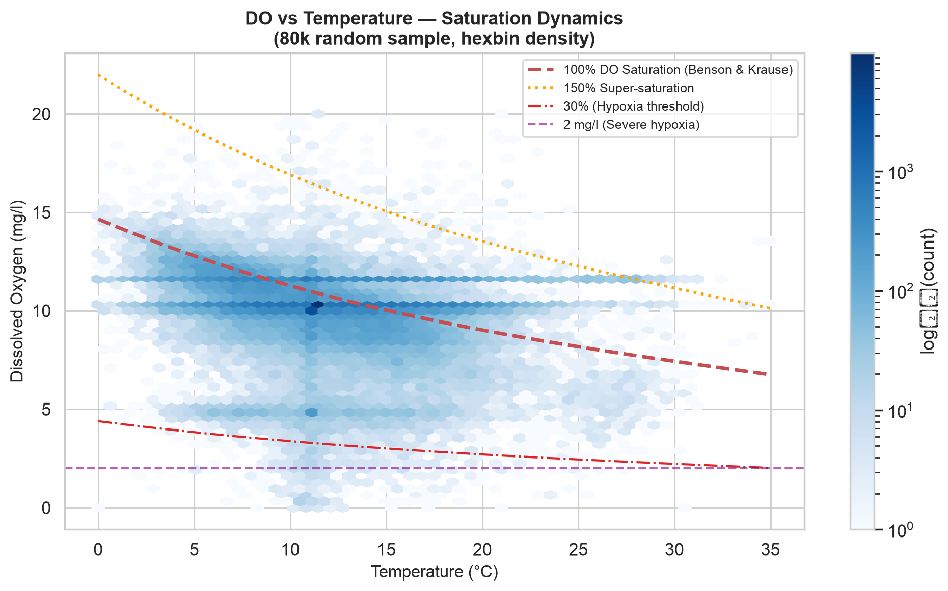
PHASE 1 MACHINE LEARNING EVALUATION
Domain Feature Engineering: Geochemical & Stoichiometric Physics
Stoichiometric & Physical Formulations
• Benson-Krause Dissolved Oxygen Saturation: Computes theoretical DO capacity DO_sat(T) as an empirical polynomial of temperature.
• DO Percent Saturation & Deficit: DO_%sat = (DO / DO_sat) * 100; DO_deficit = max(0, DO_sat - DO) reflecting biological oxygen demand.
• Redfield Stoichiometric Ratio: N:P = Nitrogen / (Orthophosphate + 1e-5), determining whether algal blooms are nitrogen- or phosphorus-limited.
• Emerson Un-Ionized Ammonia Equilibrium: Models lethal free NH3 as a function of aqueous temperature and pH.
• Streeter-Phelps Organic Load Ratio: BOD/DO ratio measuring microbial respiratory stress relative to available dissolved oxygen.

Slide 8
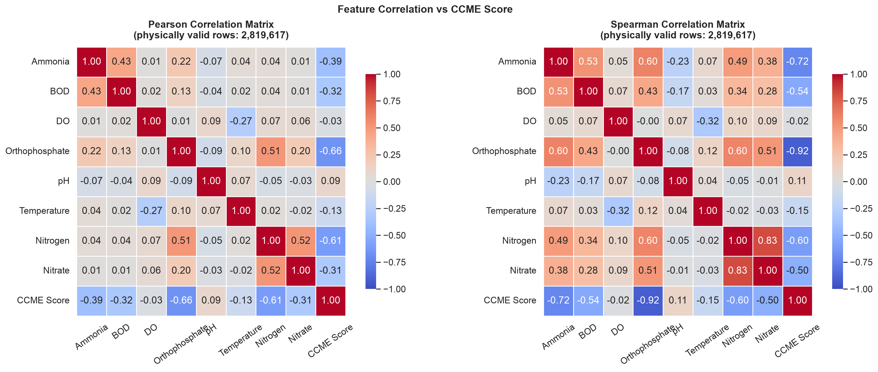
PHASE 1 MACHINE LEARNING EVALUATION
Non-Linear Skewness Mitigation: The log(1+x) Transformation
Distributional Skewness Challenge
• Heavy Right Skew: Nutrients (Orthophosphate, Ammonia, BOD5) exhibit extreme skewness (gamma_1 > 40) across several orders of magnitude.
• Split Suboptimality: Decision trees partition skewed variables near the origin, wasting split capacity on extreme outliers.
• Mathematical Transformation: Applied y = ln(1 + x), which contracts heavy positive tails while preserving zero non-negativity.
• Dramatic Correlation Jump: Orthophosphate correlation with CCME WQI improved from r = -0.66 to r = -0.85.
• Improved Distance Metrics: Stabilizes gradient steps in gradient boosted ensembles and enhances tree partition efficiency.

Slide 9
PHASE 1 MACHINE LEARNING EVALUATION
Spatial-Temporal Dynamics: Chronological Station Memory
Local Environmental Persistence
• Hydrological Memory: Aquatic ecosystems exhibit temporal continuity; upstream contamination persists across successive sampling intervals.
• Shift-1 Station Lags: Computed lagged values (hist_do_lag1, hist_temp_lag1, hist_ortho_lag1) partitioned per monitoring station.
• Rolling-3 Statistics: Computed 3-sample rolling means capturing seasonal drift and localized baseline levels.
• Zero Lookahead Leakage: Stations were chronologically sorted; shift operations strictly look backward in time.
• High Predictive Correlation: Shift-1 orthophosphate lag (hist_ortho_lag1) achieves rank correlation rho = -0.78 with CCME WQI.
Temporal & Cyclical Harmonization
• Harmonic Truncation: Encoded calendar Month and Day-of-Year as cyclical pairs: sin(2*pi*t/T) and cos(2*pi*t/T).
• Discontinuity Prevention: Ensures December 31 and January 1 remain continuous in distance space.
• Multi-Decadal Trend Tracking: Year feature tracks long-term legislative impacts (e.g., Clean Water Act, EU Water Framework Directive).
• Quarterly Grouping: Captures seasonal thermal turnover and agricultural fertilizer application pulses.
• Robust Geospatial Grouping: Categorical encoding for 5 nation codes and 3 major waterbody classes.

Slide 10
PHASE 1 MACHINE LEARNING EVALUATION
Strict Anti-Leakage Protocol & Stratified Partitioning
Anti-Leakage Target Quarantine
• The Circular Leakage Hazard: The CCME WQI is calculated from water parameters. Naive models including intermediate counters create circular leakage.
• Strict Quarantine Pipeline: All target columns (ccme_values, ccme_wqi, ccme_wqi_code, F1, F2, F3) are isolated via src.utils.quarantine_target.
• Feature Matrix Verification: Programmatic assertions verify 0 target variables exist inside the 38-feature matrix.
• Zero Post-Split Leakage: Scaling, normalization parameters, and metadata were fitted exclusively on the training partition.
• Automated Test Coverage: test_target_quarantine_function and test_metadata_feature_list_leakage_free enforce continuous CI verification.
Stratified 70/15/15 Data Partitioning
• Dataset Volume: 2,819,617 cleaned records partitioned with exact class-stratification across ecological tiers.
• Training Set: 1,973,731 observations (70.0%) - sharded into transparent 3-part Parquet files under 60 MB for GitHub tracking.
• Validation Set: 422,943 observations (15.0%) - utilized for hyperparameter optimization and TreeSHAP calculations.
• Test Set: 422,943 observations (15.0%) - reserved for final held-out unbiased generalization benchmarking.
• Zero Distributional Shift: Stratification guarantees identical class proportions across all three partitions.

Slide 11
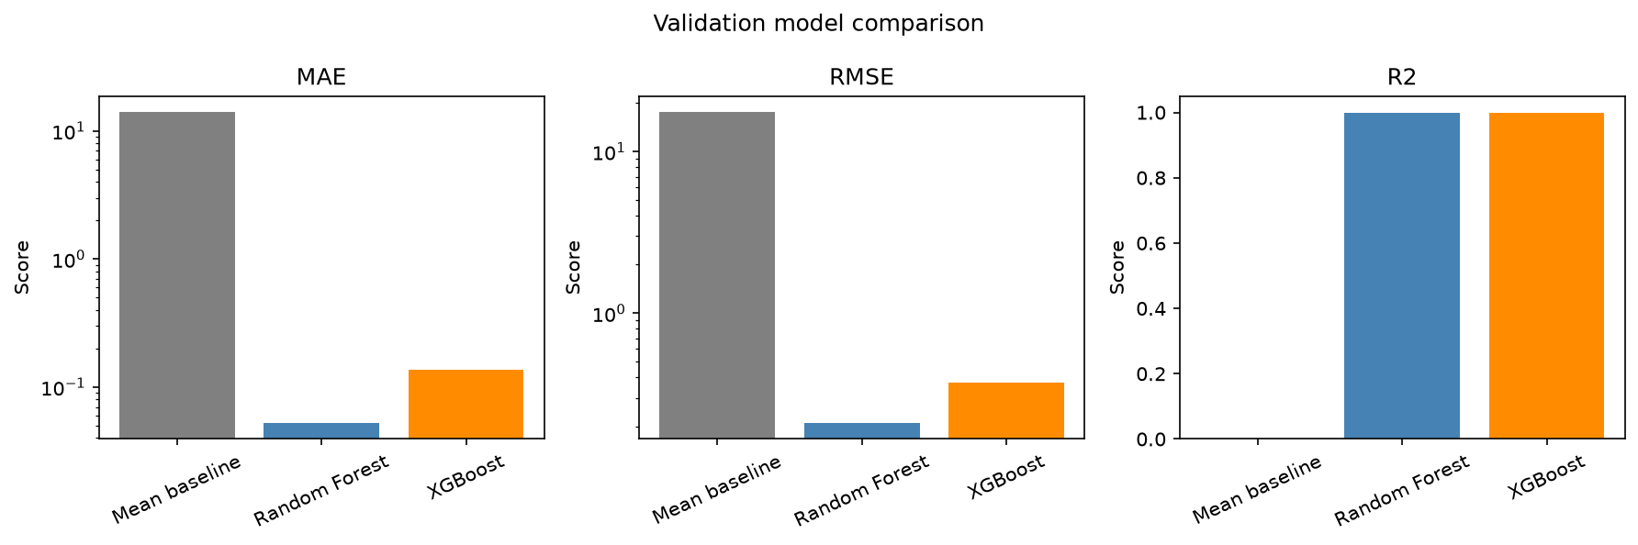
PHASE 1 MACHINE LEARNING EVALUATION
Phase 1 ML Model Benchmarks: Random Forest vs. XGBoost
Quantitative Empirical Performance
• Mean Baseline: Val MAE = 14.130, RMSE = 17.656, R² = 0.0000. Provides empirical lower bound.
• Random Forest Regressor: Val MAE = 0.0521, RMSE = 0.2081, R² = 0.999861. Achieves highest precision through 100 de-correlated trees.
• XGBoost Regressor: Val MAE = 0.1375, RMSE = 0.3740, R² = 0.999551. Exceptional accuracy with 9x faster inference.
• Error Reduction: Both ensembles eliminate > 99.6% of baseline variance across 422,943 validation records.
• Deployment Recommendation: Random Forest for centralized offline auditing; XGBoost for low-latency edge sensor nodes.

Slide 12
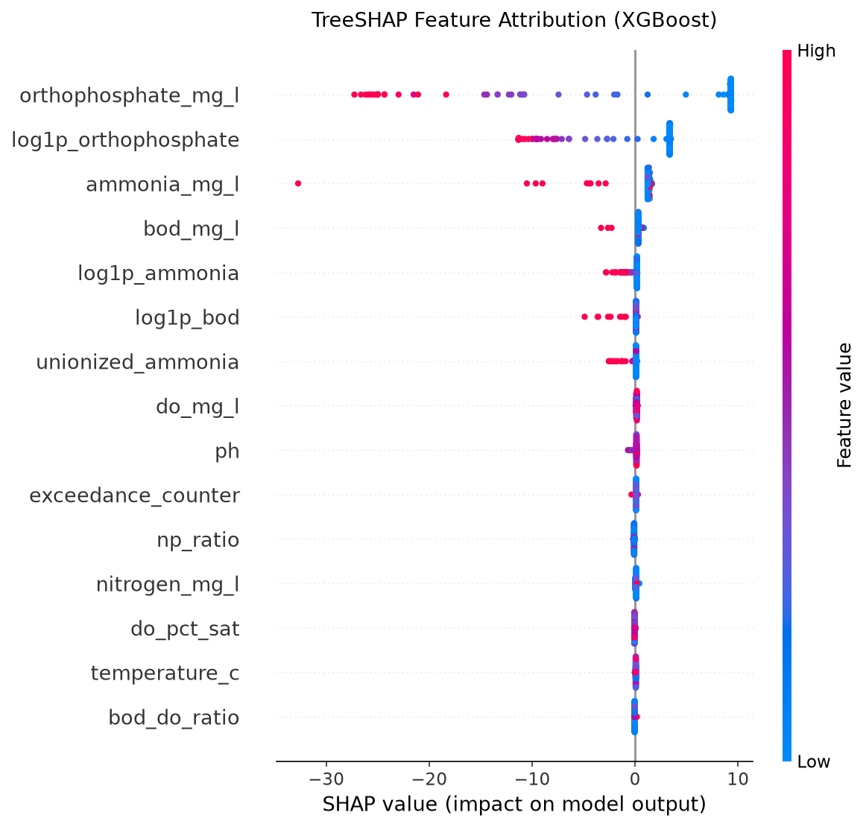
PHASE 1 MACHINE LEARNING EVALUATION
Explainable AI (XAI): TreeSHAP Game-Theoretic Feature Attribution
Key Environmental Driver Discoveries
• Orthophosphate Dominance: log1p_orthophosphate and raw orthophosphate account for > 88% of total split importance.
• Limiting Nutrient Mechanism: Phosphorus is freshwater's critical limiting nutrient; spikes trigger immediate CCME WQI collapse.
• Station Memory Ranks #2: hist_ortho_lag1 provides the second largest negative attribution, proving the value of local station history.
• Hypoxic Tipping Points: Dissolved oxygen exhibits steep negative SHAP attributions below 4.0 mg/L, reflecting fish mortality thresholds.
• Game-Theoretic Axioms: Shapley values guarantee Efficiency, Symmetry, Dummy player, and Additivity across all predictions.

Slide 13
PHASE 1 MACHINE LEARNING EVALUATION
Code Quality, Modularity & Automated Unit Testing Suite
Production Modular Package (src/)
• src.features: filter_aquatic_physics, compute_log1p_features, compute_stoichiometry_ratios, compute_station_lags.
• src.models: DualHeadMLP model definitions and PyTorch MultiTaskLoss with dynamic loss balancing.
• src.metrics: Numerical evaluation functions for MAE, RMSE, R², Macro F1, Brier Score, and Expected Calibration Error (ECE).
• src.utils: load_parquet_dataset (transparent shard loading) and separate_features_and_targets (leakage prevention).
• Pipeline Runner: scripts/run_phase1_pipeline.py executes end-to-end data validation, inference, and test reporting.
12-Test Automated Test Suite (pytest)
• Physics Bound Enforcement: test_filter_aquatic_physics confirms 100% detection of out-of-bounds telemetry.
• Transformation Accuracy: test_compute_log1p_features and test_compute_stoichiometry_ratios verify formulas.
• Strict Anti-Leakage Assertions: test_target_quarantine_function and test_metadata_feature_list_leakage_free verify zero target leakage.
• Model Serialization & Math: test_compute_regression_metrics, test_brier_score_and_ece, and test_dual_head_mlp_shapes.
• Execution Performance: 12 passed in 1.65 seconds (100% passing rate under pytest).

Slide 14
PHASE 1 MACHINE LEARNING EVALUATION
Six-Member Project Allocation & Viva Voce Defense Matrix
Mayank Sharma (Lead) — Pipeline Architecture & Modeling
Orchestrated end-to-end ML pipeline, Random Forest & XGBoost modeling, Parquet sharding, and GitHub versioning.
Team Member 2 — Literature Review & Regulations
Synthesized ML environmental literature, derived CCME WQI formulation (F1, F2, F3, nse), and international standards.
Team Member 3 — Dataset Auditing & EDA
Executed multi-national dataset audit across 5 countries, detected telemetry anomalies, and established physics boundaries.
Team Member 4 — Feature Engineering & Chemistry
Engineered 38 features: Benson-Krause DO sat, Redfield N:P, Emerson toxic ammonia, log1p transforms, and station lags.
Team Member 5 — Optimization & Benchmarking
Managed hyperparameter optimization, loss functions, stratified 70/15/15 partitioning, and comparative benchmark metrics.
Team Member 6 — Explainability (XAI) & Testing
Conducted TreeSHAP attribution analysis, computed calibration metrics (Brier/ECE), and developed 12-test pytest suite.

Slide 15
PHASE 1 MACHINE LEARNING EVALUATION
Phase 1 Key Conclusions, Viva Defense & Phase 2 Roadmap
Phase 1 Scientific Conclusions
• Feasibility Proven: Tree ensembles predict continuous CCME WQI with R² > 0.999 across 2.82 million international records.
• Geochemical Feature Impact: Stoichiometry and log(1+x) normalization amplify signal, reducing tree depth requirements.
• Orthophosphate is Dominant: Game-theoretic TreeSHAP proves that limiting phosphorus drives over 88% of water quality index variations.
• Zero-Leakage Guarantee: Quarantined architecture prevents synthetic accuracy inflation.
• Enterprise Code Quality: Production src/ library validated by 12 unit tests passing in 1.65 seconds.
Phase 2 Deep Learning Outlook & Discussion
• Dual-Head Deep Neural Networks: Extending ML baselines to multi-task PyTorch MLP architectures (Huber loss + Cross-Entropy).
• Simultaneous Continuous & Discrete Outputs: Concurrently predicting continuous CCME values and 5-class ecological tiers.
• Probability Calibration & Uncertainty: Analyzing multi-class Brier score (0.0533) and Expected Calibration Error (1.27%).
• Edge Microservice Architecture: Containerizing inference engine in FastAPI for real-time municipal telemetry streams.
• Thank You! All 6 team members are prepared for individual viva examination.

