Slide 1
PROJECT 18 · SEMESTER 5 APPLIED ML & DEEP LEARNING
Surface Water Quality
Prediction
Estimating the CCME Water Quality Index with gradient-tree ensembles and aquatic-chemistry features — plus an honest audit of what the scores mean
Mayank Sharma · Aman Soni · Aaryan Gera
Chaitanya Kumar · Ankit Kumar Pandey · Pranav Sehgal
2.82 M observations · 5 countries · 1940–2023
Department of Computer Science & Artificial Intelligence · School of Engineering and Technology
Project 18 · Surface Water Quality Prediction · CCME WQI
1
Notes:
Introduce the project: estimating CCME WQI from eight measured parameters plus engineered features. Say up front that the deck includes an audit of the very high scores; that is deliberate.

Slide 2
THE PROBLEM
Lab assays are slow and sparse; an index estimator could triage faster
Grab sample
Lab assay
Index
→
→
Field visit, discrete in space and time
BOD5 needs 5 days (120 h) incubation
Composite score computed after results arrive
Project objective
Scope of claims
Learn a fast surrogate: eight measured parameters (pH, temperature, DO, BOD, ammonia, orthophosphate, nitrogen, nitrate) plus engineered features → CCME WQI score.
Demonstrated: offline regression on a historical dataset (Random Forest, XGBoost)
Not demonstrated: real-time sensing, field deployment, replacing laboratory testing, or any neural network (planned Phase 2)
Project 18 · Surface Water Quality Prediction · CCME WQI
2
Notes:
BOD5 needs a five-day incubation (120 h). The model is a surrogate mapping already-measured parameters to an index. Do not claim real-time deployment or lab replacement: nothing like that was built or tested.

Slide 3
OBJECTIVE AND TARGET
The target is the CCME Water Quality Index: 100 minus a distance from ideal
CCME WQI = 100 − √(F₁² + F₂² + F₃²) / 1.732
F₁ Scope
F₂ Frequency
F₃ Amplitude
% of variables that fail their guideline
% of individual tests that fail
Size of excursions: nse / (0.01·nse + 0.01)
Five quality tiers (share of dataset rows)
Poor 0–44
Marginal 45–64
Fair 65–79
Good 80–94
Excellent 95–100
4.5%
11.6%
11.2%
36.6%
36.1%
Index in the data: mean ≈ 85, median 90.6, bounded 0–100, strongly left-skewed. Shares from repo graph 11 (EDA).
Project 18 · Surface Water Quality Prediction · CCME WQI
3
Notes:
Walk through F1 scope, F2 frequency, F3 amplitude. Tier thresholds are the standard CCME bands. Tier shares come from the repo's graph 11. The dataset's index values are supplied with the data and are a function of the same eight parameters used as inputs; this matters on slide 11.

Slide 4
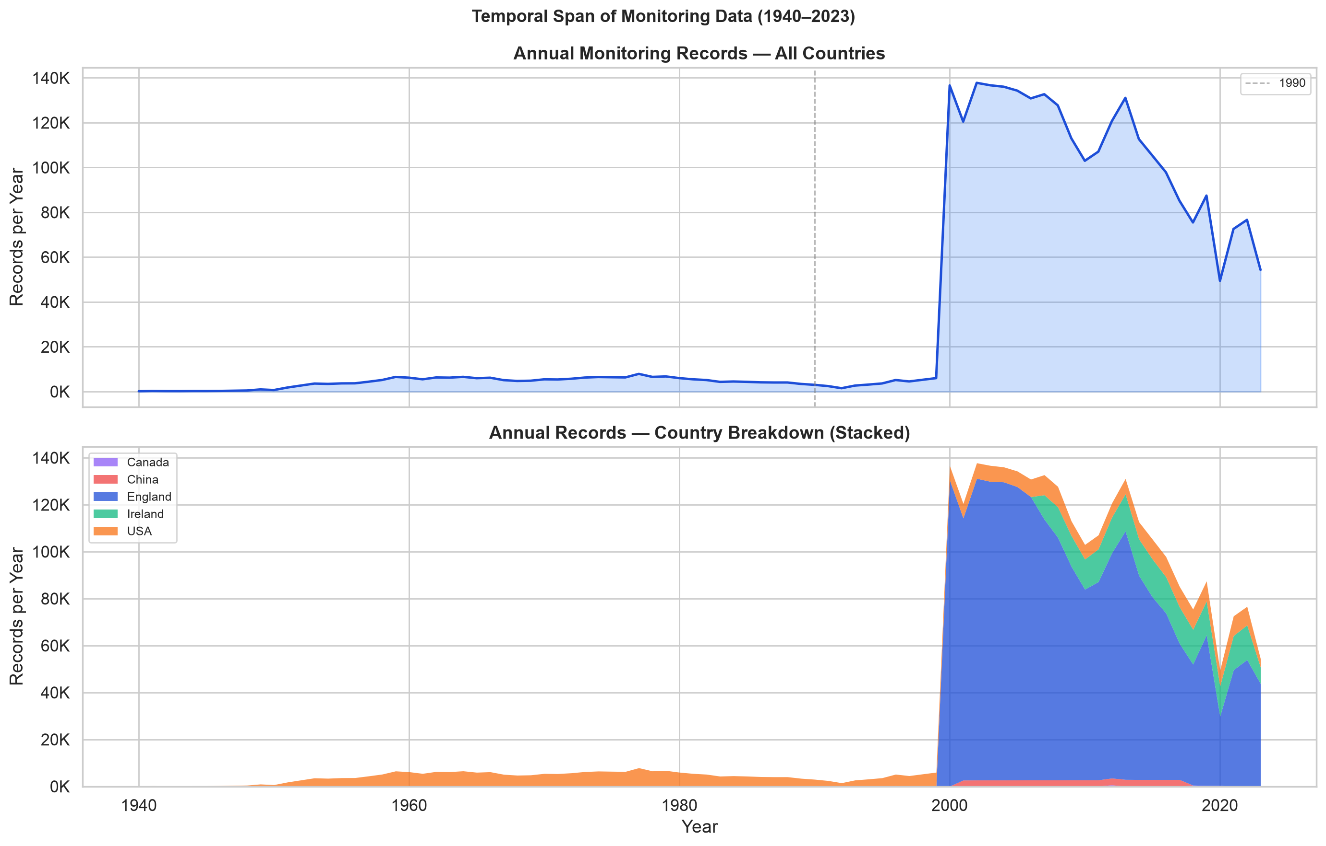
DATASET SCALE AND COMPOSITION
2.82 million observations, but 75% of them come from England
2,827,977
2,819,617
5
1940–2023
38
raw records
clean records
countries
83 years
model input features
Records per year (repo graph 03): coverage is sparse before ≈2000
Project 18 · Surface Water Quality Prediction · CCME WQI
4
Notes:
KPIs are the audited figures from the executed EDA notebook. Stress the imbalance: Canada contributes under 4,000 rows, and almost all records are from after about 2000 (graph 03). Mention that the older report Table I (England 83.7%) was wrong; the notebook counts sum exactly to 2,819,617.

Slide 5
DATA AUDIT AND PHYSICAL-BOUND SCREENING
8,360 impossible readings removed; zero nulls in the file, but one completeness question
2,827,977
Parameter | Valid range | Violations
pH | 3.0 – 12.0 | 1,581
Temperature (°C) | 0 – 45 | 6,850
Dissolved O₂ (mg/L) | 0 – 25 | 0
Ammonia / BOD (mg/L) | ≥ 0 | 2 / 2
Orthophosphate (mg/L) | ≥ 0 | 10
Nitrogen / nitrate | ≥ 0 | 0 / 0
Raw records
−8,360 (0.296%)
Removed by physical bounds
2,819,617 (99.704%)
Clean records
Missing vs implausible. No imputation was applied in our pipeline; screening removes sensor artefacts (negative or out-of-range values), not gaps.
Counts overlap; 8,360 is the unique union of violating rows (executed EDA notebook).
Qualification “0 nulls” describes the delivered file. Values cluster (BOD median 2.70, Q3 2.83) and repo graph 17 (earlier version) showed 26–34% missing, so upstream filling is possible and unverified.
Project 18 · Surface Water Quality Prediction · CCME WQI
5
Notes:
Executed notebook output: raw 2,827,977 rows x 14 columns, 0 nulls; 8,360 unique impossible rows (union). Per-parameter counts overlap. Completeness caveat: several raw columns cluster at single values (BOD median 2.70, Q3 2.83; nitrate median 4.50, Q3 4.94), and graph 17 in the repo, from an earlier data version, shows 26-34% missing in chemical columns. We cannot tell from the repo whether the 0-null file reflects genuine measurements or upstream filling. Say this plainly.

Slide 6
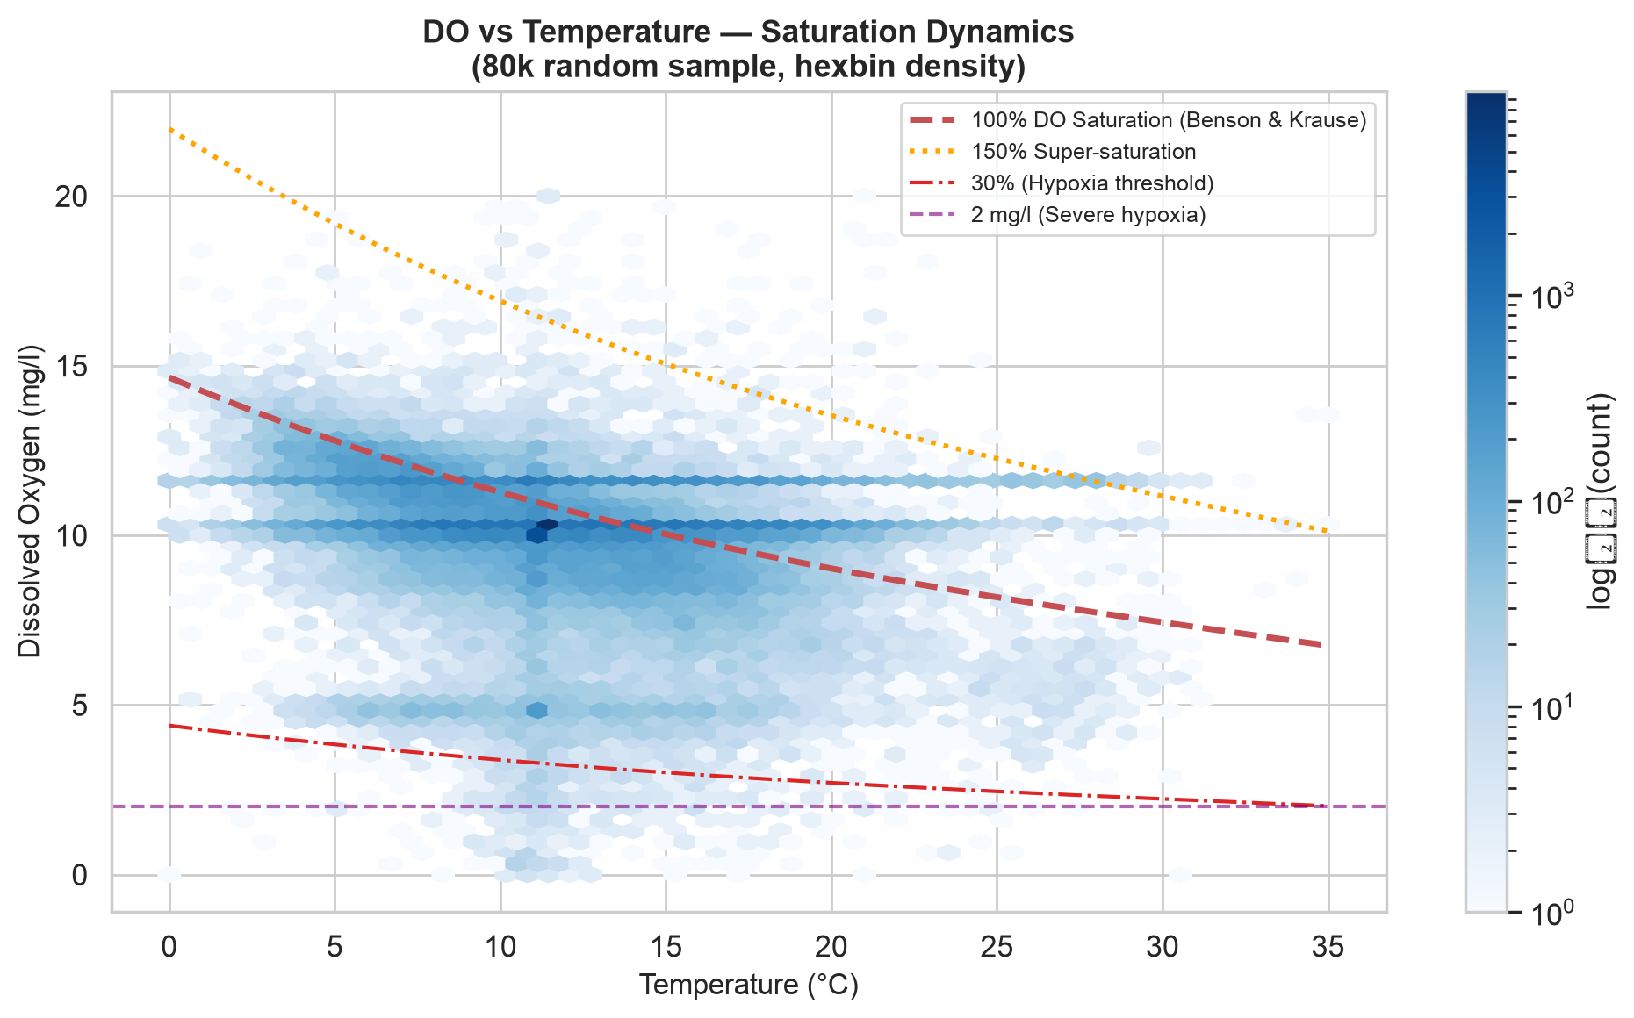
EXPLORATORY FINDINGS
Oxygen follows temperature; nutrients are heavily skewed, and log(1+x) straightens them
DO vs temperature (80k sample) with Benson–Krause saturation curves. Source: repository graphs/ folder (graph 07).
Qualification A better Pearson r is not better prediction. Orthophosphate’s Spearman ρ is −0.917 both raw and log(1+x): monotone transforms leave rank correlation, and tree splits, unchanged.
Project 18 · Surface Water Quality Prediction · CCME WQI
6
Notes:
Left: repo graph 07, dissolved oxygen against temperature with the Benson-Krause saturation envelope. Right: Pearson correlation with the WQI before and after log(1+x), from the executed preprocessing notebook (orthophosphate -0.6603 to -0.8531; ammonia -0.3922 to -0.6594; BOD -0.3212 to -0.5775; N:P log 0.5169). Nuance, verified in the same notebook table: orthophosphate Spearman is -0.9172 both raw and log, because rank correlation ignores monotone transforms; trees are invariant to them too.

Slide 7
DOMAIN-INFORMED FEATURE ENGINEERING
Eight measurements become 38 features, grouped by the chemistry they encode
8
7
7
6
Base sensors
Aquatic stoichiometry
log(1+x) variants
Station memory
pH, temperature, DO, BOD, ammonia, orthophosphate, nitrogen, nitrate
Benson–Krause DO deficit and % saturation, Redfield-style N:P, Emerson un-ionised NH₃, BOD:DO, pH deviation, nitrate share
Compress nutrient skew; help linear models, not trees
Shift-1 lags and rolling-3 means within each Area, sorted by date; first record filled with global median
7
2
1
Total: 8+7+7+6+7+2+1 = 38 features
Temporal
Context
exceedance_counter
year, month, quarter, sin/cos of month and day-of-year
country code, waterbody-type code
Count of six guideline checks computed from input columns only
ρ(hist_ortho_lag1, WQI) = −0.78 (Spearman, full data)
Project 18 · Surface Water Quality Prediction · CCME WQI
7
Notes:
Count check: 8+7+7+6+1+2+7 = 38 (from preprocessing_metadata.json). exceedance_counter is computed in the preprocessing notebook from six input columns with its own thresholds (pH outside 6.5-8.5, DO < 6.5, ammonia > 0.5, BOD > 4, nitrate > 10, orthophosphate > 0.1). It is not a target column and uses only inputs available at prediction time, so it is not target leakage by data flow, but it is redundant with the raw inputs. Lags: previous record within the same Area (sorted by date); the first record of each Area is filled with the global median.

Slide 8
PIPELINE ARCHITECTURE AND TESTING
Features are built before the split, so station history can cross partitions
1 Load cleaned data
2 38 features
3 Target check
4 Stratified split
2,819,617 rows, 0 nulls
lags built on full data
targets not in features
random, by WQI tier
5 Train RF + XGB
6 Evaluate
7 Importance
8 Test set
XGB early-stops on val
validation only
built-in + SHAP (250 rows)
held out, not yet scored
Navy = before split · Amber = leakage-sensitive · Teal = after split · Grey = not yet done
Automated tests (pytest)
They check: bound filtering, log1p, shift-1 lags per station, targets absent from X and from the 38-feature list, metric maths, model loading.
They do not show: that scores generalise to new stations or dates.
12 test functions: features 4 · leakage 2 · metrics 3 · models 3. Reported 100% pass in 1.65 s (not re-run here).
Project 18 · Surface Water Quality Prediction · CCME WQI
8
Notes:
Order taken from the preprocessing notebook: load EDA-cleaned data, engineer 38 features (including per-Area lags over the whole dataset), assert targets are not in the feature list, then a stratified random split by WQI tier (seed 42). A StandardScaler is fitted on train, but scaled partitions are not saved or used in Phase 1; trees use raw units. XGBoost early stopping watches the validation set. Tests: 12 test functions (features 4, leakage 2, metrics 3, models 3). We could not execute them here (xgboost missing offline), so pass status is as reported.

Slide 9
MODELING STRATEGY AND EVALUATION DESIGN
Three regressors on one random stratified split, with the settings taken from the training notebook
Train 1,973,731 (70%)
Val 422,943 (15%)
Test 422,943 (15%)
Random, stratified by WQI tier, seed 42 · no station or time hold-out · reported metrics are on validation; the test set has not been scored
Mean baseline
Random Forest
XGBoost
Neural network
Predicts the training mean (85.05). The floor any model must beat.
30 trees, max depth 14, min leaf 5, all 38 features considered per split, seed 42.
≤150 rounds, depth 6, η 0.08, subsample 0.8, colsample 0.8; early stopping (20) on validation; best round 149.
Not implemented in this repo version. Planned for Phase 2 (multi-task MLP).
No fitting beyond the mean
Notebook = saved model
Early stopping uses the validation set
No results claimed
Project 18 · Surface Water Quality Prediction · CCME WQI
9
Notes:
Settings are from the executed training notebook and confirmed on the saved artifacts (the RF joblib has 30 trees, depth 14, min leaf 5, all 38 features per split; the XGBoost JSON has 150 trees). These replace the older report text (100 trees depth 20; 300 rounds). XGBoost early stopping used the validation set, so its validation score is slightly optimistic. Deep learning is planned for Phase 2: no neural-network code exists in this repo version.

Slide 10
MODEL BENCHMARKING
Tree ensembles reproduce the index almost exactly on validation rows
Model | MAE | RMSE | R²
Mean baseline | 14.130 | 17.656 | 0.0000
Random Forest | 0.052 | 0.208 | 0.9999
XGBoost (comparison file) | 0.137 | 0.374 | 0.9996
XGBoost (saved model run)† | 0.161 | 0.437 | 0.9994
† Training notebook and the saved XGBoost model’s recorded validation RMSE (0.4372). The saved predictions file behind the comparison table disagrees; provenance unresolved. All values: validation set, 422,943 rows.
Qualification These scores measure how well each model reconstructs the CCME index from same-time measurements on randomly held-out rows (the repo’s own notebook says so). They do not show forecasting skill. Latency omitted: not measured in the repo.
Project 18 · Surface Water Quality Prediction · CCME WQI
10
Notes:
RF numbers are identical in model_comparison.csv and training_history.csv (MAE 0.0521, RMSE 0.2081, R2 0.99986; train MAE 0.047, so a small train-val gap). XGBoost has two versions in the repo: model_comparison.csv (from tree_val_predictions.parquet) gives MAE 0.1375, RMSE 0.3740, R2 0.99955, which is what the written report used; the training notebook and the saved model's recorded best_score give MAE 0.1611, RMSE 0.4372, R2 0.99939. The saved predictions file therefore does not match the saved model; re-run notebooks 03 and 04 to settle this. Conclusions are unchanged. Latency numbers are omitted: no timing code or hardware is documented.

Slide 11
RELIABILITY AND VALIDITY
Why R² ≈ 0.9999 needs careful reading: what the code shows
1 Target is a formula of the inputs
2 exceedance_counter re-checked
3 Random split, early stopping
CCME_Values ships with the data and is a composite of the same eight measurements. High R² means the model learned the formula. The repo’s evaluation notebook says exactly this.
Built only from six input columns with its own thresholds; not a target column, not F₁–F₃ (not in the data). Legitimate but redundant. Ablation not yet run.
Stratified random split; per-Area lags built on full data, so neighbours cross partitions; XGBoost stops on validation; test set unscored.
Confirmed in repo
Re-assessed: no data-flow leak
Confirmed in code
Can claim
A fast, accurate surrogate of the CCME computation on this dataset (validation rows).
Cannot claim
Performance on unseen stations or future dates; independent water-quality forecasting.
Project 18 · Surface Water Quality Prediction · CCME WQI
11
Notes:
Updated after reading the code. (1) The target is supplied with the data and is computed from the same eight parameters; the repo's own evaluation notebook concludes the scores measure reconstruction of the index from same-time measurements. (2) exceedance_counter: we previously treated it as a leakage risk. The code shows it uses six input columns and its own thresholds, not the target or F1-F3 (F1-F3 are not columns in the dataset). It is a legitimate, if redundant, feature. An ablation without it has not been run. (3) The split is random, station lags are built on the full data, XGBoost early-stops on validation, and the test set is unscored. Nothing here shows leakage in a pipeline sense; it shows the evaluation cannot support forecasting claims.

Slide 12
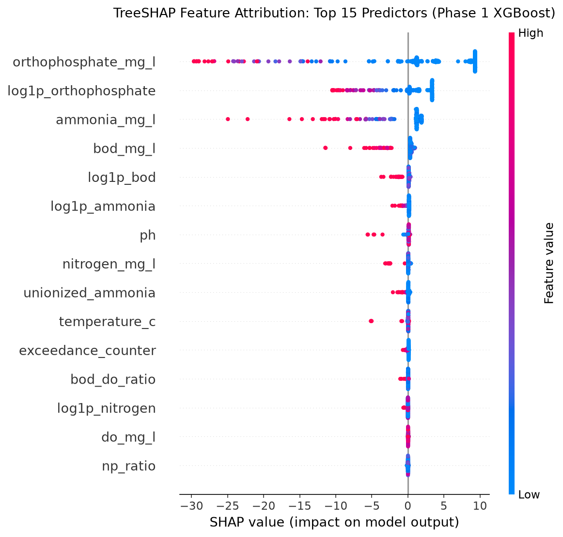
WHAT DRIVES THE PREDICTIONS
Orthophosphate dominates the models — a property of the index and data, not a causal finding
TreeSHAP beeswarm, XGBoost, 250 validation rows (repo graph 16)
Qualification Importance describes the model, not the river. Orthophosphate + log variant: 88.5% of RF impurity, 76.4% of XGBoost gain; not “88% of split decisions”. The station lag ranks 6th in XGBoost (1.5%).
Project 18 · Surface Water Quality Prediction · CCME WQI
12
Notes:
Random Forest values: built-in impurity importance read from the saved joblib. XGBoost values: average-gain share computed from the saved xgboost_model.json trees. Orthophosphate plus its log variant: 88.5% (RF) and 76.4% (XGBoost). hist_ortho_lag1 is about 0 in RF and 1.5% (rank 6) in XGBoost, so the older claim that it ranks second is wrong. country_code is about 0 in both. The SHAP beeswarm (repo graph 16) was computed on 250 validation rows; mean |SHAP| for orthophosphate is about 8.3 index points. A plausible, unverified reason for orthophosphate's weight: the guideline sits close to its median value.

Slide 13
LIMITATIONS, STATUS AND NEXT STEPS
Phase 1 delivers a tested tree baseline; stricter validation and deep learning come next
Confirmed from code and outputs
Open / not verified
Planned (not done)
Country imbalance: England ≈75% of rows
Random split; no station or time hold-out
Validation metrics only; test set unscored
XGBoost validation numbers differ between artifacts
Whether the 0-null file reflects upstream filling (clustered values; graph 17)
Effect of dropping exceedance_counter
Duplicates across partitions
Inference latency (not measured)
Station-held-out and time-forward splits
Score the held-out test set
Re-run notebooks 03–04 to align artifacts
Phase 2: multi-task neural network
Deep learning: no neural-network code or results exist in this repo version, so none are claimed. Phase 2 is planned.
Project 18 · Surface Water Quality Prediction · CCME WQI
13
Notes:
Be precise about status. Deep learning: the repo has no neural-network code, notebook or results. Older markdown reports quote an MLP table, but it cannot be reproduced from this repo, so it is excluded. The completeness caveat comes from clustered raw values and repo graph 17.

Slide 14
CONCLUSION, TEAM AND REFERENCES
A reproducible tree baseline — with a clear route to a stricter evaluation
Built: audited 2.82 M-row dataset, 38 chemistry-driven features, RF and XGBoost benchmarks, SHAP, 12 tests.
Strongest finding: trees reconstruct the CCME index with validation MAE 0.05 (RF) to 0.14–0.16 (XGBoost).
Key caveat: the target is a formula of the inputs and the split is random; next, station-held-out and time-forward evaluation.
Key references
Breiman (2001) Random Forests. Machine Learning 45(1)
Goodfellow, Bengio & Courville (2016) Deep Learning. MIT Press (feed-forward networks)
Chen & Guestrin (2016) XGBoost. KDD
Lundberg & Lee (2017) SHAP. NeurIPS
CCME (2001) Water Quality Index 1.0 Technical Report
Benson & Krause (1984) Limnol. Oceanogr. 29(3)
Redfield (1958) Am. Scientist 46(3)
Emerson et al. (1975) J. Fish. Res. Board Can. 32(12)
Team and roles
Mayank Sharma – EDA & repository management lead
Aman Soni – model training lead (baseline, RF, XGBoost)
Aaryan Gera – data preprocessing
Chaitanya Kumar – feature engineering & pipeline
Ankit Kumar Pandey – model evaluation & validation
Pranav Sehgal – research, documentation & presentation
Data: agencies listed in the repo’s DataCollectionSources sheet (data.gov.uk, USGS/EPA, EPA Ireland, MEE China, ECCC). Code: github.com/MAYANKSHARMA01010/Semester_5_AML_DL
Project 18 · Surface Water Quality Prediction · CCME WQI
14
Notes:
Close with the strongest verified result, then the main caveat. Names and roles are from the team table.

