Slide 1
Heaps and …Priority Queues

Slide 2
(Binary) Heap
Heaps are “almost complete binary trees”
  All levels are full except possibly the lowest level
  If the lowest level is not full, then nodes must be packed to the left
Pack to the left

Slide 3
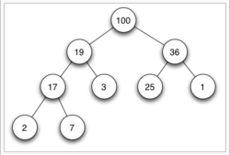
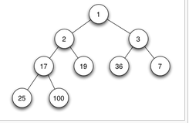
Heap - Example
Max Heap
Min Heap

Slide 4
1
4
2
5
2
5
4
3
6
1
3
6
A heap
Not a heap
Heap-order property: the value at each node is less than or equal to the values at both its descendants --- Min Heap
We may also define a Max Heap – How?
It is easy (both conceptually and practically) to perform insert and deleteMin in heap if the heap-order property is maintained

Slide 6
Structure properties
  Has 2^{h} to 2^{h+1}-1 nodes with height h
  The structure is so regular, it can be represented in an array and no links are necessary !!!
Use of binary heap is so common for priority queue implemen-tations, thus the word heap is usually assumed to be the implementation of the data structure

Slide 7
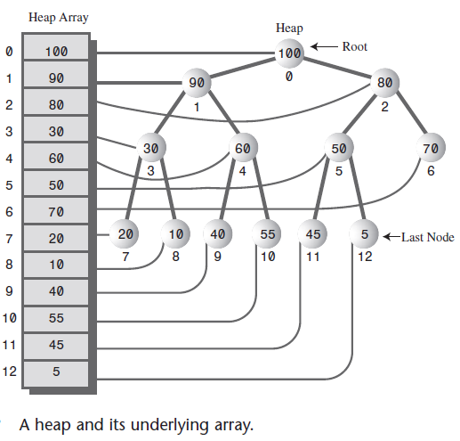

Slide 8
Heap Properties
Heap supports the following operations efficiently
  Insert in O(logN) time
  Locate the current minimum in O(1) time
  Delete the current minimum in O(log N) time

Slide 9
Array Implementation of a Binary Heap for the Alphabet
A
B
C
A
B
C
D
E
F
G
H
I
J
0
1
2
3
4
5
6
7
8
…
D
E
F
G
H
I
J
For any element in array position i
  The left child is in position 2i
  The right child is in position 2i+1
A possible problem: an estimate of the maximum heap size is required in advance (but normally we can resize if needed)
Note: we will draw the heaps as trees, with the implication that an actual implementation will use simple arrays
Side notes: it’s not wise to store normal binary trees in arrays, because it may generate many holes

Slide 10
Insertion
Algorithm
  Add the new element to the next available position at the lowest level
  Restore the min(max)-heap property if violated
    General strategy is percolate up (or bubble up): if the parent of the element is larger(less) than the element, then interchange the parent and child.
1
1
1
2
5
2
5
2
2.5
swap
4
3
6
4
3
6
2.5
4
3
6
5
Insert 2.5
Percolate up to maintain
the heap property

Slide 11
Heap – Sift-up/Bubble-up
Add the element on the bottom level of the heap.
Compare the added element with its parent; if they are in the correct order, stop.
If not, swap the element with its parent and return to the previous step.

Slide 12
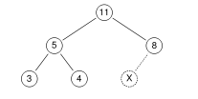

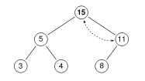
Sift –up - Illustration
Inserting 15 to position X in the Max heap

Slide 13
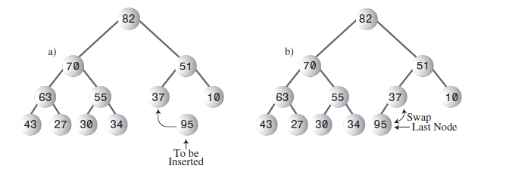

Slide 14
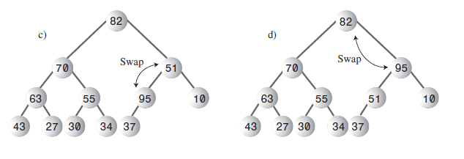
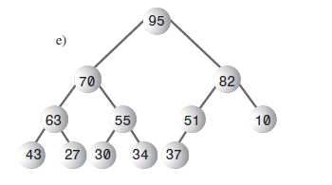

Slide 15
Insertion Complexity
7
9
8
A heap!
17
16
14
10
20
18
Time Complexity = O(height) = O(logN)

Slide 16
deleteMin: First Attempt
Algorithm
  Delete the root.
  Compare the two children of the root
  Make the lesser of the two the root.
  An empty spot is created.
  Bring the lesser of the two children of the empty spot to the empty spot.
  A new empty spot is created.
  Continue

Slide 17
Example for First Attempt
1
2
5
2
5
4
3
6
4
3
6
2
1
5
3
5
4
3
6
4
6
Heap property is preserved, but completeness is not preserved!

Slide 18
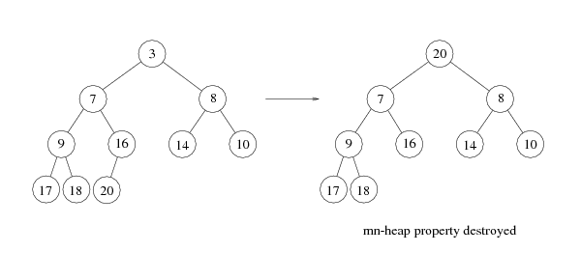
deleteMin
Copy the last number to the root (i.e. overwrite the minimum element stored there)
Restore the min-heap property by percolate down (or bubble down)

Slide 19
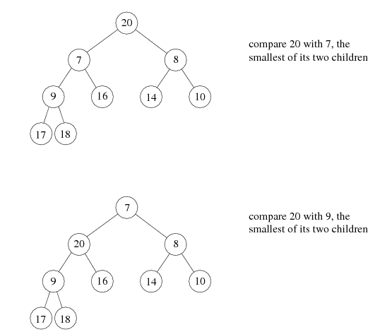
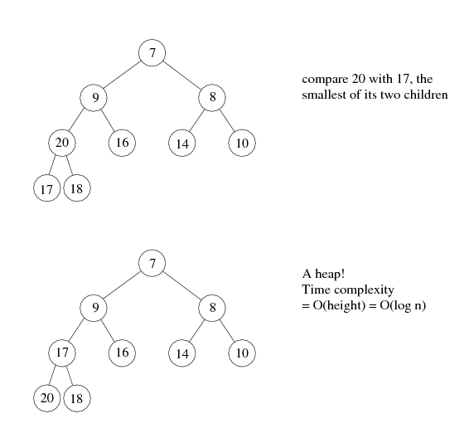

Slide 20
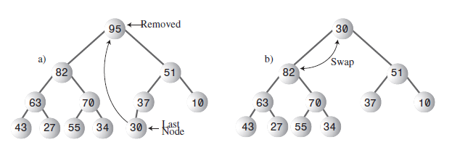
DeleteMax

Slide 21
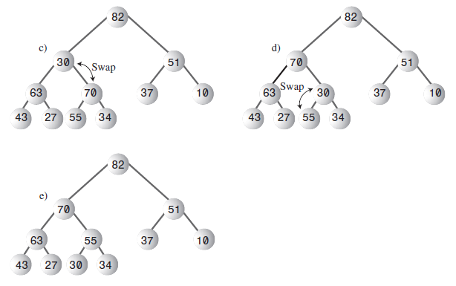

Slide 22
Consider this array representation of a heap: (2020 May Refer/Defer Exam)
index | 0 | 1 | 2 | 3 | 4 | 5 | 6 | 7 | 8 | 9
-------------------------------------------------
value | 0 | 1 | 2 | 3 | 4 | 5 | 9 | 6 | 8 | 7
Draw the tree representation of this heap. [2 marks]
Pop the minimal element off the heap three times, drawing the graph representation after each operation [6 marks]
Draw the graph representation after inserting the value 0 [2 marks]

