Slide 1
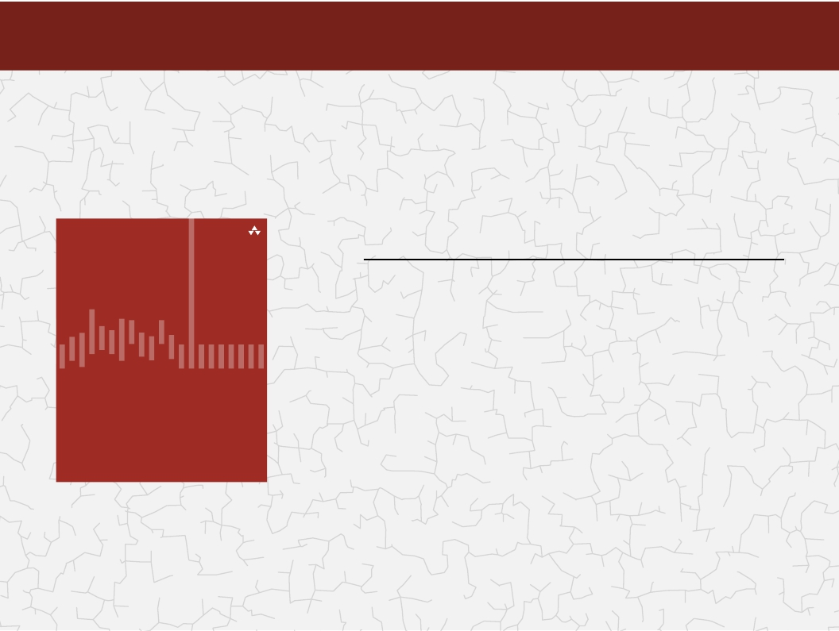
Categories of algorithms
Sorting algorithms
Search algorithms
Graph algorithms – Part II
Path-finding in AI algorithms
Network Flow algorithms
Computational Geometry
Algorithms: Theory, Design and Implementation
Algorithms
F O U R T H E D I T I O N

Slide 2
Algorithms
Algorithms
GRAPHS
Definitions
Graph representation
Depth-first, Breadth-first search algorithms
Single source shortest path
All pairs shortest path (Dijkstra’s algorithm)
F O U R T H E D I T I O N

Slide 3
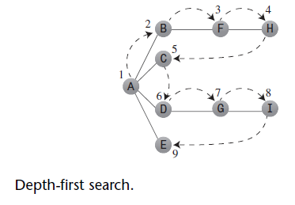
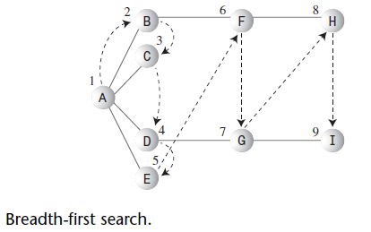
How do I walk through the graph? SEARCH
Depth-first search (needs Stacks...)
Breadth-first search (needs Queues...)

Slide 4
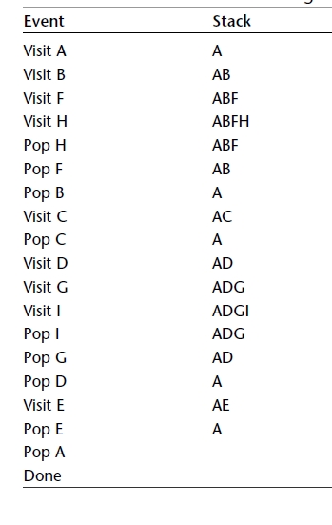
Depth-first Search with a Stack

Slide 5
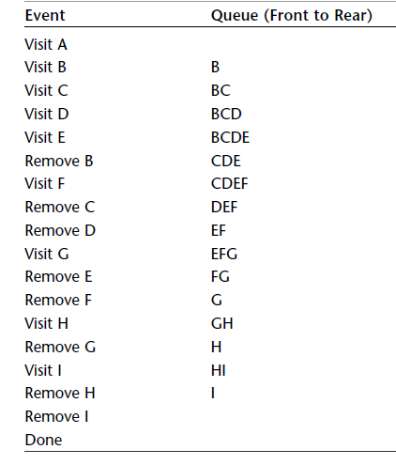
Breadth-first Search with a Queue More details on the PBL discussion notes

Slide 6
Algorithms
Algorithms
GRAPHS
Definitions
Graph representation
Depth-first, Breadth-first search algorithms
Single source shortest path
All pairs shortest path (Dijkstra’s algorithm)
Minimum spanning tree algorithms
(kruskal and Prim algorithms)
F O U R T H E D I T I O N

Slide 7
 | Brute-force | Divide-and-conquer | Decrease-and-conquer | Transform-and-conquer | Greedy | Dynamic programming
Sorting algorithms | √ | √ | √ | √
Search algorithms | √ | √ |  | √
Graph algorithms | √ | √ | √ | √ | √
Path finding algorithms | √ |  |  |  | √ | √
Network flow algorithms | √ |  |  |  | √ | √
Computational geometry algorithms | √ |  |  |  | √ | √

Slide 8
Principles of Greedy techniques
Applicable to optimization problems only.
Constructing a solution through a sequence of steps, each expanding a partially constructed solution obtained so far, until a complete solution to the problem is reached.
On each step—and this is the central point of this technique—the choice made must be:
feasible, i.e., it has to satisfy the problem’s constraints
locally optimal, i.e., it has to be the best local choice among all feasible choices available on that step
irrevocable, i.e., once made, it cannot be changed on subsequent steps of the algorithm

Slide 9
Single Source Single Destination
Possible greedy algorithm:
Leave source vertex using cheapest/shortest edge.
Leave new vertex using cheapest edge subject to the constraint that a new vertex is reached.
Continue until destination is reached.

Slide 10
Example
8
6
2
1
1
3
3
16
1
6
7
4
5
10
4
2
4
7
7
5
3
14
A path from 1 to 7.
Path length is 14.

Slide 11
Example
8
6
2
1
3
3
16
1
6
7
4
5
10
4
2
4
7
5
3
14
Another path from 1 to 7.
Path length is 11.

Slide 12
Greedy Shortest 1 To 7 Path
8
6
2
1
3
3
16
1
6
7
4
5
10
4
2
4
7
5
3
14
Path length is 12.
Not shortest path. Algorithm doesn’t work!

Slide 13
Greedy technique: Does it work?
There are problems for which a sequence of locally optimal choices does yield an optimal solution for every instance of the problem in question.
However, there are others for which this is not the case (single source single destination shortest path…)
For such problems, a greedy algorithm can still be of value if we are interested in or have to be satisfied with an approximate solution.
…but it works for the following algorithm (Dijkstra’s)

Slide 14
Algorithms
Algorithms
GRAPHS
Definitions
Graph representation
Depth-first, Breadth-first search algorithms
Single source shortest path
All pairs shortest path (Dijkstra’s algorithm)
F O U R T H E D I T I O N

Slide 15
Single Source All Destinations (Dijkstra’s algorithm)
8
6
2
1
3
3
16
1
6
7
4
5
10
4
2
4
7
5
3
14
Path
Length
6
1
2
1
0
1
3
5
4
9
1
3
2
1
3
6
10
1
3
5
5
1
3
6
7
11

Slide 16
Single Source All Destinations
Path
Length
1
0
1
3
2
1
3
5
5
1
2
6
[1]
[2]
[3]
[4]
[5]
[6]
[7]
1
3
5
4
9
0
6
2
9
5
-
10
-
14
12
11
-
1
1
5
3
-
-
3
4
1
6
1
3
6
10
1
3
6
7
11
Notes:
Can construct shortest paths from the computed p[] data.

Slide 17
Key Ideas of Algorithm Implementation
Implement d() and p() as 1D arrays.
Keep a linear list L of reachable vertices to which shortest path is yet to be generated.
Select and remove vertex v in L that has smallest d() value.
Update d() and p() values of vertices adjacent to v.

