Slide 1
INTERNOVA TECHNOLOGIES
WEEK 6
FINAL CAPSTONE
Sales Data Analytics
& Business Intelligence
From raw transactions to business-ready insights
Tiwari Aman Dhananjay
Data Analytics Internship • 2026

Slide 2
Executive Summary
A quick view of the dataset and the strongest reported signals.
CLEAN TRANSACTIONS
TOTAL SALES
AVERAGE TRANSACTION
VISUALIZATIONS
120
₹95.34 lakh
₹79,451.50
6
After duplicate handling
₹9,534,180 total
Per cleaned transaction
Python-generated charts
• Computers is the leading category by sales.
• East is the highest-performing region in the reported analysis.
• Corporate is the largest customer segment by sales.
• Revenue alone does not prove profitability; check discounts and costs.
INTERNOVA • WEEK 6 | 02

Slide 3
Business Problem & Objectives
The questions guiding the analysis.
BUSINESS QUESTION
ANALYSIS GOAL
BUSINESS OUTPUT
Where are sales strongest?
Explain performance
Actionable next steps
Across time, category, region and segment.
Summarize patterns and focus areas.
Turn findings into measurable tests.
Core questions
• Which product category contributes the most sales?
• Which region and customer segment lead on sales?
• How does performance vary by month?
• How can improvements be tested without assuming revenue equals profit?
INTERNOVA • WEEK 6 | 03

Slide 4
Dataset & Data Preparation
The capstone continues the Week 5 Sales project.
SOURCE TABLES
120
4
Sales_Raw, Sales_Clean, Customers, Products
cleaned transactions
Data quality steps
A consistent dataset supports more reliable comparisons across time, category, region and customer segment.
• Removed duplicate Sale_ID records.
• Recovered missing values where Sales_Amount supported it.
• Checked cleaned row count and key fields.
Review generated outputs before final submission.
INTERNOVA • WEEK 6 | 04

Slide 5
Tools & Analysis Workflow
A reproducible path from data preparation to communication.
01
Inspect
Review data types, duplicates and missing values.
02
Clean
Prepare a consistent sales table and enrich context.
03
Analyze
Calculate statistics, correlations and outliers.
04
Visualize
Create six charts for sales patterns.
05
Communicate
Share insights, recommendations and dashboard evidence.
INTERNOVA • WEEK 6 | 05

Slide 6
Finding 1 | Category Performance
Computers is the largest sales category in the reported analysis.
TOP CATEGORY
CATEGORY SALES
What this suggests
Computers
₹53.71 lakh
• Protect availability of leading products.
• Check stock-out risk and supplier lead times.
• Compare margins before increasing inventory.
Highest sales contribution
₹5,371,450
Reported sales value
₹5,371,450
Category-level figure reported in the project analysis.
INTERNOVA • WEEK 6 | 06

Slide 7
Finding 2 | Region & Customer Segment
Two dimensions with the strongest reported sales totals.
LEADING REGION
LEADING SEGMENT
East
Corporate
₹5,490,620 in sales
₹4,168,450 in sales
How to use these findings
• Review product mix and customer needs in leading areas.
• Compare regions and segments using the same date range.
• Investigate weaker areas before shifting resources or launching promotions.
INTERNOVA • WEEK 6 | 07

Slide 8
Finding 3 | Transaction & Time Patterns
Use monthly results and transaction spread to understand variation.
HIGHEST TRANSACTION
LOWEST TRANSACTION
AVERAGE TRANSACTION
₹432,250
₹1,080
₹79,451.50
Sale ID: S0032
Sale ID: S0086
Across 120 records
Monthly review checklist
• Compare month-on-month totals and identify unusual changes.
• Check whether large transactions materially affect monthly totals.
• Confirm date ordering and filters in Power BI.
INTERNOVA • WEEK 6 | 08

Slide 9
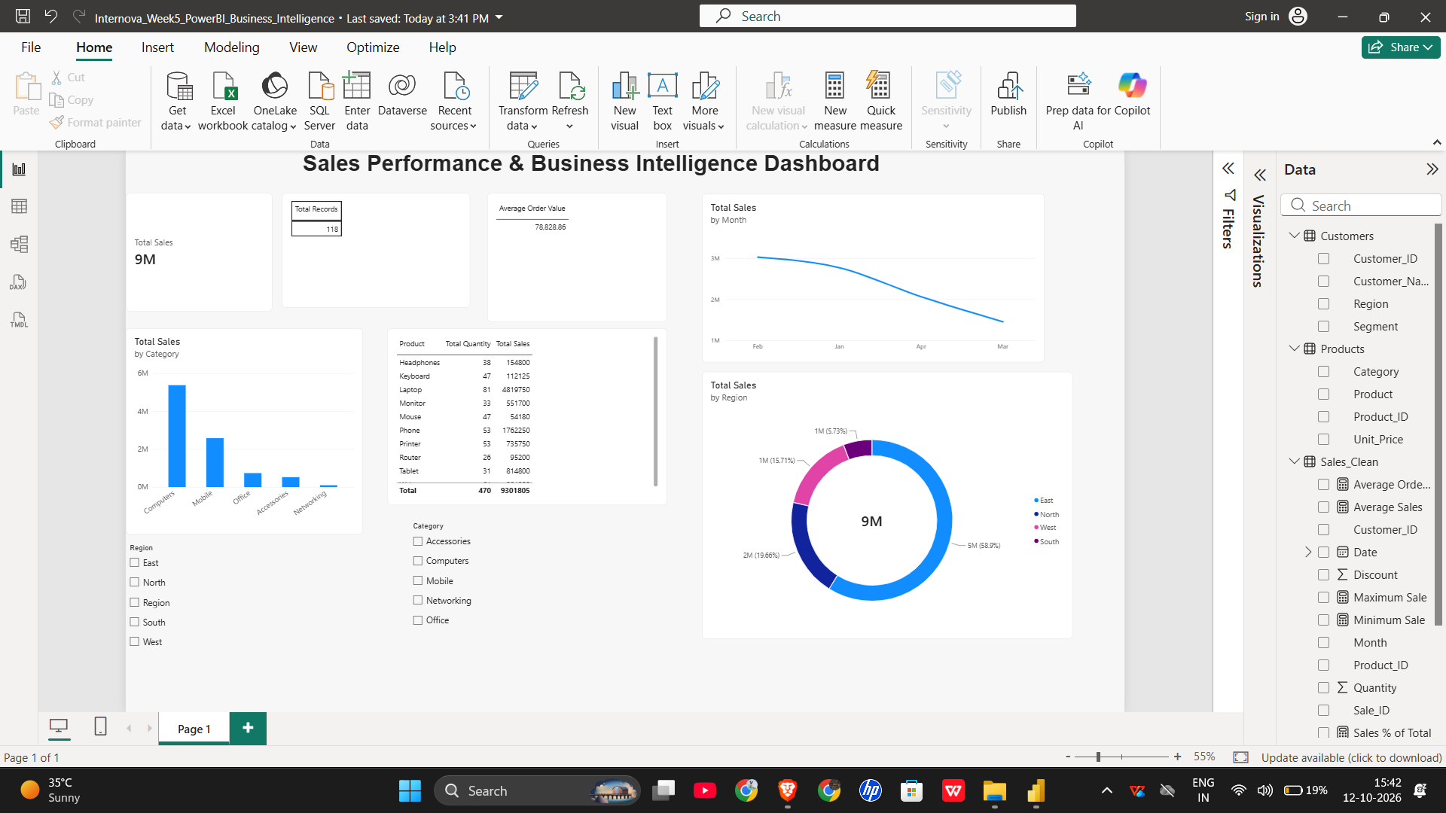
Power BI Dashboard | Interactive View
The Week 5 dashboard is retained as the BI foundation.
Dashboard components
• KPI cards
• Category sales chart
• Monthly sales trend
• Regional sales donut
• Product detail table
• Region and category slicers
Save a separate Week 6 PBIX copy if you make changes.
INTERNOVA • WEEK 6 | 09

Slide 10
Recommendations & Next Actions
Practical steps grounded in the reported patterns.
01
Protect availability
02
Test focused promotions
Prioritize inventory checks for leading categories and regions; validate stock-out and margin data.
Run limited campaigns in weaker areas and compare results to a baseline.
03
Track revenue and margin
04
Make decisions measurable
Review discounts, costs and order values; high sales do not automatically mean high profit.
Set a time period and success metric before scaling an action.
INTERNOVA • WEEK 6 | 10

Slide 11
GitHub, Reproducibility & Submission
The repository records the analysis and makes the work easier to review.
SOURCE CODE
OUTPUTS
DOCUMENTATION
analysis.py
CSV + PNG
README + report
Python analysis workflow
Tables and six visualizations
Workflow and project narrative
Final validation checklist
• Run the analysis and review generated outputs.
• Verify chart titles, labels and values.
• Open the PBIX and confirm the dashboard is readable.
• Ensure report/presentation include five findings and two recommendations.
• Verify at least three meaningful Git commits in GitHub.
INTERNOVA • WEEK 6 | 11

Slide 12
CONCLUSION
Turn sales data
into better decisions.
RECORDS ANALYZED
120
Clean sales transactions
This capstone combines data preparation, exploratory analysis, visual storytelling, Power BI reporting and GitHub documentation.
TOTAL SALES
₹95.34 lakh
Reported total
Thank you
Tiwari Aman Dhananjay • Internova Technologies

