Slide 1
Week 6 Final Capstone
Sales Data Analytics & Business Intelligence
Tiwari Aman Dhananjay | Internova Technologies

Slide 2
Business Problem & Dataset
Analyze 120 cleaned sales transactions from the Week 5 project.
Compare monthly, category, region, and customer-segment performance.
Source tables: Sales_Raw, Sales_Clean, Customers, Products.
Cleaning: remove duplicate Sale_ID; recover missing values where supported by Sales_Amount.

Slide 3
Tools & Workflow
Python, Pandas, NumPy, Matplotlib for EDA and charts.
Power BI Desktop, Power Query, DAX for interactive reporting.
Git/GitHub for version control and documentation.
Six charts and reproducible outputs are included in the repository.

Slide 4
Key Findings
The cleaned dataset contains 120 transactions and total sales of ₹9,534,180.
Average transaction value is ₹79,451.50; the highest transaction is ₹432,250 (S0032) and the lowest is ₹1,080 (S0086).
Computers is the top sales category at ₹5,371,450.
East is the leading region at ₹5,490,620.
Corporate is the largest customer segment by sales at ₹4,168,450.

Slide 5
Recommendations
Maintain inventory availability for leading categories and regions.
Test focused promotions or bundles in weaker areas and compare to baseline.
Track discounts alongside sales to avoid equating revenue with profit.

Slide 6
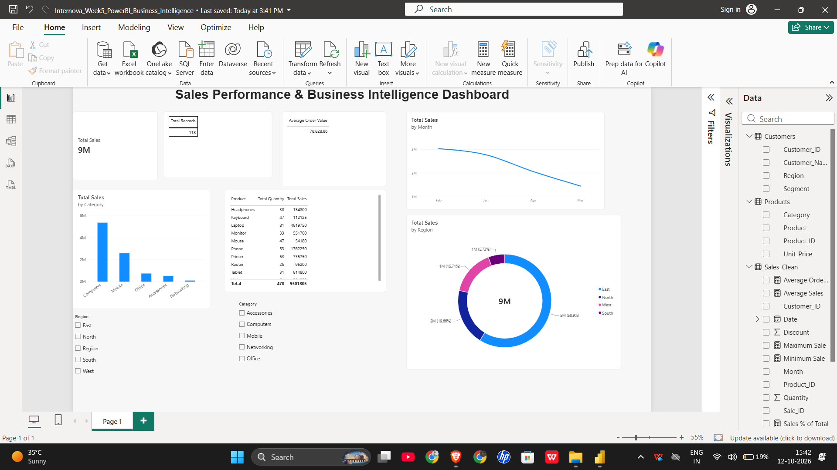
Existing Week 5 Power BI Dashboard

Slide 7
Conclusion & Submission
Week 6 continues the real Week 5 sales project.
Review report, outputs, and six visualizations before submission.
Save a separate Week 6 PBIX if you make changes.
Complete at least three meaningful Git commits and verify GitHub.

