Slide 1

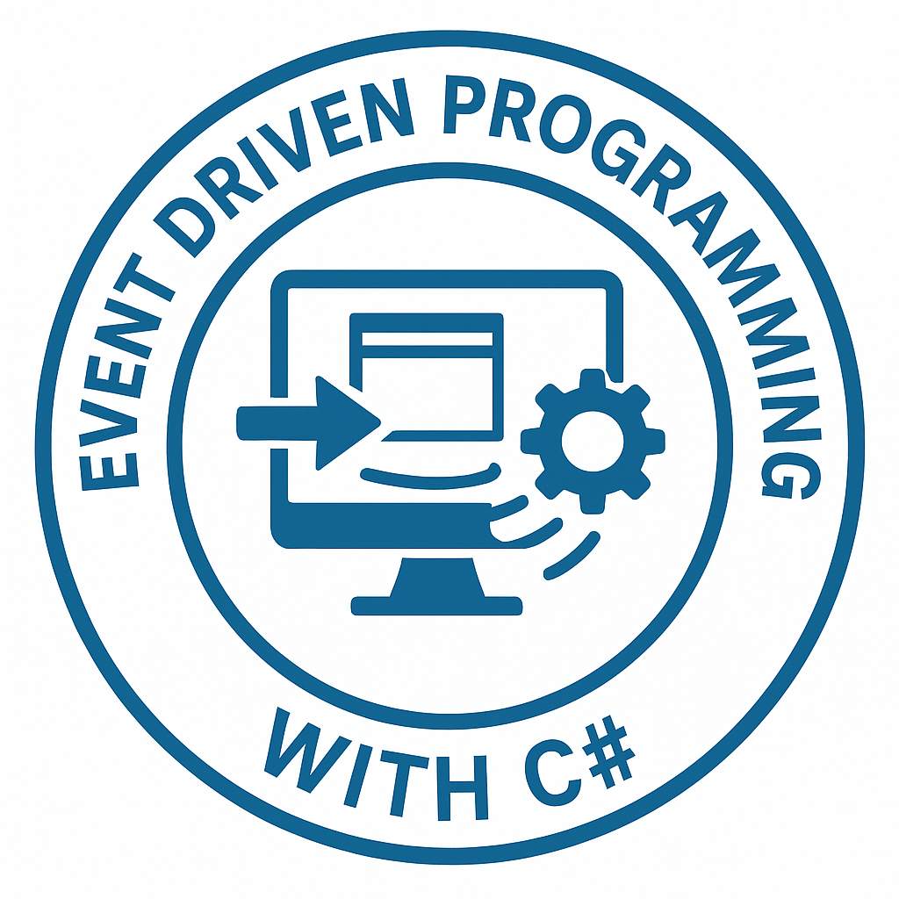
DEBRE BERHAN UNIVERSTITY
College of Computing
Chapter 2: Programming with Event Driven in C#
By Binyam T.
March 23, 2026

Slide 2
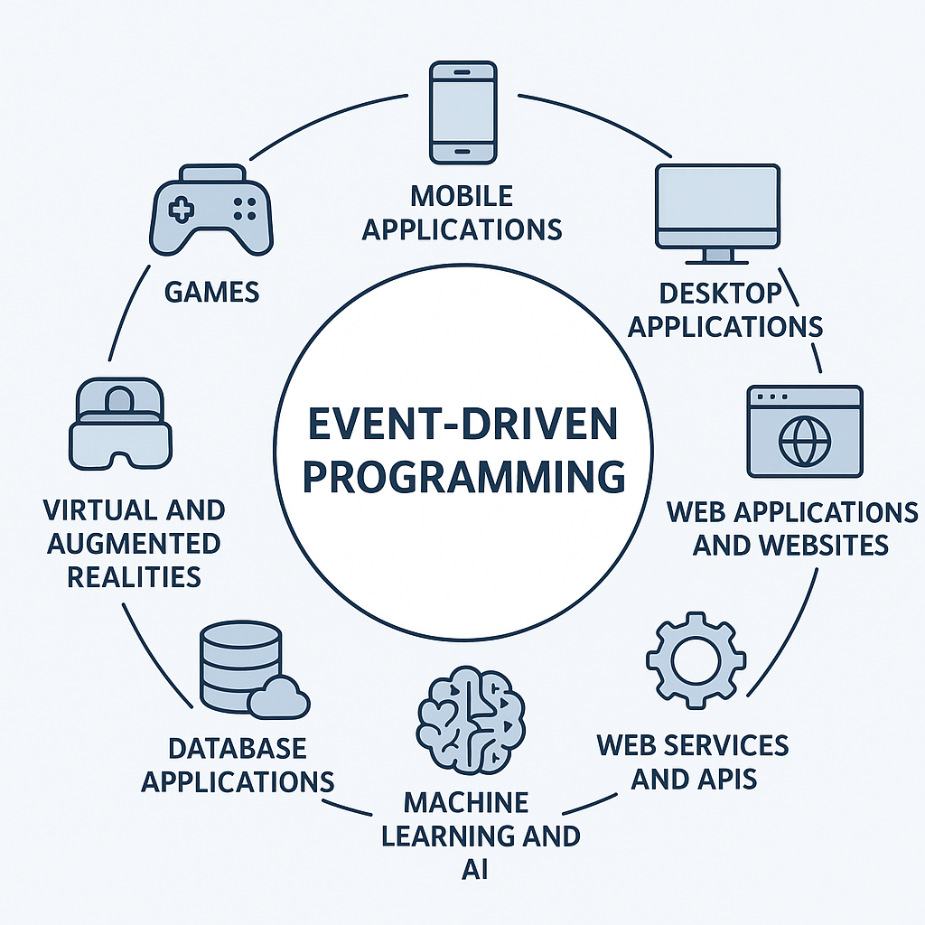

Outline
C# Fundamentals:
Data types,
Variables,
Operators,
Control Flow Statements,
Arrays,
Strings,
Functions…
OOP
Event
Delegate
Namespace and Library

Slide 3
Data Types in C#
A data type defines:
What data is stored
How much memory it uses
Common Types
Example:
int age = 20;
string name = "Abel";
bool isPassed = true;
Data Type | Size | Description
int | 4 bytes | Stores whole numbers from -2,147,483,648 to 2,147,483,647
long | 8 bytes | Stores whole numbers from -9,223,372,036,854,775,808 to 9,223,372,036,854,775,807
float | 4 bytes | Stores fractional numbers & sufficient for storing 6 to 7 decimal digits
double | 8 bytes | Stores fractional numbers & sufficient for storing 15 decimal digits
bool | 1 byte | Stores true or false values
char | 2 bytes | Stores a single character/letter, surrounded by single quotes
string | 2 bytes per character | Stores a sequence of characters, surrounded by double quotes

Slide 4
Value vs Reference Types C#?
Value types directly contain their data.
Assigning one variable to another creates a completely independent copy.
Key Characteristics:
Memory: Typically stored on the Stack.
Common Types: int, bool, double, char, and struct.
Behavior: Changing the "copy" does not affect the original.
Example:
int a = 10;
int b = a; // A copy of '10' is created for 'b'
b = 20; // Only 'b' changes
Console.WriteLine(a); // Output: 10
Console.WriteLine(b); // Output: 20

Slide 5
Value vs Reference Types C#?
Reference types store a pointer (memory address) to the data.
Common Types: class, string, array, and interface.
Behavior: Changing the object through one variable affects all variables pointing to it.
Example:
class Person { public string Name; }
Person p1 = new Person { Name = "Alice" };
Person p2 = p1; // Both p1 and p2 point to the SAME object
p2.Name = "Bob"; // Changes the actual object in memory
Console.WriteLine(p1.Name); // Output: Bob (Surprise!)

Slide 6
Variables and Rules
Rules:
Must declare before use
Must have type
Case-sensitive
Unique name
Example:
int score = 90;
double tax = 0.15;
string studentName = "Marta";

Slide 7
Operators
Arithmetic
+ - * / %
Comparison
== != > < >= <=
Logical
&& || !
Example:
int a = 10;
int b = 5;
Console.WriteLine(a > b); // true

Slide 8
Conditional Statements
if statement
int mark = 60;
if(mark >= 50)
{
Console.WriteLine("Pass");
}
else
{
Console.WriteLine("Fail");
}

Slide 9
Conditional Statements
switch Statement
int day = 2;
switch(day)
{
case 1:
Console.WriteLine("Monday");
break;
case 2:
Console.WriteLine("Tuesday");
break;
}

Slide 10
Loops
for loop
while loop
for(int i=0;i<5;i++)
{
Console.WriteLine(i);
}
int i=0;
while(i<5)
{
Console.WriteLine(i);
i++;
}

Slide 11
C# Arrays
An array is a collection of variables of the same data type stored in contiguous memory locations.
They are zero-indexed.
Fixed Size: The length of an array is established when it is created and cannot be changed during its lifetime.
Reference Type: Arrays are objects derived from the System.Array class.
int[] numbers = new int[5];
string[] fruits = ["Apple", "Banana", "Cherry"];
double[] prices = { 10.5, 20.0, 5.75 };

Slide 12
C# Arrays
Provides three main structures for organizing collection data
1. Single-Dimensional: A simple list of elements (the most common type).
2. Multidimensional (Rectangular): A single block of memory structured like a matrix (rows and columns).
Every row must have the same number of columns.
3. Jagged Array: An "array of arrays" where each inner array can have a different length.
int[][] jagged = new int[2][];
jagged[0] = [1, 2, 3];
jagged[1] = [4, 5];
Type | Declaration Syntax | Visual Structure
Multidimensional | int[,] matrix = new int[3, 2]; | Fixed 3x2 Grid
Jagged | int[][] jagged = new int[3][]; | Variable row lengths

Slide 13
Common Array Utility Methods
System.Array class provides powerful static methods for manipulating array data without needing manual loops.
1. Array.Sort(): Reorders elements in ascending order.
2. Array.Reverse(): Flips the order of elements (often used after Sort for descending order).
3. Array.Resize(): Changes the size of a one-dimensional array.
Note: This actually creates a new array and copies the old data into it.
4. Array.IndexOf(): Searches for a specific value and returns its first index position

Slide 14
C# Array Methods
string[] students = ["Zoe", "Alice", "Bob"];
// Sort alphabetically: ["Alice", "Bob", "Zoe"]
Array.Sort(students);
// Search for a value
int position = Array.IndexOf(students, "Alice");
// Returns 0
// Flip the order: ["Zoe", "Bob", "Alice"]
Array.Reverse(students);
// Increase size to 5 (fills new slots with null)
Array.Resize(ref students, 5);

Slide 15
Strings
Strings store text.
string name = “Abebe";
Console.WriteLine(name.ToUpper());
Common methods:
Length
ToUpper()
ToLower()
Contains()
Substring()
String Methods:
Length: Gets the number of characters
ToUpper(): Converts to uppercase
ToLower(): Converts to lowercase
Contains("Hello"): Checks if substring exists
IndexOf("World"): Finds index of substring
Replace("World", "C#"): Replaces text
Substring(0, 5): Extracts part of the string
Trim(): Removes whitespace from both ends
Concat(): combines two or more strings into a single new string.
StartsWith()/EndsWith(): Returns true if the string begins/ends with the specified substring.

Slide 16
Functions
A function (method) is a block of code that performs a specific task.
Functions improve code reusability, readability, and maintainability.
In C#, functions are usually called methods because they belong to a class.
In C#, a function, also called a method, typically has:
Function Name: Identifies the method(Mandatory).
Parameter List: Defines inputs (0 or more) (Optional).
Return Type: Defines the type of value returned (Mandatory). Use void if no value is returned.
Access Specifier: Controls accessibility (public, private, protected) (Optional).
Modifier: Defines behavior (static, virtual, sealed, partial) (Optional).
Function Body: Contains the code to execute, enclosed in { }.
[access_modifier] [return_type] [function_name]([parameters])
{
// Function body
}

Slide 17
Methods (Functions)
A method is a reusable block of code.
Calling method:
static int Add(int a, int b)
{
return a + b;
}
int result = Add(3,4);

Slide 18
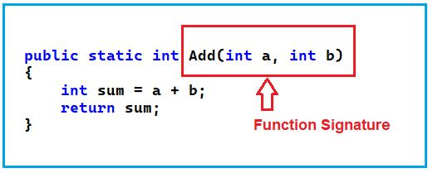
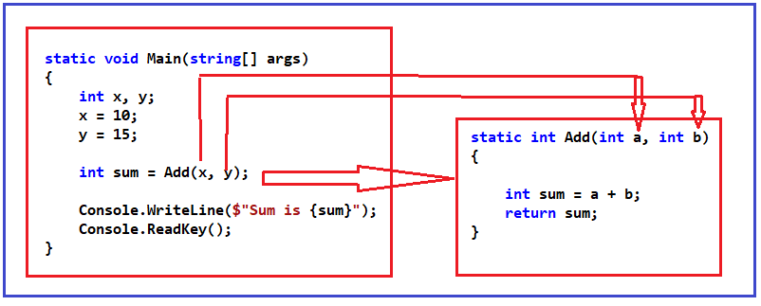
Functions
Function Signature
The combination of Function Name and Parameter List.
Note: Return type is not part of the signature.
Return Statement
Terminates the function execution.
Returns a value to the calling function (if required).
Control returns to the point immediately after the function call.
Calling a Function
Control transfers to the called function.
Returned value (if any) is stored in a variable or used directly.
Function completes when:
return statement is executed.
Closing brace } of the function is reached.
An unhandled exception occurs.

Slide 19
Functions: Types of Functions
Built-in Functions: Functions already defined by .NET /.NET framework.
It is already tested and optimized, saves development time, and is reliable and widely used.
It cannot customize beyond the function's original purpose.
Examples: Console.WriteLine(), Math.Sqrt(), String.Length().

Slide 20
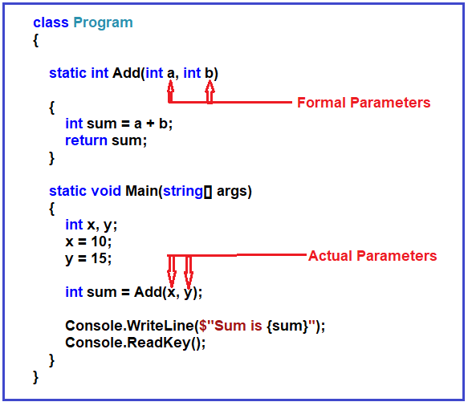
Functions: Types of Functions
User-defined Functions: Created by the programmer to perform specific tasks.
Created by the programmer to perform specific tasks.
Reduces code duplication, improves readability, and optimizes program size.
Fully customizable according to project requirements.
public void Greet() {
Console.WriteLine("Welcome!"); }

Slide 21
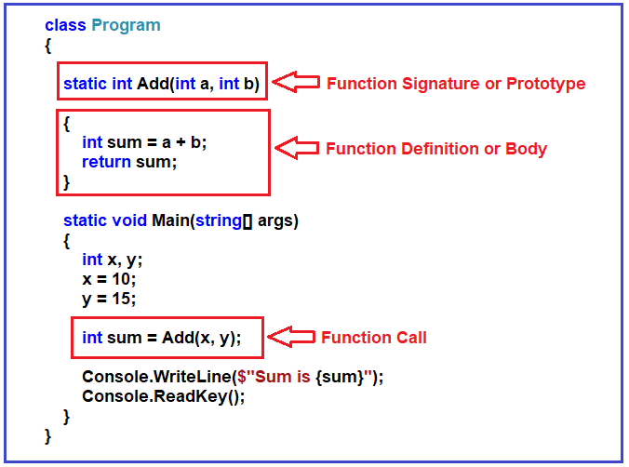
Functions: Types of Functions
Functions with Return Type:
Return a value to the caller.
public string GetName() {
return "Degu"; }
Parameterized Functions:
Functions that take inputs.
public int Add(int a, int b) {
return a + b; }
Void Functions:
Perform an action but do not return a value.
public void PMessage() {
Console.WriteLine("This is a void function"); }

Slide 22
What is OOP?
OOP = Organizing code using objects.
Object contains:
Data (fields)
Behavior (methods)
Real-world examples:
Student
Bank account
Car
OOP helps:
Reusability
Maintainability
Scalability

Slide 23
Class and Object
Class
Blueprint/template
Object
Instance of class
Example:
class Student
{
public string name;
public int age;
}
Student s1 = new Student();
s1.name = "Abel";
s1.age = 20;

Slide 24
Class Structure
Typical class contains:
Fields
Methods
Properties
Constructors
Example:
class Car
{
public string model;
public void Show()
{
Console.WriteLine(model);
}
}

Slide 25
Creating and Using Objects
Memory:
Class → blueprint
Object → real instance
Multiple objects:
Car c1 = new Car();
Car c2 = new Car();
Car c1 = new Car();
c1.model = "Toyota";
c1.Show();

Slide 26
Encapsulation
Encapsulation = protecting data.
Core Concepts:
Data Hiding: Marking fields as private or protected to prevent direct modification from outside the class.
Controlled Access: Exposing data only through well-defined Properties (getters/setters) or Methods.

Slide 27
Encapsulation
class BankAccount
{
private double balance;
public double Balance
{
get { return balance; }
set { if(value >= 0) balance = value; }
}
}

Slide 28
Why Encapsulation?
Benefits:
Data protection
Validation
Prevent invalid values
Without encapsulation:
balance = -1000 ❌
With encapsulation:
Blocked ✔
Important for:
Banking
Login systems
Event-based apps

Slide 29
Constructors
Special method
Same name as class
No Return Type
Runs when object created
class Student
{
public string name;
public Student()
{
name = "Unknown";
}
}

Slide 30
Parameterized Constructor
Default (Parameterless):
Provided by the compiler if none are defined.
Initializes fields to default values (0, null, or false).
Parameterized:
Takes arguments to assign custom values to fields
Create object:
class Student
{
public string name;
public int age;
public Student(string n, int a)
{
name = n;
age = a;
}
}
Student s = new Student("Sara",22);

Slide 31
Method in Class
class Calculator
{
public int Add(int a,int b)
{
return a+b;
}
}
Use:
Calculator c = new Calculator();
Console.WriteLine(c.Add(3,4));

Slide 32
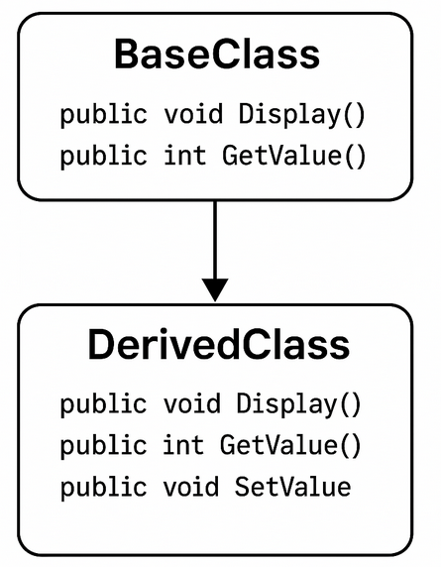
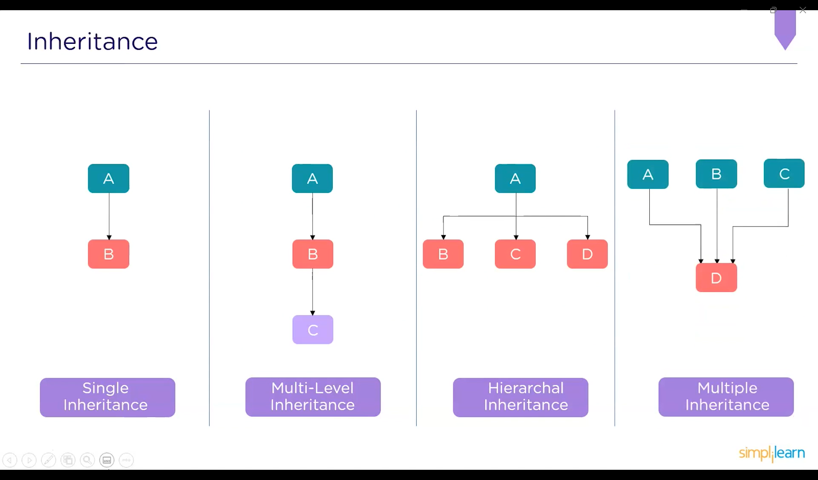
OOP: Inheritance
Inheritance allows a class to acquire fields and methods from another class, promoting code reuse.
Base Class(Parent): The class being inherited from.
Derived Class(Child): The class that inherits from the base class.
It uses a colon(:) to indicate inheritance.
Single Inheritance
Multi-level Inheritance
Hierarchical Inheritance
Multiple Inheritance

Slide 33
Inheritance
Inheritance allows reuse.
Parent class → base Child class → derived
class Animal
{
public void Eat()
{
Console.WriteLine("Eating");
}
}
class Dog : Animal
{
public void Bark()
{
Console.WriteLine("Barking");
}
}

Slide 34
Using Inheritance
Benefits:
Code reuse
Cleaner structure
Extensibility
Used in UI frameworks and event systems.
Dog d = new Dog();
d.Eat();
d.Bark();

Slide 35
Polymorphism
Polymorphism allows a single interface (method or property) to represent different underlying forms (data types or logic).
The Goal: It enables you to write code that is more flexible, reusable, and easier to maintain by treating specialized objects as their general base types.
The Two Pillars in C#:
Static (Compile-time): Resolved by the compiler based on method signatures.
Dynamic (Runtime): Resolved by the CLR (Common Language Runtime) based on the actual object type.

Slide 36
Static Polymorphism (Method Overloading)
Resolved at Compile-time
In C#, static polymorphism is achieved through Method Overloading.
This occurs when multiple methods in the same class have the same name but different parameters
(type, number, or order).
The compiler looks at the arguments passed during the call to decide which specific version of the method to trigger.
Example Code:
public int Add(int a, int b) => a + b;
public int Add(int a, int b, int c) => a + b + c;
public double Add(double a, double b) => a + b;

Slide 37
Dynamic Polymorphism (Method Overriding)
Resolved at Runtime
Dynamic polymorphism occurs when a derived class provides a specific implementation of a method already defined in its base class.
This requires the virtual and override keywords.
The Mechanism:
virtual: Used in the Base Class to signal that a method can be changed.
override: Used in the Derived Class to provide the new implementation.

Slide 38
Dynamic Polymorphism (Method Overriding)
public class Animal {
public virtual void Speak() => Console.WriteLine("Animal makes a sound");
}
public class Dog : Animal
{
public override void Speak() => Console.WriteLine("Bark!");
}
public class Cat : Animal {
public override void Speak() => Console.WriteLine("Meow!");
}
// Usage:
Animal myPet = new Dog(); myPet.Speak();

Slide 39
Abstract Classes and Methods
An abstract class is a "restricted" class that acts as a blueprint.
It cannot be used to create objects directly (instantiate).
Key Rules:
Instantiation: You cannot use new on an abstract class.
It must be inherited by a derived class.
Mixed Members: It can contain both abstract methods (no body) and regular methods (with implementation).
Abstract Methods: Must be declared inside an abstract class and have no body.
They end with a semicolon.
Implementation: Any non-abstract class inheriting from it must provide a body for all abstract methods using the override keyword.

Slide 40
Abstract Classes and Methods
abstract class Shape {
public string Color { get; set; } // Field to hold state
public abstract double GetArea(); // No implementation here
}
class Circle : Shape {
public double Radius { get; set; }
public override double GetArea() => Math.PI * Radius * Radius;
}

Slide 41
Delegate Definition
A delegate is a type-safe reference to a method.
Meaning:
It stores the address of a method
But only methods with the same signature (return type + parameters) can be assigned
Signature must match exactly.

Slide 42
How to Use Delegates
The Three-Step Process
To use a custom delegate, you follow these three steps:
Declaration: Define the delegate's signature (return type and parameters).
Instantiation: Create a delegate instance and point it to a specific method.
Invocation: Call the delegate as if it were a normal method.

Slide 43
Delegate example
// 1. Declaration
Public delegate void LogMessage(string text);
class Logger {
public static void ToConsole(string msg) => Console.WriteLine(msg);
static void Main() {
// 2. Instantiation (pointing to a method)
LogMessage log = ToConsole;
// 3. Invocation
log("Hello, Delegates!");
}
}

Slide 44
Example
using System;
delegate int Operation(int a, int b);
class Program
{
static int Add(int a, int b) => a + b;
static int Multiply(int a, int b) => a * b;
static void Main()
{
Operation op1 = Add;
Console.WriteLine("Add: " + op1(5, 2));
Operation op2 = Multiply;
Console.WriteLine("Multiply: " + op2(5, 2));
}
}

Slide 45
Events
The Publisher-Subscriber Pattern
An Event is a notification sent by an object (Publisher) to signal the occurrence of an action to other objects (Subscribers).
The Roles:
Publisher: The class that contains the event. It decides when the event is raised.
Subscriber: The class that "listens" for the event and provides a handler (method) to execute when the event occurs.
The Keyword: We use the event keyword to wrap a delegate.
A subscriber can only add (+=) or remove (-=) itself;

Slide 46
Even example
using System;
public class BankAccount {
//Step 1 Declare a delegate type
public delegate void BalanceChangedHandler(decimal newBalance);
//Step 2 Declare an event based on that delegate
public event BalanceChangedHandler BalanceChanged;
private decimal balance;
public void Deposit(decimal amount) {
balance += amount;
Console.WriteLine($"Deposited: {amount}");
OnBalanceChanged();
}
public void Withdraw(decimal amount) {
if (amount <= balance) {
balance -= amount;
Console.WriteLine($"Withdrawn: {amount}");
OnBalanceChanged();
}
else{
Console.WriteLine("Insufficient funds!");
} }
//Step 3 Protected method to raise the event
protected virtual void OnBalanceChanged() {
BalanceChanged?.Invoke(balance);
} }
//Step 4 Subscriber class
public class SMSNotifier {
public void SendSms(decimal newBalance) {
Console.WriteLine($"[SMS] Your new balance is {newBalance:C}");
} }
public class Program {
public static void Main() {
BankAccount account = new BankAccount();
SMSNotifier notifier = new SMSNotifier();
//Step 5 Subscribe to event
account.BalanceChanged += notifier.SendSms;
account.Deposit(1000);
account.Withdraw(300);
}
}

Slide 47
Namespaces
Logical containers used to organize classes, interfaces, and other types into a hierarchical structure.
Key Purposes:
Avoid Naming Conflicts: Allows different developers to use the same class names in different contexts without errors.
Code Organization: Groups related items together, making large projects easier to maintain and navigate.
How to Declare:
Use the namespace keyword followed by the name and curly braces.

Slide 48
Namespaces
How to Use:
using Directive: Imports a namespace so you can use its types without typing the full path (e.g., using System;).
Fully Qualified Names: Reference a type directly using dot notation (e.g., System.Console.WriteLine()).
Standard Examples:
System: Basic system functions like Console.
System.Collections.Generic: Contains the C# List class and other dynamic data structures.

Slide 49
Library
A project that compiles into a Dynamic Link Library (.dll) rather than an executable (.exe).
No Entry Point: Unlike Console or Web apps, libraries do not have a Main() method; they cannot be run directly.
Primary Benefit: Encourages code reuse and modularity by allowing you to write logic once and share it with many applications.
Physical Form: A library is physically an Assembly, which contains compiled CIL (Common Intermediate Language) code and metadata.

Slide 50
Creating and Using a Library
Create: In Visual Studio, choose the Class Library project template.
Code: Define public classes and methods (e.g., public class MathUtils { ... }).
Build: Compile the project to generate the .dll file.
Reference: In your main application, right-click Dependencies (or References) and select Add Project Reference or browse for the .dll.
Consume: Use the using directive at the top of your file to access the library's namespace.

Slide 51
Thank You!
?

