Slide 1

Chapter 1
Digital Systems and Number Systems
Digital Logic Design - ECEG-3161
By: Getinet G(Msc)

Slide 2
Outline of Chapter 1
1.1 Digital Systems
1.2 Binary Numbers
1.3 Number-base Conversions
1.4 Octal and Hexadecimal Numbers
1.5 Complements
1.6 Binary Codes

Slide 3
Digital Systems and Binary Numbers
An analog system has continuous range of values
E.g.
A mercury thermometer
Tape and radio player
Human Eye
Daily Temprature
A digital system has a set of discrete values
Digital Thermometer
Compact Disc (CD)
Digital camera

Slide 4
Analog and Digital Signal
Analog system
  The physical quantities or signals may vary continuously over a specified range.
Digital system
  The physical quantities or signals can assume only discrete values.
  Greater accuracy
X(t)
X(t)
t
t
Analog signal
Digital signal

Slide 5
Binary Digital Signal
Two level, or binary values are the most prevalent values.
Binary values are represented abstractly by:
  Digits 0 and 1
  Words (symbols) False (F) and True (T)
  Words (symbols) Low (L) and High (H)
  And words ON and OFF
Benefits of using digital Systems
Cheap electronic circuits
Easier to calibrate and adjust
Resistance to noise: Clearer picture and sound
V(t)
Logic 1
undefine
Logic 0
t
Binary digital signal

Slide 6
Decimal Number System
Base (also called radix) = 10
  10 digits { 0, 1, 2, 3, 4, 5, 6, 7, 8, 9 }
Digit Position
  Integer & fraction
Digit Weight
  Weight = (Base) ^{Position}
Magnitude
  Sum of “Digit x Weight”
Formal Notation
2
1
0
-1
-2
5
1
2
7
4
100
10
1
0.1
0.01
d₂*B²+d₁*B¹+d₀*B⁰+d₋₁*B⁻¹+d₋₂*B⁻²
500
10
2
0.7
0.04
(512.74)₁₀

Slide 7

Octal Number System
Base = 8
  8 digits { 0, 1, 2, 3, 4, 5, 6, 7 }
Weights
  Weight = (Base) ^{Position}
Magnitude
  Sum of “Digit x Weight”
Formal Notation
64
8
1
1/8
1/64
5
1
2
7
4
2
1
0
-1
-2
5 *8²+1 *8¹+2 *8⁰+7 *8⁻¹+4 *8⁻²
=(330.9375)₁₀
(512.74)₈

Slide 8
Binary Number System
Base = 2
  2 digits { 0, 1 }, called binary digits or “bits”
Weights
  Weight = (Base) ^{Position}
Magnitude
  Sum of “Bit x Weight”
Formal Notation
Groups of bits
4 bits = Nibble
8 bits = Byte
4
2
1
1/2
1/4
1
0
1
0
1
2
1
0
-1
-2
1 *2²+0 *2¹+1 *2⁰+0 *2⁻¹+1 *2⁻²
=(5.25)₁₀
(101.01)₂
1 0 1 1
1 1 0 0 0 1 0 1

Slide 9
Hexadecimal Number System
Base = 16
  16 digits { 0, 1, 2, 3, 4, 5, 6, 7, 8, 9, A, B, C, D, E, F }
Weights
  Weight = (Base) ^{Position}
Magnitude
  Sum of “Digit x Weight”
Formal Notation
256
16
1
1/16
1/256
1
E
5
7
A
2
1
0
-1
-2
1 *16²+14 *16¹+5 *16⁰+7 *16⁻¹+10 *16⁻²
=(485.4765625)₁₀
(1E5.7A)₁₆

Slide 10
The Power of 2
n | 2^{n}
0 | 2⁰=1
1 | 2¹=2
2 | 2²=4
3 | 2³=8
4 | 2⁴=16
5 | 2⁵=32
6 | 2⁶=64
7 | 2⁷=128
n | 2^{n}
8 | 2⁸=256
9 | 2⁹=512
10 | 2¹⁰=1024
11 | 2¹¹=2048
12 | 2¹²=4096
20 | 2²⁰=1M
30 | 2³⁰=1G
40 | 2⁴⁰=1T
Kilo
Mega
Giga
Tera

Slide 11
Number Base Conversions
Evaluate Magnitude
Octal
(Base 8)
Evaluate Magnitude
Decimal
(Base 10)
Binary
(Base 2)
Hexadecimal
(Base 16)
Evaluate Magnitude

Slide 12
Decimal (Integer) to Binary Conversion
Divide the number by the ‘Base’ (=2)
Take the remainder (either 0 or 1) as a coefficient
Take the quotient and repeat the division
Example: (13)₁₀
Quotient
Remainder
Coefficient
13
/ 2 = 6
1 a₀ = 1
6
/ 2 = 3
0 a₁ = 0
3
/ 2 = 1
1 a₂ = 1
1
/ 2 = 0
1 a₃ = 1
Answer: (13)₁₀ = (a₃ a₂ a₁ a₀)₂ = (1101)₂
MSB LSB

Slide 13
Decimal (Fraction) to Binary Conversion
Multiply the number by the ‘Base’ (=2)
Take the integer (either 0 or 1) as a coefficient
Take the resultant fraction and repeat the division
Example: (0.625)₁₀
Integer
Fraction
Coefficient
0.625
* 2 = 1 . 25
a₋₁ = 1
0.25
* 2 = 0 . 5 a₋₂ = 0
0.5
* 2 = 1 . 0 a₋₃ = 1
Answer: (0.625)₁₀ = (0.a₋₁ a₋₂ a₋₃)₂ = (0.101)₂
MSB LSB

Slide 14
Decimal to Octal Conversion
Example: (175)₁₀
Quotient
Remainder
Coefficient
175
/ 8 = 21
7 a₀ = 7
21
/ 8 = 2
5 a₁ = 5
2
/ 8 = 0
2 a₂ = 2
Answer: (175)₁₀ = (a₂ a₁ a₀)₈ = (257)₈
Example: (0.3125)₁₀
Integer
Fraction
Coefficient
0.3125
* 8 = 2 . 5
a₋₁ = 2
0.5
* 8 = 4 . 0 a₋₂ = 4
Answer: (0.3125)₁₀ = (0.a₋₁ a₋₂ a₋₃)₈ = (0.24)₈

Slide 15
Binary − Octal Conversion
Octal | Binary
0 | 0 0 0
1 | 0 0 1
2 | 0 1 0
3 | 0 1 1
4 | 1 0 0
5 | 1 0 1
6 | 1 1 0
7 | 1 1 1
8 = 2³
Each group of 3 bits represents an octal digit
Example:
Assume Zeros
( 1 0 1 1 0 . 0 1 )₂
( 2 6 . 2 )₈
Works both ways (Binary to Octal & Octal to Binary)

Slide 16
Binary − Hexadecimal Conversion
16 = 2⁴
Each group of 4 bits represents a hexadecimal digit
Hex | Binary
0 | 0 0 0 0
1 | 0 0 0 1
2 | 0 0 1 0
3 | 0 0 1 1
4 | 0 1 0 0
5 | 0 1 0 1
6 | 0 1 1 0
7 | 0 1 1 1
8 | 1 0 0 0
9 | 1 0 0 1
A | 1 0 1 0
B | 1 0 1 1
C | 1 1 0 0
D | 1 1 0 1
E | 1 1 1 0
F | 1 1 1 1
Example:
Assume Zeros
( 1 0 1 1 0 . 0 1 )₂
( 1 6 . 4 )₁₆
Works both ways (Binary to Hex & Hex to Binary)

Slide 17
Octal − Hexadecimal Conversion
Convert to Binary as an intermediate step
Example:
( 2 6 . 2 )₈
Assume Zeros
Assume Zeros
( 0 1 0 1 1 0 . 0 1 0 )₂
( 1 6 . 4 )₁₆
Works both ways (Octal to Hex & Hex to Octal)

Slide 18
Decimal, Binary, Octal and Hexadecimal
Decimal | Binary | Octal | Hex
00 | 0000 | 00 | 0
01 | 0001 | 01 | 1
02 | 0010 | 02 | 2
03 | 0011 | 03 | 3
04 | 0100 | 04 | 4
05 | 0101 | 05 | 5
06 | 0110 | 06 | 6
07 | 0111 | 07 | 7
08 | 1000 | 10 | 8
09 | 1001 | 11 | 9
10 | 1010 | 12 | A
11 | 1011 | 13 | B
12 | 1100 | 14 | C
13 | 1101 | 15 | D
14 | 1110 | 16 | E
15 | 1111 | 17 | F

Slide 19
1.5 Complements
There are two types of complements for each base-r system: The radix complement and Diminished radix complement.
Diminished Radix Complement - (r-1)’s Complement
  Given a number N in base r having n digits, the (r–1)’s complement of N is defined as:
  (r^{n} –1) – N
Example for 6-digit decimal numbers:
  9’s complement is (r^{n} – 1)–N = (10⁶–1)–N = 999999–N
  9’s complement of 546700 is 999999–546700 = 453299
Example for 7-digit binary numbers:
  1’s complement is (r^{n} – 1) – N = (2⁷–1)–N = 1111111–N
  1’s complement of 1011000 is 1111111–1011000 = 0100111
Observation:
  Subtraction from (r^{n} – 1) will never require a borrow
  Diminished radix complement can be computed digit-by-digit
  For binary: 1 – 0 = 1 and 1 – 1 = 0

Slide 20
Complements
1’s Complement (Diminished Radix Complement)
  All ‘0’s become ‘1’s
  All ‘1’s become ‘0’s
  Example (10110000)₂
  ⇨ (01001111)₂
  If you add a number and its 1’s complement …
1 0 1 1 0 0 0 0
+ 0 1 0 0 1 1 1 1
1 1 1 1 1 1 1 1

Slide 21
Complements
Radix Complement
Example: Base-10
Example: Base-2
The r's complement of an n-digit number N in base r is defined as
r^{n} – N for N ≠ 0 and as 0 for N = 0. Comparing with the (r − 1) 's complement, we note that the r's complement is obtained by adding 1 to the (r − 1) 's complement, since r^{n} – N = [(r^{n} − 1) – N] + 1.
The 10's complement of 012398 is 987602
The 10's complement of 246700 is 753300
The 2's complement of 1101100 is 0010100
The 2's complement of 0110111 is 1001001

Slide 22
Complements
2’s Complement (Radix Complement)
  Take 1’s complement then add 1
  Toggle all bits to the left of the first ‘1’ from the right
  Example:
  Number:
  1’s Comp.:
OR
1 0 1 1 0 0 0 0
0 1 0 0 1 1 1 1
+ 1
1 0 1 1 0 0 0 0
0 1 0 1 0 0 0 0
0
1
0
1
0
0
0
0

Slide 23
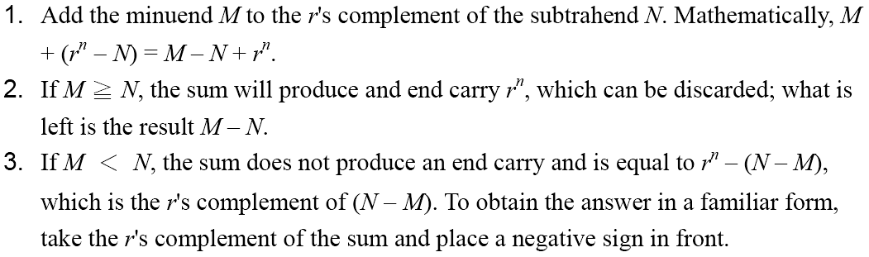
Complements
Subtraction with Complements
  The subtraction of two n-digit unsigned numbers M – N in base r can be done as follows:

Slide 24
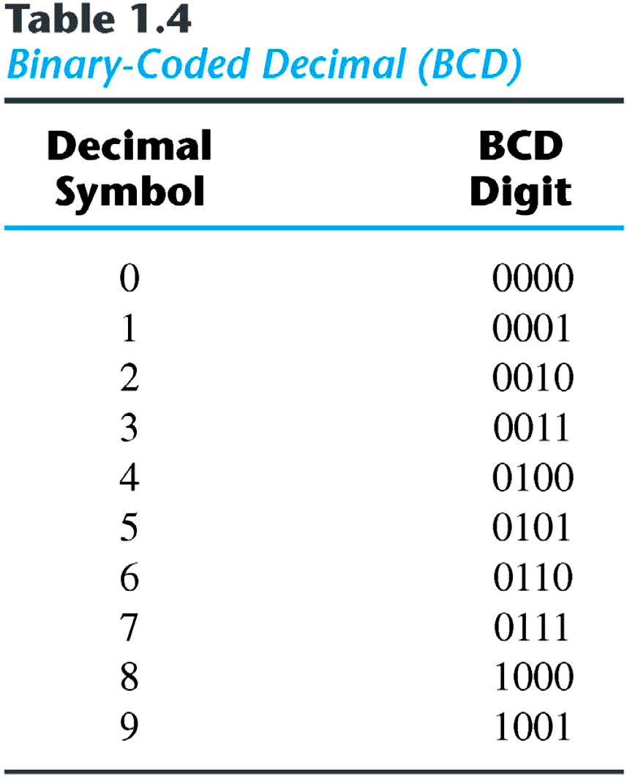
1.7 Binary Codes
BCD Code
  A number with k decimal digits will require 4k bits in BCD.
  Decimal 396 is represented in BCD with 12bits as 0011 1001 0110, with each group of 4 bits representing one decimal digit.
  A decimal number in BCD is the same as its equivalent binary number only when the number is between 0 and 9.
  The binary combinations 1010 through 1111 are not used and have no meaning in BCD.

Slide 25
BCD
BCD number stands for binary coded decimal.
These numbers are not greater than 9.
if number is greater than 9, 6 is added to get the required value.
Each number is represented by 4 bit binary number.
The decimal values should be represented in binary number but not in any other form of number systems.

Slide 26
Cont’d
It is equally easy to understand a decimal number from a BCD number.
Start at the right most bit and break the code into groups of four bits.
Then write the decimal digit represented by each 4 – bit group.
Example: convert each of the following BCD codes to decimal.
a. 00101001 b. 010000101000

Slide 27
Cont’d
Step 2: if a 4-bit sum is equal to or less than 9, it is a valid BCD number.
Step 3: if a 4-bit sum is greater than 9, or if a carry out of the 4-bit group is generated, it is an invalid result.
Add 6 (0110) to the 4-bit sum in order to skip the six invalid states and return the code to 8421.
if a carry results when 6 is add, simply add the carry to the next 4-bit group.

Slide 28
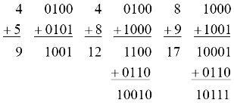
Binary Code
Example:
  Consider decimal 185 and its corresponding value in BCD and binary:
BCD addition

Slide 29
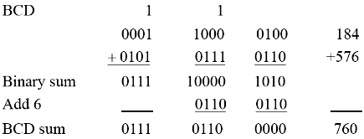

Binary Code
Example:
  Consider the addition of 184 + 576 = 760 in BCD:
Decimal Arithmetic: (+375) + (-240) = +135
Hint 6: using 10’s of BCD

Slide 30
Exercise
1. Add the following numbers using BCD
29 + 17
421 + 127
268 + 474

Slide 31
Digital Codes
There are other specialized codes used in digital systems ➔ e.g. Gray code, ASCII code.
Some codes are
  strictly numeric : e.g. BCD
  Alphanumeric – to represent numbers, letters, symbols, instructions : e.g. ASCII

Slide 32
Exercise
1. Find the Excess 3 code of the number 596.
2. Convert following binary number into gray code and vise-versa: 10101111

Slide 33
ASCII
ASCII is the abbreviation for American Standard Code for Information Interchange. Pronounced “askee”.
ASCII is a universally accepted alphanumeric code used in most computers and other electronic equipment.
Most computer keyboards are standardized with the ASCII.
When you enter a letter, a number, or control command, the corresponding ASCII code goes into the computer.

Slide 34
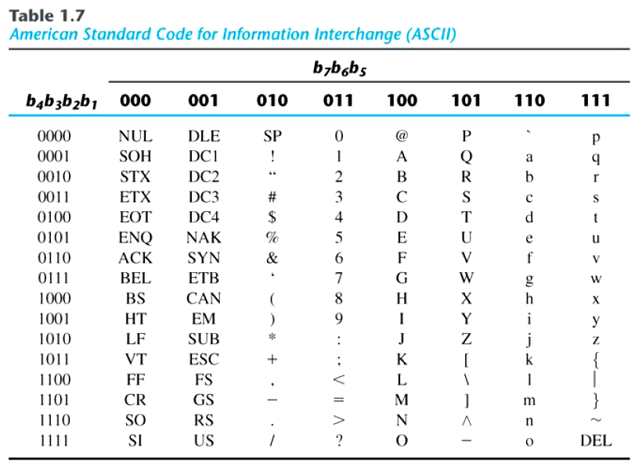
ASCII
American Standard Code for Information Interchange (ASCII) Character Code

Slide 35
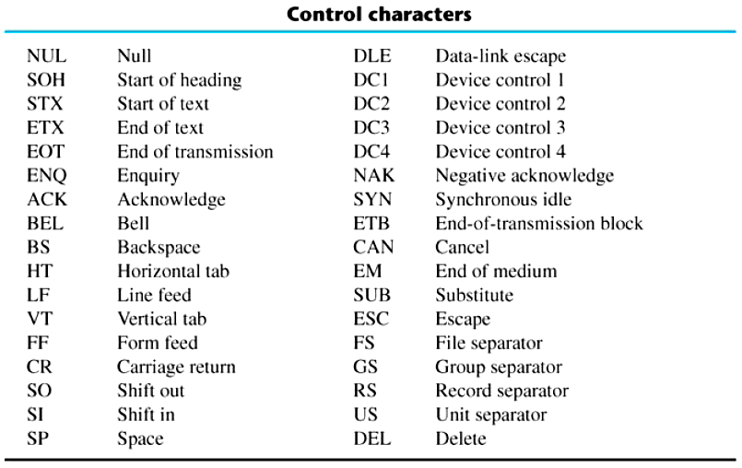
Binary Codes
ASCII Character Code

Slide 36
ASCII Character Codes
American Standard Code for Information Interchange (Refer to Table 1.7)
A popular code used to represent information sent as character-based data.
It uses 7-bits to represent:
  94 Graphic printing characters.
  34 Non-printing characters.
Some non-printing characters are used for text format (e.g. BS = Backspace, CR = carriage return).
Other non-printing characters are used for record marking and flow control (e.g. STX and ETX start and end text areas).

Slide 37
ASCII Properties
ASCII has some interesting properties:
  Digits 0 to 9 span Hexadecimal values 30₁₆ to 39₁₆
  Upper case A-Z span 41₁₆ to 5A₁₆
  Lower case a-z span 61₁₆ to 7A₁₆
    Lower to upper case translation (and vice versa) occurs by flipping bit 6.
    When you enter a letter, a number, or control command, the corresponding ASCII code goes into the computer.

Slide 38
ASCII Cont’d
1. Example: determine the binary ASCII codes that are entered from the computer’s keyboard when the following BASIC program statement is typed in. Also express each code in hexadecimal.
20 PRINT A=“X”;

Slide 39
ASCII solution:
20 PRINT A=“X”;
Symbol | Binary | Hexadecimal
2 | 0110010 | 32
0 | 0110000 | 30
Space | 0100000 | 20
P | 1010000 | 50
R | 1010010 | 52
I | 1001001 | 49
N | 1001110 | 4E
T | 1010100 | 54
Space | 0100000 | 20
A | 1000001 | 41
= | 0111101 | 3D
“ | 0100010 | 22
X | 1011000 | 3B
“ | 0100010 | 22
; | 0111011 | 3B
1000001₂ = 0100 0001₂
4 1

Slide 40
END OF CHAPTER ONE & TWO

