Slide 1

Chapter 5
Combinational logic circuits
By:Getinet G
Digital Logic Design - ECEG-3161

Slide 2
Outline of Chapter 4
4.1 Introduction
4.2 Combination Circuits
4.3 Analysis Procedure
4.4 Design Procedure
4.5 Binary Adder-Subtractor,
4.6 Decimal Adder,
4.7 Binary Multiplier,
4.8 Magnitude Comparator,
4.9 Decoders,
4.10 Encoders,
4.11 Multiplexers ,Demultiplexers
1/63

Slide 3
Introduction
Logic circuits for digital systems are either:-
  Combinational or
  Sequential
A combinational circuit Contains
  Logic gates and Input variables
  Logic gates :Accept signals from Input & generate signals to output
  outputs at any time are determined from the present combination of inputs only.

Slide 4
Introduction
Sequential circuits
Employ storage elements(Memory) in addition to logic gates.
Their outputs are a function of inputs and state of the storage elements.
Not only present values of inputs, but also on past inputs.
Circuit behavior must be specified by a time sequence of inputs and internal states.

Slide 5
Combinational Logic Circuits
Output is function of input only
  i.e. No feedback
  When input changes, output may change (after a delay)
Combinational
Circuits
n inputs
m outputs
•
•
•
•
•
•
✗
4/63

Slide 6
Design Procedure
Given a problem statement:
  Determine the number of inputs and outputs
  Derive the truth table
  Simplify the Boolean expression for each output
  Produce the required logic circuit
Example:
Design a circuit to convert a “BCD” code to “Excess 3” code
4-bits
0-9 values
?
4-bits
Value+3
5/63

Slide 7
Design Procedure
BCD-to-Excess 3 Converter
 |  |  |  | C
 |  |  | 1 | 1 | 1 | B
A |  | x | x | x | x
 |  | 1 | 1 | x | x
 |  |  | D
 |  |  |  | C
 |  |  | 1 | 1 | 1
 |  | 1 |  |  |  | B
A |  | x | x | x | x
 |  |  | 1 | x | x
 |  |  | D
A B C D | w x y z
0 0 0 0 | 0 0 1 1
0 0 0 1 | 0 1 0 0
0 0 1 0 | 0 1 0 1
0 0 1 1 | 0 1 1 0
0 1 0 0 | 0 1 1 1
0 1 0 1 | 1 0 0 0
0 1 1 0 | 1 0 0 1
0 1 1 1 | 1 0 1 0
1 0 0 0 | 1 0 1 1
1 0 0 1 | 1 1 0 0
1 0 1 0 | x x x x
1 0 1 1 | x x x x
1 1 0 0 | x x x x
1 1 0 1 | x x x x
1 1 1 0 | x x x x
1 1 1 1 | x x x x
w = A+BC+BD
x = B’C+B’D+BC’D’
 |  |  |  | C
 |  | 1 |  | 1
 |  | 1 |  | 1 |  | B
A |  | x | x | x | x
 |  | 1 |  | x | x
 |  |  | D
 |  |  |  | C
 |  | 1 |  |  | 1
 |  | 1 |  |  | 1 | B
A |  | x | x | x | x
 |  | 1 |  | x | x
 |  |  | D
y = C’D’+CD
z = D’
6/63

Slide 8
Design Procedure
BCD-to-Excess 3 Converter
A B C D | w x y z
0 0 0 0 | 0 0 1 1
0 0 0 1 | 0 1 0 0
0 0 1 0 | 0 1 0 1
0 0 1 1 | 0 1 1 0
0 1 0 0 | 0 1 1 1
0 1 0 1 | 1 0 0 0
0 1 1 0 | 1 0 0 1
0 1 1 1 | 1 0 1 0
1 0 0 0 | 1 0 1 1
1 0 0 1 | 1 1 0 0
1 0 1 0 | x x x x
1 0 1 1 | x x x x
1 1 0 0 | x x x x
1 1 0 1 | x x x x
1 1 1 0 | x x x x
1 1 1 1 | x x x x
w = A + B(C+D)
y = (C+D)’ + CD
x = B’(C+D) + B(C+D)’
z = D’
7/63

Slide 9
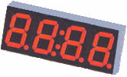
1.Design a Seven-Segment Decoder
Group Assignment
a
w x y z | a b c d e f g
0 0 0 0
0 0 0 1
0 0 1 0
0 0 1 1
0 1 0 0
0 1 0 1
0 1 1 0
0 1 1 1
1 0 0 0
1 0 0 1
1 0 1 0
1 0 1 1
1 1 0 0
1 1 0 1
1 1 1 0
1 1 1 1
w
x
y
z
a
b
c
d
e
f
g
f
b
g
?
e
c
BCD code
d
a = ?
b = ?
c = ?
d = ?
e = ?
f = ?
Design the logic circuit
g = ?
8/63

Slide 10
2) Design a combinational code converter that converts a 4-bit gray code to binary number.
3)Design a combinational circuit with three inputs, A, B, and C, and three outputs, x, y, and z . When the binary input is 0, 1, 2, or 3, the binary output is one greater than the input. When the binary input is 4, 5, 6, or 7, the binary output is two less than the input.

Slide 11
Binary Adder
Half Adder
  Adds 1-bit plus 1-bit
  Produces Sum and Carry
x
y
S
C
HA
x
+ y
───
C S
x y | C S
0 0 | 0 0
0 1 | 0 1
1 0 | 0 1
1 1 | 1 0
x
y
S
C
10/63

Slide 12
Binary Adder
Full Adder
  Adds 1-bit plus 1-bit plus 1-bit
  Produces Sum and Carry
x
y
z
S
C
FA
x
+ y
+ z
───
C S
x y z | C S
0 0 0 | 0 0
0 0 1 | 0 1
0 1 0 | 0 1
0 1 1 | 1 0
1 0 0 | 0 1
1 0 1 | 1 0
1 1 0 | 1 0
1 1 1 | 1 1
 |  |  |  | y
 |  | 0 | 1 | 0 | 1
x |  | 1 | 0 | 1 | 0
 |  |  | z
S = xy'z'+x'yz'+x'y'z+xyz = x ⊕ y ⊕ z
 |  |  |  | y
 |  | 0 | 0 | 1 | 0
x |  | 0 | 1 | 1 | 1
 |  |  | z
C = xy + xz + yz
11/63

Slide 13
Binary Adder
Full Adder
S = xy'z'+x'yz'+x'y'z+xyz = x ⊕ y ⊕ z
C = xy + xz + yz
x
y
z
S
C
S
C
x
y
z
12/63

Slide 14
Binary Adder
Full Adder
HA
HA
x
y
z
S
C
x
y
z
S
C
13/63

Slide 15
Binary Adder
x₃x₂x₁x₀ y₃y₂y₁y₀
c₃ c₂ c₁ .
+ x₃ x₂ x₁ x₀
+ y₃ y₂ y₁ y₀
────────
Cy S₃ S₂ S₁ S₀
Binary Adder
Carry Propagate Addition
C_{y}
C₀
S₃S₂S₁S₀
x₃ x₂ x₁ x₀
y₃ y₂ y₁ y₀
0
FA
FA
FA
FA
C₄ C₃ C₂ C₁
S₃ S₂ S₁ S₀
14/63

Slide 16
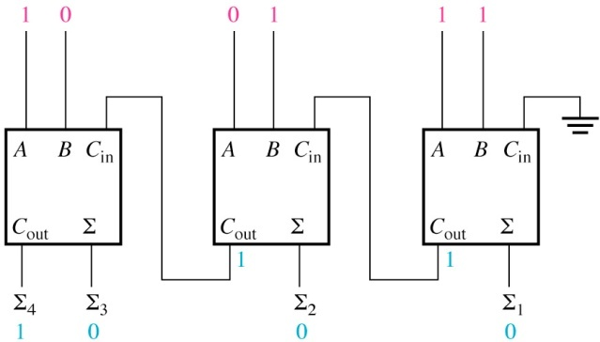
Parallel Adder : Exercise
  Determine the sum generated by the 3-bit parallel adder below and show the intermediate carries when the binary numbers 101 and 011 are being added.

Slide 17
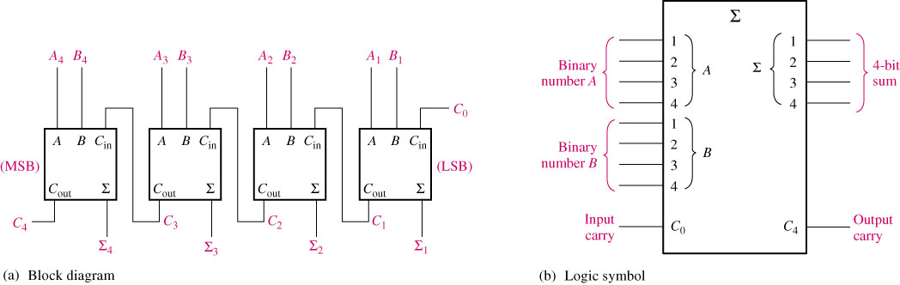
Figure 6.9 A 4-bit parallel adder

Slide 18
Binary Subtractor
Use 2’s complement with binary adder
  x – y = x + (-y) = x + y’ + 1
17/63

Slide 19
Binary Adder/Subtractor
M: Control Signal (Mode)
  M=0 ➔ F = x + y
  M=1 ➔ F = x – y
18/63

Slide 20
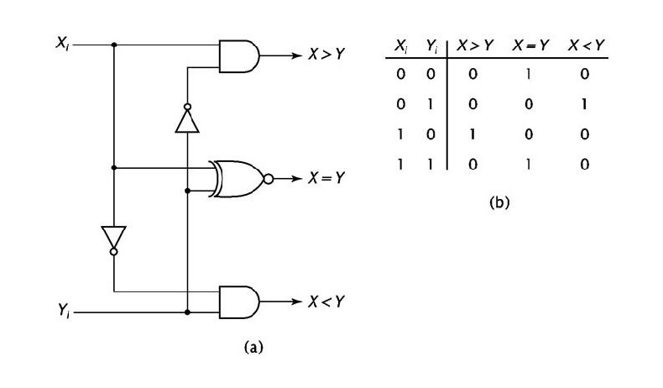
Comparators
The basic function of a comparator is to compare the magnitudes of two binary quantities to determine the relationships of those quantities.
Compares two n-bit binary values to determine which one is larger.
Inputs : 2 single-bit inputs (X and Y).
Outputs : 3 lines: X>Y, X=Y, X<Y.

Slide 21
Decoders
Extract “Information” from the code
Binary Decoder
  Example: 2-bit Binary Number
Only one lamp will turn on
0
1
2
3
Binary
Decoder
1
0
0
0
x₁
x₀
0
0
20/63

Slide 22
Decoders
A decoder has
  N inputs
  2^{N} outputs
A decoder selects one of 2^{N} outputs by decoding the binary value on the N inputs.
The decoder generates all of the minterms of the N input variables.
Exactly one output will be active for each combination of the inputs.
What does “active” mean?

Slide 23
Decoders
2-to-4 Line Decoder
Binary
Decoder
y₃
y₂
y₁
y₀
I₁
I₀
I₁ I₀ | Y₃ Y₂ Y₁ Y₀
0 0 | 0 0 0 1
0 1 | 0 0 1 0
1 0 | 0 1 0 0
1 1 | 1 0 0 0
22/63

Slide 24
Decoders
“Enable” Control
Binary
Decoder
Y₃
Y₂
Y₁
Y₀
I₁
I₀
E
E | I₁ I₀ | Y₃ Y₂ Y₁ Y₀
0 | x x | 0 0 0 0
1 | 0 0 | 0 0 0 1
1 | 0 1 | 0 0 1 0
1 | 1 0 | 0 1 0 0
1 | 1 1 | 1 0 0 0
23/63

Slide 25
Decoders
3-to-8 Line Decoder
Binary
Decoder
Y₇
Y₆
Y₅
Y₄ Y₃
Y₂
Y₁
Y₀
I₂
I₁
I₀
24/63

Slide 26
Decoders
Expansion
I₂ I₁ I₀
I₂ I₁ I₀ | Y₇ Y₆ Y₅ Y₄ Y₃ Y₂ Y₁ Y₀
0 0 0 | 0 0 0 0 0 0 0 1
0 0 1 | 0 0 0 0 0 0 1 0
0 1 0 | 0 0 0 0 0 1 0 0
0 1 1 | 0 0 0 0 1 0 0 0
1 0 0 | 0 0 0 1 0 0 0 0
1 0 1 | 0 0 1 0 0 0 0 0
1 1 0 | 0 1 0 0 0 0 0 0
1 1 1 | 1 0 0 0 0 0 0 0
Binary
Decoder
Y₇
Y₆
Y₅
Y₄
Y₃
Y₂
Y₁
Y₀
Y₃
Y₂
Y₁
Y₀
I₀
I₁
E
Binary
Decoder
Y₃
Y₂
Y₁
Y₀
I₀
I₁
E
25/63

Slide 27
Encoders
An encoder has
  2^{N} inputs
  N outputs
An encoder outputs the binary value of the selected (or active) input.
An encoder performs the inverse operation of a decoder.
Issues
  What if more than one input is active?
  What if no inputs are active?

Slide 28
Encoders
Put “Information” into code
Binary Encoder
  Example: 4-to-2 Binary Encoder
Only one switch should be activated at a time
1
x₁
x₂
X₃
Binary
Encoder
x₃ x₂ x₁ | y₁ y₀
0 0 0 | 0 0
0 0 1 | 0 1
0 1 0 | 1 0
1 0 0 | 1 1
y₁
y₀
2
3
27/63

Slide 29
Encoders
Octal-to-Binary Encoder (8-to-3)
Binary
Encoder
I₇
I₆
I₅
I₄ I₃
I₂
I₁
I₀
I₇ I₆ I₅ I₄ I₃ I₂ I₁ I₀ | Y₂ Y₁ Y₀
0 0 0 0 0 0 0 1 | 0 0 0
0 0 0 0 0 0 1 0 | 0 0 1
0 0 0 0 0 1 0 0 | 0 1 0
0 0 0 0 1 0 0 0 | 0 1 1
0 0 0 1 0 0 0 0 | 1 0 0
0 0 1 0 0 0 0 0 | 1 0 1
0 1 0 0 0 0 0 0 | 1 1 0
1 0 0 0 0 0 0 0 | 1 1 1
Y₂
Y₁
Y₀
28/63

Slide 30
Encoder / Decoder Pairs
Binary
Encoder
Binary
Decoder
Y₇
Y₆
Y₅
Y₄ Y₃
Y₂
Y₁
Y₀
7
7
I₇
I₆
I₅
I₄ I₃
I₂
I₁
I₀
6
6
5
5
Y₂
Y₁
Y₀
I₂
I₁
I₀
4
4
3
3
2
2
1
1
0
0
29/63

Slide 31
Multiplexers
A multiplexer has
  N control inputs
  2^{N} data inputs
  1 output
A multiplexer routes (or connects) the selected data input to the output.
  The value of the control inputs determines the data input that is selected.

Slide 32
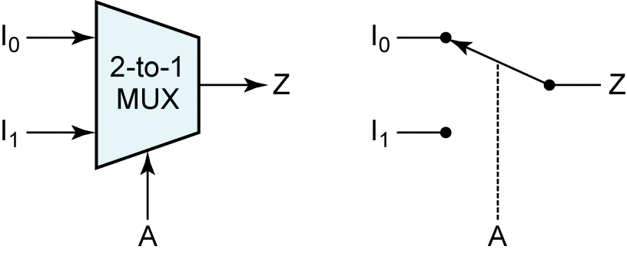
Multiplexers
Data
inputs
Z = A′.I₀ + A.I₁
Control
input

Slide 33
Multiplexers
S₁ S₀ | Y
0 0 | I₀
0 1 | I₁
1 0 | I₂
1 1 | I₃
MUX
I₀
I₁
I₂
I₃
Y
S₁ S₀
32/63

Slide 34
Multiplexers
2-to-1 MUX
4-to-1 MUX
MUX
I₀
I₁
Y
S
MUX
I₀
I₁
I₂
I₃
Y
S₁ S₀
33/63

Slide 35
Implementation Using Multiplexers
Example
F(x, y) = ∑(0, 1, 3)
x y | F
0 0 | 1
0 1 | 1
1 0 | 0
1 1 | 1
MUX
1
1
0
1
I₀
I₁
I₂
I₃
Y
F
S₁ S₀
x y
34/63

Slide 36
Demultiplexers
A demultiplexer has
  N control inputs
  1 data input
  2^{N} outputs
A demultiplexer routes (or connects) the data input to the selected output.
The value of the control inputs determines the output that is selected.
A demultiplexer performs the opposite function of a multiplexer.

Slide 37
DeMultiplexers
DeMUX
Y₃
Y₂
Y₁
Y₀
I
S₁ S₀
S₁ S₀ | Y₃ | Y₂ | Y₁ | Y₀
0 0 | 0 | 0 | 0 | I
0 1 | 0 | 0 | I | 0
1 0 | 0 | I | 0 | 0
1 1 | I | 0 | 0 | 0
36/63

Slide 38
Multiplexer / DeMultiplexer Pairs
MUX
DeMUX
Y₇
Y₆
Y₅
Y₄ Y₃
Y₂
Y₁
Y₀
7
7
I₇
I₆
I₅
I₄ I₃
I₂
I₁
I₀
6
6
5
5
4
4
Y
I
3
3
2
2
1
1
0
0
S₂ S₁ S₀
S₂ S₁ S₀
Synchronize
x₂ x₁ x₀
y₂ y₁ y₀
37/63

Slide 39
Thank You !!!
?

