Slide 1
Wolkite University
College of Engineering and Technology
Department of Electrical and Computer Engineering
Digital Logic Design
CH-3: Logic Gates
.

Slide 2
Outline
Introduction
The Inverter
The AND Gate
The OR Gate
The NAND Gate
The NOR Gate
The Exclusive-OR and Exclusive-NOR Gates
Fixed-Function Logic: IC Gates

Slide 3
Introduction
Logic gates are the basic elements that makes up a digital system.
The electronic gate is a circuit that is able to operate on a number of binary inputs in order to perform a particular logic function.
The logic operations are basically NOT, AND and OR.
From these basic gates we can obtain the other gates. NAND,NOR and EX-OR, EX-NOR gate.

Slide 4
Cont’d
The NAND and NOR gates are called as the universal gates.
These gates are used to perform any type of logic application.
A logical gate can have minimum of two inputs( except NOT) and gives output based on the operation.
The operation of logic gates can be easily understood by a truth table.
The truth table is table consisting binary values of inputs and outputs.
The outputs are given based on the logical operation.

Slide 5
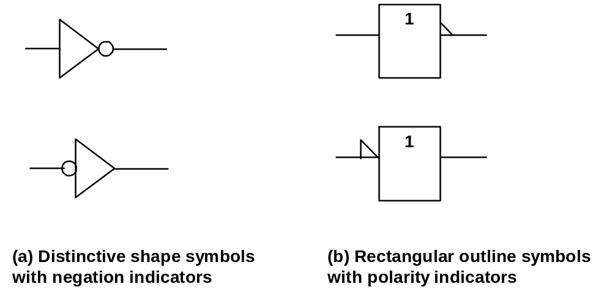
The Inverter
Performs inversion or complementation
  Changes a logic level to the opposite
  0(LOW) ➔ 1(HIGH) ; 1 ➔ 0;
Symbols used:

Slide 6
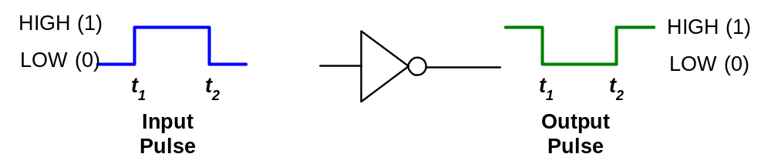
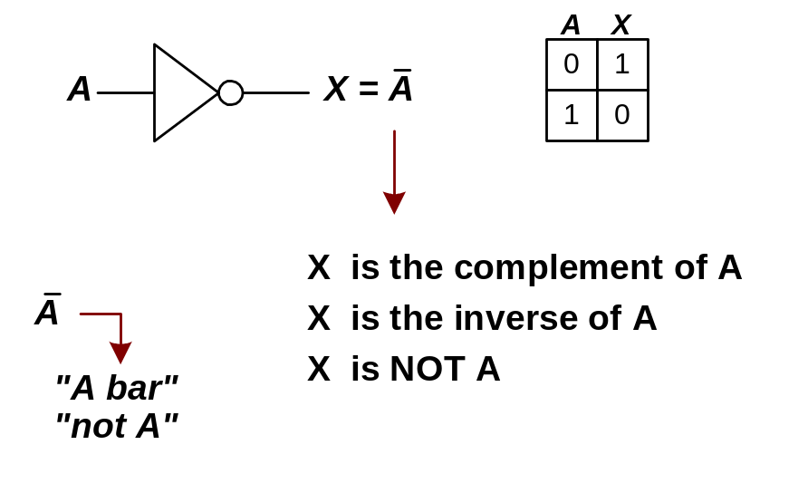
Inverter operation:
Logic expression for an Inverter:

Slide 7
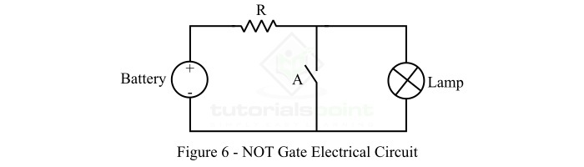
Electrical Analogy of NOT Gate
When A = 0 (open), the current flows through the lamp making it ON. Hence, the output lamp = 1.
When A = 1 (close), the current will bypass through the switch A making the lamp OFF. Hence, the output Lamp = 0.
Hence, the electric circuit shown in Figure-6 represents the NOT gate operation
Inputs | Output
A | Lamp = A’
0(OFF) | 1 (ON)
1(ON) | 0 (OFF)

Slide 8

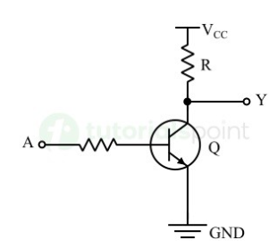
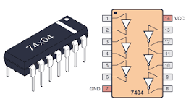
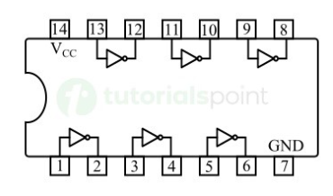
NOT Gate IC

Slide 9
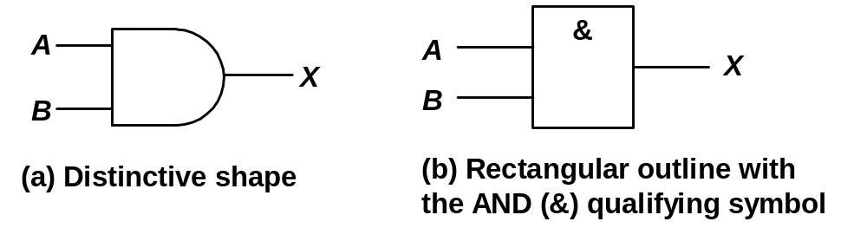
The AND Gate
Performs ‘logical multiplication’
  If all of the input are HIGH, then the output is HIGH.
  If any of the input are LOW, then the output is LOW.
Symbols used:

Slide 10
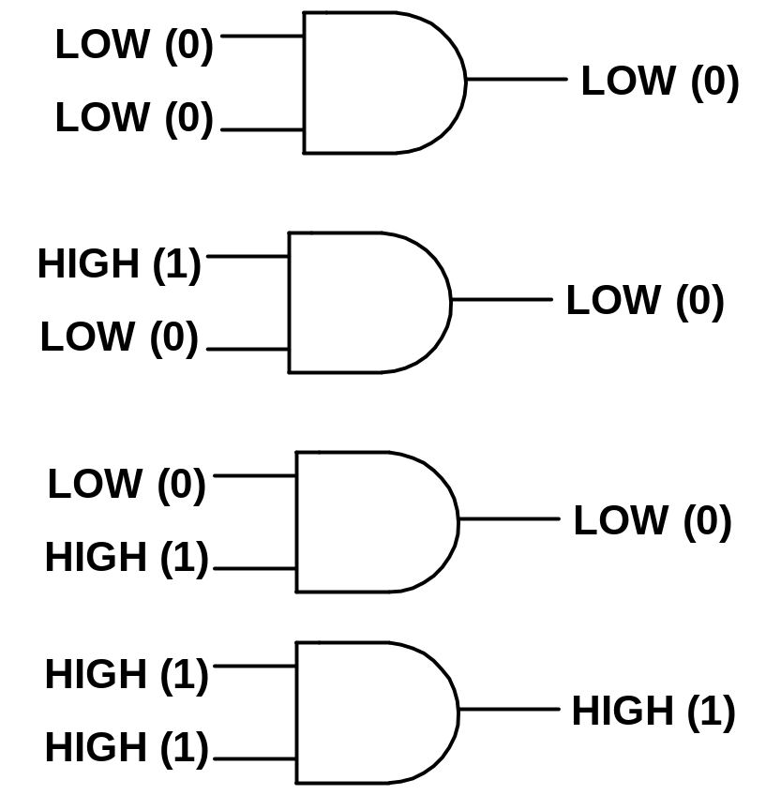
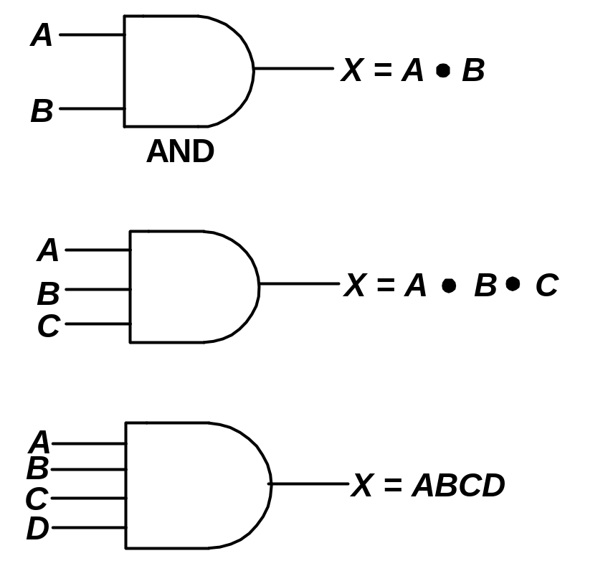
AND gate operation:

Slide 11
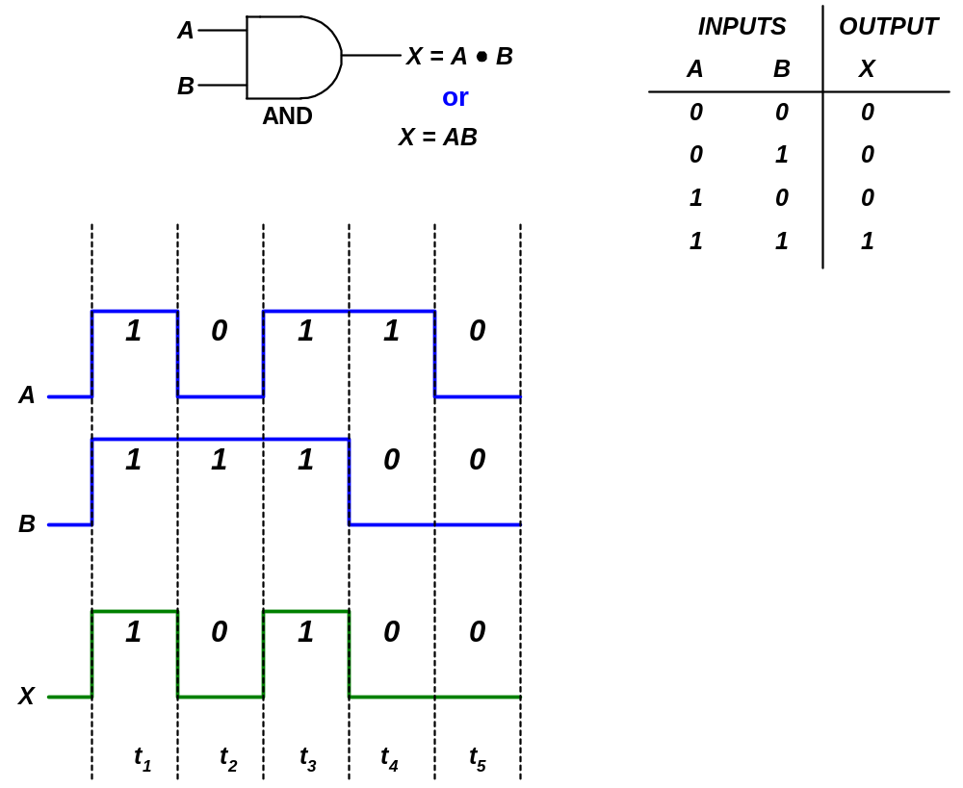

Slide 12
Logic expressions for AND gate:
AND gate performs Boolean multiplication.
Boolean multiplication follows the same basic rule as binary multiplication:
0 . 0 = 0
0 . 1 = 0
1 . 0 = 0
1 . 1 = 1

Slide 13
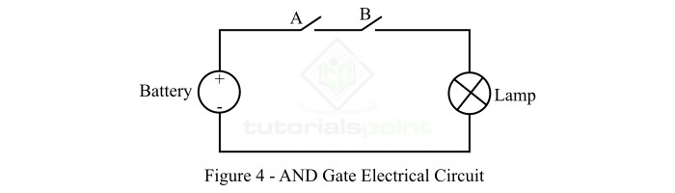
Electrical Analogy of AND Gate
Inputs |  | Output
A | B | Lamp = A B
0 | 0 | 0
0 | 1 | 0
1 | 0 | 0
1 | 1 | 1
When A = 1 (close) and B = 1 (close), the lamp will be ON as there is no break in the circuit, so current can flow. Thus, the output Lamp = 1 (ON)

Slide 14
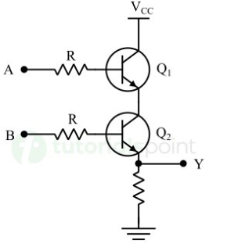
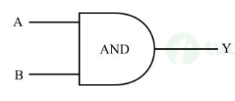
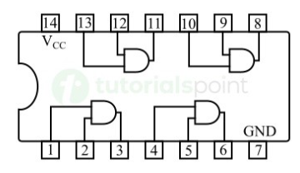
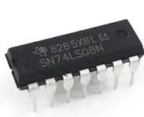
AND Gate IC

Slide 15
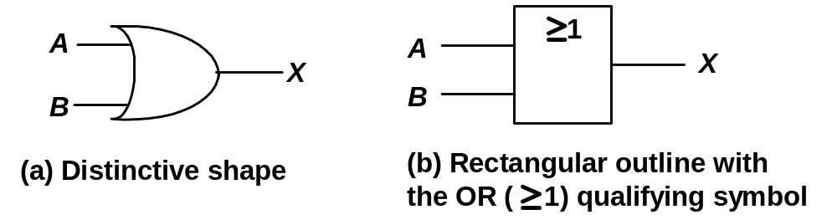
The OR Gate
Performs ‘logical addition’
  If any of the input are HIGH, then the output is HIGH.
  If all of the input are LOW, then the output is LOW
Symbols used:

Slide 16
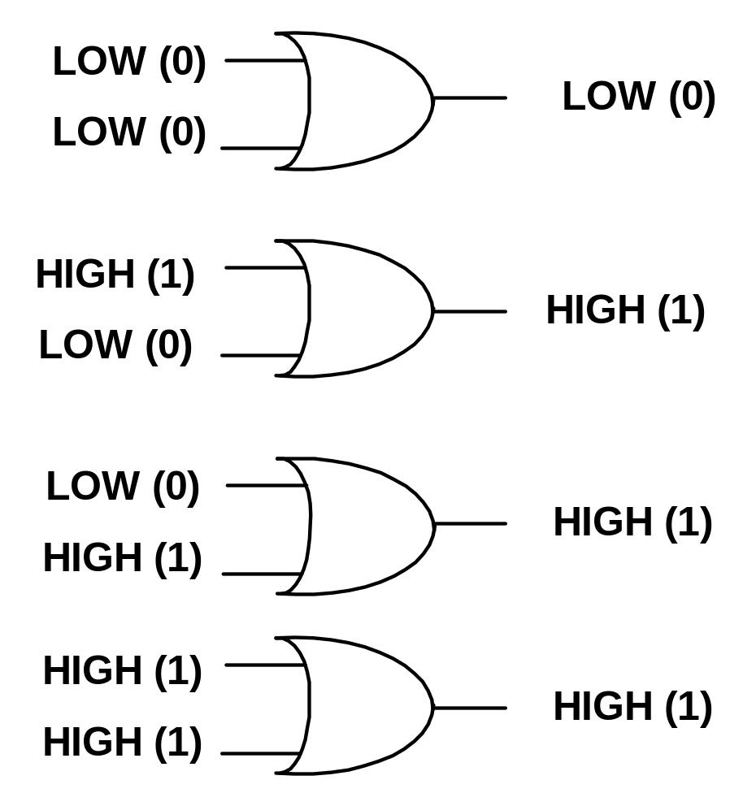
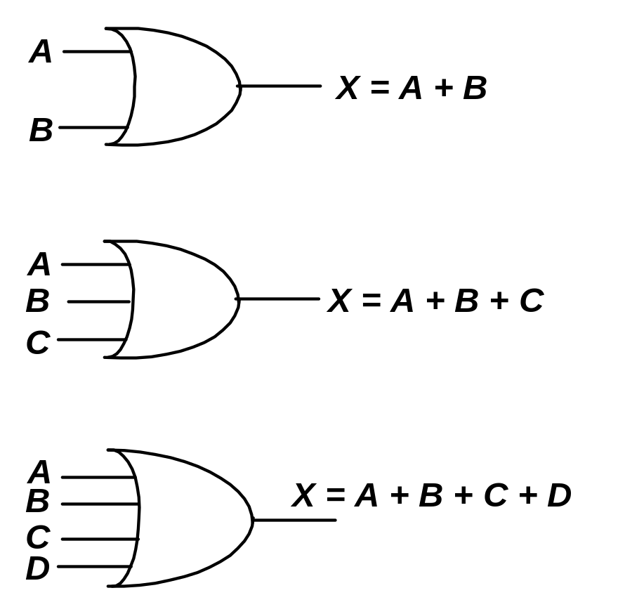
The OR gate operation:

Slide 17
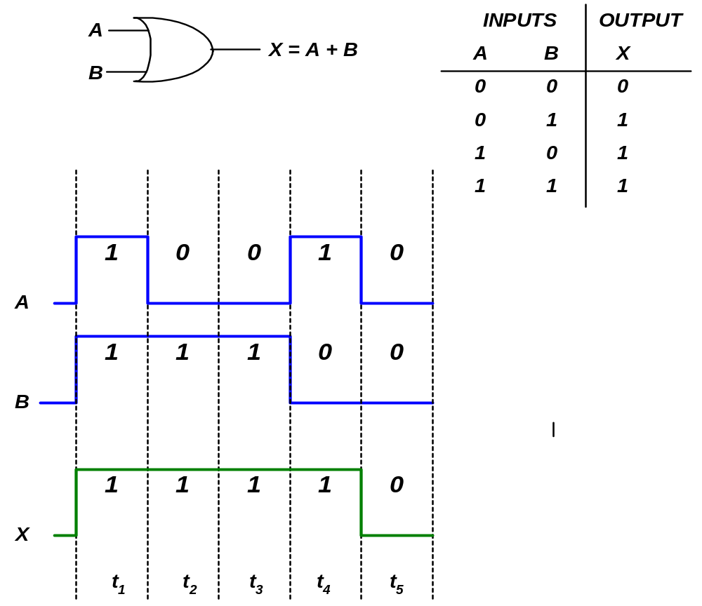

Slide 18
Logic expressions for OR gate:
OR gate performs Boolean addition
Boolean addition follows the basic rules as follows:
0 + 0 = 0
0 + 1 = 1
1 + 0 = 1
1 + 1 = 1

Slide 19
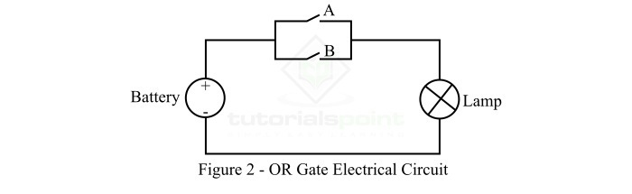
Electrical Analogy of OR Gate
Inputs |  |  | Output
A | B |  | Y = A + B
0 | 0 |  | 0
0 | 1 |  | 1
1 | 0 |  | 1
1 | 1 |  | 1
When A = 0 (open) and B = 0 (open), the lamp will be OFF, i.e. output Y = 0.
When A = 0 (open) and B = 1 (close), the lamp will be ON, and current follows the path through switch B. Hence, the output Y = 1.
When A = 1 (close) and B = 0 (open), the lamp will be ON, i.e. current flow through switch A making the output Y = 1.
When A = 1 (close) and B = 1 (close), the lamp will be ON and current flows through both switches A and B. Thus, the output Y = 1.

Slide 20
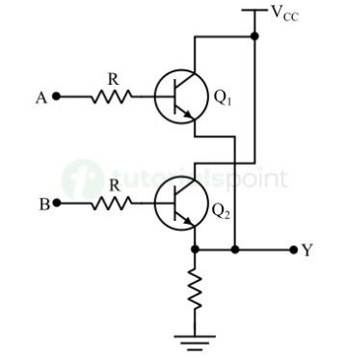
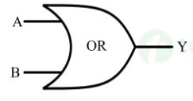
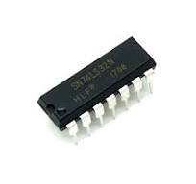
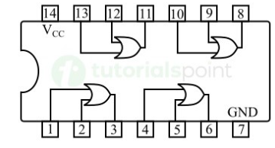
The OR Gate IC
The OR gate IC 7432 has 14 pins and it is a transistor-transistor logic (TTL) OR gate IC.

Slide 21
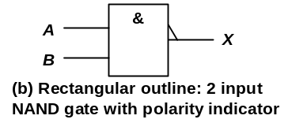
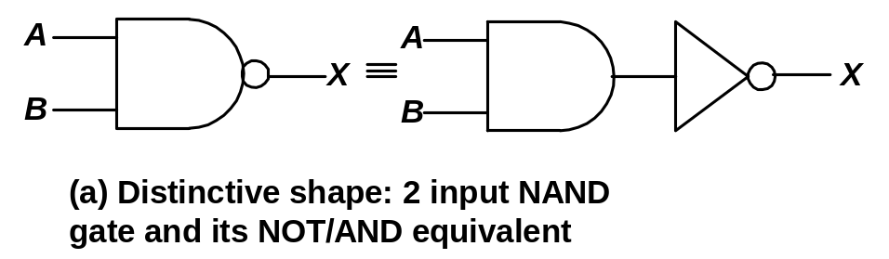
The NAND Gate
NAND ➔ NOT-AND ⇨combines the AND gate and an inverter.
Used as a universal gate
  Combinations of NAND gates can be used to perform AND, OR and inverter operations.
  If all or any of the input are LOW, then the output is HIGH.
  If all of the input are HIGH, then the output is LOW.
Symbol used:

Slide 22
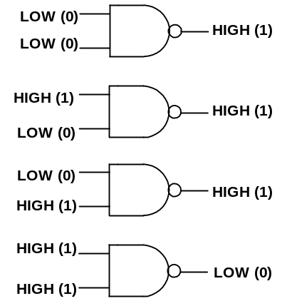
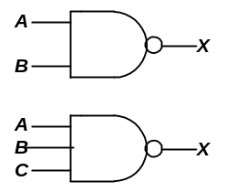
The NAND gate operation:

Slide 23
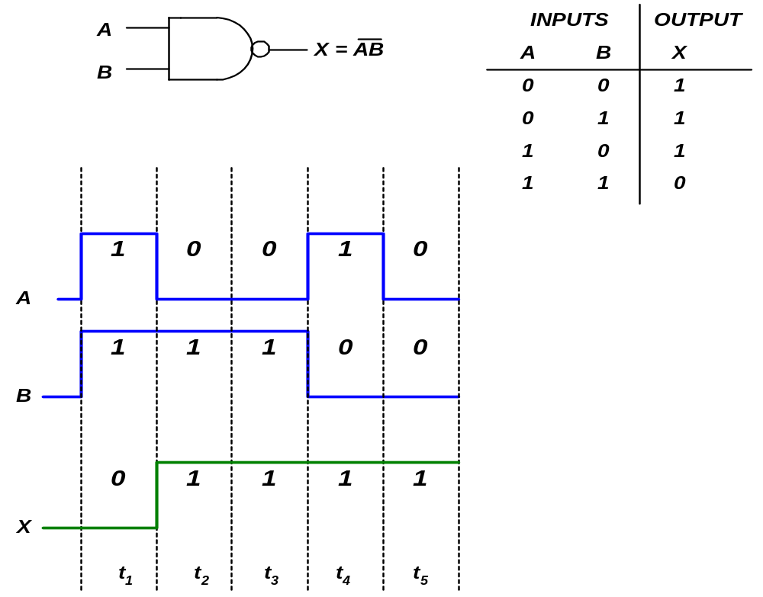

Slide 24
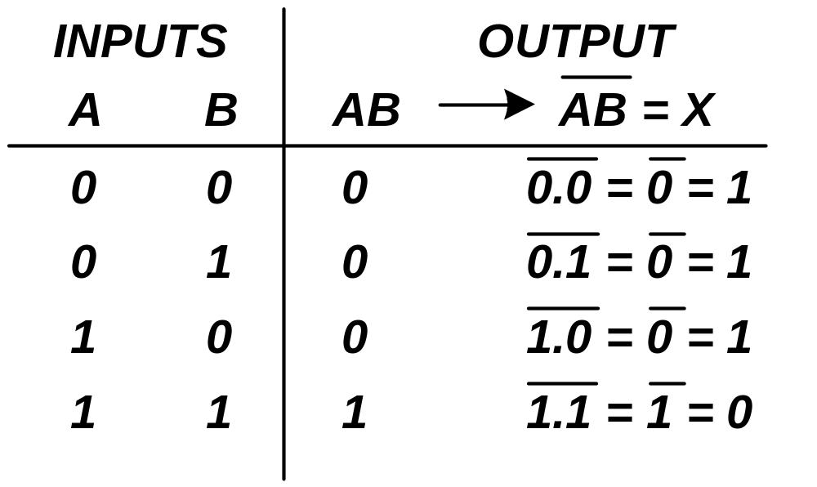
Logic expressions for NAND gate:
Boolean expression for NAND is a combination of AND and Inverter Boolean expressions.

Slide 25
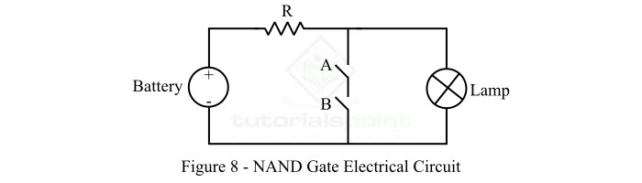
Electrical Analogy of NAND Gate
When A = 0 (open) and B = 0 (open), the current will pass through the lamp making it ON. Hence, the output Y = 1.
When A = 0 (open) and B = 1 (close), the current will pass through the lamp making it ON. Hence, the output Y = 1.
When A = 1 (close) and B = 0 (open), the current will pass through the lamp making it ON. Thus, the output Y = 1.
When A = 1 (close) and B = 1 (close), the current will follow the short-circuited path provided by closed switches A and B, and no current will flow through the lamp making it OFF. Therefore, the output Y = 0.

Slide 26
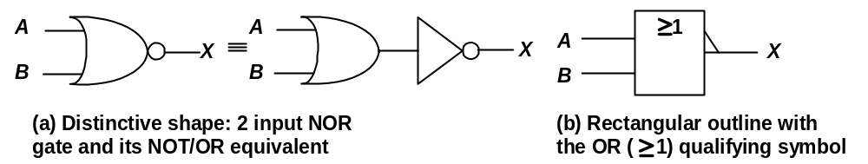
The NOR Gate
NOR ➔ NOT-OR ⇨combines the OR gate and an inverter
Used as a universal gate
  Combinations of NOR gates can be used to perform AND, OR and inverter operations
  If all or any of the input are HIGH, then the output is LOW.
  If all of the input are LOW, then the output is HIGH.
Symbol used:

Slide 27
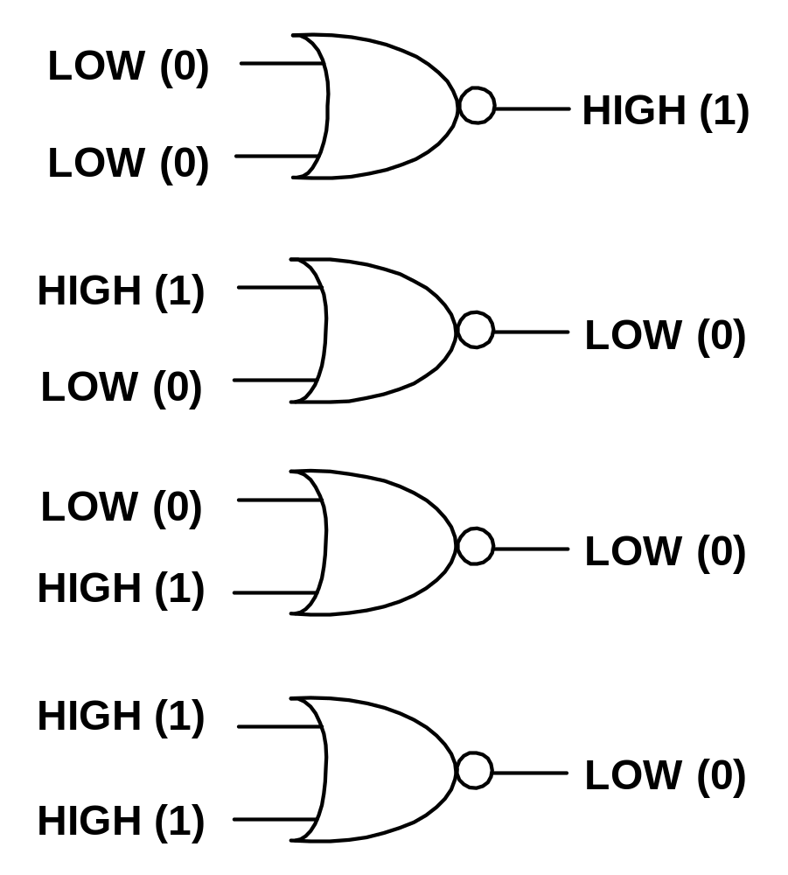
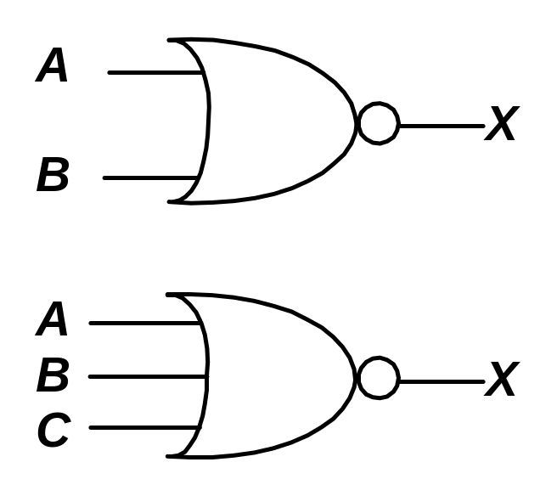
The NOR gate operation:

Slide 28
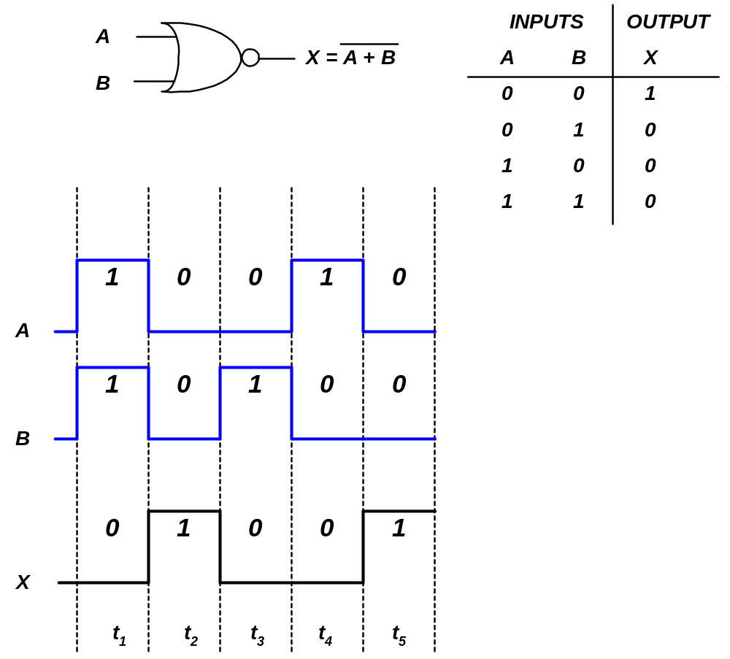

Slide 29
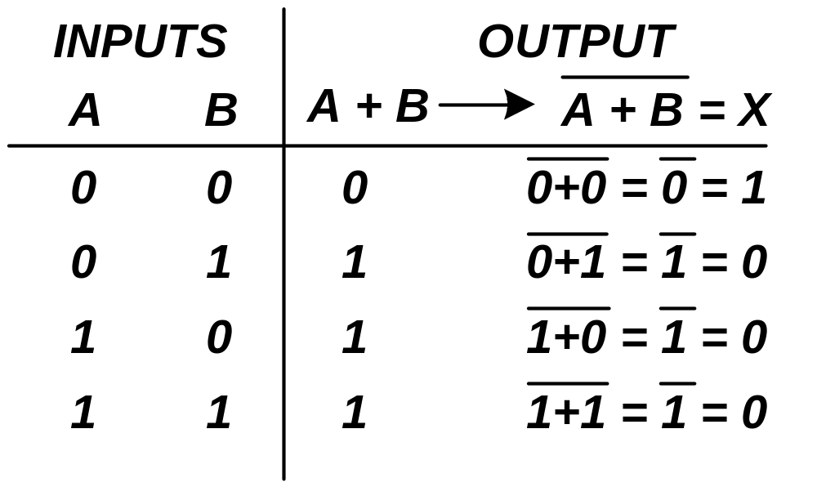
Logic expressions for NOR gate:
Boolean expression for NOR is a combination of OR and Inverter Boolean expressions.

Slide 30
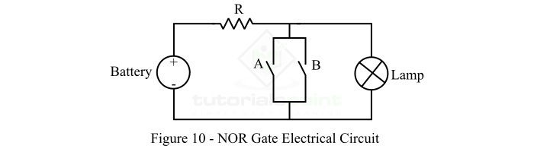
Electrical Analogy of NOR Gate
When A = 0 (open) and B = 0 (open), the current will pass through the lamp making it ON. Hence, the output Y = 1.
When A = 0 (open) and B = 1 (close), the current will pass through short-circuited path provided by the switch B and no current will flow through the lamp making it OFF. Hence, the output Y = 0.
When A = 1 (close) and B = 0 (open), the current will pass through short-circuited path provided by the switch A, and no current will flow through the lamp making it OFF. Hence, the output Y = 0.
When A = 1 (close) and B = 1 (close), the current will pass through short-circuited paths provided by switches A & B, and no current will flow through the lamp making it OFF. Hence, the output Y = 0.

Slide 31
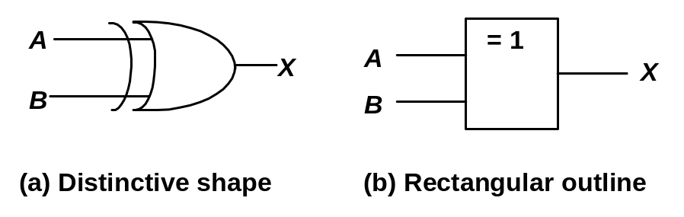
The Exclusive-OR gate
Combines basic logic circuits of AND, OR and Inverter. Has only 2 inputs.
Used as a universal gate
  Can be connected to form an adder that allows a computer to do perform addition, subtraction, multiplication and division in ALU (Arithmetic and Logic Unit).
  If both of the input are at the same logic level, then the output is LOW.
  If both of the input are at opposite logic levels, then the output is HIGH
Symbol used:

Slide 32
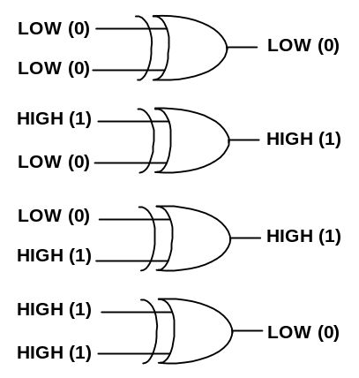
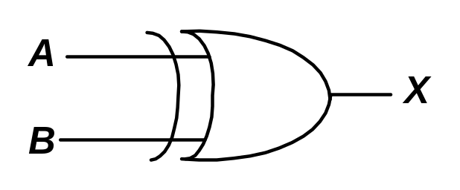
The XOR gate operation:

Slide 33
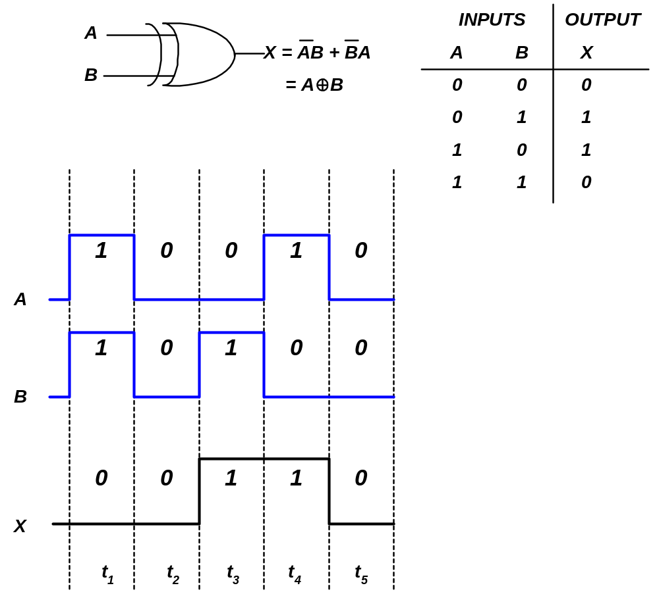

Slide 34
Home Assignment
Develop electrical analogy circuit For exclusive OR gate ?

Slide 35
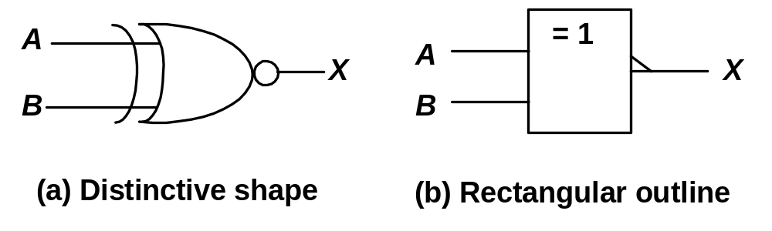
The Exclusive-NOR gate
Has only 2 inputs, but output of XNOR is the opposite of XOR.
  If both of the input are at the same logic level, then the output is HIGH.
  If both of the input are at opposite logic levels, then the output is LOW.
Symbol used:

Slide 36
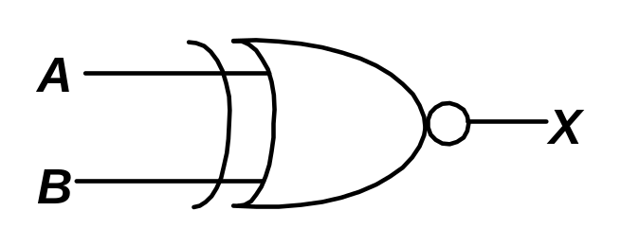
The XNOR gate operation:
LOW (0)
LOW (1)
LOW (0)
HIGH (1)
HIGH (0)
LOW (0)
LOW (0)
HIGH (0)
HIGH (1)
HIGH (1)
LOW (1)
HIGH (1)

Slide 37
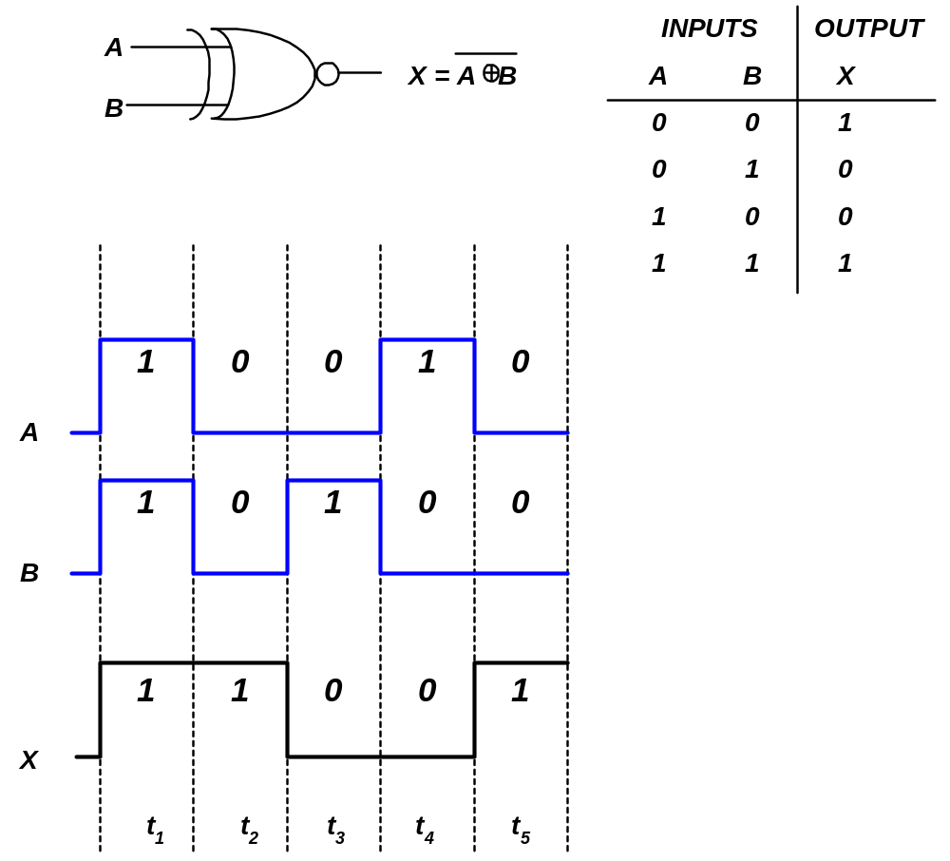

Slide 38
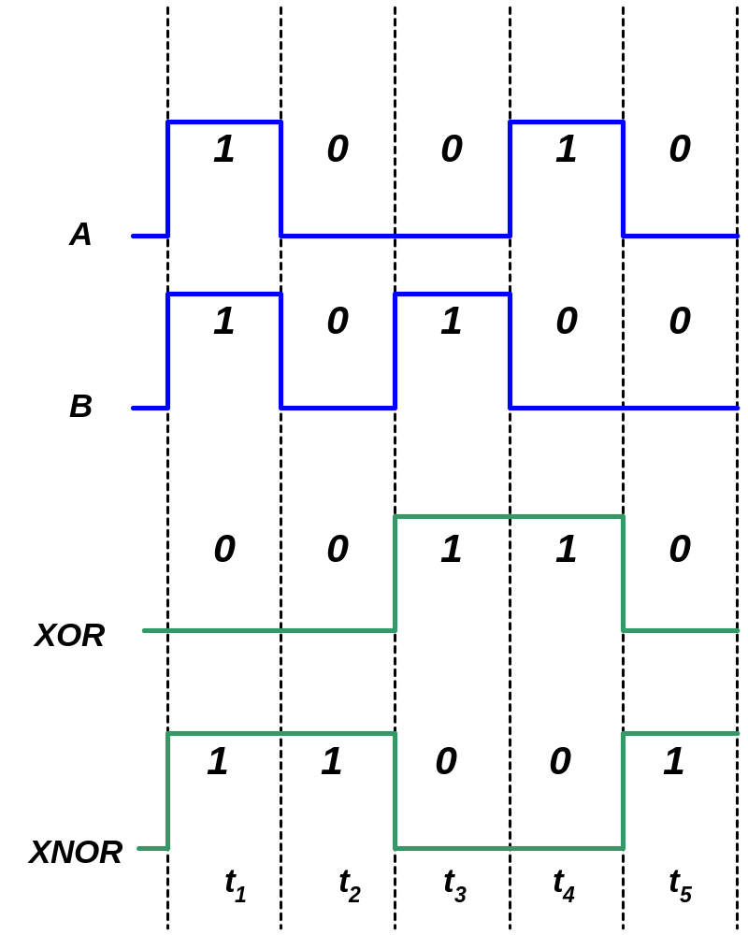
XOR vs XNOR

Slide 39
Fixed-function Logic : IC Gates
3 digital IC technologies used to implement basic logic gates:
  CMOS (Complementary Metal-Oxide Semiconductor)
  TTL (Transistor-Transistor Logic)
  ECL (Emitter-Coupled Logic)
CMOS and TTL is widely used
ECL is for more specialized applications

Slide 40
CMOS vs TTL
The logic operations of all gates are the same regardless of the IC technology used
CMOS and TTL differ only in the type of circuit components and value parameters; not in the basic logic operations.
  CMOS AND gate = TTL AND gate.

Slide 41
CMOS
Advantage:
  Lower power dissipation
There are 2 categories:
  5V & 3.3V
    Prefix : 74 and 54
      74 : commercial grade for general use
      54 : military grade for more severe environments

Slide 42
TTL
Advantage:
  Faster switching speed – CMOS is catching up
  Greater selection of device types
  Not sensitive to electrostatic discharge
All TTL operates on 5V and comes in 74 or 54 prefixes.
TTL Series:
  74 – Standard TTL
  74S – Schottky TTL
  74AS – Advanced Schottky TTL
  74LS – Low-power Schottky TTL
  74ALS – Advanced Low-power Schottky TTL
  74F – Fast TTL

Slide 43
Cont’d
All of the 74 series CMOS are pin-compatible with the same types of devices in TTL
Typical IC gate packages:
  Dual in-line package (DIP)
  Small-outline integrated circuit (SOIC)

Slide 44
THANK YOU!!

