Slide 1

Capstone 2
3 Point Shot Analysis
Presented by: Amanuel Tekle
6/8/2022

Slide 2
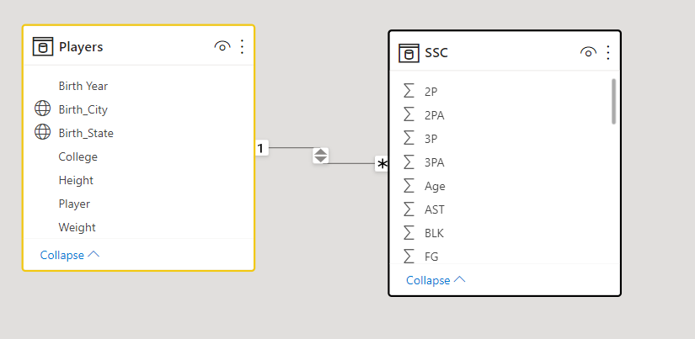
Dataset
NBA Players stats since 1950
Scraped from Basketball-reference.com
Aggregate individual statistics for 60+ NBA Seasons
Player information (Name, Weight, Height)
https://www.kaggle.com/datasets/drgilermo/nba-players-stats

Slide 3
Topic of Interest
Two Point Shot vs Three Point Shot: How Basketball Has Changed
How has the 3-point line changed the game of basketball?

Slide 4
Tools/Steps
Excel/ Juypter Notebook
Git Bash
Power BI

Slide 5
Stretch
Drill through options
Python Integration
Navigation buttons

Slide 6
Demo

Slide 7
Questions?

