Slide 1

Capstone 2
3 Point Shot Analysis
Presented by: Amanuel Tekle
6/8/2022

Slide 2
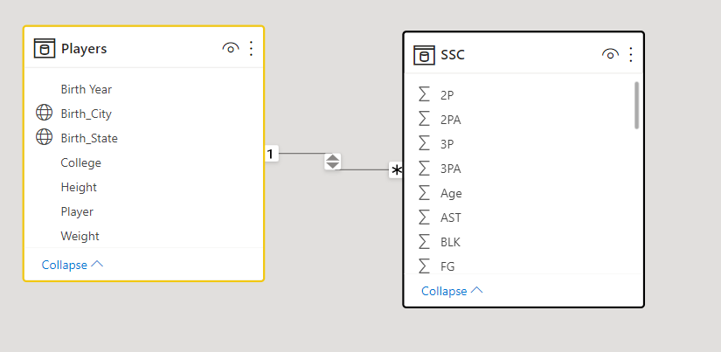
Dataset
NBA Players stats since 1950
Scraped from Basketball-reference.com
Aggregate individual statistics for 60+ NBA Seasons
Player information (Name, Weight, Height)
https://www.kaggle.com/datasets/drgilermo/nba-players-stats

Slide 3
Stretch
Drill through options
Python Integration
Navigation buttons

Slide 4
Demo

Slide 5
Questions?

