Slide 1
CROPS OF INDIA
Team members,
Name-Amanurrab , Reg no-220301120345
Branch- B.Tech (CSE)

Slide 2
Content:
Contribution
Introduction
Dataset Overview
Exploratory Data Analysis (EDA)
Main Crop Based On State
MAP
Crops of India Based on states
DashBoard
Conclusion
Reference

Slide 3
CONTRIBUTION:
Amanurrab :- Data preparation & Dataset , Visualisation and Graphs,
Ansh Raj :- PowerPoint , Visualisation,Dashboard Design, Research Paper Analysis
Subrat Kar :- Report in crops analysis , Research Paper Analysis , Final Editing and completion ,Graph Designing
Sohail Akhtar :- Result Analysis , Visualization and graphs , Research Paper Analysis
Anankan Ghos:- Literature Survey ,Project Report , Research Paper Analysis

Slide 4
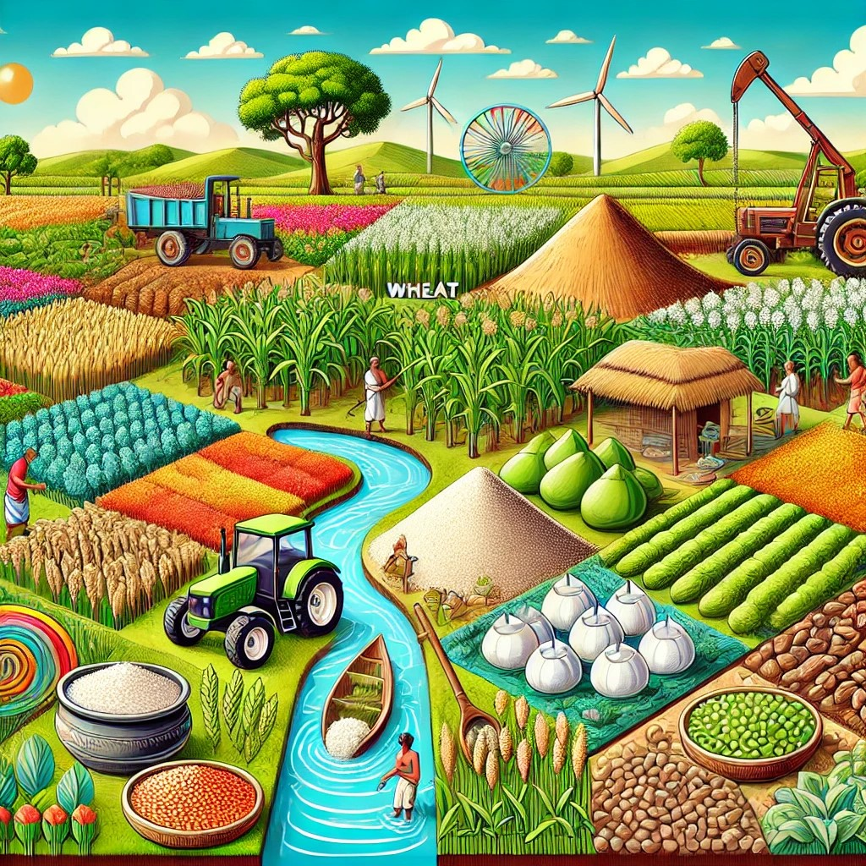
Introduction
Introduction:
Purpose of Analysis:
To explore the diversity, production patterns, and economic impact of major crops in India.
To identify trends and challenges in agriculture across regions.
Scope of Study:
Focus on major crops: Rice, Wheat, Sugarcane, Cotton, Pulses, etc.
Analysis of production, yield, geographical distribution, and market dynamics.

Slide 5
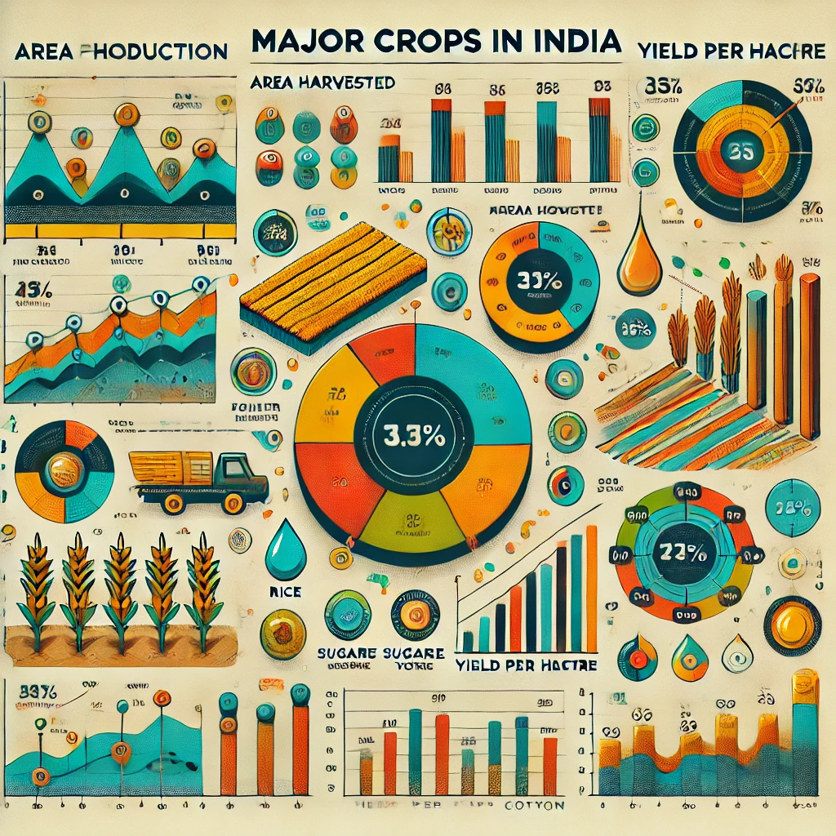
Dataset Overview
Dataset Description
This dataset contains key features for analyzing the production and distribution of major crops in India. Key features include:
Crop Details:
Crop Type: The type of crop (e.g., Rice, Wheat, Sugarcane, Cotton, Pulses).
Production Volume: Total production of each crop in metric tons.
Area Harvested: Land area used for cultivating each crop.
Yield per Hectare: Productivity of each crop (production per hectare).
Geographical and Environmental Factors:
Region/State: The state or region where the crop is grown.
Climatic Zone: Classification of region by climate (e.g., tropical, subtropical).
Soil Type: The soil type suitable for the crop (e.g., alluvial, black soil).
Agricultural Inputs:
Water Source: Main irrigation source (e.g., rainfall, groundwater, canal).
Fertilizer Usage: Amount of fertilizer applied to each crop type.
Data Cleaning and Preparation
Handling Missing Data:
Impute missing values based on regional averages or similar crop types.
Use interpolation for missing production or area values when possible.
Removing Duplicates:
Remove duplicate entries to avoid redundancy, especially in crop production by state.

Slide 6
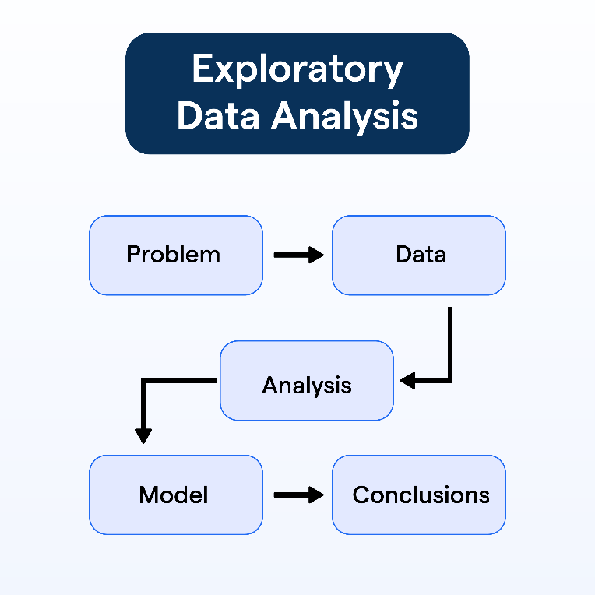
Exploratory Data Analysis (EDA
Exploratory Data Analysis (EDA) is a crucial initial step in data science projects. It involves analyzing and visualizing data to understand its key characteristics, uncover patterns, and identify relationships between variables refers to the method of studying and exploring record sets to apprehend their predominant traits, discover patterns, locate outliers, and identify relationships between variables.

Slide 7
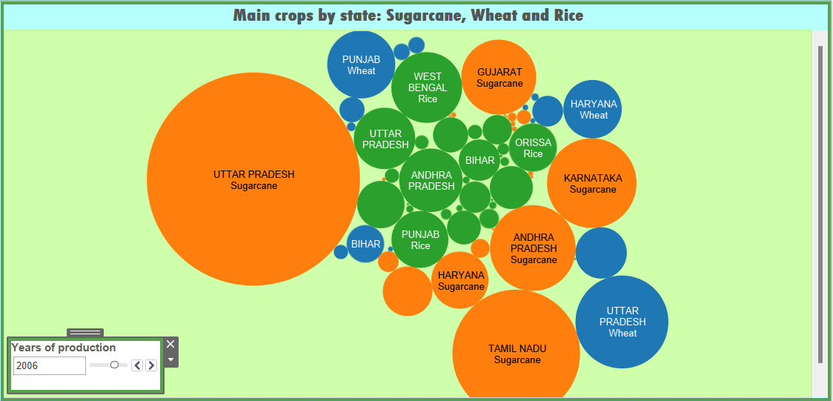
main crops by state
This visualization shows a bubble chart representing the main crops by state in India, focusing on Sugarcane, Wheat, and Rice. Each bubble corresponds to a specific crop and state, with:
Bubble Size: Represents the production level of the crop in a particular state. Larger bubbles indicate higher production.
Color Coding: Each crop is color-coded (e.g., orange for Sugarcane, blue for Wheat, green for Rice).
Key Observations:
Uttar Pradesh: Dominates in sugarcane production (largest orange bubble).
Punjab: Strong in wheat production (large blue bubble).
Bihar and Andhra Pradesh: Significant producers of rice.
Interactive Element: A slider allows filtering production data by the year (currently showing 2006).
.

Slide 8
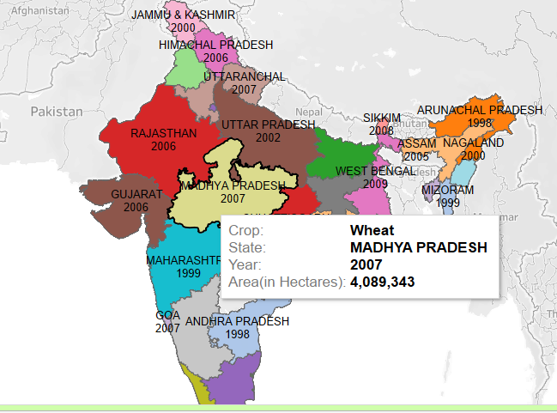
MAP
This choropleth map shows state-wise crop production in India, highlighting the crop type, year, and cultivated area. For example, in Madhya Pradesh (2007), Wheat was grown over 4,089,343 hectares. Each state is color-coded, with interactive tooltips providing details for specific crops and years. It helps analyze the geographic distribution of crops and identify leading states in agricultural production..

Slide 9
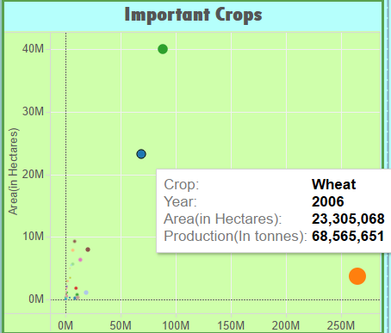
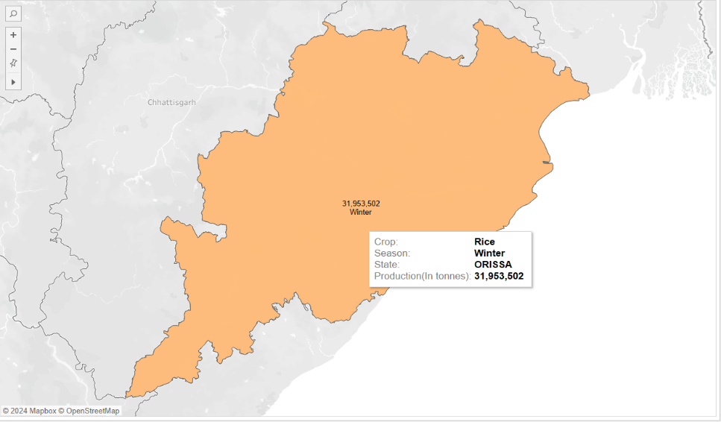
Crops of india based on state chart:
Important crops in india . :
Main Crops by States :-Sugarcane,Wheat and Rice
Rice in winter(Orissa) :
All Crops based on Each States :

Slide 10
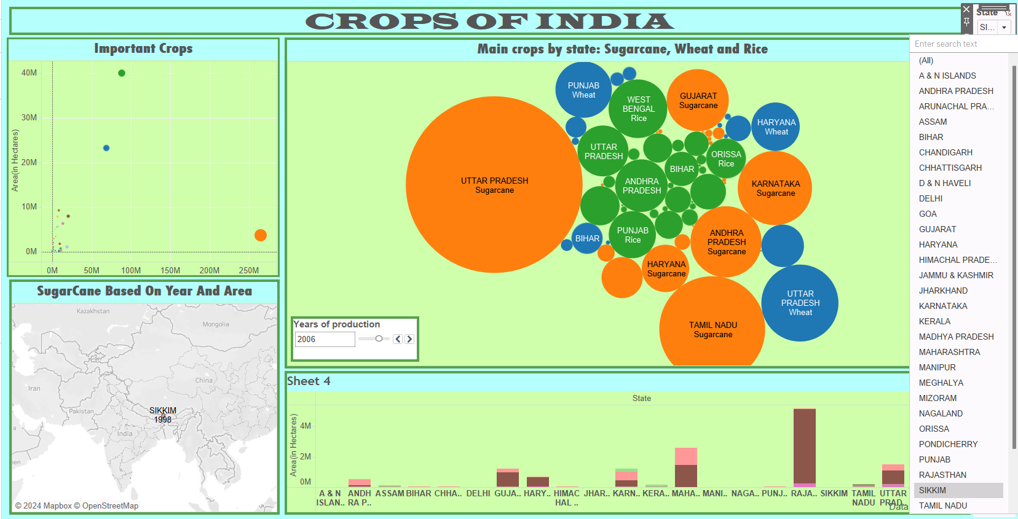
SHOW THE DASHBOARD:

Slide 11
Conclusion
India grows many types of crops because of its varied climate, which supports many people's jobs and the economy. Using better farming methods and technology can help us grow more food and protect the environment for the future.

Slide 12
Reference
Ministry of Agriculture & Farmers Welfare, Government of India The Ministry’s website provides comprehensive data on crop production, agricultural practices, and policies in India. https://agricoop.nic.in
Food and Agriculture Organization of the United Nations (FAO) FAO publishes reports and data on agriculture in India, covering crop diversity, food security, and sustainable practices. https://www.fao.org
National Statistical Office (NSO), India The NSO offers detailed statistics and surveys related to agriculture, production, and employment in the sector. https://mospi.gov.in
Indian Council of Agricultural Research (ICAR) ICAR conducts research on various crops and farming practices and provides updates on agricultural innovations in India. https://icar.org.in
World Bank Agriculture Data The World Bank’s data portal includes agricultural data and reports relevant to India, including crop production and rural development. https://data.worldbank.org

Slide 13
Thank You

