Slide 1
ESE 3014 Embedded System Communication Protocol and Security
Linchen Wang

Slide 2
Digital signal system
Information source
& Input transducer
Source encoder
Channel
encoder
Digital
modulator
Reduce redundancy
Add redundancy
Shift keying
Channel
Output transducer
& Output signal
Source decoder
Channel
decoder
Digital
demodulator

Slide 3
Channel
Physical media that do transmission
We choose five different channels for special attention, Telephone channels, Twisted-pair, Optical fibers, Mobile radio channels, and Satellite channels.
They play important roles in today’s communication environment.

Slide 4
Telephone channel
It uses a switching mechanism called circuit switching to establish an end – to – end communication link on a temporary basis.
The primary purpose of the network is to ensure that the telephone transmission between a speaker at one end and a listener at the other end.
In this form, message source is : sound from speaker’s voice to listener’s ear.
Transducer: a microphone is placed near speaker’s mouth to convert sound waves into an electrical signal. And a moving – coil receiver is placed near listener’s ear to convert electrical signal back into acoustic form.

Slide 5
Telephone channel
Nowadays, these transducer can respond well to frequencies from 20 to 8000 Hz
The telephone channel is essentially a linear, bandwidth – limited channel.
A speech signal is essentially limited to a band from 300 to 3100 Hz, and frequencies outside this band range do not contribute much to articulation efficiency.

Slide 6

Telephone channel
E.g. Call someone and play 1000Hz, 2000Hz, and 3000Hz from a computer, the person will be able to hear that tone. However, the person will have trouble to hear 4000Hz sound, and will not hear anything in 5000Hz and 6000 Hz. That is because telephone channel “clips” them.
And that is why someone’s voice on a telephone channel is different from face - to - face communication.

Slide 7
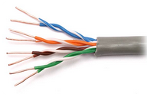
Twisted-pair
It is the ordinary copper wire that connects home and many business computers to the telephone company.
To reduce crosstalk or electromagnetic induction between pairs of wires, two insulated copper wires are twisted around each other. Each connection on twisted pair requires both wires.

Slide 8
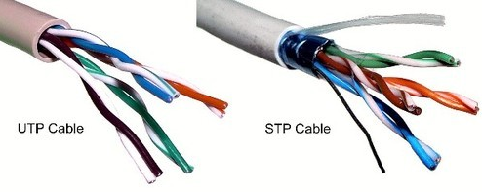
Twisted-pair
For some business locations, twisted pair is enclosed in a shield that functions as a ground. This is known as shielded twisted pair (STP). Ordinary wire to the home is unshielded twisted pair (UTP).

Slide 9
Twisted-pair
Category 1—Used for telephone communications. Not suitable for transmitting data.
Category 2—Capable of transmitting data at speeds up to 4 megabits per second (Mbps).
Category 3—Used in 10BASE-T networks. Can transmit data at speeds up to 10 Mbps.
Category 4—Used in Token Ring networks. Can transmit data at speeds up to 16 Mbps.
Category 5—Can transmit data at speeds up to 100 Mbps.
Category 5e —Used in networks running at speeds up to 1000 Mbps (1 gigabit per second [Gbps]).

Slide 10
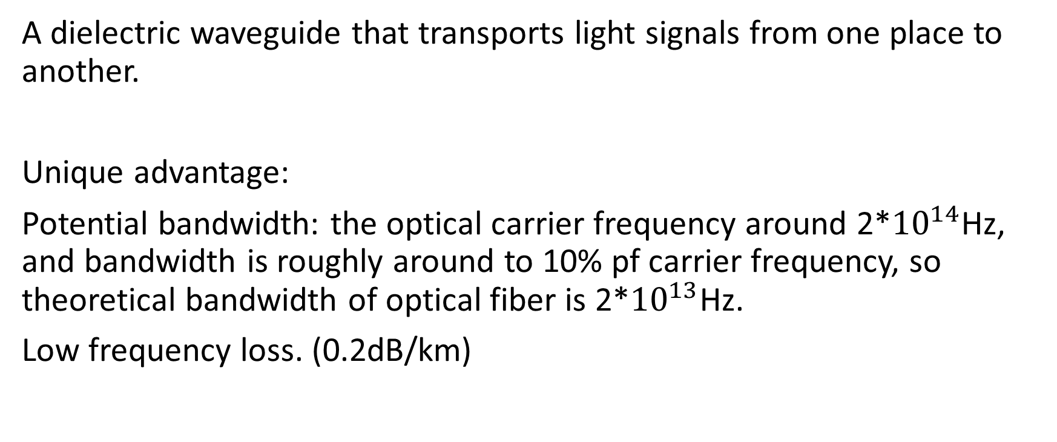
Optical fiber
A dielectric waveguide that transports light signals from one place to another.
Unique advantage:
Potential bandwidth: the optical carrier frequency around 2*${10}^{14}$Hz, and bandwidth is roughly around to 10% pf carrier frequency, so theoretical bandwidth of optical fiber is 2*${10}^{13}$Hz.
Low frequency loss. (0.2dB/km)

Slide 11
Optical fiber
Immunity to electromagnetic interference: a characteristic of optical fiber as a dielectric waveguide.
Small size and weight: a diameter no greater than human hair.
Ruggedness and flexibility: high tensile strengths and possibility of being bent or twisted without damage.
Low cost: silica glass made from sand, unlike cable used in metallic conductor.

Slide 12


Optical fiber
Multi mode fiber (MMF) and Single mode fiber (SMF). The diameter of MMF is bigger than SMF (SMF can be um). So the cost of SMF is higher than MMF, as we need semiconductor laser unit to send pulse in SMF, whereas we only need luminous diode in MMF.
In the transmission, the angle of the MMF light is larger, so it tends to decay. However, the transmission distance of SMF is much longer (10-70 km).
MMF
SMF

Slide 13
Mobile radio channel
It extends the capability of the public telecommunications network by introducing mobility into the network.
There may be a multitude propagation paths with different electrical lengths, and their contributions to the received signal could combine in a variety of ways.
So, a mobile channel may be viewed as a linear time-varying channel.

Slide 14
Satellite channel
It provides broad – area coverage communication.
Two requirements:
1. satellite should keep an altitude of 22,300 miles, and it is geosynchronous with each station.
2. It is placed directly above the equator (no any angle).
So earth station do not have to track the satellite, and just point its antenna along a fixed direction.

Slide 15
Satellite channel
Broad – area coverage.
Reliable transmission links.
Wide transmission bandwidth. 6GHz uplink and 4 GHz downlink
A typical satellite is assigned a 500 MHz bandwidth and is divided among 12 transponders. Each transponder using approximately 36 MHz of satellite bandwidth. That can carry at least one color TV signal, 1200 voice circuits or digital data at rate of 50mb/s.

