Slide 1
ESE 3014 Embedded System Communication Protocol and Security
Linchen Wang

Slide 2
Electrical communication systems are designed to send message or information from a source to one or more destinations.
Information source
Input transducer
Transmitter
Channel
Output
signal
Output
transducer
Receiver

Slide 3
Transducer: It converts the output of a source into an electrical signal that is suitable for transmission.
E.g. A microphone serves as the transducer that converts voice (acoustic speech) into an electrical signal.
A video camera converts an image into an electrical signal.
At the output transducer, it converters the electrical signals to a form suitable of users.

Slide 4
Transmitter: It converts the electrical signal into a form that is suitable for transmission through the physical channel.
E.g. in radio and TV broadcast, the FCC (Federal Communications Commission) specifies the frequency range for each transmitting station.
So, transmitters must translate information signal into the appropriate frequency range, and multiple radio stations would not interfere with each other.
Similar functions in mobile communication system.

Slide 5
Mobile communication companies in Canada
MVNO
(7-11 Petro-Canada)
(postpaid) PC (prepaid)
Onstar Execulink
Rogers
Telus
Bell
Subsidiaries
Fido
Chatr
Koodo
Public Mobile
Virgin
UMTS
In NA
Band 5 850MHZ 824 – 849 Up 869 – 894 Down
Band 2 1900MHZ 1850 – 1910 Up 1930 – 1990 Down
Freedom Mobile Band 4 1700MHZ 1710 – 1755 Up 2110 – 2155 Down

Slide 6
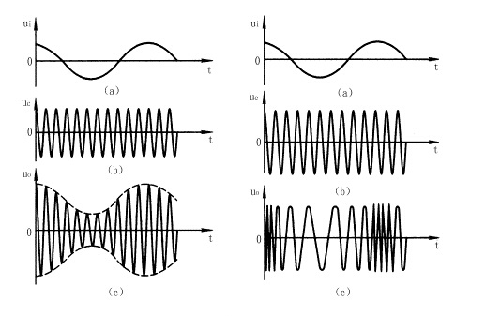
In transmitter, it can match the message signal to the channel and that is called modulation.
- Amplitude Modulation (AM) : the information signal is contained in amplitude variations. (535-1705 KHZ)
- Frequency Modulation (FM) : the information signal is contained in frequency variations. (88-108 MHZ)
Original Signal
Carrier Signal
AM
FM

Slide 7
Channel: the physical medium that is used to send the signal from transmitter to receiver
Wirelines: optical fiber, cable
Wireless: electromagnetic wave, micro wave
Additive signal distortion: noise
a) man-made: automobile ignition
b) natural: lightning in thunderstorms
Non-additive signal distortion: fading

Slide 8
The receiver: it recovers the message signal contained in the received signal.
In may contain demodulation, filtering, or noise suppression

Slide 9
In the system above, we assume message signal is a continuous time varying waveform, we refer that continuous-time signal as analog signal, and the information source as analog source. So we can call this communication system an analog communication system.
On the other hand, an analog source output can be converted into a digital form, and message can be transmitted via digital modulation and demodulation.
But why we need to convert analog into digital?

Slide 10
Reason:
1. The signal fidelity is better in digital transmission than analog transmission. In long-term transmission, digital transmission allows us to regenerate the digital signal in each regenerate point; however, in analog transmission, noise is amplified with signal when amplifiers are used periodically to boost the signal.
2. analog signal may be highly redundant.
3. digital communication system are often cheaper to implement.

Slide 11
Digital signal system
Information source
& Input transducer
Source encoder
Channel
encoder
Digital
modulator
Channel
Output transducer
& Output signal
Source decoder
Channel
decoder
Digital
demodulator

Slide 12
Source: It may be either analog signal e.g. audio, video
Or digital signal e.g. output of computer
In source encoder: we seek an efficient representation of the source output (eliminate redundancy) that results in little or no redundancy, so encoder convert the output either analog or digital source into a sequence of binary digits. This is called encoding or compression.

Slide 13
In channel encoder: add some redundancy to overcome the effects of noise and interference in the transmission.
Channel encoder
Noise
Say apple
a a p p p p l l e e
a ? p ? p ? ? l ? e
a p p l e
There are two ways to ensure information communication:
1. increase signal/noise ratio
2. add redundancy.

Slide 14
In digital encoder: map the binary information sequence into signal waveforms. It means use different waveforms to represent different bit information.
Say we want to play a melody with four tones (00, 01 ,10 ,11). We play 100 tones per second, so the symbol rate is 100 symbol or baud/s, each tone is represented by two bits. Which bit rate is 200 bit/s

Slide 15
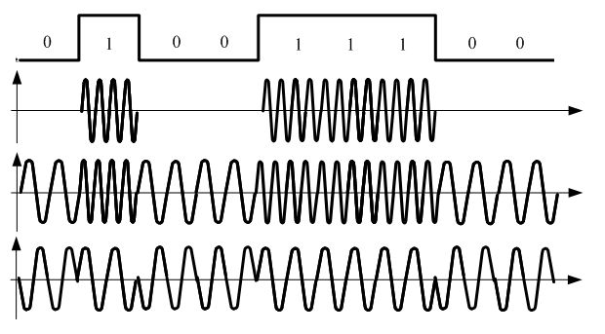
We use shift keying in digital encoder.
ASK (Amplitude shift keying)
FSK (Frequency shift keying)
PSK (Phase shift keying)

Slide 16
Digital decoder: Process waveform to data symbol.
Channel decoder: Determine and pick up the signal we want from a lot of signals we get.
Source decoder: Attempts to reconstruct the original signal from the source.

