Slide 1
ESE 3014 Embedded System Communication Protocol and Security
Linchen Wang

Slide 2
Review
The Serial Peripheral Interface (SPI) bus is a fast, full duplex synchronous serial data link.
It can transmit and receive data at the same time.
SPI communication takes place between a single master device and one or more slave devices

Slide 3
UART
UART(Universal Asynchronous Receiver/Transmitter), it is a microprocessor peripheral device used for the serial transfer of data , one bit at a time, between two electronic devices. UARTs were originally standalone ICs, but now are often integrated with the host microprocessor/microcontroller.

Slide 4
UART
A UART is not, a strictly speaking bus, but its capacity to implement serial data communications overlaps with similar capacities with I2C and SPI. It is described as asynchronous because the sender does not have to send a clock signal to synchronize the transmission, rather a communication structure is agreed upon that uses start and stop bit to synchronize the transmission of data.

Slide 5
UART
No clock = only two signal lines.
Just like a regular telephone line, the transmit data connection (TXD) from one end is connected to the receive data connection (RXD) on the other end of connection.

Slide 6
UART
Normally, UARTs have been used with level converters/ line drivers to implement such as RS-232 or RS-485, but for short-distance communications, it is possible to use the original logic level for the UART outputs and inputs to enable two UART to communicate with each other.

Slide 7
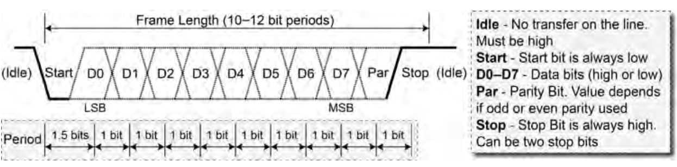
UART
In UART, transmission begins when the transmitter sends a start bit (logic low) on the receiver’s end, the falling edge of the start bit is detected and then after 1.5 bit periods, the first bit value is sampled. Every subsequent bit is sampled after 1.0 bit period, until the agreed upon number of bits is transferred. (normally seven or eight).

Slide 8
UART
The parity bit is optional, if used, it can identify whether a transmission error has occurred. Finally, one stop bit is sent, which is always a logic high. This is a standard 8N1 form, means that 8 bits are sent in each frame.

Slide 9
UART
Baud rate: Data transfer rate. There are the following: 300, 600, 1200, 2400, 4800, 9600, 19200, 38400, 43000, 56000, 57600, 115200. On both sides of data transmission and reception, the baud rate needs to be unified in advance in order to transmit data correctly.

Slide 10
UART
BBB UART Header Pins
We use UART4 of BBB. We can test UART4 by loopback (wiring) P9_11 to P9_13 “talking to itself”. Once the wiring is complete, the UART4 overlap is loaded in order to enable UART.
 | UART1 | UART2 | UART3 | UART4 | UART5
TXD | P9_24 (0) | P9_21 (1) | Not exposed | P9_13 (6) | P8_37 (4)
RXD | P9_26 (0) | P9_22 (1) | Not exposed | P9_11 (6) | P8_38 (4)

Slide 11
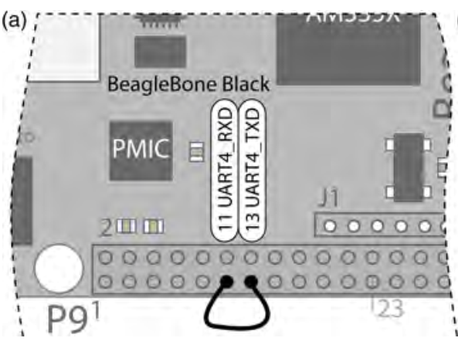
UART
P9_13 UART4_TXD: Output that transmits data to a receiver
P9_11 UART4_RXD: Input that receives data from a transmitter

Slide 12
UART
When the overlay is loaded, the contents of the /dev directory now includes a new entry for ttyO4 (letter O, not zero).
The first human computer interface was the teletypewriter, also known as the teletype or TTY, an electromechanical typewriter that can be used to send and receive messages. It is still in use today.
This “teletype” (terminal) device, which is a software interface that enables you to send and receive data. On the UART we can check the available terminal devices:
/dev$ ls ttyO*
ttyO0 ttyO4

Slide 13
UART
By using minicom:
∼$ minicom ‐b 9200 ‐o ‐D /dev/ttyO4
Port /dev/ttyO4
Press CTRL-A Z for help on special keys
Type Ctrl+A followed by Z and then E to turn on local Echo. Now, whichever key you press is transmitted from the TXD output, and is also echoed on the console. When the character is received on the RXD input, it is then displayed on console. So if you can see the characters you typed appearing twice, that means UART working correctly.

Slide 14
Arduino UART
Arduino is a popular, lowcost, and powerful microcontroller that can be a very useful companion controller for the BBB.
You can find some videos on exploringbeaglebone website on getting started with Arduino
I post the link of GitHub for the programming environment (BBBSerialEcho.ino) for Arduino on your moodle.

Slide 15
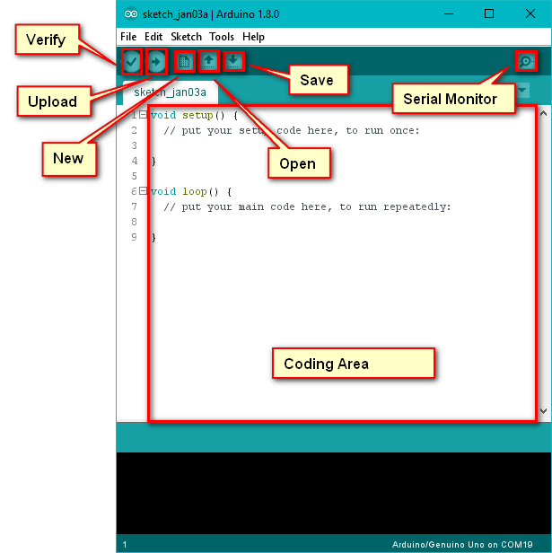
Arduino UART
The setup() function is called once when the program is started. It configures the serial port to use a baud rate with a 8N1 format.
The loop() function will repeat as fast as it possible.
Serial Monitor Window can be opened in the Arduino development environment by pressing the button in the top right-hand corner.

Slide 16
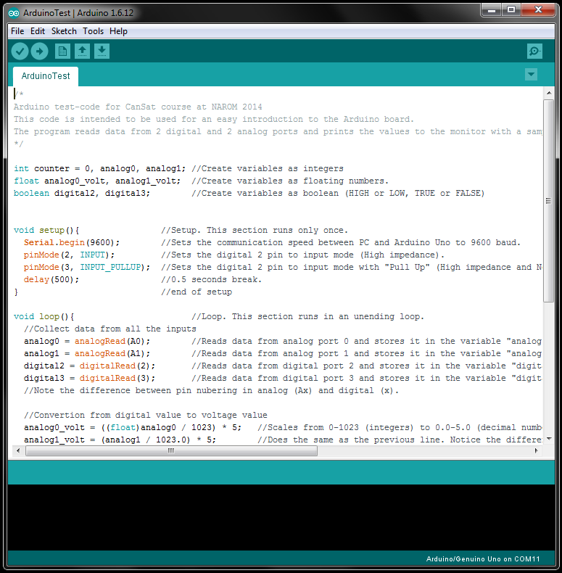
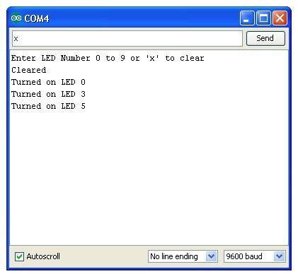
Arduino UART
Choose the baud rate that corresponds in the program. When a string is entered in the text field and the send button is pressed, the string is sent to the Arduino and the response should display in the text area.

Slide 17
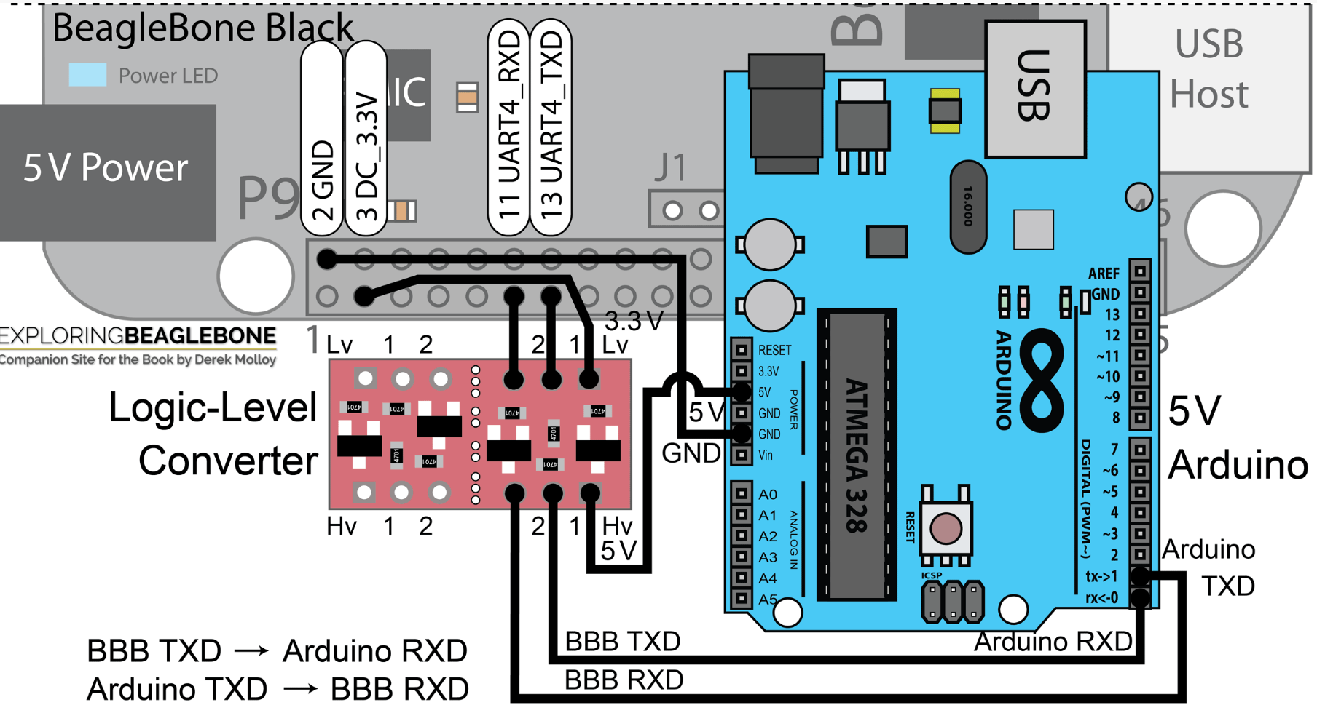
Arduino UART
BBB 3.3V supply, TXD, and RXD are connected to lv, 1, 2. And on the other side of converter, Arduino 5V supply, RXD, TXD is connected to hv, 1, 2.

