Slide 1
ESE 3014 Embedded System Communication Protocol and Security
Linchen Wang

Slide 2
Review
Error correction
1. Automatic report request (ARQ)
2. Forward error correction (FEC)
Authentication is the process of verifying that somebody really is who he claims to be.
Authorization is the process of verifying you are allowed security level to do something.

Slide 3
Review
Cryptography
symmetric cryptography & asymmetric cryptography

Slide 4
Outline
Man in the middle attack (MITM)
Authentication
RSA cryptography
Generate RSA keys

Slide 5
Communication security
Man in the middle attack (MITM)
The attacker secretly relays and possibly alters the communication between two parties who believe they are directly communicating with each other.
A's key
A
B
B's key
A's key
C's key
C's key
B's key
C

Slide 6
Man in the middle attack (MITM)
1. A sends a message to B, which is intercepted by C:
A "Hi B, it is A, please give me your key" → C B
2. C relays this message to B, and B can't tell it is not real from A:
A C "Hi B, it is A, please give me your key" → B
3. B responds with his encryption key:
A C ← [B's key] B

Slide 7
Man in the middle attack (MITM)
4. C replaces B's key with his own key, and relays it to A, claiming it is B's key:
A ← [C's key] C B
5. A encrypts a message with A believes to be B's key, thinking that only B can read it:
A "Meet me at the bus station" → C B
6.However, since it was actually encrypted with C's key, C can decrpyt it, and even modify it by re-encrypting with B's key, and forward to B:
A C "Meet me at the van in backstreet" → B

Slide 8

How to prevent MITM?
Sealing wax?
Digital signature and digital certificate
In encryption, we use public key to encrypt, and private key to decrypt. Here we should use authentication, which use private key to encrypt, and public key to decrypt.

Slide 9


Authentication
1. A want to sent a letter to B, A uses Hash function to get a digest $α$.
2. A encrypts the digest with his private key, get a digital signature.
3. A appends this signature to his letter and sents it to B.
Private key
Digest$α$
Signature
....
...............................................................................................
append
Signature
Sign

Slide 10



Authentication
4. After B receives the letter, B uses A's public key to decrypt signature, and get digest $α$. And B will also Hash the letter to get another digest $β$, and compares these two digests.
If they are same, means the letter has not be modified.
....
........................................................................................................................
Hash
Digest $β$
?
A's public key
Sign
Digest $α$

Slide 11
Authentication
Now, things could be complex, say C used B's computer, and replaces A's public key with C's own key. B thinks he is using A's public key, but actually it is C's own key. So C can pretend A, uses his private key to make digital signature, and let B uses "A's key" (truth is C's key) to decrypt.
And now, we need a Certificate Authority, known as CA to authenticate somebody really is who he claims to be.
This CA must be a trusted well-known institution. Like a bank.

Slide 12
Authentication
1. A can go to CA and upload his public key to CA in person.
2. CA encrypt A's public key with his own private key, and get a digital certificate.
A's Info
...................
Certificate Info
...................
A's Public key
Digital Certificate
CA's private key

Slide 13
Authentication
3. A sents letter to B, appends both his signature and digital certificate to the letter.
......
......................................................................................................................................................................................................................................................
Digital Certificate
Sign

Slide 14
Authentication
4. Since CA is trusted and well-known, B has CA's public key when B installed IE (Internet Explorer), these CA's public keys are embedded in those communiation program.
5. B receives letter, he uses CA's public key to decrypt digital certificate and gets A's public key, this key can proof does digital signature is really from A.
Digital certificate
CA's public key
A's public key
Decrypt sign
Digest

Slide 15
RSA cryptography
Asymmetric cryptographic algorithm
1. A, B have two pairs of key, public keys and private keys.
2. If A sends message to B, B should give his public key to A;
3. A uses B’s public key to encrypt the message and sends it to B;
4. B receives encrypted message, and uses his private key to decrypt it.

Slide 16
RSA cryptography
Prime number: they are integers greater than 1 that have no positive divisors other than 1 and themselves.
2, 3, 5, 7, 11, 13, 17, 19, 23, 29, 31, 37, …

Slide 17
RSA cryptography
Coprime (relatively prime): Two integers are said to be coprime if the only positive divisor of them is 1.
Their greatest common divisor (gcd) is 1.
E.g. 15 and 32 have no common factor except 1, so they are coprime.
14 and 21 have common factor 7 and 1, so they are not coprime.

Slide 18
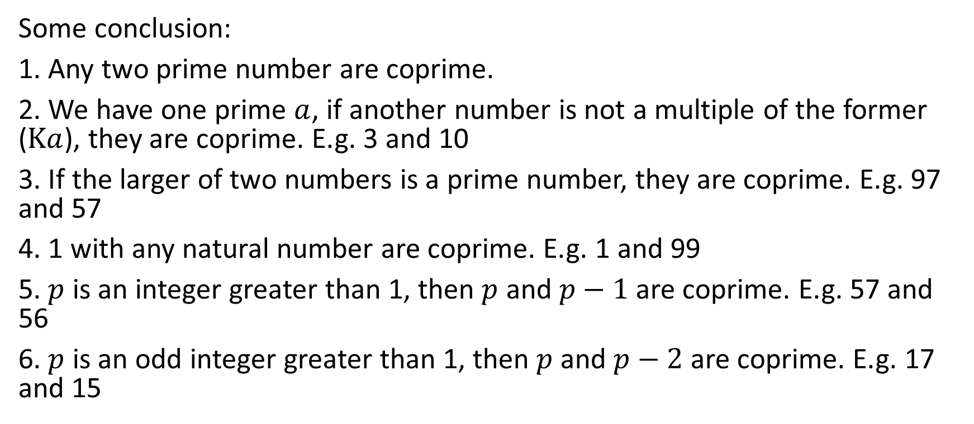
RSA cryptography
Some conclusion:
1. Any two prime number are coprime.
2. We have one prime $a$, if another number is not a multiple of the former ($Ka$), they are coprime. E.g. 3 and 10
3. If the larger of two numbers is a prime number, they are coprime. E.g. 97 and 57
4. 1 with any natural number are coprime. E.g. 1 and 99
5. $p$ is an integer greater than 1, then $p$ and $p−1$ are coprime. E.g. 57 and 56
6. $p$ is an odd integer greater than 1, then $p$ and $p−2$ are coprime. E.g. 17 and 15

Slide 19
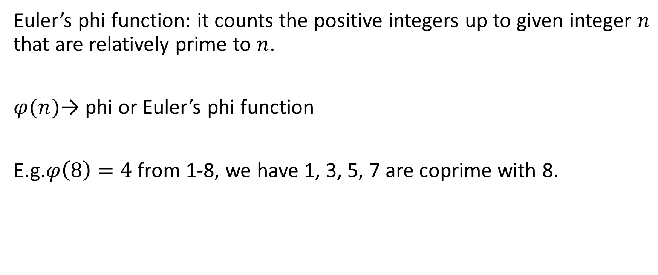
RSA cryptography
Euler’s phi function: it counts the positive integers up to given integer $n$ that are relatively prime to $n$.
$φ(n)$→ phi or Euler’s phi function
E.g.$φ\left(8\right)=4$ from 1-8, we have 1, 3, 5, 7 are coprime with 8.

Slide 20
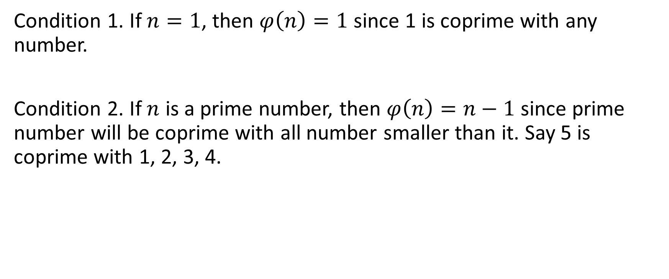
RSA cryptography
Condition 1. If $n=1$, then $φ\left(n\right)=1$ since 1 is coprime with any number.
Condition 2. If $n$ is a prime number, then $φ\left(n\right)=n−1$ since prime number will be coprime with all number smaller than it. Say 5 is coprime with 1, 2, 3, 4.

Slide 21
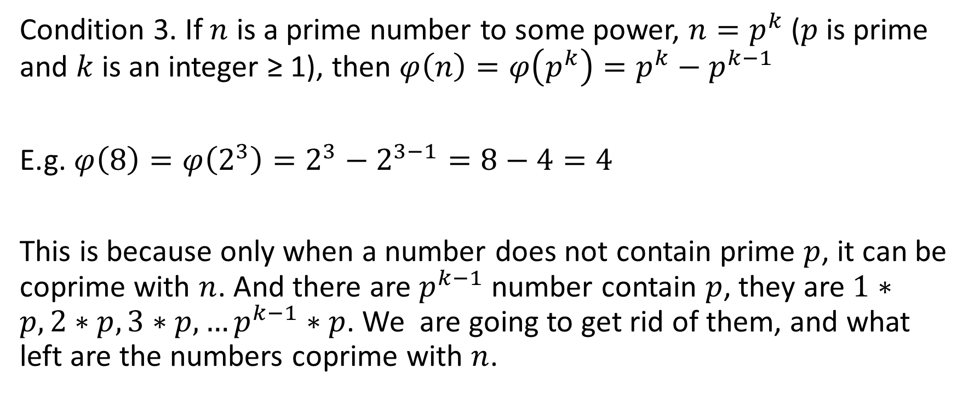
RSA cryptography
Condition 3. If $n$ is a prime number to some power, $n=p^{k}$ ($p$ is prime and $k$ is an integer ≥ 1), then $φ\left(n\right)=φ\left(p^{k}\right)=p^{k}−p^{k−1}$
E.g. $φ\left(8\right)=φ\left(2^{3}\right)=2^{3}−2^{3−1}=8−4=4$
This is because only when a number does not contain prime $p$, it can be coprime with $n$. And there are $p^{k−1}$ number contain $p$, they are $1∗p, 2∗p, 3∗p,…p^{k−1}∗p$. We are going to get rid of them, and what left are the numbers coprime with $n$.

Slide 22
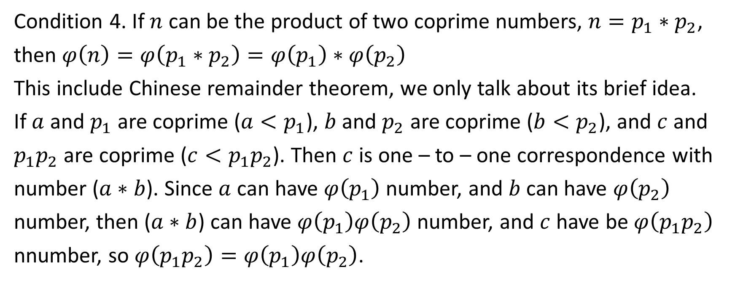
RSA cryptography
Condition 4. If $n$ can be the product of two coprime numbers, $n=p_{1}∗p_{2}$,
then $φ\left(n\right)=φ\left(p_{1}∗p_{2}\right)=φ\left(p_{1}\right)∗φ\left(p_{2}\right)$
This include Chinese remainder theorem, we only talk about its brief idea.
If $a$ and $p_{1}$ are coprime ($a<p_{1}$), $b$ and $p_{2}$ are coprime ($b<p_{2}$), and $c$ and
$p_{1}p_{2}$ are coprime ($c<p_{1}p_{2}$). Then $c$ is one – to – one correspondence with
number ($a∗b$). Since $a$ can have $φ\left(p_{1}\right)$ number, and $b$ can have $φ\left(p_{2}\right)$
number, then ($a∗b$) can have $φ\left(p_{1}\right)φ\left(p_{2}\right)$ number, and $c$ have be $φ\left(p_{1}p_{2}\right)$
nnumber, so $φ\left(p_{1}p_{2}\right)=φ\left(p_{1}\right)φ\left(p_{2}\right)$.

Slide 23
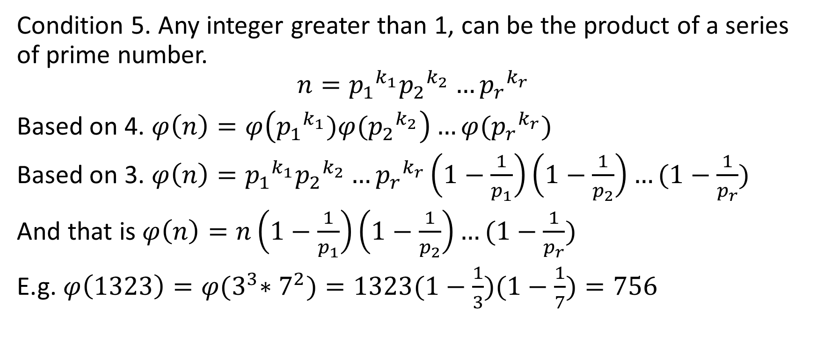
RSA cryptography
Condition 5. Any integer greater than 1, can be the product of a series of prime number.
$$n={p_{1}}^{k_{1}}{p_{2}}^{k_{2}}…{p_{r}}^{k_{r}}$$
Based on 4. $φ\left(n\right)=φ\left({p_{1}}^{k_{1}})φ({p_{2}}^{k_{2}}\right)…φ({p_{r}}^{k_{r}})$
Based on 3. $φ\left(n\right)={p_{1}}^{k_{1}}{p_{2}}^{k_{2}}…{p_{r}}^{k_{r}}\left(1−\frac{1}{p_{1}}\right)\left(1−\frac{1}{p_{2}}\right)…(1−\frac{1}{p_{r}})$
And that is $φ\left(n\right)=n\left(1−\frac{1}{p_{1}}\right)\left(1−\frac{1}{p_{2}}\right)…(1−\frac{1}{p_{r}})$
E.g. $φ\left(1323\right)=φ{(3}^{3}∗7^{2})=1323(1−\frac{1}{3})(1−\frac{1}{7})=756$

Slide 24
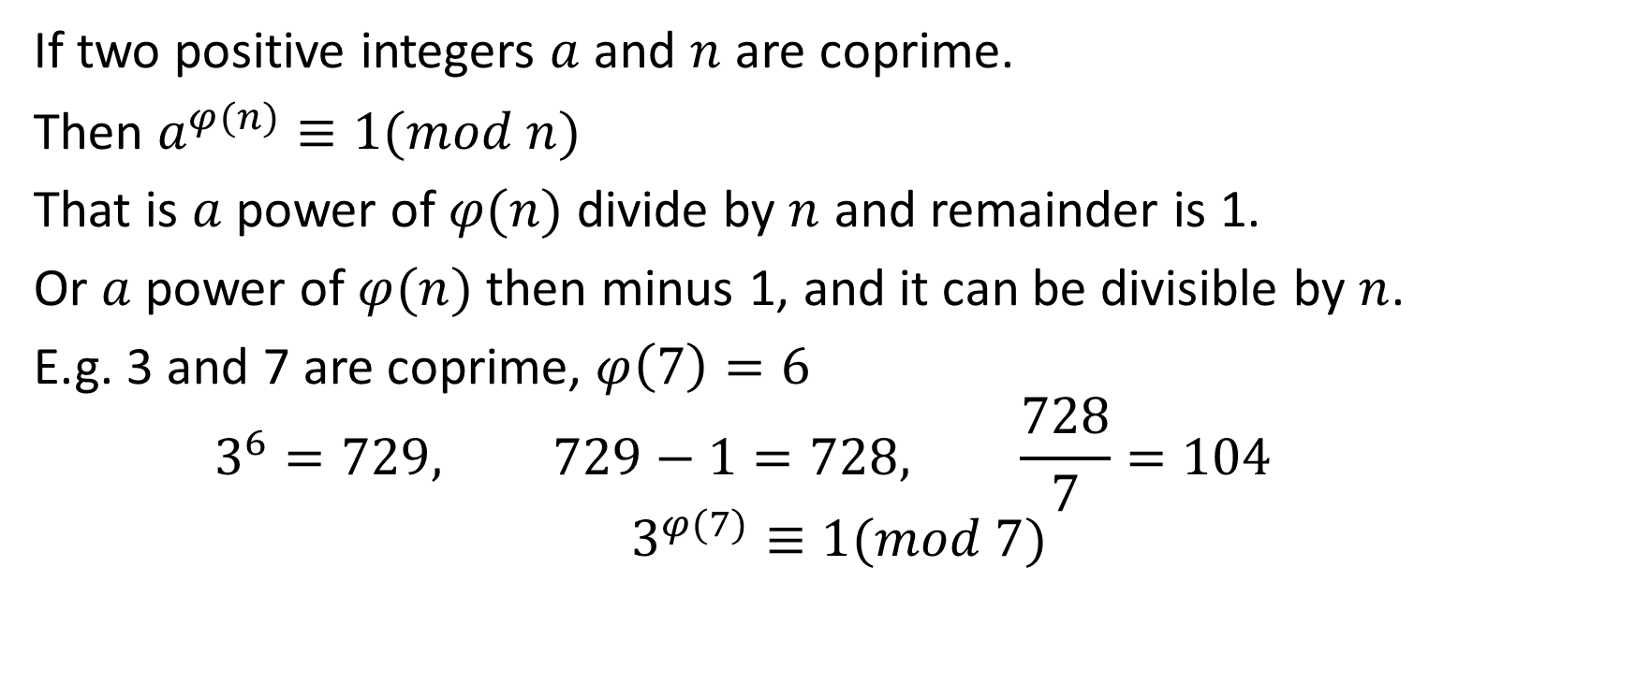
Euler’s theorem
If two positive integers $a$ and $n$ are coprime.
Then $a^{φ(n)}≡1(mod n)$
That is $a$ power of $φ(n)$ divide by $n$ and remainder is 1.
Or $a$ power of $φ(n)$ then minus 1, and it can be divisible by $n$.
E.g. 3 and 7 are coprime, $φ\left(7\right)=6$
$$3^{6}=729, 729−1=728, \frac{728}{7}=104$$
$$3^{φ(7)}≡1(mod 7)$$

Slide 25
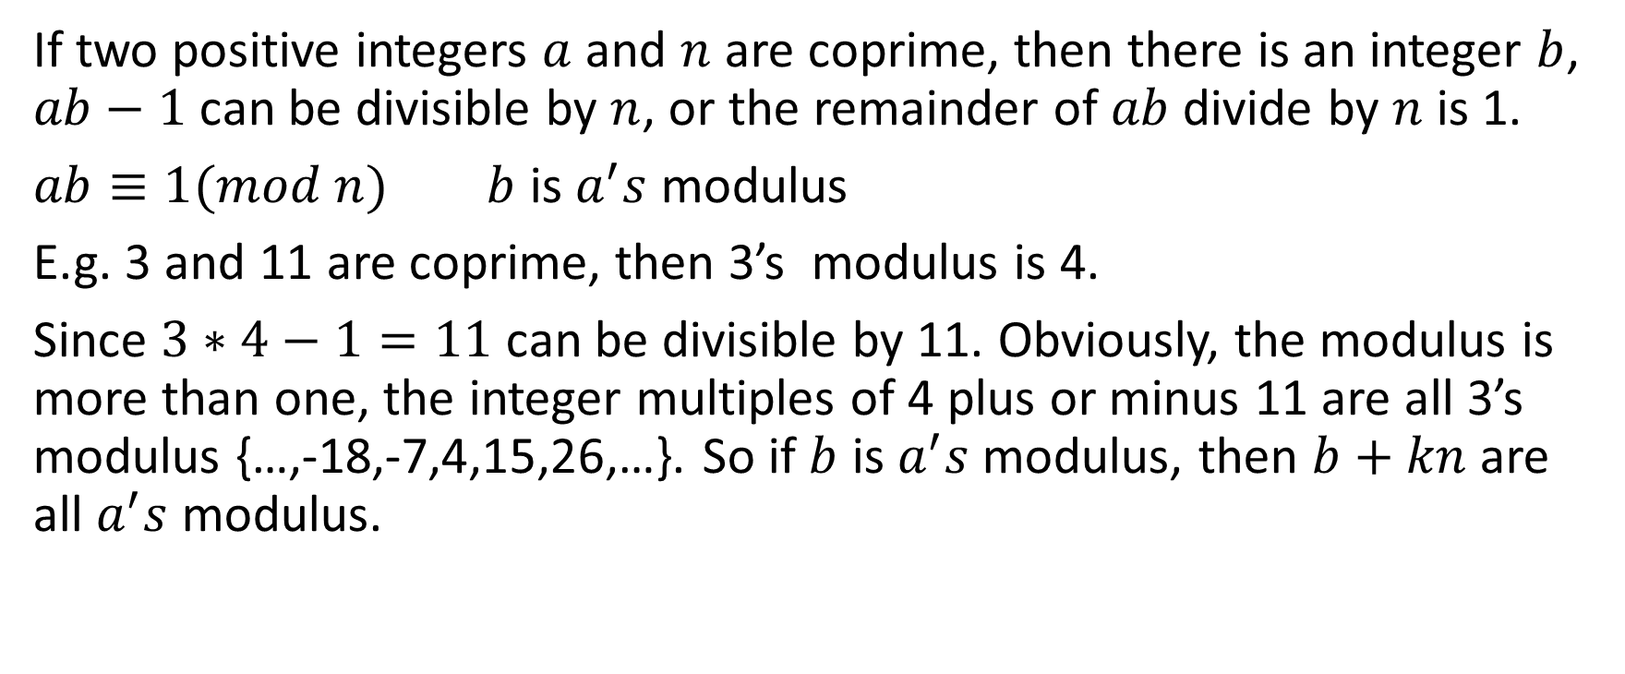
Modular multiplicative inverse
If two positive integers $a$ and $n$ are coprime, then there is an integer $b$, $ab−1$ can be divisible by $n$, or the remainder of $ab$ divide by $n$ is 1.
$ab≡1(mod n)$ $b$ is $a^{′}s$ modulus
E.g. 3 and 11 are coprime, then 3’s modulus is 4.
Since $3∗4−1=11$ can be divisible by 11. Obviously, the modulus is more than one, the integer multiples of 4 plus or minus 11 are all 3’s modulus {…,-18,-7,4,15,26,…}. So if $b$ is $a^{′}s$modulus, then $b+kn$ are all $a^{′}s$ modulus.

Slide 26

Modular multiplicative inverse
We can use Euler’s theorem to proof modulus are exist.
$$a^{φ(n)}=a∗a^{φ\left(n\right)−1}≡1(mod n)$$
So $a^{φ\left(n\right)−1}$ is $a^{′}s$ modulus.

Slide 27
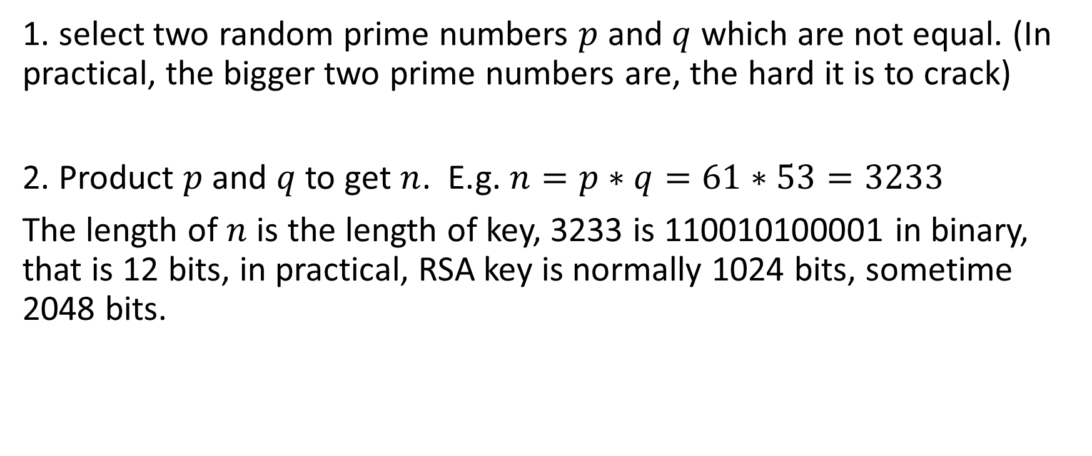
Generate RSA keys
1. select two random prime numbers $p$ and $q$ which are not equal. (In practical, the bigger two prime numbers are, the hard it is to crack)
2. Product $p$ and $q$ to get $n$. E.g. $n=p∗q=61∗53=3233$
The length of $n$ is the length of key, 3233 is 110010100001 in binary, that is 12 bits, in practical, RSA key is normally 1024 bits, sometime 2048 bits.

Slide 28
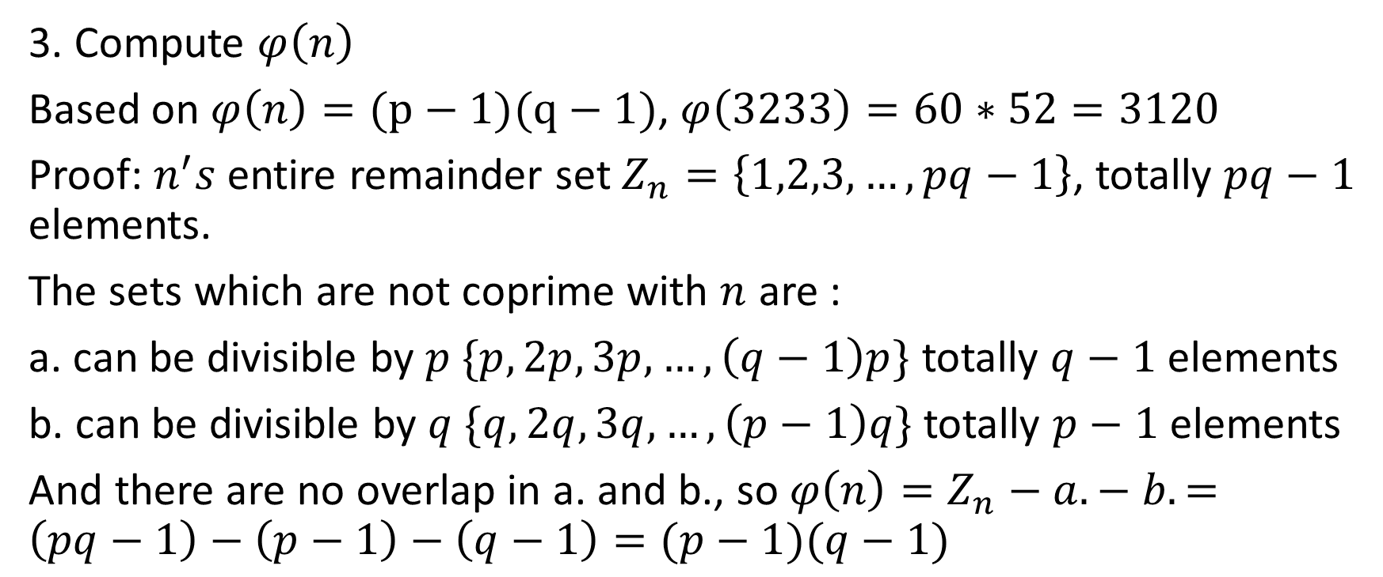
Generate RSA keys
3. Compute $φ\left(n\right)$
Based on $φ\left(n\right)=(p−1)(q−1)$, $φ\left(3233\right)=60∗52=3120$
Proof: $n^{′}s$ entire remainder set $Z_{n}=\left\{1,2,3,…,pq−1\right\}$, totally $pq−1$ elements.
The sets which are not coprime with $n$ are :
a. can be divisible by $p$ $\{p,2p,3p,…,\left(q−1\right)p\}$ totally $q−1$ elements
b. can be divisible by $q$ $\{q,2q,3q,…,\left(p−1\right)q\}$ totally $p−1$ elements
And there are no overlap in a. and b., so $φ\left(n\right)=Z_{n}−a. − b.=\left(pq−1\right)−\left(p−1\right)−\left(q−1\right)=(p−1)(q−1)$

Slide 29
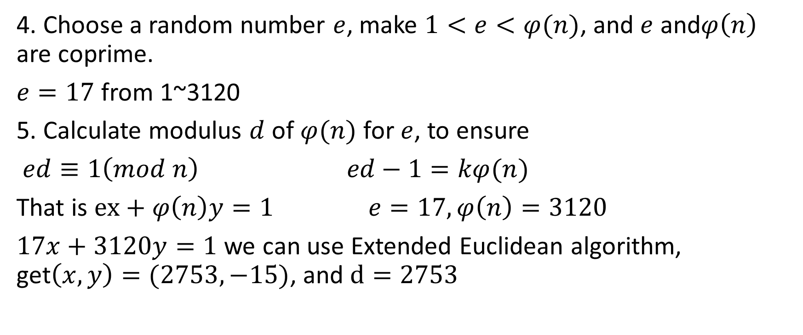
Generate RSA keys
4. Choose a random number $e$, make $1<e<φ(n)$, and $e$ and$φ\left(n\right)$ are coprime.
$e=17$ from 1~3120
5. Calculate modulus $d$ of $φ(n)$ for $e$, to ensure
$ed≡1\left(mod n\right) ed−1=kφ(n)$
That is $ex+φ\left(n\right)y=1 e=17,φ\left(n\right)=3120$
$17x+3120y=1$ we can use Extended Euclidean algorithm, get$\left(x,y\right)=(2753,−15)$, and $d=2753$

Slide 30

Generate RSA keys
6. $n$ and $e$ are encapsulated as public key, and $n$ and $d$ are encapsulated as private key.
$n=3233,e=17,d=2753$. So Public key is (3233,17) ,and private key is (3233,2753).

