Slide 1
ESE 3014 Embedded System Communication Protocol and Security
Linchen Wang

Slide 2
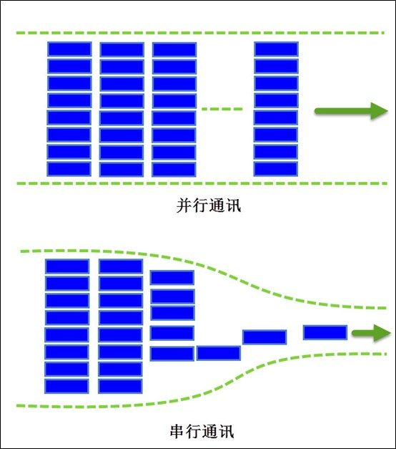
Review
I2C is a Two-wire serial bus.
The serial Data (SDA) line for the bidirectional transmission of data.
The serial Clock (SCL) line, is used to synchronize the data transfer.
Parallel transmission
Serial transmission

Slide 3
Outline
The features of SPI
Data transmission in SPI
SPI on BBB

Slide 4
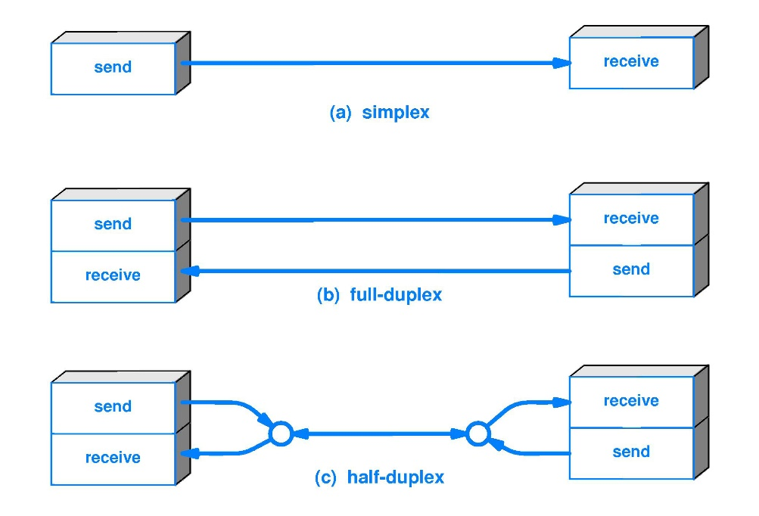
SPI
The Serial Peripheral Interface (SPI) bus is a fast, full duplex synchronous serial data link that enables devices such as the BBB to communicate with other device over short distances.
Like I2C, the SPI bus is synchronous, but SPI is full duplex. This means that it can transmit and receive data at the same time, by separate lines for both sending data and receiving data.

Slide 5
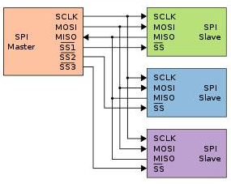
SPI
SPI has four wires, Serial clock (SCLK), Serial data output (SDO), Serial data input (SDI), and Slave select (SS).
SPI communication takes place between a single master device and one or more slave devices. The device who provide clock is the master device. Unlike I2C, SPI supports only one master, and it doesn’t have the acknowledge mechanism verifies that the data is received.

Slide 6
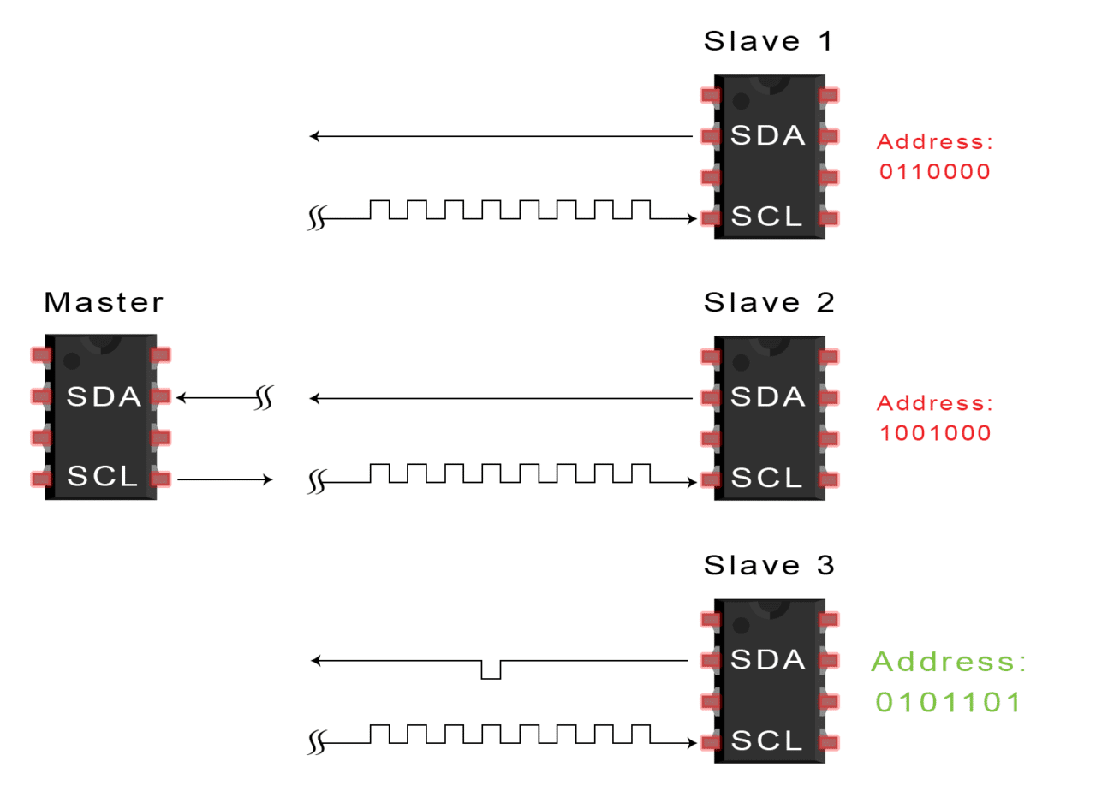
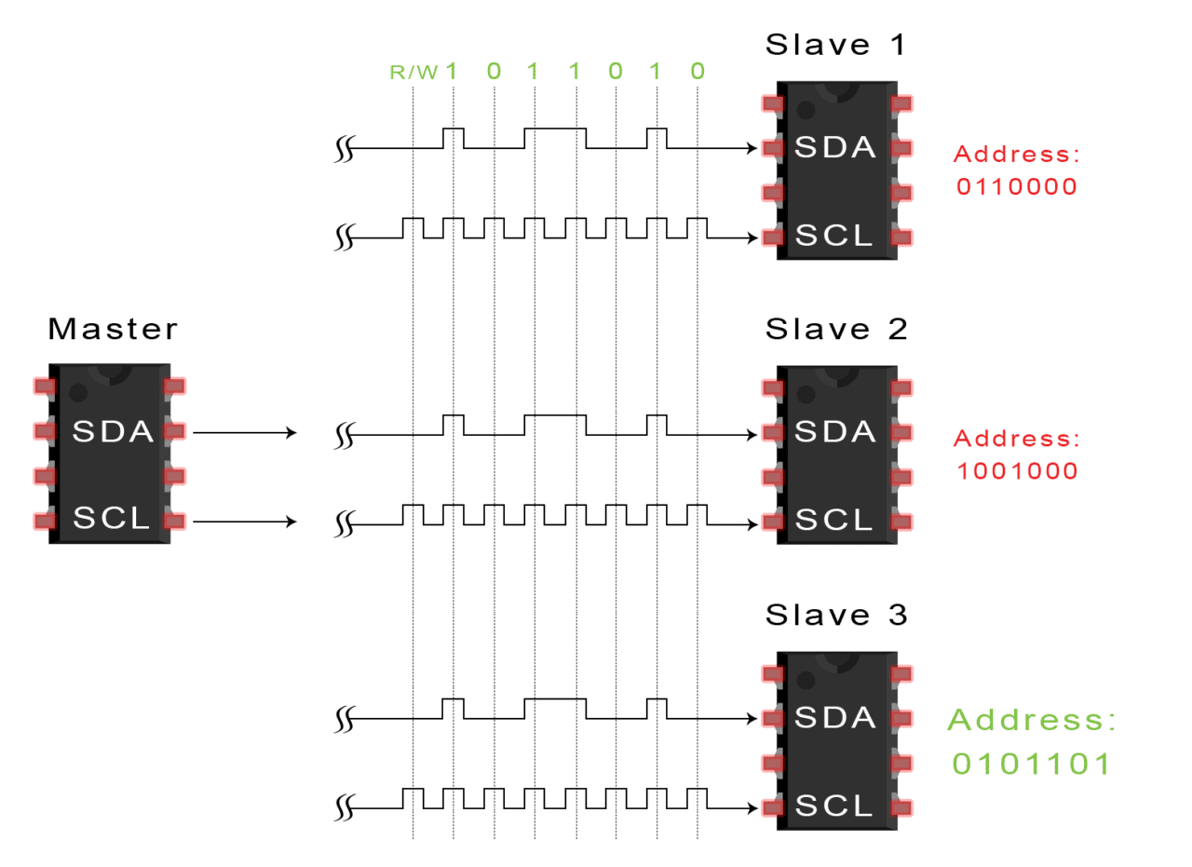
SPI
I2C has acknowledge mechanism.

Slide 7
SPI
The data output passes through the SDO line, where the data sends along the rising or falling edge, and reads along the next falling or rising edge, to complete one-bit data transfer. So, the transmission of 8-bit data requires at least 8 clock signal changes (the rising edge and the falling edge are counted as once).

Slide 8
SPI
While the normal serial communication transmits at least 8 bits of data continuously at one time, SPI allows data to be transmitted bit by bit, or even paused, because the SCLK is controlled by the master device, and when there is no clock jump, the slave device does not collect or transmit data. In other words, the master device can control the communication by controlling the SCLK.

Slide 9
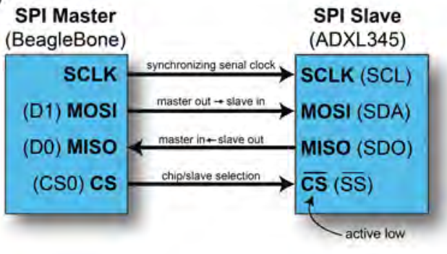
SPI
Four steps to communicate with SPI
1. The SPI master defines the clock frequency at which to synchronize the data communication channels.
2. The SPI master pulls the chip select (cs) line low, which activates the client device. It is therefore said to be active low. This line is also called as slave select (ss).

Slide 10
SPI
3. After a short delay, the SPI master issues clock cycles, sending data out on the master out – slave in (MOSI) line and receiving data on the master in – slave out (MISO) line. One bit is sent and one bit is received on each clock cycle. Usually is in one-byte (8 bit) chunks.
4. When complete, the SPI master stops sending a clock signal and then pulls the cs line high, deactivating the SPI slave device.

Slide 11
Data transmission in SPI
SPI needs to determine two things when it comes to data transfer:
First, whether the data is collected at the rising edge or the falling edge of the clock;
The second is whether the initial (idle) state of the clock is high or low.
Comparison: I2C idle state, clock line is a high level, and the clock line is also a high level when it is collecting data, but SPI provides a more free way.

Slide 12
Data transmission in SPI
Two concepts
CPOL: clock polarity, means when SPI is in idle time, the clock signal is a high level or low level.
CPHA: clock phase, SPI equipment is sampling in the rising edge or falling edge of the clock.
So, the SPI data transmission has four possible - according to the standard, SPI data transmission there are four modes.

Slide 13
Data transmission in SPI
SPI data transmission there are four modes.
Mode | Clock Polarity (CPOL) | Clock Phase (CPHA)
0 | 0 (low at idle) | 0 (data captured on the rising edge of the clock signal)
1 | 0 (low at idle) | 1 (data captured on the falling edge of the clock signal)
2 | 1 (high at idle) | 0 (data captured on the falling edge of the clock signal)
3 | 1 (high at idle) | 1 (data captured on the rising edge of the clock signal)

Slide 14
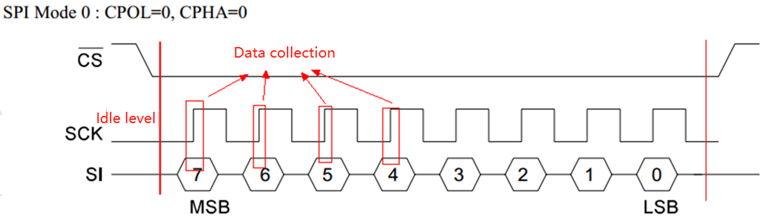
Data transmission in SPI
Mode 0

Slide 15
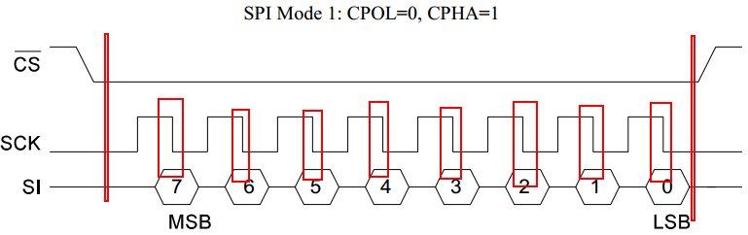
Data transmission in SPI
Mode 1

Slide 16
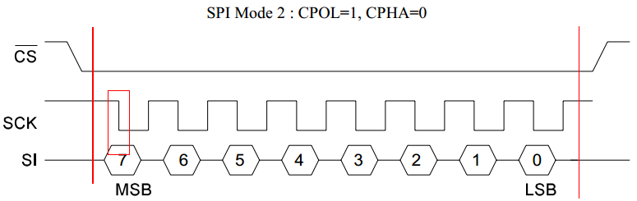
Data transmission in SPI
Mode 2

Slide 17
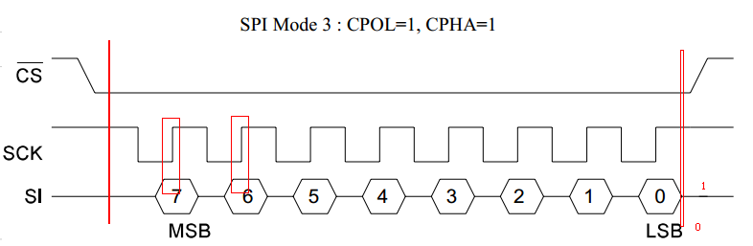
Data transmission in SPI
Mode 3

Slide 18
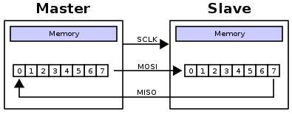
Data transmission in SPI
SPI in the hardware design adopts double cable system, according to the design, in the process of SPI communication, it can form a data link between master-slave equipment as a ring - the master to write a data to the slave, and the slave will be back to a data.

Slide 19
Data transmission in SPI
Assume that the master and slave are initialized and that the master's buff=0xaa=0b1010 1010 and the slave's buff=0x55=0b0101 0101. And we are in sending in rising edge, and reading in falling edge.
At the rising edge of clock (pulse) 1, master send out data as one bit from left side (MSB), plus the shifter.
Clock
0
Master
1010 1010
Slave
0101 0101
SDI
X
SDO
X
Master
1 0101 010X
Just move (send) out
Don’t know yet since it didn’t read data from slave

Slide 20
Data transmission in SPI
At the same time, slave send out data from its left side (MSB), plus the shifter.
Slave
0 1010 101X
Just move (send) out
Don’t know yet since it didn’t read data from master

Slide 21
Data transmission in SPI
At the falling edge of clock (pulse) 1, it is time to read data.
Master
0101 010X
Master
0101 0100
Send from slave
Slave
1010 101X
Slave
1010 1011
Send from master

Slide 22
Data transmission in SPI
Summary:
1. A clock cycle completes the sending and receiving of data.
2. Both the master and the slave send first from the MSB (left side), and the data received is added to the right side.
3. Eight clock cycles complete a data exchange.

Slide 23
SPI
Do not connect a 5V SPI slave device to your BBB, if so, use logic-level translation.
Both SPI0 and SPI1 bus are accessible from P9, SPI1 clashes with the mcasp0_pins, so to use SPI1, you should to disable HDMI to remove device tree (225-226 in chapter 6), and enable SPI0 and SPI1 (222-224,226 in chapter 6) since they are disabled by default.

Slide 24
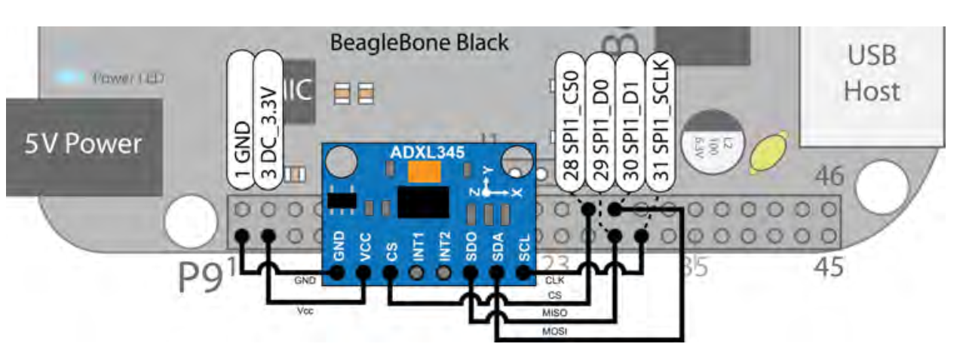
SPI
The pin for SPI1 are shown:
Chip Select: P9_28 spi1_cs0 (Mode 3) $PINS 103 Offset 0x19C.
MOSI: P9_30 spi1_d1 (Mode 3) $PINS 102 Offset 0x198.
MISO: P9_29 spi1_d0 (Mode 3) $PINS 101 Offset 0x194.
Clock: P9_31 spi1_sclk (Mode 3) $PINS 100 Offset 0x190.

