Slide 1
ESE 3014 Embedded System Communication Protocol and Security
Linchen Wang

Slide 2
Review
CDMA: we assign a specific code for a pair of user, only this pair of user can understand each other by using this specific code, and all other message will be considered as noise.

Slide 3
Outline
The transmitter of PCM (Pulse - code modulation)

Slide 4
Pulse - code modulation
In pulse code modulation, a message signal is represented by a sequence of coded pulses, which is accomplished by representing the signal in discrete form in both time and amplitude.
Low pass filter
Sampler
Quantizer
Encoder
Source of continuous time signal
PCM signal

Slide 5


PCM Sampling
Sampling: The message signal is sampled with a train of narrow rectangular pulse so as to closely approximate the sampling process.
Sampler close every $T_{s}$ second to get a pulse with width t, and we get a continuous amplitude for this t second.
Amplitude
Time
$$T_{s}$$
t

Slide 6
PCM Sampling
In order to ensure prefect reconstruction of the message signal at the receiver (recall Nyquist sampling rate). The sampling rate must be twice greater than the frequency (say it is w) of the message signal.
So, in practice, a low pass filter is used at the front end of the sampler in order to exculde frequencies greater than w before sampling.
Low pass filter can reduce the continuous varying message signal to limite the number of discrete values per second.

Slide 7
PCM Quantization
Quantization: providing a new representation of the signal, and that is discrete in both time and amplitude.
The discrete amplitude of the quantized output are called as representation levels, and the spacing between the two adjancent representation levels is called a quantum or step size.

Slide 8
PCM Quantization
There are two types of quantization
Uniform quantization: the quantization levels are uniformly spaced.
Non uniform quantization: the quantization levels are unequal and mostly the relation between them in logarithmic.

Slide 9
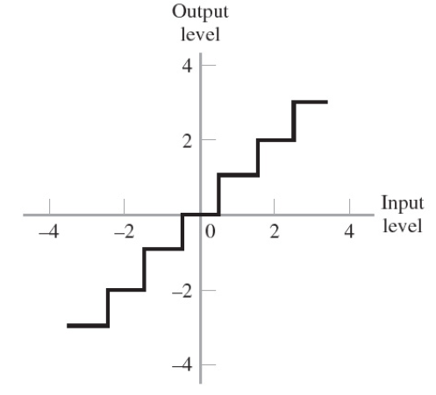
PCM Quantization
In terms of uniform quantization, the quantizer characteristic can be mid-tread type and mid-rise type.
Mid-tread type: the origin lies in the middle of a tread of stair-case waveform.

Slide 10
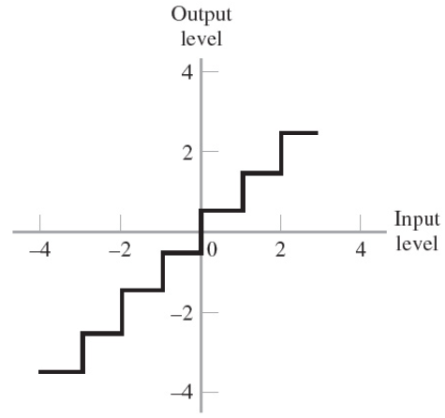
PCM Quantization
Mid-rise type: the origin lies in the middle of a rising part of the stair-case waveform.
Both mid-tread and mid-rise types are symmetric about the origin.

Slide 11
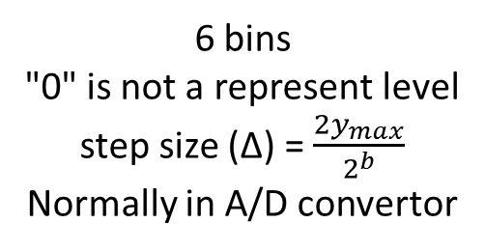
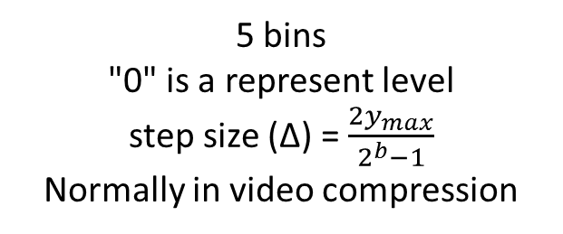
PCM Quantization
Mid-tread: odd number of representation levels
Mid-rise: even number of representation levels.
-2.5Δ
-1.5Δ
-0.5Δ
0.5Δ
1.5Δ
2.5Δ
-3Δ
-2Δ
-Δ
Δ
2Δ
3Δ
Y
Y
0
0
Mid-tread
Mid-rise
5 bins
"0" is a represent level
step size (Δ) = $\frac{{2y}_{max}}{2^{b}−1}$
Normally in video compression
6 bins
"0" is not a represent level
step size (Δ) = $\frac{{2y}_{max}}{2^{b}}$
Normally in A/D convertor

Slide 12
Quantization
The maximum and the minimum amplitudes are 20 and -20, so we can divide [-20, 20] into 8 sets, and mark them as 0, 1, 2, 3, … , 7.
Set
Value
7
20
15
6
5
10
4
5
3
0
2
-5
1
-10
-15
0
-20
Sample data
-6.1
7.5
16.2
19.7
11.0
-5.5
-11.3
-9.4
-6.0
Quantized data
2
5
7
7
6
2
1
2
2
Encoding
010
101
111
111
110
010
001
010
010

Slide 13
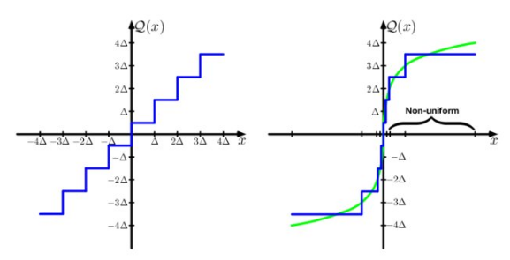

PCM Quantization
Non uniform quantization: logarithmic relation between input and output.
The use of a nonuniform quantizer is equivalent to passing the baseband signal through a compressor and then applying the compressed signal to a unform quantizer.
E.g. Since the sense of human ears approximates the logarithmic curve to the voice.
A speech signal is essentially limited to a band from 300 to 3100 Hz

Slide 14
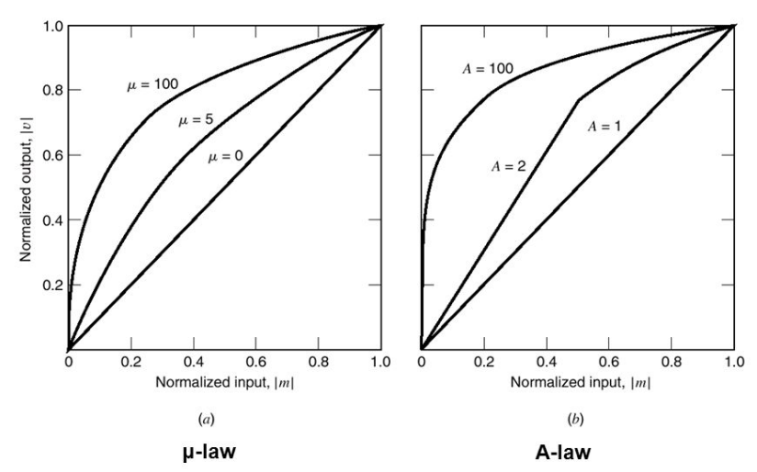

PCM Quantization
$μ$ law is used in NA
$$\left|V\right|=\frac{\log\left(1+μ\left|m\right|\right)}{\log\left(1+μ\right)}$$
A law is used in EU
$$\left|V\right|=\left\{\begin{aligned}\frac{A\left|m\right|}{1+\log{A}} ,0≤\left|m\right|≤\frac{1}{A} \\ \frac{1+\log\left(A\left|m\right|\right)}{1+\log{A}} ,\frac{1}{A}≤\left|m\right|≤1\end{aligned}\right.$$

Slide 15
PCM Encoding
Encoding: process to translate the discrete set of sample values to a more appropriate form of signal.
Any plan for representation each of this discrete set of values as particular arrangment of discrete events is called code.
One of the discrete events in code is called a code element or symbol.
A particular arrangement of symbols used in a code to represent a signal value of the discrete set is called a code word.

Slide 16
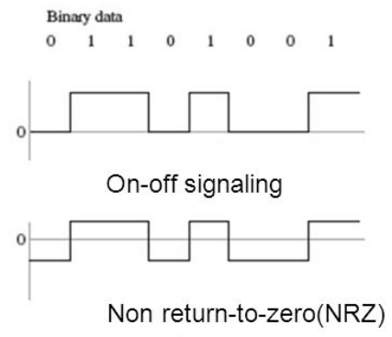
PCM Encoding
There are several line code can be used for electrical representation of binary symbols "1" and "0".
1. on-off signaling: symbol "1" is represented by transmitting a pulse of constant amplitude for the duration of the symbol, and symbol "0" is represented by switching off the pulse.
2. Non return - to - zero (NBZ) signaling: symbol "1" and "0" are represented by pulses of equal positive and negative amplitudes.

Slide 17

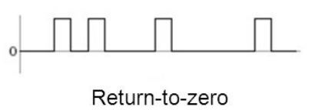
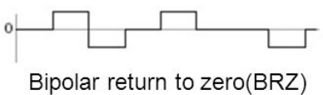
PCM Encoding
3. Return - to - zero (RZ) signaling: symbol "1" is represented by positive rectengular pulse of half-symbol width, and symbol "0" is represented by transmitting no pulse.
4. Bipolar return – to – zero (BRZ) signaling: positive and negative pulses of equal amplitude are used alternately for symbol “1”, and no pulse is used for symbol “0”.

Slide 18
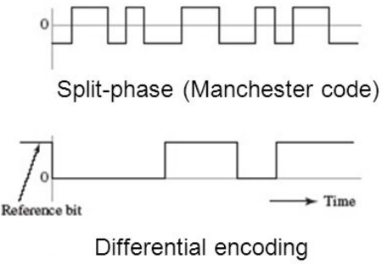
PCM Encoding
5. Split – phase (Manchester code): symbol “1” is represented by a positive pulse followed by a negative pulse, and both pulses being of equal amplitude and half – symbol width. For symbol “0”, the two pulses are reversed.
6. Differential encoding: a transition is used to designate symbol “0”, whereas no transition is used to designate symbol “1”.

