Slide 1
ESE 3014 Embedded System Communication Protocol and Security
Linchen Wang

Slide 2

Review
In RSA, we have two different/asymmetric key
Public key and Private key
Encrypt Decrypt in RSA encryption
Decrypt Encrypt in Authentication

Slide 3
Outline
Bus communication
I2C
ADXL345 Accelerometer
I2C Hardware

Slide 4
Bus communication
Bus interface on BBB: it is a mechanism that enables data to be transferred between the high-level components of an embedded platform, using standardized communication protocols.
Two common embedded system bus are:
I2C (Inter-Integrated Circuit)
SPI (Serial peripheral Interface)

Slide 5
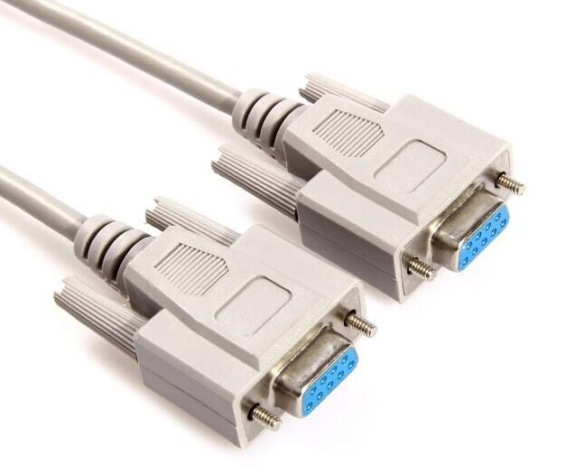
Bus communication
One more: UART (Universal Asynchronous Receiver/Transmitter), it can implement standard serial communications protocol, such as RS-232, RS-422, or RS-485.

Slide 6
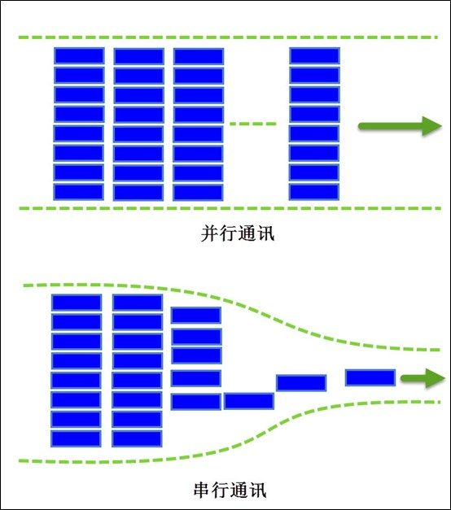
Bus communication
According to the mode of data transmission, it can be divided into the following two types:
1. Serial transmission bus
2. Parallel transmission bus
Serial transmission is like a car or a person taking one path at a time.
What is parallel transmission? it is multiple cars or multiple people taking multiple paths at the same time.
Parallel transmission
Serial transmission

Slide 7
Bus communication
In terms of efficiency, the efficiency of parallel transmission must be higher than serial transmission . But Parallel transmission consumes far more resources than serial transmission. Serial transmission of one line (MCU with one IO) can complete the transmission of multiple bits, but it takes a long time, which is a disadvantage. Parallel transmission requires multiple lines (MCU uses multiple IOs) to send multiple bits, but the corresponding time is saved. Therefore, in general, parallel communication is suitable for short distance transmission, usually less than 30m, while serial communication is more suitable for long distance transmission, ranging from a few meters to thousands of kilometers.

Slide 8

Bus communication
From the data communication direction, bus communication will be divided into simplex, half duplex, full duplex.
1. Simplex: only one direction of communication can be carried out at any time, that is, one is fixed as sending device and the other is fixed as receiving device.

Slide 9
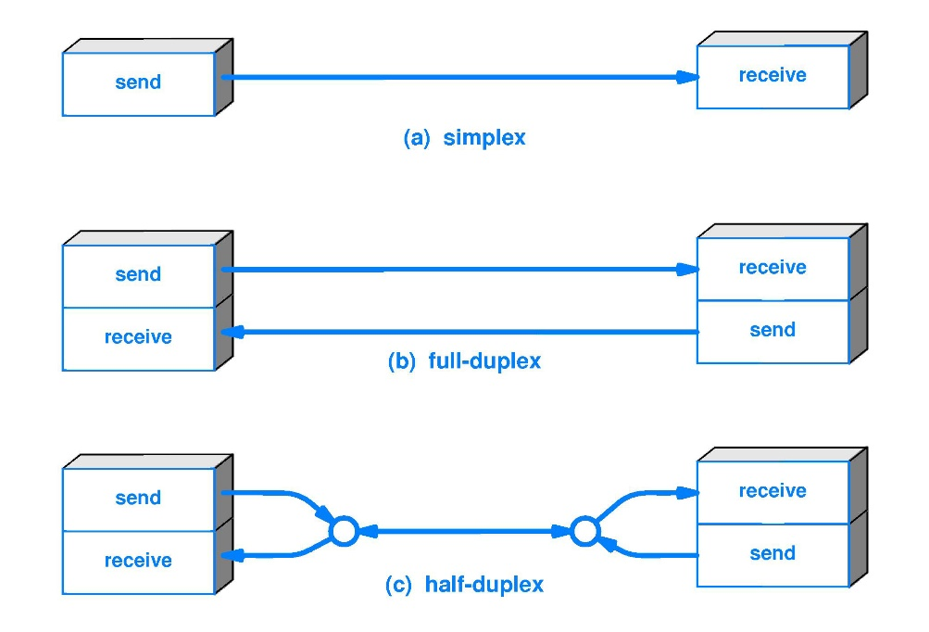
Bus communication
From the data communication direction, bus communication will be divided into simplex, half duplex, full duplex. Conceptually:
2. Half duplex: data can be sent and received between two devices, but not at the same time.
3. Full duplex: data can be sent and received between two devices at the same time.

Slide 10
Bus communication
In the process of transmission, according to the way of data transmission, can be divided into synchronous and asynchronous.
1. Synchronous, literally, means that both parties are doing the same thing at the same time, In communication, from the start of the clock line to the end, the data line must follow the frequency of the clock transmission.
2. Asynchronous, relative to the synchronous, asynchronous don't need a common clock on both sides, namely the receiver don't know when the sender to send, so need to be prompted to the receiver to receive the information, such as start bit, at the time when it starts, and stop bit when it is over.

Slide 11
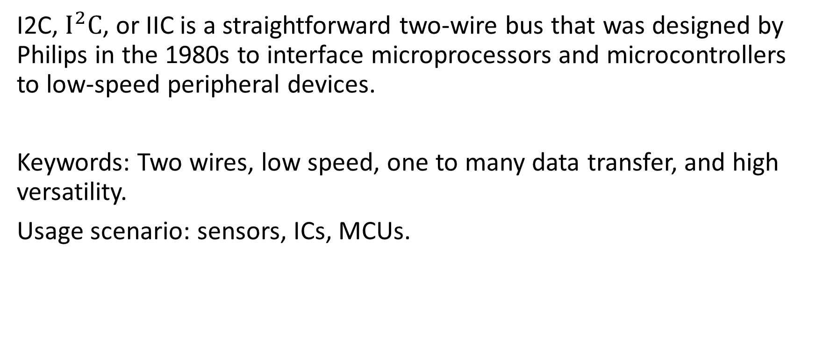
I2C
I2C, $I^{2}C$, or IIC is a straightforward two-wire bus that was designed by Philips in the 1980s to interface microprocessors and microcontrollers to low-speed peripheral devices.
Keywords: Two wires, low speed, one to many data transfer, and high versatility.
Usage scenario: sensors, ICs, MCUs.

Slide 12
I2C
Some features of I2C
1. Only two signal lines are required for communication.
The serial Data (SDA) line for the bidirectional transmission of data.
The serial Clock (SCL) line, is used to synchronize the data transfer.
So SDA wire can be used for sending and receiving data with synchronizing clock.

Slide 13
I2C
2. Each device on the bus can act as a master or a slave.
The master device(e.g. BBB) is the one that initiates communication and the slave(e.g. ADXL345 accelerometer) is the one that responds. Designated slave devices can not initiate communication with the master device.
3. Each slave device attached to the bus is pre-assigned an unique address which is in either 7-bit or 10-bit form.

Slide 14
I2C
Instead of UART (Universal Asynchronous Receiver/Transmitter) has one to one communication, I2C can achieve one to many. It can extend the interface with software simulation, but not with UART. The biggest reason for its talent is simplicity and flexibility.
A master device controls the bus and many addressable slave devices (such as many sensors) can be attached to the same two wires.

Slide 15
I2C
In 7-bit unique address, the 4 high bit is for device type, which is made by the manufacturer. 3 low bit is definition address of device pin, defined by user. Master device uses the address code to set up multi-device communication mechanism, so I2C saves chip select line for peripheral devices. The devices with different logic families can be intermixed on the bus, and a large number of devices can be added to a single bus. Up to 128 devices could be attached to a single bus in theory.

Slide 16
Data transmission in I2C
If multiple devices are mounted on an I2C bus, doesn't the CPU send data and all peripherals can see it?
Yes, the CPU sends an address first, and all peripherals receive that address, which is like the name of the peripheral. The peripheral responses when its name is called, and doesn’t response until it's called.

Slide 17
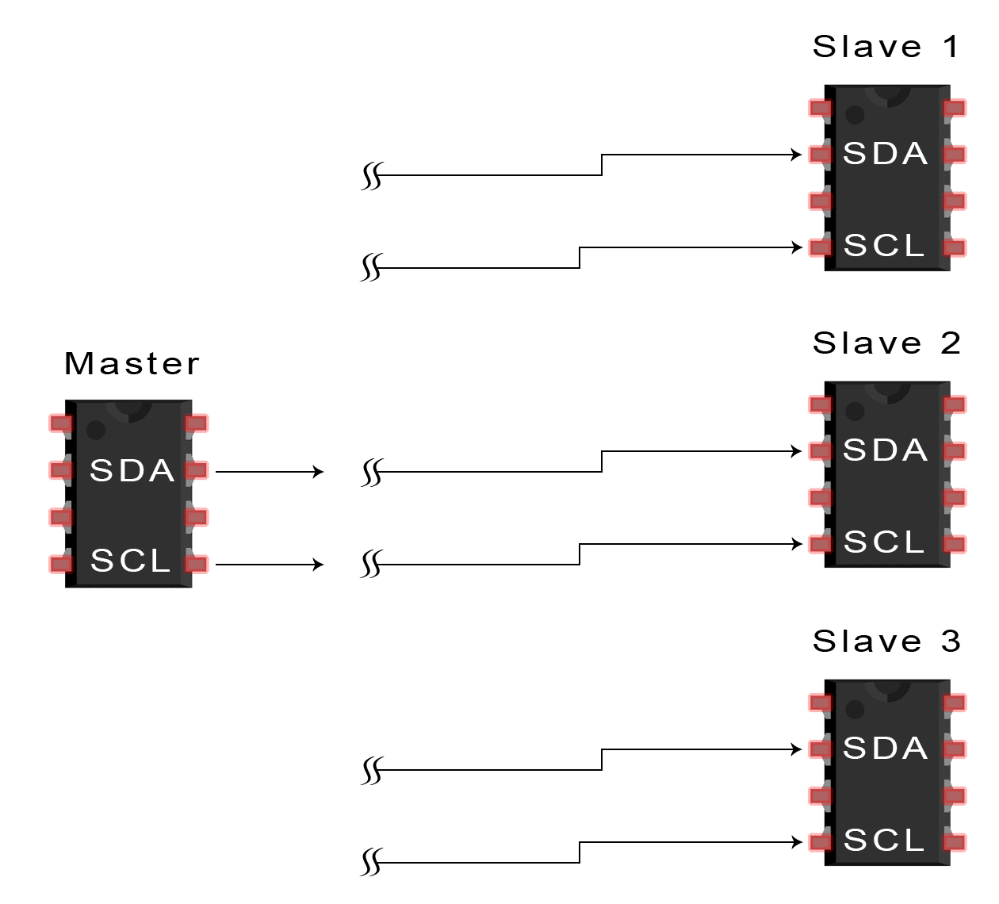
Data transmission in I2C
1. The master sends the start condition to every connected slave by switching the SDA line from a high voltage level to a low voltage level before switching the SCL line from high to low:

Slide 18
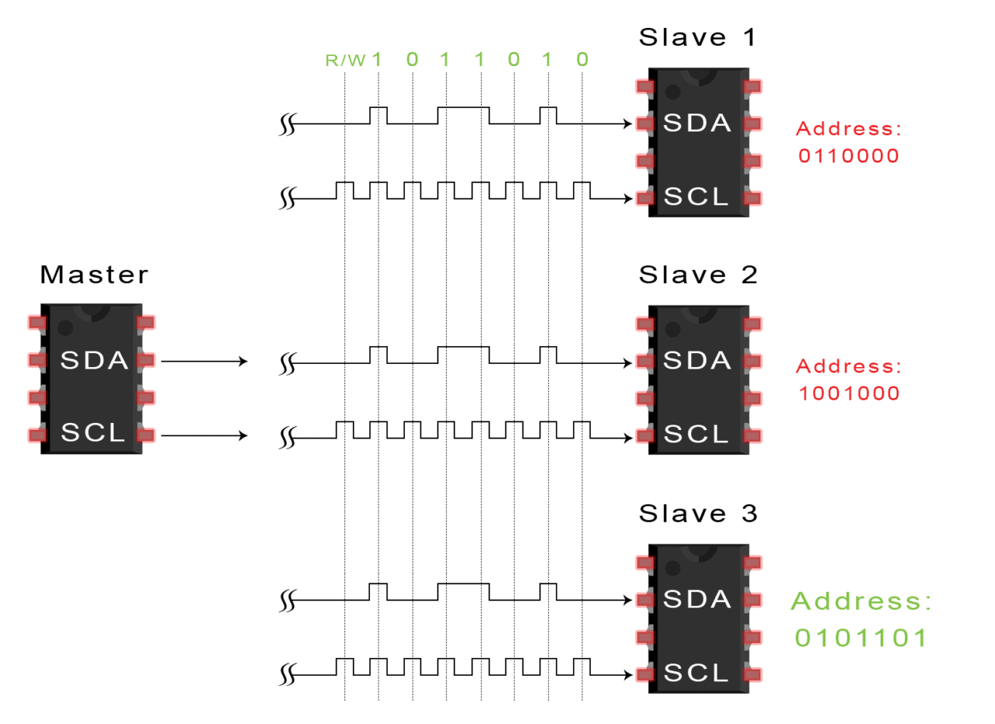
Data transmission in I2C
2. The master sends each slave the 7 or 10 bit address of the slave it wants to communicate with, along with the read/write bit:

Slide 19
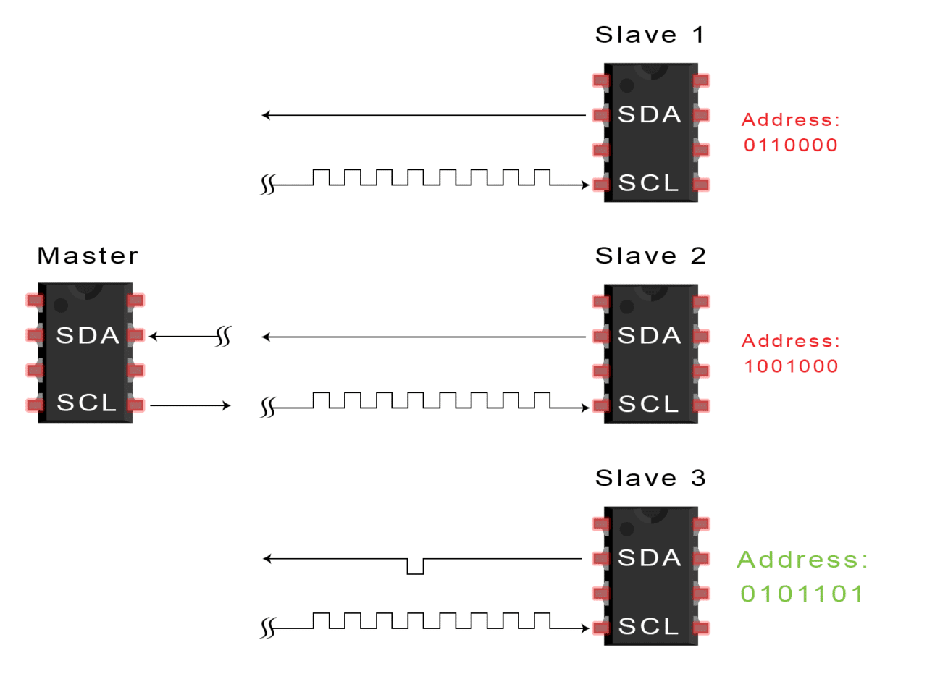
Data transmission in I2C
3. Each slave compares the address sent from the master to its own address. If the address matches, the slave returns an ACK bit by pulling the SDA line low for one bit. If the address from the master does not match the slave’s own address, the slave leaves the SDA line high.

Slide 20
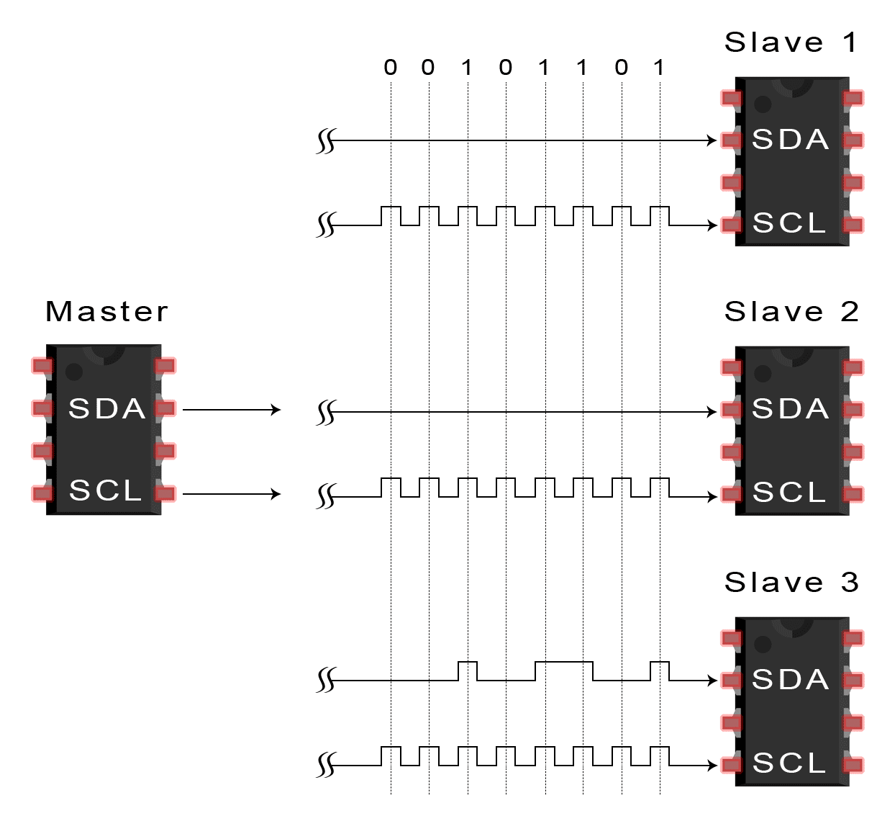
Data transmission in I2C
4. The master sends or receives the data frame.

Slide 21
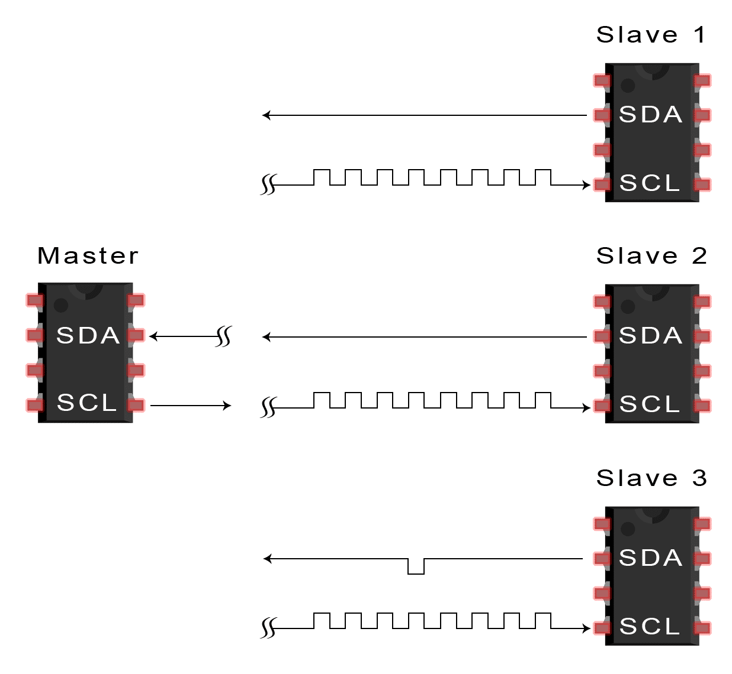
Data transmission in I2C
5. After each data frame has been transferred, the receiving device returns another ACK bit to the sender to acknowledge successful receipt of the frame.

Slide 22
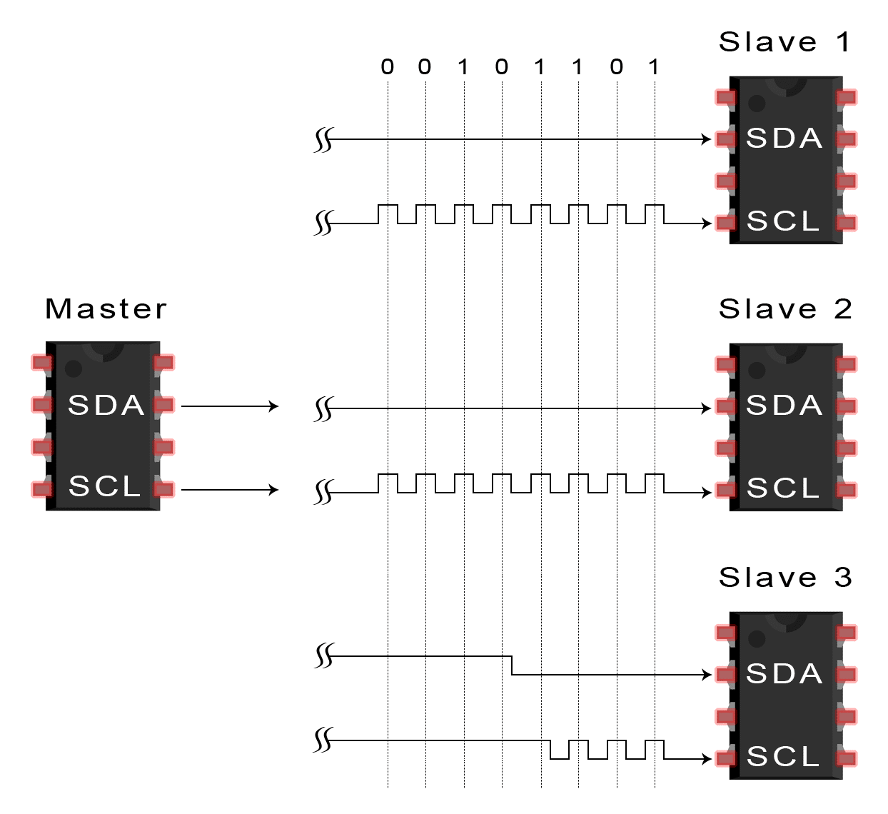
Data transmission in I2C
6. To stop the data transmission, the master sends a stop condition to the slave by switching SCL high before switching SDA high.

Slide 23
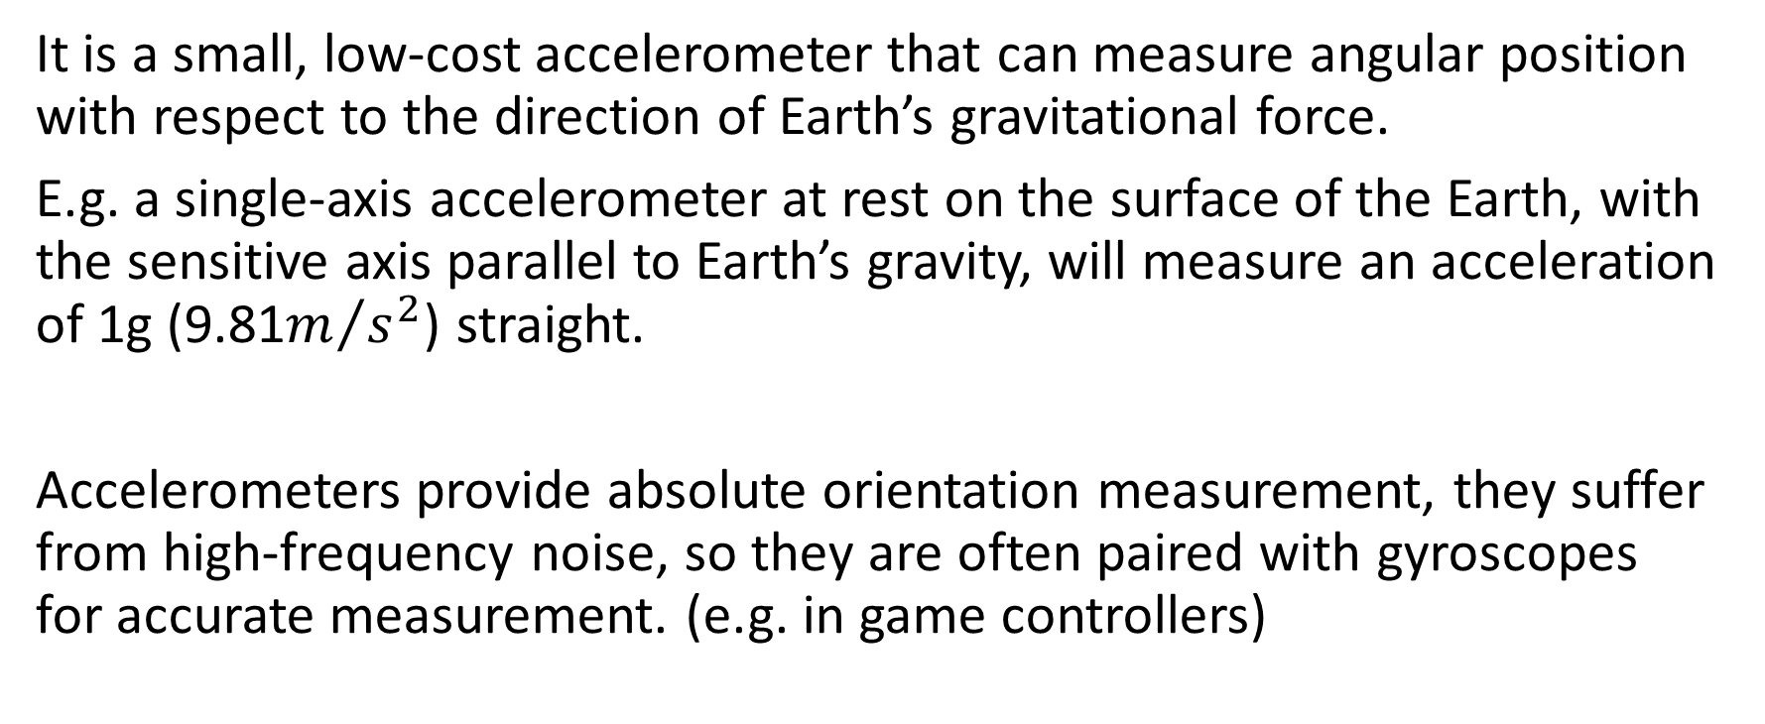
ADXL345 Accelerometer
It is a small, low-cost accelerometer that can measure angular position with respect to the direction of Earth’s gravitational force.
E.g. a single-axis accelerometer at rest on the surface of the Earth, with the sensitive axis parallel to Earth’s gravity, will measure an acceleration of 1g (9.81$m/{s^{2}}$) straight.
Accelerometers provide absolute orientation measurement, they suffer from high-frequency noise, so they are often paired with gyroscopes for accurate measurement. (e.g. in game controllers)

Slide 24

ADXL345 Accelerometer
Our ADXL345 can be set to measure values with a fixed 10-bit resolution, or using a 13-bit resolution at up to $±$16g. It can be interfaced to the BBB using I2C or SPI bus.

Slide 25
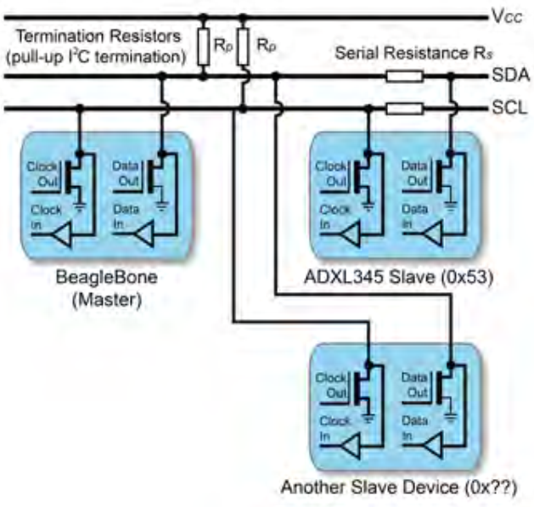
I2C Hardware
I2C bus configuration

Slide 26
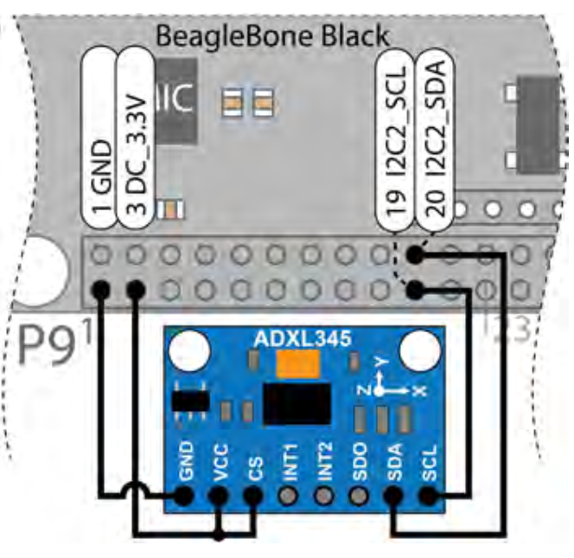
I2C Hardware
When cs input is tied high, the ADXL345 is placed in I2C mode, the breakout board contains the resistors that are required for the I2C bus to work correctly. The ADXL345’s ALT address (Alternate) pin is fixed to GND on the breakout board, placing the device at I2C address 0X53.

Slide 27
What is INT
We know only master can initiate communication, and slave would never send data to master by its own initiative. But master can’t ask “do you have data for me” periodically since it will consume resources and may not go into sleep mode.
So slave has a way of telling the master, "I have the data." That's what the interrupt signal does. Slave has data, first send an interrupt signal to master, master then read the data sent by slave through I2C.

Slide 28
What is INT
For low power application scenario, and slave trigger scenario, need to be designed in this way. For example, capacitive touch screen, usually the CPU is dormant, click to wake up the system.

Slide 29
ADXL345 Accelerometer
In I2C, the slave address is determined by the salve device itself. E.g. ADXL345 breakout board has the address 0X53, which is determined at manufacture.
Many devices, including ADXL345, have selection inputs that allow you to alter this value within a defined range.

Slide 30
I2C Hardware
I2C buses on BBB
H/W Bus | S/W Device | SDA PIN | SCL PIN | Description
I2C0 | /dev/i2c-0 | N/A | N/A | Internal bus for HDMI control
I2C1 | /dev/i2c-2 | P9_18 | P9_17 | General I2C bus. Disable by default
I2C2 | /dev/i2c-1 | P9_20 | P9_19 | General I2C bus. Enable by default

Slide 31
I2C Hardware
Linux provide i2c-tools for interfacing to I2C bus devices. This tools are already installed on BBB, but we can update them.
The first step: i2cdetect to detect the device is present on the bus
If ADXL sensor is physically connected to the I2C bus (I2C2), the I2C2 bus can be probed (/dev/i2c-1)
$ i2cdetect –y –r 1

Slide 32
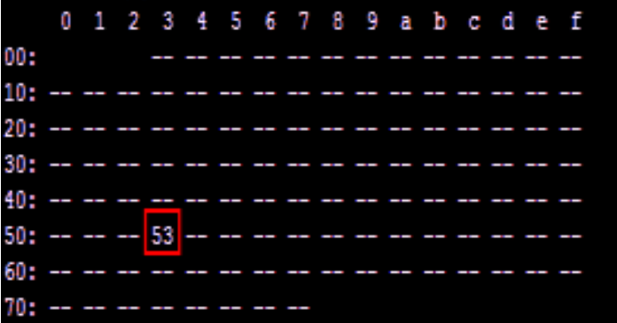
I2C Hardware
When -- is displayed, the address was probed but no device responded, when UU is displayed, probing was skipped, as the address is already in use by a driver. And if the device is functioning and correctly wired, it will appear at its predefined address, which is 0X53.
Running i2cdetect on the internal I2C0 will highlight there is a device at 0X34 which related to the consumer electronics control (CEC) interface on the HDMI.

Slide 33
I2C Hardware
We can enable i2c-2 (I2C1) as a second public I2C bus.
/dev$ sudo sh –c “echo BB-I2C1 > $SLOTS”
/dev$ ls i2*
i2c-0 i2c-1 i2c-2

Slide 34
I2C Hardware
i2cdump, this command can be used to read in the values of the registers and display them in a hexadecimal form consult the datasheet for slave device before using this command, since in certain modes i2cdump will write to the device.

Slide 35
I2C Hardware
i2cget, it can be used to read the value of a register in order to test the device, or as an input for Linux shell scripts.
E.g. to read the DEVIO of attached device
$ i2cget –y 1 0X53 0X00
0Xe5

Slide 36
I2C Hardware
i2cset, it can be used to set a register.
E.g. to take the ASXL345 out of power saving mode, by writing 0X08 to the power_CTL register, which at 0X2D
$ i2cset –y 1 0X53 0X2D 0X08
$ i2cget –y 1 0X53 0X2D
0X08

