Slide 1
ESE 3014 Embedded System Communication Protocol and Security
Linchen Wang

Slide 2
Review
Transmitter of PCM
Low pass filter
Sampler
Quantizer
Encoder
Source of continuous time signal
PCM signal

Slide 3
The receiver of PCM system
Regeneration circuit
Decoder
Reconstruction filter
Channel input
Destination

Slide 4
The receiver of PCM system
PCM – regeneration:
It is the most important feature of PCM system which is the ability to control the effects of distortion and noise produced by transmitting a PCM signal though a channel.

Slide 5
Why we need regeneration
The signal attenuation is proportional to the frequency. Recall the high frequency signal would be hard to go through the concrete building.

Slide 6
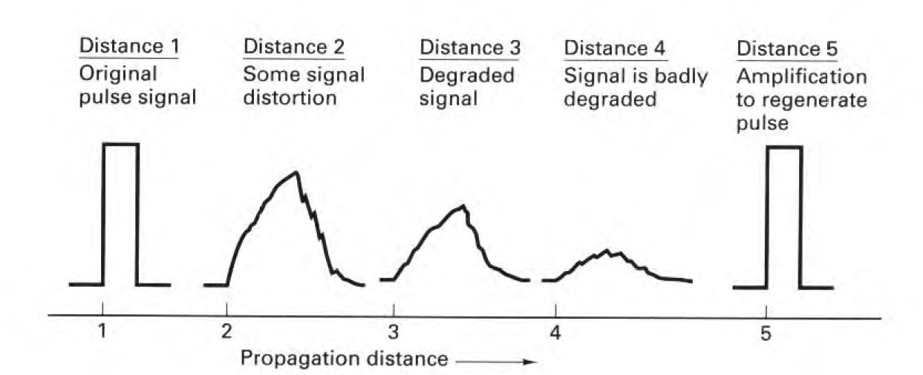
Why we need regeneration
Effects in distance as:
1. the amplitude of received signal pulse is reduced. Since there is attenuation in transmission line, the longer transmission distance, the higher attenuation, and the more obvious of amplitude decrease.
It is also affected by transmission distance.

Slide 7
Why we need regeneration
Effects in distance as:
2. wave peak is delayed, it is the delay characteristic of transmission.
3. The pulse width is increased, it is because of attenuation – frequency characteristic, that causes pulse wave distortion, and this distortion causes trailing, so ISI will happen.
It is also affected by transmission distance.

Slide 8
Why we need regeneration
And if we consider noise, the performance will be worse.
So, when the transmission distance increase to a certain range, the received pulse would be hard to identify.
We need a chain of regenerative repeaters to reconstruct the PCM signal.

Slide 9
The receiver of PCM system
It is also called Regeneration circuit.
Three basic functions are performed by a regenerative repeater:
Amplifier equalizer
Decision making device
Distorted PCM wave
Regenerated PCM wave
Timing circuit
Regeneration circuit

Slide 10
The receiver of PCM system
The equalizer shapes the received pulses so compensate (correct) for the effects of amplitude and phase distortions.
The timing circuit provide a periodic pulse train, derived from the received pulses, for sampling the equalized pulses at the instants of time.
In decision – making device, there is a predetermined threshold, by compare the sample with threshold to make whether the received symbol is “1” or “0”. If it is “1”, a clean new pulse representing symbol “1” is transmitted, whereas another clean new pulse for “0”.

Slide 11
The receiver of PCM system
The key is equalizer, we can add a compensate wave in time domain equalizer. For example to reduce the effect of ISI, we can add pulse waves has same wave form and opposite polarity of trailing.
ISI tail
compensate wave

Slide 12
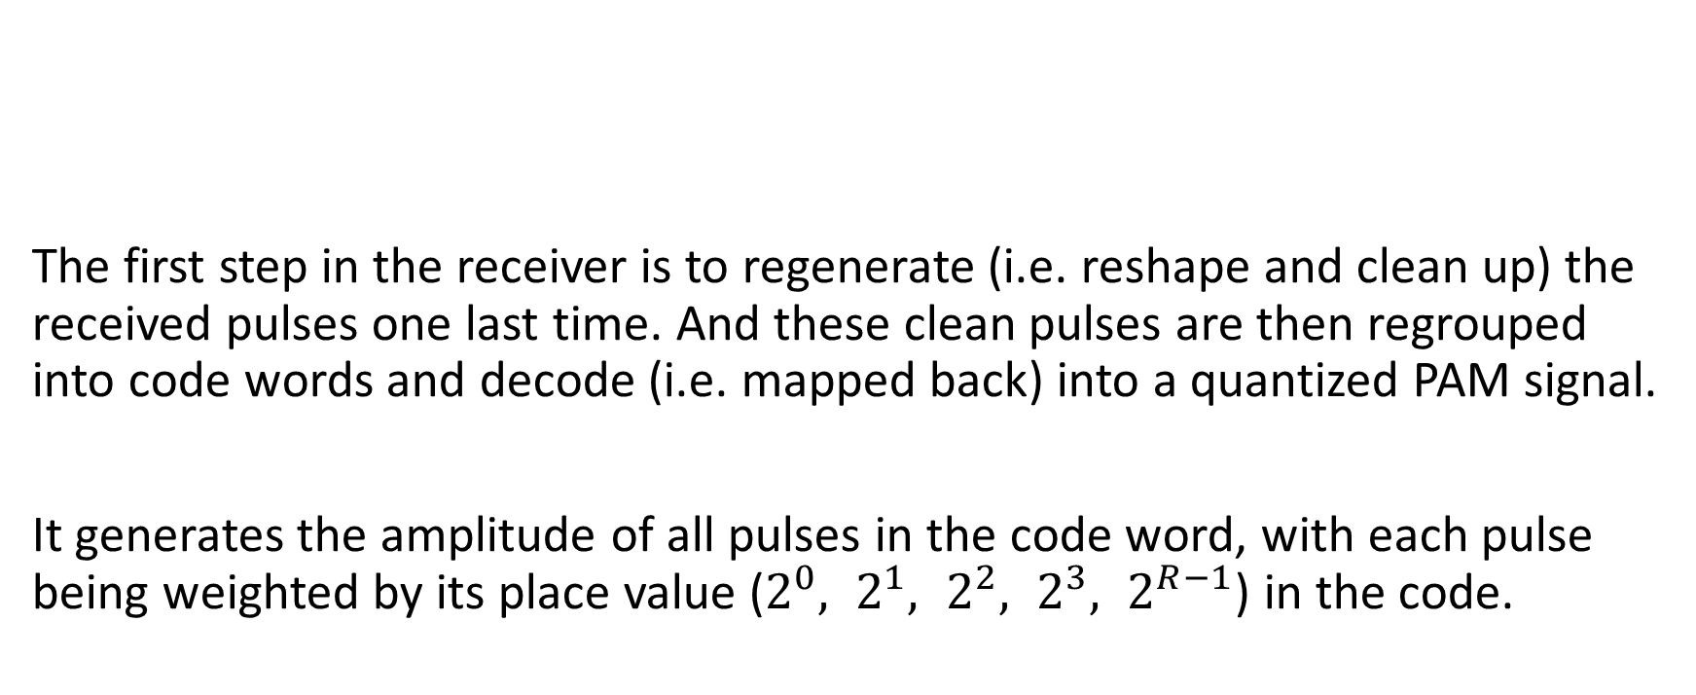
The end of receiver
Decoder
Reconstruction filter
The first step in the receiver is to regenerate (i.e. reshape and clean up) the received pulses one last time. And these clean pulses are then regrouped into code words and decode (i.e. mapped back) into a quantized PAM signal.
It generates the amplitude of all pulses in the code word, with each pulse being weighted by its place value ($2^{0}, 2^{1}, 2^{2}, 2^{3}, 2^{R−1}$) in the code.
Regeneration circuit
Regenerated PCM wave
Destination

Slide 13
The receiver of PCM system
Filtering: to recover the message signal wave by passing a low – pass reconstruction filter whose cutoff frequency is equal to the message bandwidth W.

