Slide 1
ESE 3014 Embedded System Communication Protocol and Security
Linchen Wang

Slide 2
Review
Regeneration circuit
Decoder
Reconstruction filter
Channel input
Destination
Amplifier equalizer
Decision making device
Distorted PCM wave
Regenerated PCM wave
Timing circuit

Slide 3
Outline
Error correction
Automatic report request (ARQ)
Forward error correction (FEC)
Communication security
Authentication and Authorization
Cryptography
Asymmetric and symmetric

Slide 4
Error correction
Techniques that enable reliable delivery of digital data over unreliable communication channels.
Two different ways
1. Automatic report request (ARQ)
2. Forward error correction (FEC)

Slide 5
Automatic report request (ARQ)
An error detection scheme combined with an error control technique, it requests for retransmission of error data.
A. stop - and - wait
After sending each frame, the sender doesn't send any frames further until it receive an acknowledgement (ACK) from receiver. If sender doesn't receive ACK before a certain time, known as time out, the sender will resend the same frame again and keep waiting.

Slide 6
Automatic report request (ARQ)
Continuous ARQ
B. GO - Back - N: The sender sends out all frames without waiting, and if receiver gets a undesired frame N, it will discard all the frames after frame N-1, and replys ACK N-1. Then sender will resend all frames in order started with frame N.
C. selective repeat: The receiver sends back all ACKs for every frames, once sender doesn't get ACKN, it will resend frame N only.

Slide 7
Forward error correction (FEC)
Also known as channel coding. The sender encodes the data using an error - correcting (ECC) prior for transmission.
Recall our "apple" example.
Triple modular redundancy: transmit each bit 3 times.
In coding theory, we call codes that include the unmodified input in the output are systematic codes, and while those do not are non-systematic codes.

Slide 8
Forward error correction (FEC)
Systematic code is any error - correcting code in which the original input data is embedded in the encode output.
In non - systematic code, the output does not contain the original input symbols.
Input info bit (a0, a1, a2, a3) check bit (b1, b2)
Output: A (a0, a1, a2, a3, b1, b2), B (a0, b1, a1, b2, a2, a3)

Slide 9
Communication security
Authentication and Authorization
Authentication is the process of verifying that somebody really is who he claims to be.
In short: login + password (who you are)
Authorization is the process of verifying you are allowed security level to do something.
In short: permissions (what you are allowed to do)

Slide 10
Shared key authentication
We give every network interface a unique address (MAC address) as media access control. It is uesd as a network address for most IEEE 802 network technologies both ethernet and WiFi.
But
MAC address is transmitted in the clear, an attacker can just sniff for MACs
Managing a large number of MAC address is difficult.
MAC address filtering does not provide a means to temporarily allow a guest user to access the network, other than manually entering the user's MAC address into access point.

Slide 11
Shared key authentication
So, in shared key authentication, we can use Wired Equivalent Privacy Protocol (WEP).
It is designed to ensure that only authorized parties can view transmitted information, and it uses encryption to protect traffic.

Slide 12
Shared key authentication
In WEP, both server and client have one or one group password. When client need to process identity authentication, he can input the password that match this server. After server receives this password, it will match this password with the password in its record. If they two match, authentication succeed, if not, authentication fail.

Slide 13
Shared key authentication
Client
Attempting to connect
1. Authentication request sent to server
Server
2. Server sends challenge text
3. Client encrypts challenge text and sends it back to server
4. Server decrypts, and if correct, authenticates client
5. Client connects to server

Slide 14
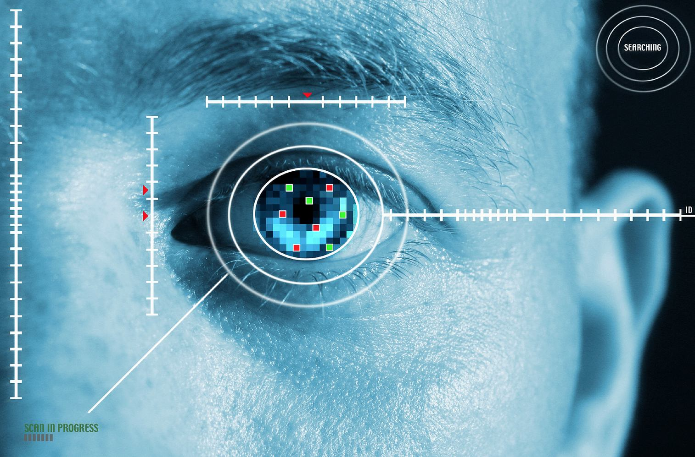
Authentication of biological characteristics
Authenticate by everyone's unique features.
like fringer print, iris.

Slide 15
Authentication of public key encryption algorithm
Like SSL (https), digital certificate, RSA (Rivest, Shamir, Adlemah)
There are a public key and a private key. And they are related mathematically.
Normally, we use public key to encrypt message, and private key to decrypt.
But in Authentication, user use private key to encrypt, and server use public key to decrypt, if decryption succeed, wa say that user is an authenticated user.

Slide 16
Cryptography
Asymmetric cryptography, like RSA.
And, there is symmetric cryptography, like DES (Data Encryption Standard), AES (Advanced Encryption Standard).

Slide 17
Symmetric cryptography
Say user A and B want to communicate, A sends message to B.
1. A encrypts a text message with key K1 to get an encrypted message C1.
2. A sends key K1 to B
3. A sends message C1 to B.
4. B uses K1 to decrypt C1, and get A’s text message.

Slide 18
Asymmetric cryptography
1. B has a mathematical paired key K1a and K1b, K1a is for encrypt and K1b is for decrypt.
2. B sends key K1a to A.
3. A uses K1a to encrypt his text message, gets encrypted message C1.
4. A sends C1 to B.
5. B uses key k1b to decrypt, and get A’s text message.

Slide 19
Cryptography
Asymmetric cryptography is more secure than symmetric cryptography, but symmetric cryptography takes less time to encrypt.

Slide 20
Caesar cipher
Another encryption algorithm: Caesar cipher, one of the simplest and most widely known encryption techniques.
In Caesar cipher, we choose an integer K as our key, and we shift or rotate alphabet k place to get a cipher alphabet.

Slide 21
Caesar cipher
Say k = 3.
Alphabet: a b c d e f g h I j k l m n o p q r s t u v w x y z
x y z a b c d e f g h I j k l m n o p q r s t u v w
So apple → xmmib, banana → yxkxkx
In decryption, user shift/rotate k place back.
Is Caser cipher symmetric or asymmetric?
Cipher alphabet (rotate 3 place):

