Slide 1
ESE 3014 Embedded System Communication Protocol and Security
Linchen Wang

Slide 2
Review
Prime number & coprime
Generate RSA public key and private key.

Slide 3
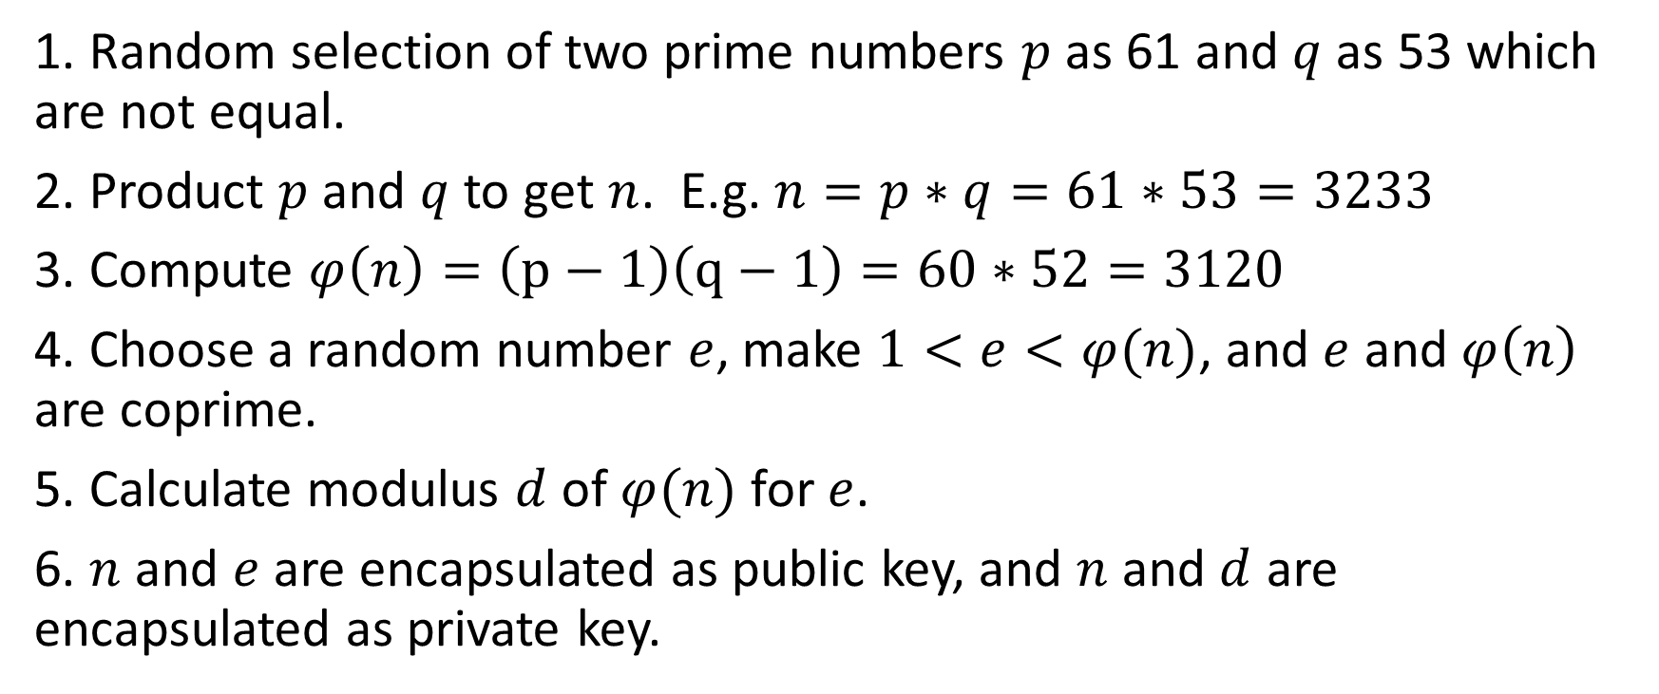
The process to create RSA keys
1. Random selection of two prime numbers $p$ as 61 and $q$ as 53 which are not equal.
2. Product $p$ and $q$ to get $n$. E.g. $n=p∗q=61∗53=3233$
3. Compute $φ\left(n\right)=\left(p−1\right)\left(q−1\right)=60∗52=3120$
4. Choose a random number $e$, make $1<e<φ(n)$, and $e$ and $φ\left(n\right)$ are coprime.
5. Calculate modulus $d$ of $φ(n)$ for $e$.
6. $n$ and $e$ are encapsulated as public key, and $n$ and $d$ are encapsulated as private key.

Slide 4

The process to create RSA keys
In our process, we get $p, q, n, φ\left(n\right), e, d$
Public key will use $n$ and $e$, and the other number are not public.

Slide 5
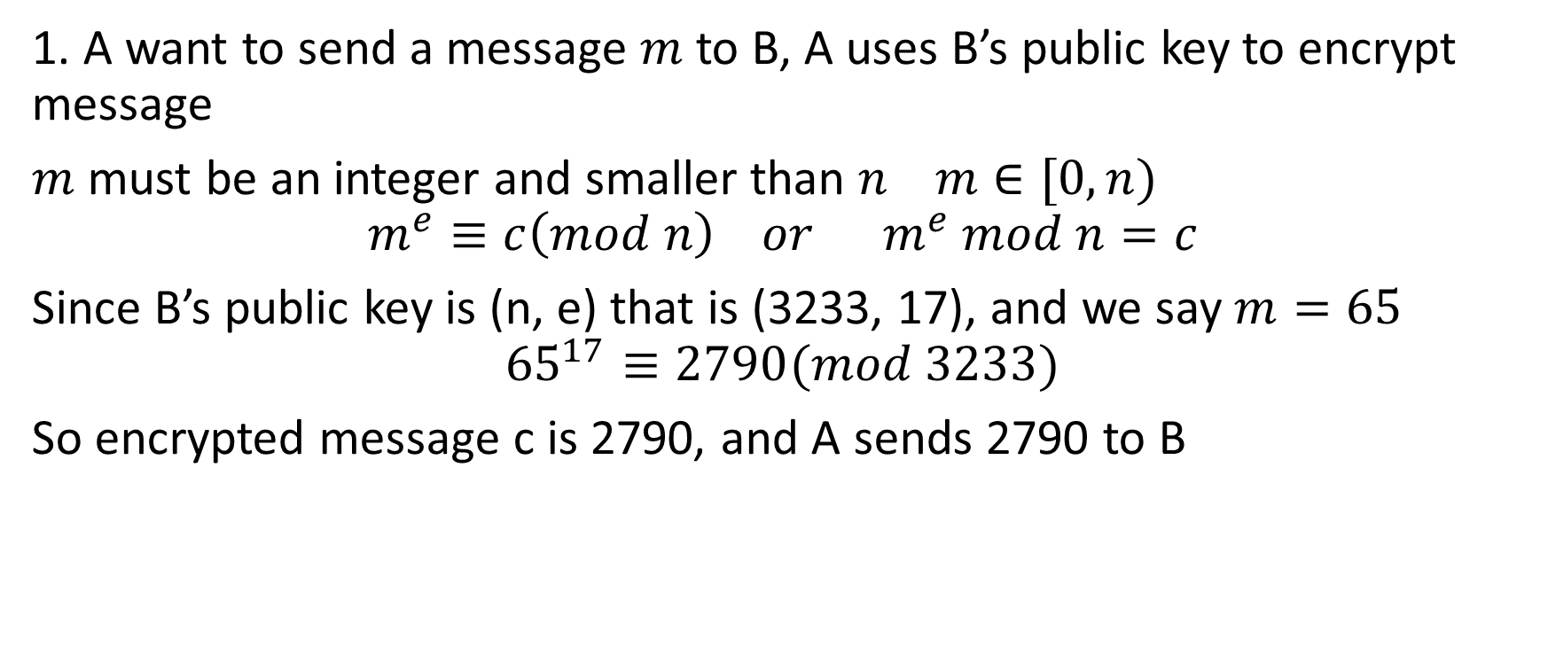
Encrypt and decrypt with RSA
1. A want to send a message $m$ to B, A uses B’s public key to encrypt message
$m$ must be an integer and smaller than $n m∈[0,n)$
$$m^{e}≡c\left(mod n\right) or m^{e} mod n=c$$
Since B’s public key is (n, e) that is (3233, 17), and we say $m=65$
$${65}^{17}≡2790(mod 3233)$$
So encrypted message c is 2790, and A sends 2790 to B

Slide 6
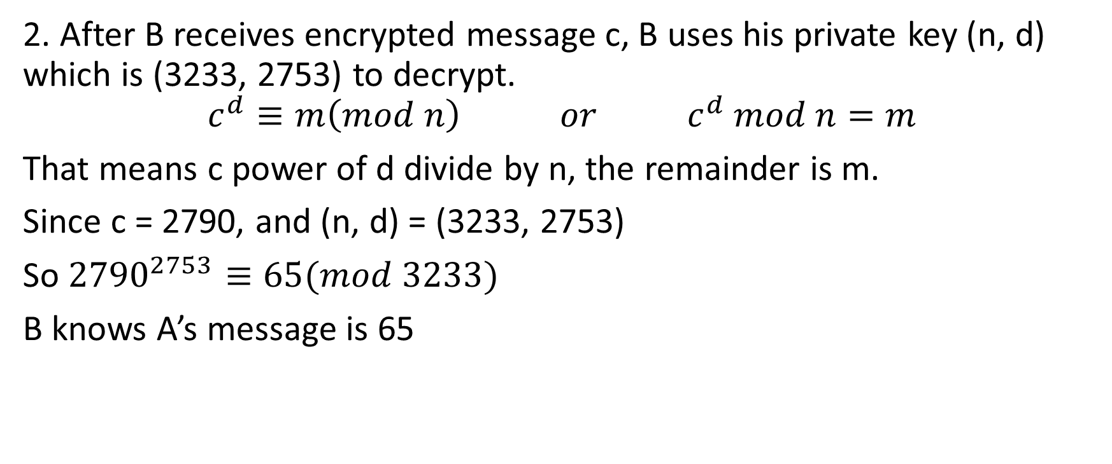
Encrypt and decrypt with RSA
2. After B receives encrypted message c, B uses his private key (n, d) which is (3233, 2753) to decrypt.
$$c^{d}≡m\left(mod n\right) or c^{d} mod n=m$$
That means c power of d divide by n, the remainder is m.
Since c = 2790, and (n, d) = (3233, 2753)
So ${2790}^{2753}≡65(mod 3233)$
B knows A’s message is 65

Slide 7
Encrypt and decrypt with RSA
So if we don’t know d, then we can not get m (message) from c (encrypted message). And to know d, we must factorize n. Because factorization a huge number n is extremely hard, RSA algorithm ensures the security of communication.
You may ask public key (n, e) an only encrypt message m < n, then how about we want to encrypt a message bigger than n?

Slide 8
Encrypt and decrypt with RSA
Two ways:
1. The long information divided into several section of short message, and encrypt them respectively.
2. Use a symmetry encryption algorithm, like DES and then use RSA public key to encrypt DES encrypted message.

Slide 9
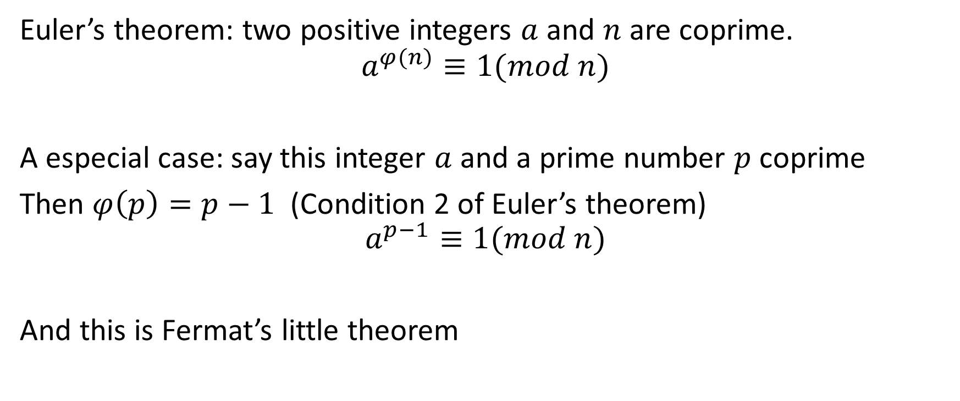
Encrypt and decrypt with RSA
Euler’s theorem: two positive integers $a$ and $n$ are coprime.
$$a^{φ(n)}≡1(mod n)$$
A especial case: say this integer $a$ and a prime number $p$ coprime
Then $φ\left(p\right)=p−1$ (Condition 2 of Euler’s theorem)
$$a^{p−1}≡1(mod n)$$
And this is Fermat’s little theorem

Slide 10
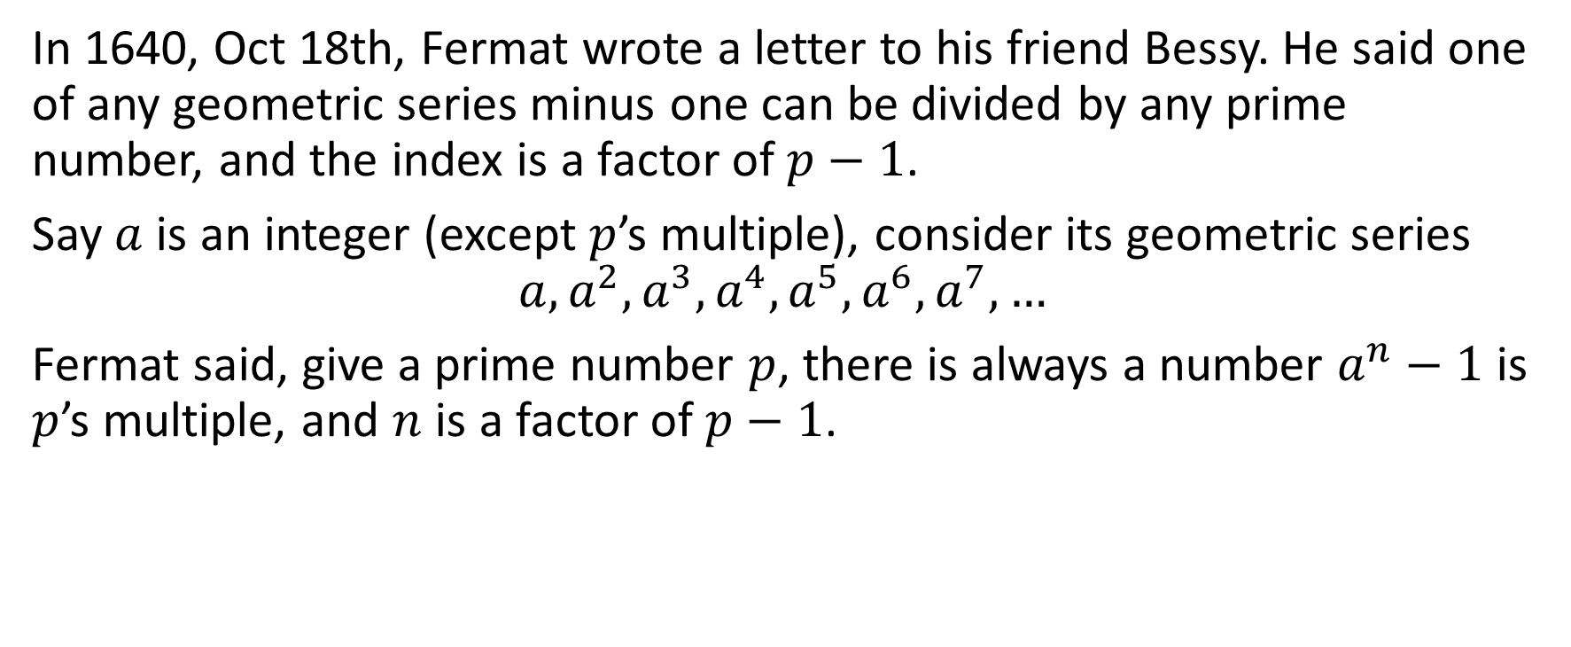
Encrypt and decrypt with RSA
In 1640, Oct 18th, Fermat wrote a letter to his friend Bessy. He said one of any geometric series minus one can be divided by any prime number, and the index is a factor of $p−1$.
Say $a$ is an integer (except $p$’s multiple), consider its geometric series
$$a,a^{2},a^{3},a^{4},a^{5},a^{6},a^{7},…$$
Fermat said, give a prime number $p$, there is always a number $a^{n}−1$ is $p$’s multiple, and $n$ is a factor of $p−1$.

Slide 11
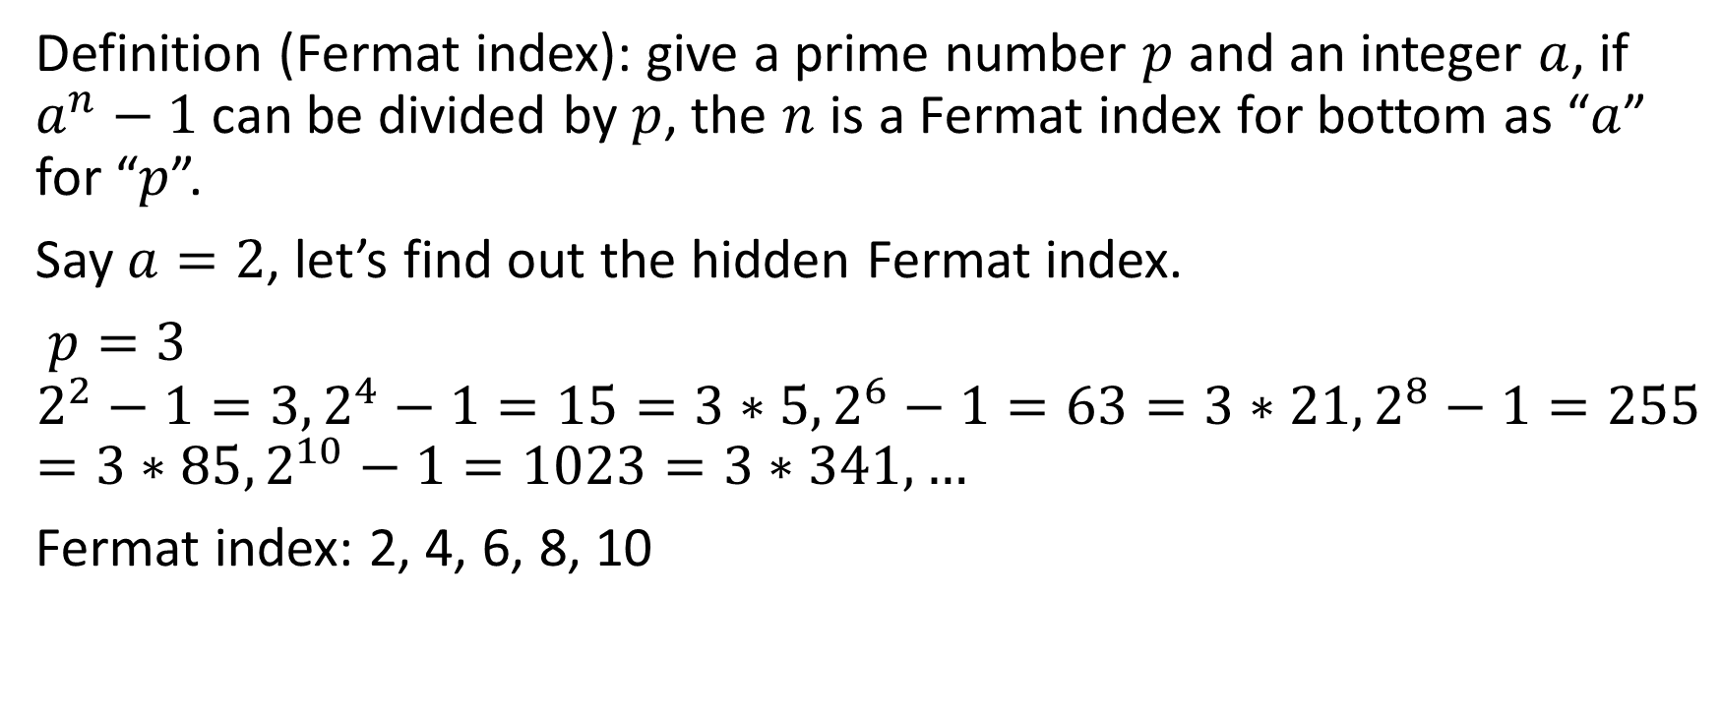
Encrypt and decrypt with RSA
Definition (Fermat index): give a prime number $p$ and an integer $a$, if $a^{n}−1$ can be divided by $p$, the $n$ is a Fermat index for bottom as “$a$” for “$p$”.
Say $a=2$, let’s find out the hidden Fermat index.
$p=3$
$$2^{2}−1=3, 2^{4}−1=15=3∗5, 2^{6}−1=63=3∗21, 2^{8}−1=255=3∗85, 2^{10}−1=1023=3∗341,…$$
Fermat index: 2, 4, 6, 8, 10

Slide 12
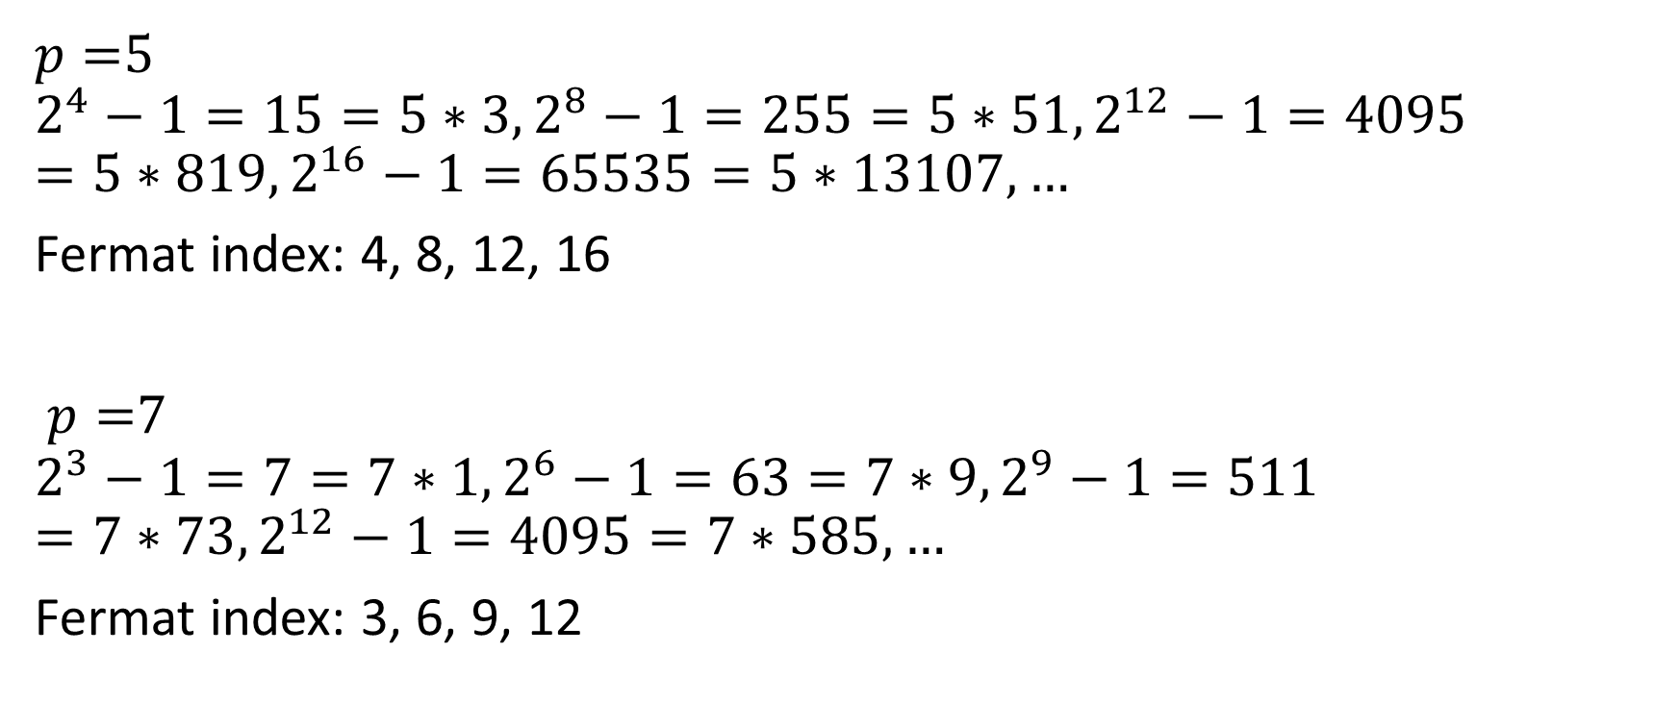
Encrypt and decrypt with RSA
$p=$5
$$2^{4}−1=15=5∗3, 2^{8}−1=255=5∗51, 2^{12}−1=4095=5∗819, 2^{16}−1=65535=5∗13107,…$$
Fermat index: 4, 8, 12, 16
$p=$7
$$2^{3}−1=7=7∗1, 2^{6}−1=63=7∗9, 2^{9}−1=511=7∗73, 2^{12}−1=4095=7∗585,…$$
Fermat index: 3, 6, 9, 12

Slide 13

Encrypt and decrypt with RSA
$p=$11
$$2^{10}−1=1023=11∗93, 2^{20}−1=1048578=11∗95325, 2^{30}−1=1073741823=11∗797612893, …$$
Fermat index: 10, 20, 30
Any rule of them?

Slide 14
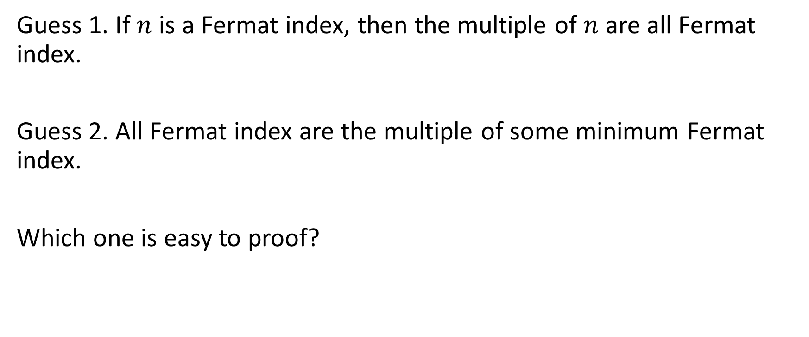
Encrypt and decrypt with RSA
Guess 1. If $n$ is a Fermat index, then the multiple of $n$ are all Fermat index.
Guess 2. All Fermat index are the multiple of some minimum Fermat index.
Which one is easy to proof?

Slide 15
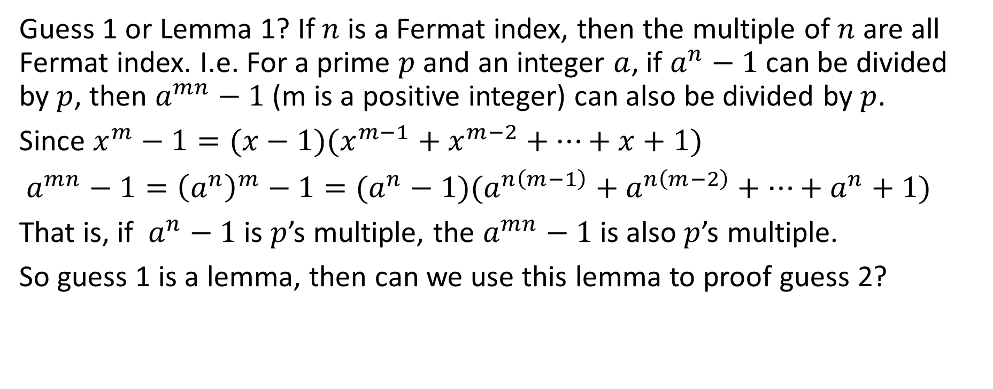
Encrypt and decrypt with RSA
Guess 1 or Lemma 1? If $n$ is a Fermat index, then the multiple of $n$ are all Fermat index. I.e. For a prime $p$ and an integer $a$, if $a^{n}−1$ can be divided by $p$, then $a^{mn}−1$ (m is a positive integer) can also be divided by $p$.
Since $x^{m}−1=(x−1)(x^{m−1}+x^{m−2}+…+x+1)$
$a^{mn}−1={\left(a^{n}\right)}^{m}−1=(a^{n}−1)(a^{n\left(m−1\right)}+a^{n\left(m−2\right)}+…+a^{n}+1)$
That is, if $a^{n}−1$ is $p$’s multiple, the $a^{mn}−1$ is also $p$’s multiple.
So guess 1 is a lemma, then can we use this lemma to proof guess 2?

Slide 16

Encrypt and decrypt with RSA
No, it is an illusion, say a set combine multiple of 2 and 3,
$$\left\{2,4,6,8,10,…\right\}∪\left\{3,6,9,12,15,…\right\}=\left\{2,3,4,6,8,9,10,12,15,…\right\}$$
Every number’s multiple are in this set, but not all the number are the multiple of minimum Fermat index 2. So this lemma is not enough to proof guess 2.

Slide 17
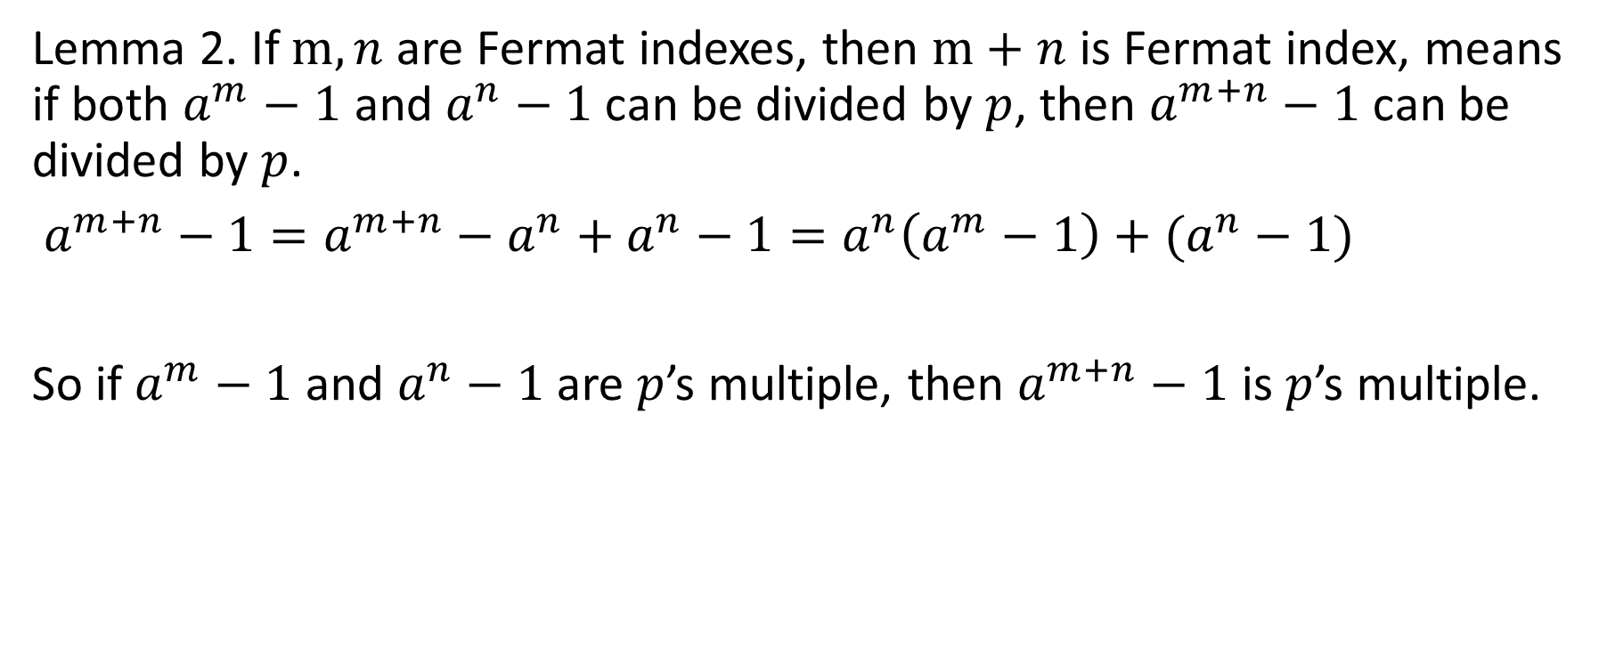
Encrypt and decrypt with RSA
Lemma 2. If $m,n$ are Fermat indexes, then $m+n$ is Fermat index, means if both $a^{m}−1$ and $a^{n}−1$ can be divided by $p$, then $a^{m+n}−1$ can be divided by $p$.
$a^{m+n}−1=a^{m+n}−a^{n}+a^{n}−1=a^{n}\left(a^{m}−1\right)+(a^{n}−1)$
So if $a^{m}−1$ and $a^{n}−1$ are $p$’s multiple, then $a^{m+n}−1$ is $p$’s multiple.

Slide 18
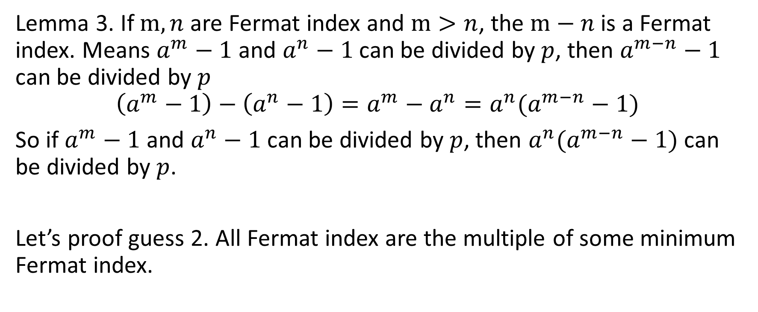
Encrypt and decrypt with RSA
Lemma 3. If $m,n$ are Fermat index and $m>n$, the $m−n$ is a Fermat index. Means $a^{m}−1$ and $a^{n}−1$ can be divided by $p$, then $a^{m−n}−1$ can be divided by $p$
$$\left(a^{m}−1\right)−\left(a^{n}−1\right)=a^{m}−a^{n}=a^{n}(a^{m−n}−1)$$
So if $a^{m}−1$ and $a^{n}−1$ can be divided by $p$, then $a^{n}(a^{m−n}−1)$ can be divided by $p$.
Let’s proof guess 2. All Fermat index are the multiple of some minimum Fermat index.

Slide 19
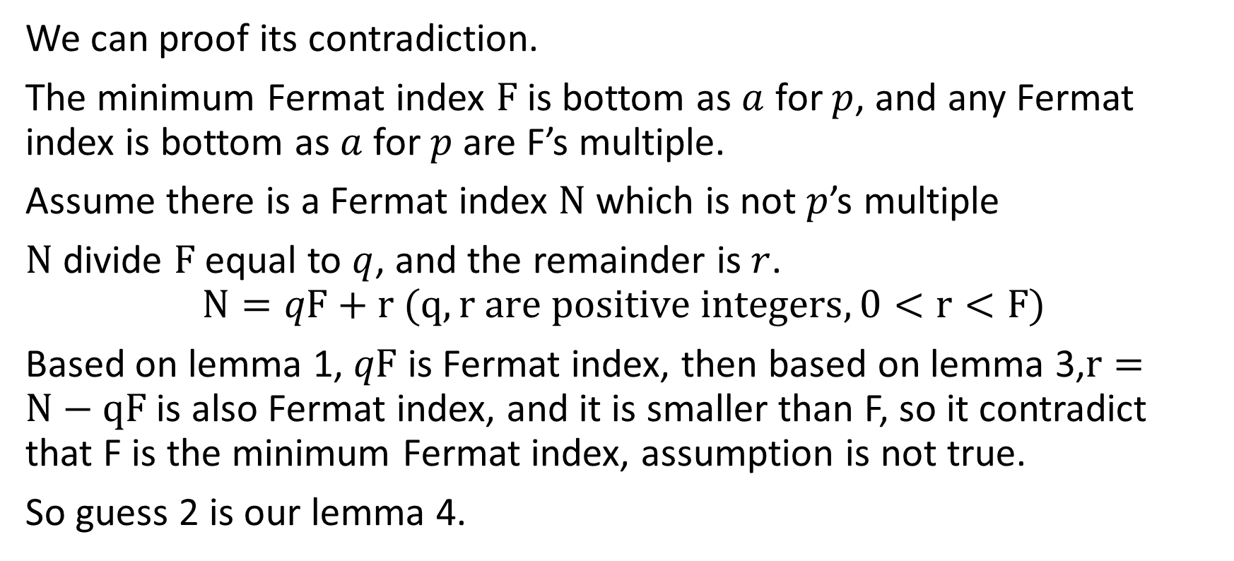
Encrypt and decrypt with RSA
We can proof its contradiction.
The minimum Fermat index $F$ is bottom as $a$ for $p$, and any Fermat index is bottom as $a$ for $p$ are F’s multiple.
Assume there is a Fermat index $N$ which is not $p$’s multiple
$N$ divide $F$ equal to $q$, and the remainder is $r$.
$$N=qF+r (q,r are positive integers, 0<r<F)$$
Based on lemma 1, $qF$ is Fermat index, then based on lemma 3,$r=N−qF$ is also Fermat index, and it is smaller than F, so it contradict that F is the minimum Fermat index, assumption is not true.
So guess 2 is our lemma 4.

