Slide 1
ESE 3014 Embedded System Communication Protocol and Security
Linchen Wang

Slide 2
Outline
Multiplexing
CDMA

Slide 3
Multiplexing
Multiplexing: a method by which multiple signal are combined into one signal over a shared medium.
Frequency-division multiplexing: combining of several signal into one medium by sending signal in several distinct frequency ranges over a single medium.
Rogers, Telus, Bell: Band 2 850MHZ 824~849 ↑ 869~894 ↓
Band 5 1900MHZ 1850~1910 ↑ 1930~1990 ↓
Freedom Mobile : Band 4 1700MHZ 1710~1755 ↑ 2110~2155 ↓

Slide 4
Multiplexing
Time-division multiplexing: it uses time frame to separate the different data stream over shared medium.
Conversation A A
Conversation B B
Conversation C C
Need time synchronization
Time t
Time t+1

Slide 5
Multiplexing
Code-division multiplexing: multiple data signals are combined for simultaneous transmission over a common frequency bandwidth. And when CDM is used to allow multiple users to share a single communication channel, the technology is called code division multiple access (CDMA)
Why we choose CDMA, it doesn’t require the bandwidth allocation of FDM, not the time synchronization needed in TDM. Most important, it can minimize the interference from each other (users).

Slide 6
CDMA
How I understand CDMA, like Caesar cipher, we assign a specific code for a pair of user, only this pair of user can understand each other by using this specific code, and all other message will be considered as noise.
One example as mask card of ooc in OCDMA.

Slide 7
OCDMA
We call each piece ``chip”
Unordered message
Cover user A’s mask card, and get A’s message ``LOVE”
Cover user B’s mask card, and get B’s message ``YORK”

Slide 8
CDMA
Another example can be consider as language.
If you know a language, then you have this specific code of language in your brain.
You can understand the language you know, and filtrate the language you don’t know.

Slide 9
CDMA
Say you are on a train of a long journey, and you are sleepy. But there are two guys sit behind you are chatting.
Case 1. You don’t know their language, and you don’t have the code of this language in your brain, so you have no idea what they are talking about, and you can consider the voice is noise. You can keep sleeping if their voice is not loud.
Case 2. You know their language, and you have the code of this language in your brain. So you know what they are talking about, and it will be hard for you to keep sleep.

Slide 10
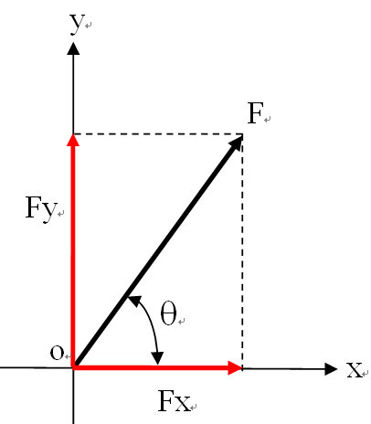
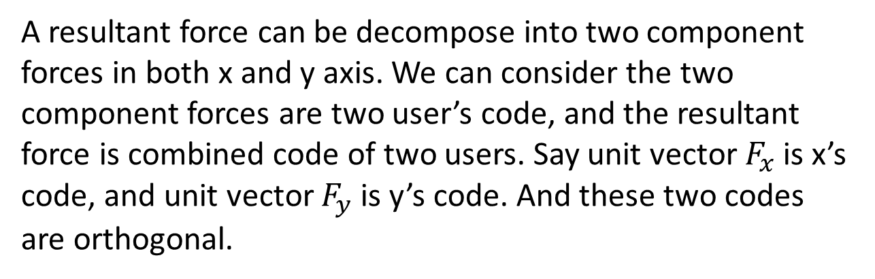
CDMA
Now, you may know what is code in CDMA. But how to make these code to minimize interference in multiple access?
The codes should be orthogonal.
To understand orthogonality of code.
Think about a vector in coordinate system.
A resultant force can be decompose into two component forces in both x and y axis. We can consider the two component forces are two user’s code, and the resultant force is combined code of two users. Say unit vector $F_{x}$ is x’s code, and unit vector $F_{y}$ is y’s code. And these two codes are orthogonal.

Slide 11
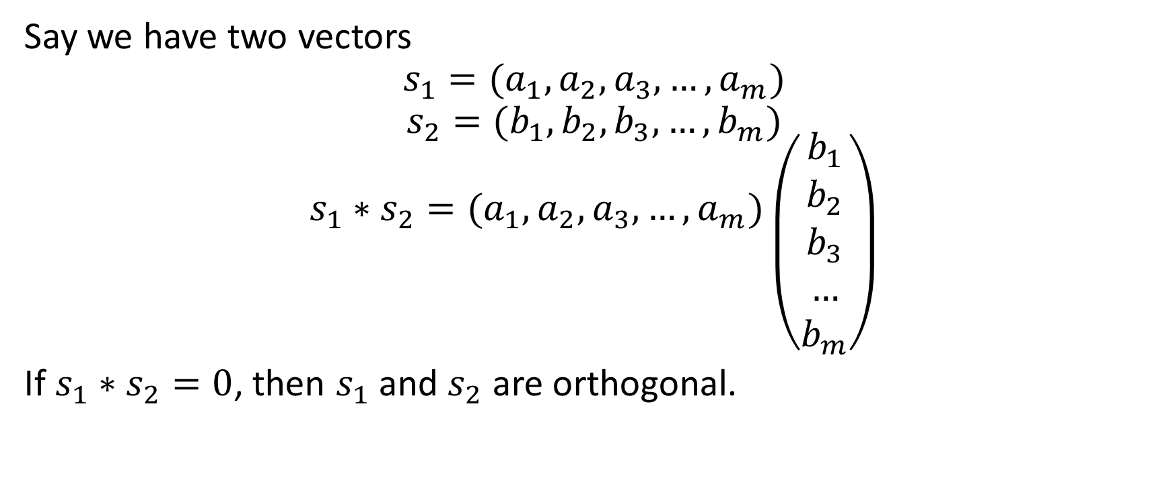
CDMA
Say we have two vectors
$$s_{1}=(a_{1},a_{2},a_{3},…,a_{m})$$
$$s_{2}=(b_{1},b_{2},b_{3},…,b_{m})$$
$$s_{1}∗s_{2}=(a_{1},a_{2},a_{3},…,a_{m})\left({b_{1} \atop \begin{aligned}b_{2} \\ b_{3} \\ … \\ b_{m}\end{aligned}}\right)$$
If $s_{1}∗s_{2}=0$, then $s_{1}$ and $s_{2}$ are orthogonal.

Slide 12
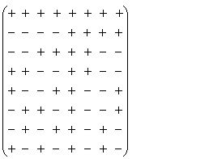
CDMA
How to get orthogonal vectors?
Walsh matrix
“+” is +1, “–” is -1, and in Walsh matrix, any two lines
or two columns are orthogonal.

Slide 13
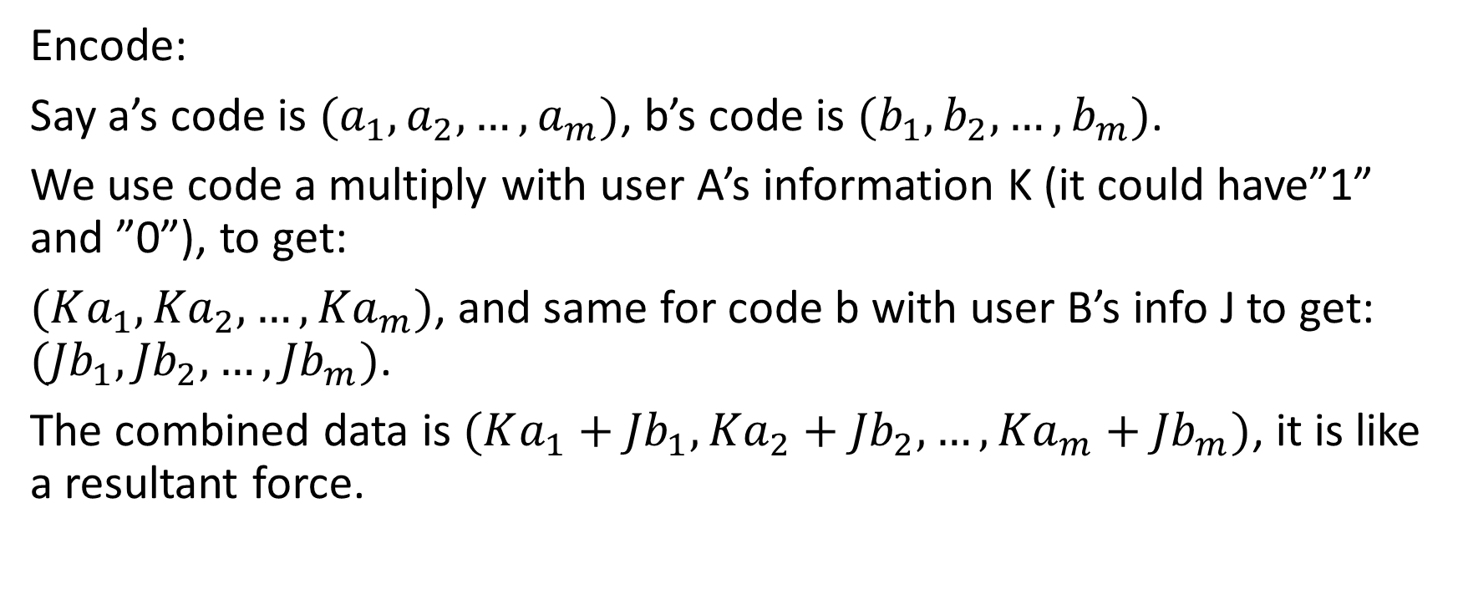
CDMA
Encode:
Say a’s code is $(a_{1},a_{2},…,a_{m})$, b’s code is $(b_{1},b_{2},…,b_{m})$.
We use code a multiply with user A’s information K (it could have”1” and ”0”), to get:
$(Ka_{1},{Ka}_{2}, …,{Ka}_{m})$, and same for code b with user B’s info J to get: $({Jb}_{1},{Jb}_{2},…,{Jb}_{m})$.
The combined data is $(Ka_{1}+{Jb}_{1},{Ka}_{2}+{Jb}_{2}, …,{Ka}_{m}+{Jb}_{m})$, it is like a resultant force.

Slide 14
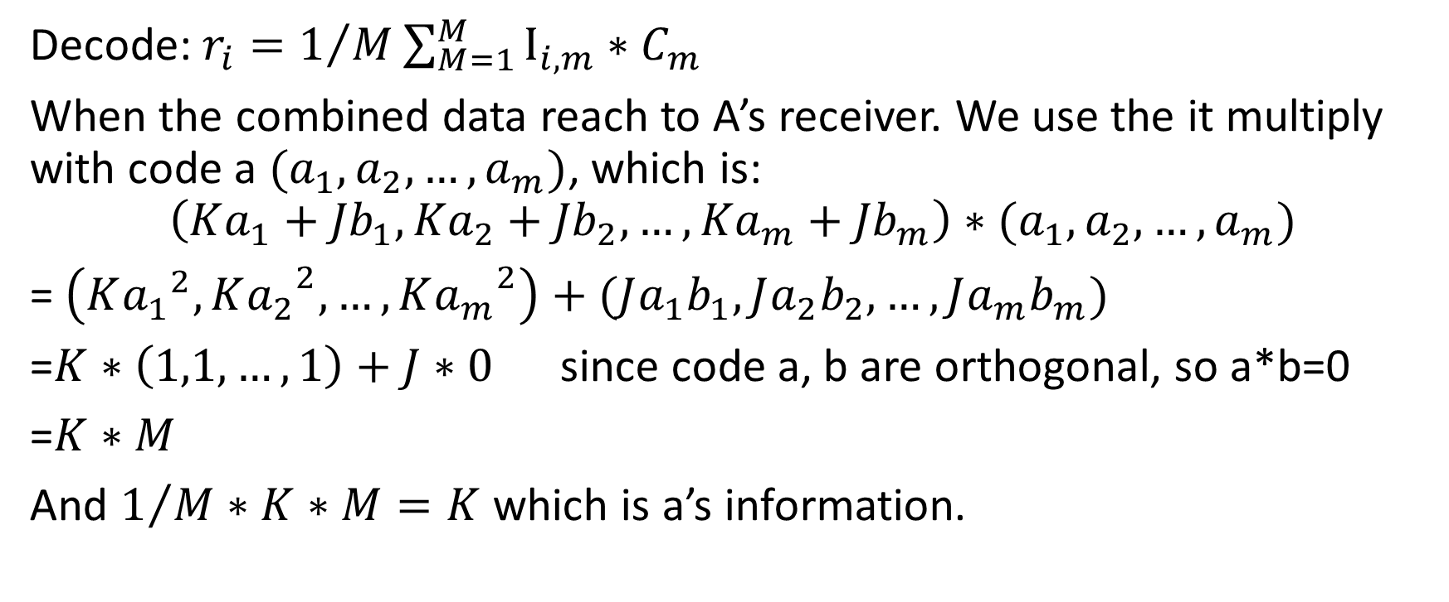
CDMA
Decode: $r_{i}=1/M\sum_{M=1}^{M}{I_{i,m}∗C_{m}}$
When the combined data reach to A’s receiver. We use the it multiply with code a $(a_{1},a_{2},…,a_{m})$, which is:
$$\left(Ka_{1}+{Jb}_{1},{Ka}_{2}+{Jb}_{2}, …,{Ka}_{m}+{Jb}_{m}\right)∗(a_{1},a_{2},…,a_{m})$$
= $\left(K{a_{1}}^{2},{Ka_{2}}^{2}, …,{Ka_{m}}^{2}\right)+({Ja_{1}b}_{1},{Ja_{2}b}_{2},…,{Ja_{m}b}_{m})$
=$K∗\left(1,1,…,1\right)+J∗0$ since code a, b are orthogonal, so a*b=0
=$K∗M$
And $1/M∗K∗M=K$ which is a’s information.

Slide 15

CDMA
How to understand it?
E.g. user A chooses line 2
$a_{1}$= (-1 -1 -1 -1 1 1 1 1)
User B chooses line 7
$a_{2}$ = (-1 1 -1 1 1 -1 1 -1)
And, user A’s information is 110
user B’s information is 010

Slide 16
CDMA
Let’s encode, user A’s message:
(-1 -1 -1 -1 1 1 1 1)|(-1 -1 -1 -1 1 1 1 1)|(0 0 0 0 0 0 0 0 0)
User B’s message:
(0 0 0 0 0 0 0 0 0)|(-1 1 -1 1 1 -1 1 -1)|(0 0 0 0 0 0 0 0 0)
And we combine these two message:
(-1 -1 -1 -1 1 1 1 1)|(-2 0 -2 0 2 0 2 0)|(0 0 0 0 0 0 0 0 0)
You can consider this is a resultant force.

Slide 17
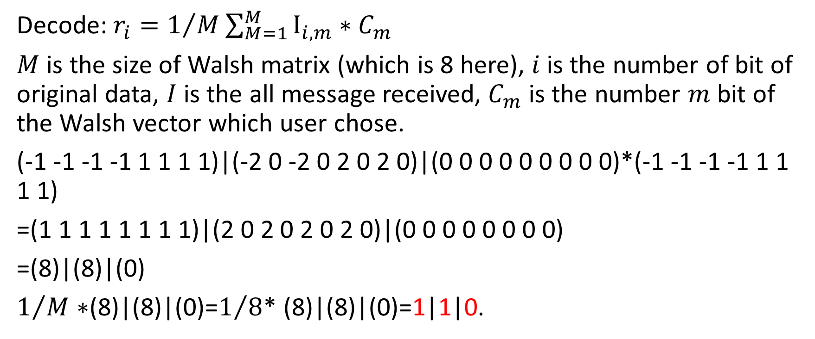
CDMA
Decode: $r_{i}=1/M\sum_{M=1}^{M}{I_{i,m}∗C_{m}}$
$M$ is the size of Walsh matrix (which is 8 here), $i$ is the number of bit of original data, $I$ is the all message received, $C_{m}$ is the number $m$ bit of the Walsh vector which user chose.
(-1 -1 -1 -1 1 1 1 1)|(-2 0 -2 0 2 0 2 0)|(0 0 0 0 0 0 0 0 0)*(-1 -1 -1 -1 1 1 1 1)
=(1 1 1 1 1 1 1 1)|(2 0 2 0 2 0 2 0)|(0 0 0 0 0 0 0 0)
=(8)|(8)|(0)
$1/M∗$(8)|(8)|(0)=$1/8$* (8)|(8)|(0)=1|1|0.

