Slide 1


POLICE CRIME RECORD MANAGEMENT
PRESENTED BY-
DARSH JAIN
AMAN USMANI
MD KAIF SHAIKH

Slide 2

INDEX
………..
INTRODUCTION
E-R DIAGRAM
SCHEMA DIAGRAM
FUNCTIONALTIES
TECHNOLOGY USED
CONCLUSION
REFERNCE
.................................................
.................................................
.................................................
.................................................
.................................................
.................................................
.................................................

Slide 3

Introduction
The proposed system applies to all Police stations across the city and specifically looks into the subject of Crime Records Management. It is well understood that Crime Prevention, Detection and Conviction of criminals depend on a highly responsive backbone of Information Management System.
It is proposed to centralize Information Management in Crime for the purposes of fast and efficient sharing of critical information across all Police Stations across the territory. The project has been planned to be having the view of distributed architecture, with centralized storage of the database.
The application for the storage of the data has been planned. Using the constructs of SQL server and all the user interfaces have been designed using the JS technologies. The application takes care of different modules and their associated reports, which are produced as per the applicable strategies and standards that are put forwarded by the administrative staff

Slide 4

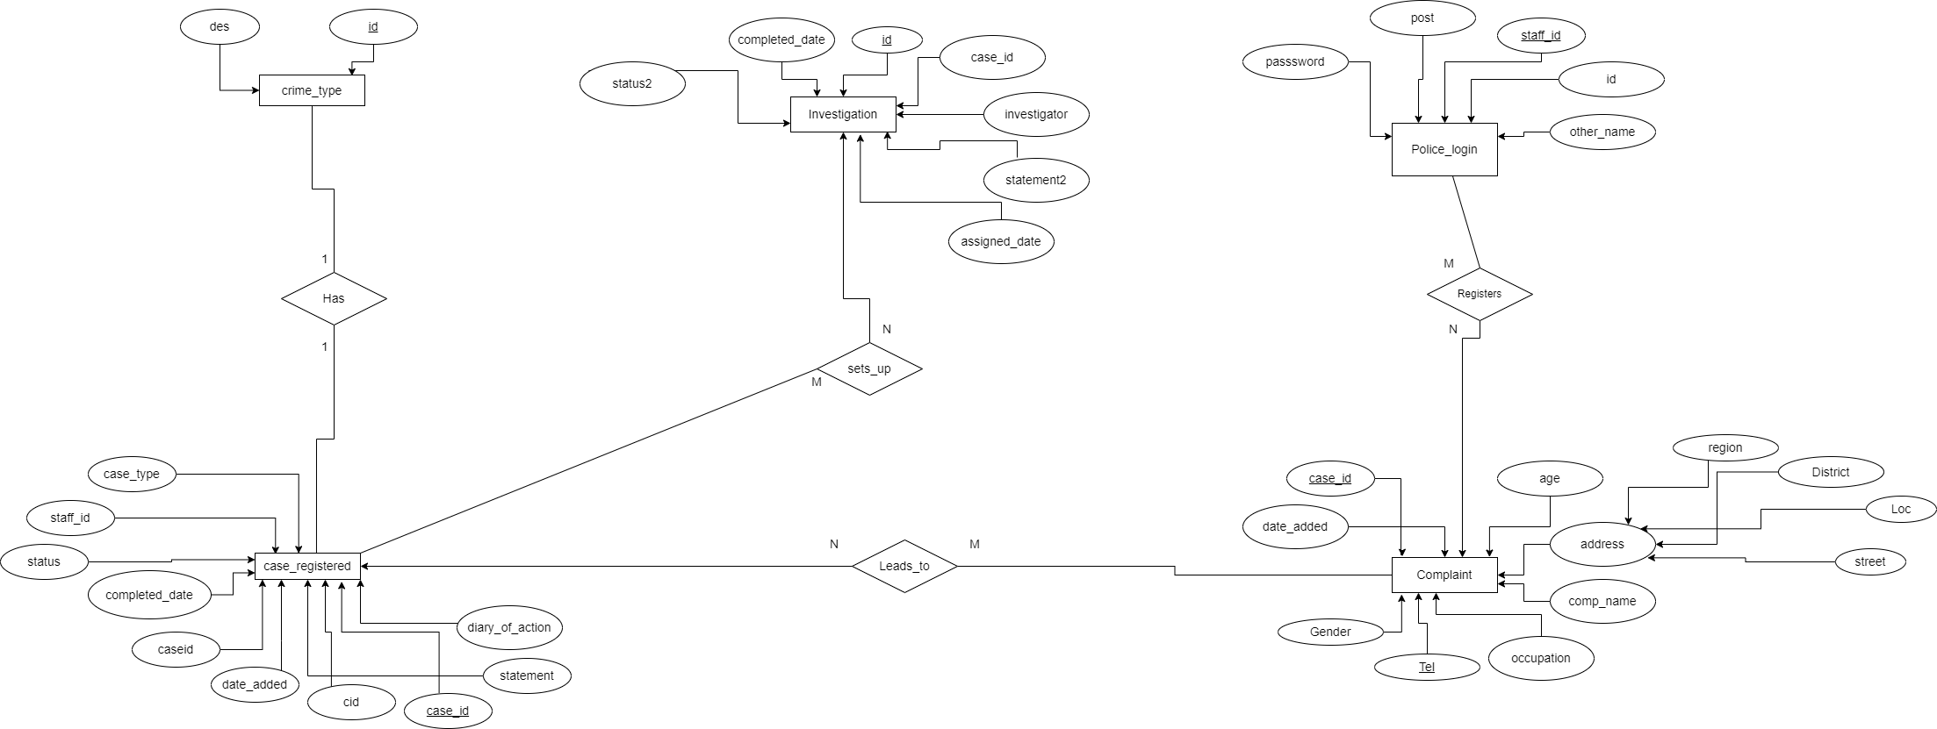
E-R DIAGRAM

Slide 5
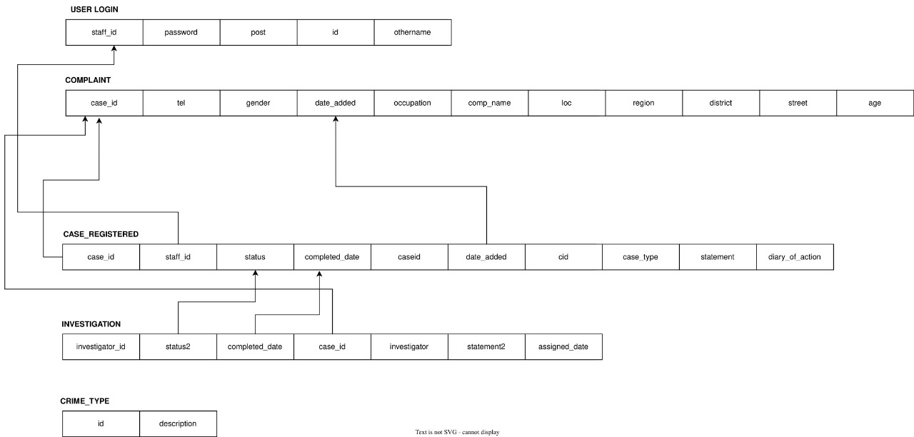
SCHEMA DIAGRAM

Slide 6

FUNCTIONALITIES
• Online complaint portal for prompt action against criminals
• Appending data of new police staff
• No data redundancy- Quick information processing
• Marinating criminal records
• View list of complains
• View details of case investigation
• Admin can assign a case to CID Officer
• Manage Account/Change Password

Slide 7
Front end Database Back-end •HTML MySQL PHP •CSS •JavaScript (jQuery) •Bootstrap Framework
TECHNOLOGIES USED

Slide 8
CONCLUSION
………..
The project titled “Police Crime Record Management System ”is a web based application. The framework provides facility for reporting online crimes, complaints of missing individuals.
The need for a computerized platform for crime record management cannot be overemphasized.
CRMS enhances proper and efficient management of criminal records by the police department thereby helping in making informed decisions and improving reliability thus improving law enforcement operations.
This results in lower crime rate in the country thereby increasing national security

Slide 9
REFERENCES (BIBLIOGRAPHY)
………..
criminal justice information management system. (2010). Retrieved from www.replaceportal.com: http://www.replaceportal.com/what-we-do/criminal-justiceinformation-system-(crimsys).html
Falaye, A., Adama, N., & Agemerien, F. (2013, November). Design And Implementation Of Crime Investigation System Using Biometric Approach(Nigeria Police Force). The pacicific journal of science and technlogy.
Kawai, D., & Samson, D. (2011). Development Of A Criminals Record Management System. Information Technology for People Centred Development, 1-8.

Slide 10
THANK YOU

