Slide 1

Hotel Aggregator Analysis
Power bi

Slide 2
Data set
1. id: Unique identifier for each listing.
2. listing_url: URL of the listing on the hotel aggregator platform.
3. scrape_id: Identifier for the data scraping event.
4. last_scraped: Date of the last data scrape.
5. source: Source of the listing information.
6. name: Name of the listing.
7. description: Description of the listing.
8. neighborhood_overview: Overview of the neighborhood where the listing is located.
9. picture_url: URL of the listing's picture.
10. host_id: Unique identifier for the host.
11. ... (and many more columns capturing details about hosts, location, property type, room details,
amenities, pricing, availability, reviews, and other relevant information)

Slide 3
introduction
Interns analyze a hotel aggregator dataset using Power BI to visualize trends and factors affecting listing
performance. Tasks include geographical insights, pricing analysis, host evaluation, review scores
examination, and property/room type analysis. Deliverables include interactive dashboards and reports
with recommendations for hosts and the platform.

Slide 4
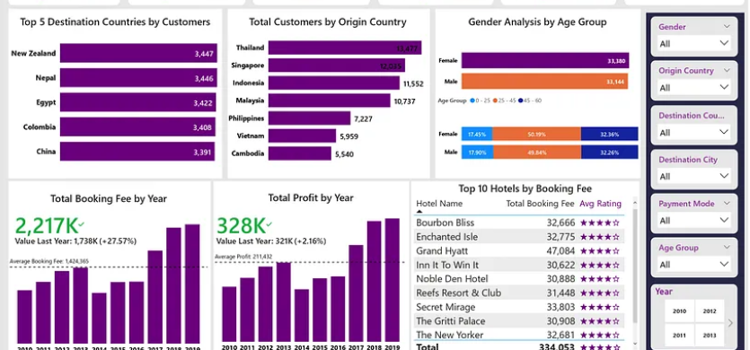

Slide 5
Thank you

