Slide 1
Think Green Investing Project 3
Amany El Gouhary, Nicolas Hernandez Al Bakomito, Katharine Zenta

Slide 2

Project analysis slide 2
AGENDA
PROJECT 2 RECAP
2. PROJECT 3
HYPOTHESIS
3. DATA DISCOVERY
AND SENTIMENT ANALYSIS
Investing
4. MACHINE LEARNING
& FINDINGS
5. KEY TAKEAWAYS

Slide 3




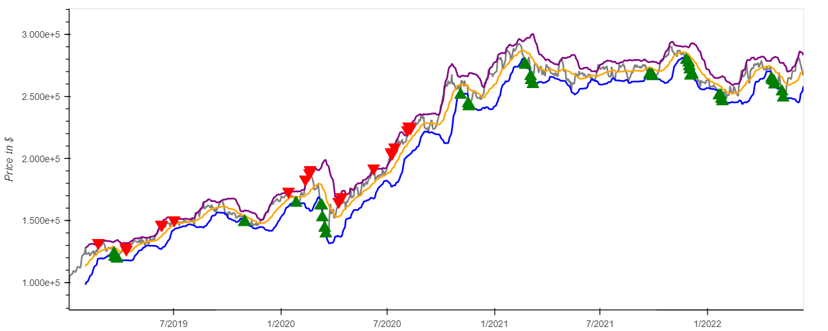
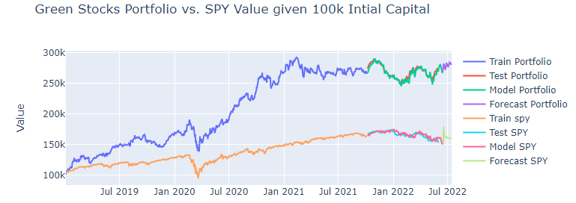
Project analysis slide 2
Project 2 Recap
EXPLORATION
Green stocks outperformed SP500 since 2019: increased solar projects, post covid recovery, Russia – Ukraine war.
ALGO
TRADING
Green Energy stocks double the profit vs SP500 driven by SEDG.
MACHINE LEARNING
NEXT STEPS
Consider more variables for this LSTM model and explore alternatives ML models to predict the performance of the portfolio vs SP500
Based on our LSTM simple model, Green Stocks were expected to continue to outperform the SP500

Slide 4



Project analysis slide 2
Project 3
Key Questions
Can we use historical Revenue, EPS and closing prices to predict future performance?
Can we create an interactive dashboard allowing under-served retail investors to use fundamental data (EPS, P/E, Revenue) to help inform their investment decisions?
What other companies can we compare our Portfolio to?
Major fossil fuel companies with strong revenues and profits.

Slide 5



Project analysis slide 3
Data Discovery &
Analysis
Data Sourcing
Exploration
Machine Learning
NLP
Deployment
Challenges with deep learning…
Solution:
Classification model
LSTM
Data pulled from
Google News API
Function pulls daily closing prices, PEs, EPS and Revenue for tickers in the given time period
Different timeframes for training and testing of models
Deploy Classification code into a .py to navigate in Streamlit

Slide 6
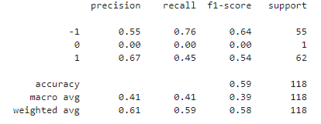
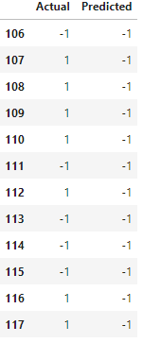
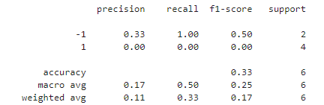
Project analysis slide 3
ML Classification model
Including Fundamentals
Last 12 Weeks
W/O Fundamentals

Slide 7
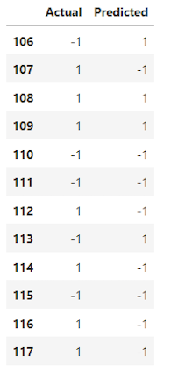
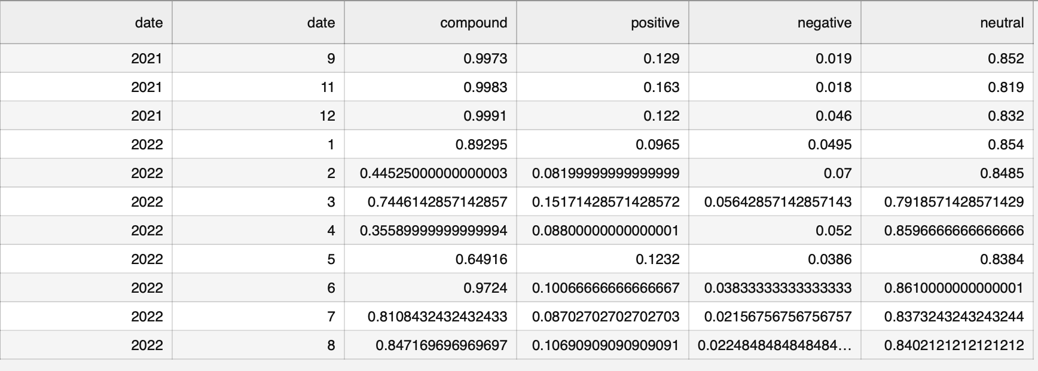
Project analysis slide 3
Sentimental Analysis
First Solar Inc. FSLR

Slide 8
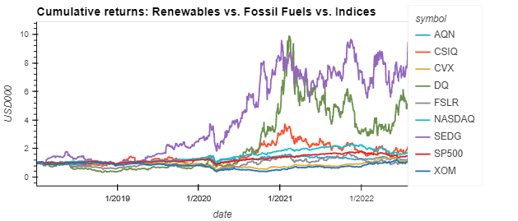
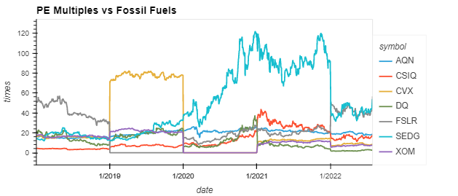
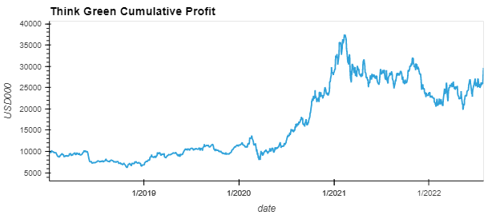
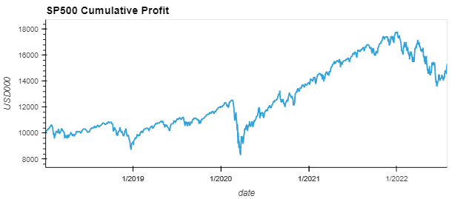
Project analysis slide 3
Fundamental Analysis
Think Green vs. Fossil Fuels vs. Indices
PEs high, but justified
TFG achieved double SP500 cumulative returns through the cycle

Slide 9


Project analysis slide 3
Streamlit Deployment

Slide 10
Thank You

