Slide 1

Full stack diploma
Css3

Slide 2

Block Elements
A block-level element always starts on a new line and takes up the full width available (stretches out to the left and right as far as it can).
Example:
<div>
<h1> - <h6>
<p>
<form>
<header>
<footer>
<section>
V 2.0

Slide 3
Inline Elements
An inline element does not start on a new line and only takes up as much width as necessary. This is a paragraph.
Example:
<span>
<a>
<img>
an inline <span> element inside
V 2.0

Slide 4
Font Family
The font-family property can hold several font names as a "fallback" system. If the browser does not support the first font, it tries the next font.
Example:
p {
font-family: "Times New Roman", Times, serif;
}
V 2.0

Slide 5
Font Size
The font-size property sets the size of a font.
Example:
div.a {
font-size: 15px;
}
div.b {
font-size: large;
}
div.c {
font-size: 150%;
}
V 2.0

Slide 6
Borders
The CSS border properties allow you to specify the style, width, and color of an element's border.
The border-style property specifies what kind of border to display.
The following values are allowed:
ridge : Defines a 3D ridged border. The effect depends on the border-color value
inset : Defines a 3D inset border. The effect depends on the border-color value
outset : Defines a 3D outset border. The effect depends on the border-color value
none : Defines no border
hidden : Defines a hidden border
dotted : Defines a dotted border
dashed : Defines a dashed border
solid : Defines a solid border
double : Defines a double border
groove : Defines a 3D grooved border. The effect depends on the border-color value
V 2.0

Slide 7
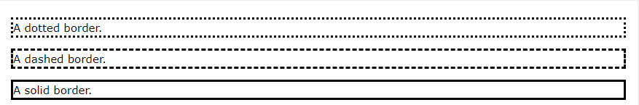
Borders
Example:
p.dotted {border-style: dotted;}
p.dashed {border-style: dashed;}
p.solid {border-style: solid;}
V 2.0

Slide 8
Text Decoration
The text-decoration property specifies the decoration added to text, and is a shorthand property for:
text-decoration-line (required): Sets the kind of text decoration to use (like underline, overline, line-through)
text-decoration-color: Sets the color of the text decoration.
text-decoration-style: Sets the style of the text decoration (like solid, wavy, dotted, dashed, double).
V 2.0

Slide 9
Text Decoration
Example:
div.a {
text-decoration-line: underline;
text-decoration-style: solid;
text-decoration-color: red;
}
V 2.0

Slide 10
Text Decoration
Example:
div.b {
text-decoration-line: underline;
text-decoration-style: wavy; text-decoration-color: blue;
}
V 2.0

Slide 11
Text Decoration
Example:
div.c {
text-decoration-line: underline;
text-decoration-style: double;
text-decoration-color: green;
}
V 2.0

Slide 12
Text Decoration
Example:
div.d {
text-decoration-line: overline underline;
text-decoration-style: wavy;
text-decoration-color: cyan;
}
V 2.0

Slide 13
Text -align
The text-align property specifies the horizontal alignment of text in an element.
CSS Syntax:
text-align: left|right|center|justify|initial|inherit;
left: Aligns the text to the left.
right: Aligns the text to the right.
center: Centers the text.
justify: Stretches the lines so that each line has equal width (like in newspapers and magazines)
initial: Sets this property to its default value.
inherit: Inherits this property from its parent element.
V 2.0

Slide 14
Text -transform
The text-transform property controls the capitalization of text.
Example:
div.a {
text-transform: uppercase; /*transform the selected text to uppercase*/
}
div.b {
text-transform: lowercase; /*transform the selected text to lowercase */
}
div.c {
text-transform: capitalize;
/*automatically capitalize the first letter of each word within the selected text*/
}
V 2.0

Slide 15
CSS Variables
The var() function is used to insert the value of a CSS variable.
CSS variables have access to the DOM, which means that you can create variables with local or global scope, change the variables with JavaScript, and change the variables based on media queries.
CSS variables can also be used to store numbers as values to be used in calculations, you can check an example at page 15.
A good way to use CSS variables is when it comes to the colors of your design. Instead of copy and paste the same colors over and over again, you can place them in variables.
To create a variable with global scope, declare it inside the :root selector.
V 2.0

Slide 16
CSS Variables
Example:
If a variable is to be used only one single place, we could also declare a new local variable like this:
button {
--button-blue: #0000ff; /*this variable will be used only inside the button scope. */ background-color: var(--white);
color: var(--button-blue);
border: 1px solid var(--button-blue); padding: 5px;
}
V 2.0

Slide 17
CSS Variables
Example:
:root {
--blue: #1e90ff;
--white: #ffffff;
}
Now we can call the variable to specify any color within the CSS style sheet using the var() method.
.container {
color: var(--blue);
background-color: var(--white); padding: 15px;
}
V 2.0

Slide 18
CSS advanced selectors
In CSS, selectors are patterns used to select the element(s) you want to style.
In the advanced selectors you can call the parent element and specify their child elements in order to style them easily.
You can check the different patterns of selecting the elements through this reference link: https://www.w3schools.com/cssref/css_selectors.asp
V 2.0

Slide 19
CSS Height Property
The height property sets the height of an element.
The height of an element does not include padding, borders, or margins!
If height: auto; the element will automatically adjust its height to allow its content to be displayed correctly.
The max-height property defines the maximum height of an element.
If the content is larger than the maximum height, it will overflow. How the container will handle the overflowing content is defined by the overflow property.
If the content is smaller than the maximum height, the max-height property has no effect.
V 2.0

Slide 20
CSS Width Property
The width property sets the width of an element.
The width of an element does not include padding, borders, or margins!
If width: auto; the element will automatically adjust its width to allow its content to be displayed correctly.
CSS Syntax:
width: auto|value|initial|inherit;
You can read more regarding the units to measure the height and width by checking the link below: https://developer.mozilla.org/en-US/docs/Learn/CSS/Building_blocks/Values_and_units
V 2.0

Slide 21
CSS Margin Property
The margin property sets the margins for an element, and is a shorthand property for the following properties:
Margin-top
Margin-right
Margin-bottom
Margin-left
If the margin property has four values:
margin: 10px 5px 15px 20px;
top margin is 10px
right margin is 5px
bottom margin is 15px;
left margin is 20px
V 2.0

Slide 22
CSS Margin Property
If the margin property has three values:
margin: 10px 5px 15px;
top margin is 10px
right and left margins are 5px
bottom margin is 15p
If the margin property has two values:
margin: 10px 5px;
top and bottom margins are 10px
right and left margins are 5px
V 2.0

Slide 23
CSS Margin Property
If the margin property has one values:
margin: 10px;
all four margin are 10px.
V 2.0

Slide 24
CSS Padding Property
An element's padding is the space between its content and its border. The padding property is a shorthand property for:
Padding-top
Padding-right
Padding-bottom
Padding-left
Note: Padding creates extra space within an element, while margin creates extra space around an element. And declaring the value of the padding is the same as margin.
V 2.0

Slide 25
CSS box-sizing
The box-sizing property allows us to include the padding and border in an element's total width and height.
If you set box-sizing: border-box; on an element padding and border are included in the width and height.
V 2.0

Slide 26
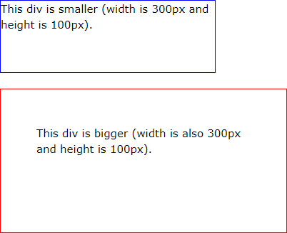
CSS box-sizing
Example:
The following two boxes are the same in width and height:
.div1 {
width: 300px; height: 100px;
border: 1px solid blue;
}
.div2 {
width: 300px; height: 100px; padding: 50px;
border: 1px solid red;
}
V 2.0

Slide 27
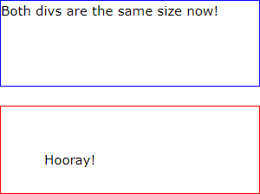
CSS box-sizing
As we can see the two boxes are the same in width and height, however, the below box has padding of 50px but by default it’s not included in the width and height of the element, therefore, it created it’s space within the element.
Let’s see how we can fix this issue using the box-sizing below:
.div1 {
width: 300px; height: 100px;
border: 1px solid blue; box-sizing: border-box;
}
.div2 {
width: 300px; height: 100px; padding: 50px;
border: 1px solid red; box-sizing: border-box;
}
V 2.0

Slide 28
CSS box-sizing
Using the box-sizing property allowed us to include the padding of the word into the width the height of the element, therefore, the added padding will affect only the word inside the element but it will now take a bigger size in the overall element.
V 2.0

Slide 29
Background-image
The background-image property specifies an image to use as the background of an element.
By default, the image is repeated so it covers the entire element. The background image for a page can be set like this:
body {
background-image: url("paper.gif");
}
By default, the background-image property repeats an image both horizontally and vertically.
Some images should be repeated only horizontally or vertically, or they will look strange.
V 2.0

Slide 30
Background-image
The following properties will help you to modify and edit the position and the appearance of the background-image we set to an element:
background-color: Is to set a background color to an element.
background-image: To set a background image to an element.
background-repeat: This property prevent the background image from repeating in case it doesn’t fill the hole background space by it’s size.
background-attachment: property specifies whether the background image should scroll or be fixed (will not scroll with the rest of the page).
background-position: This property is used to specify the position of the background image(right top, left bottom, etc.).
V 2.0

Slide 31
CSS Animation
CSS allows animation of HTML elements without using JavaScript or Flash!.
When you specify CSS styles inside the @keyframes rule, the animation will gradually change from the current style to the new style at certain times.
To get an animation to work, you must bind the animation to an element.
The following example binds the "example" animation to the <div> element. The animation will last for 4 seconds, and it will gradually change the background-color of the <div> element from "red" to "yellow":
V 2.0

Slide 32
CSS Animation
/* The animation code */
@keyframes example {
from {background-color: red;} to {background-color: yellow;}
}
/* The element to apply the animation to */
div {
width: 100px; height: 100px;
background-color: red;
animation-name: example;
animation-duration: 4s;
}
Note: If the animation-duration property is not specified, no animation will occur, because the default value is 0s (0 seconds).
V 2.0

Slide 33
CSS Animation
In the example above we have specified when the style will change by using the keywords "from" and "to" (which represents 0% (start) and 100% (complete)).
It is also possible to use percent. By using percent, you can add as many style changes as you like.
The following example will change the background-color of the <div> element when the animation is 25% complete, 50% complete, and again when the animation is 100% complete:
V 2.0

Slide 34
CSS Animation
/* The animation code */
@keyframes example {
0% {background-color: red;}
25% {background-color: yellow;}
50% {background-color: blue;}
100% {background-color: green;}
}
/* The element to apply the animation to */
div {
width: 100px; height: 100px;
background-color: red; animation-name: example; animation-duration: 4s;
}
V 2.0

Slide 35
CSS Animation
animation-direction: Property defines whether an animation should be played forwards, backwards or in alternate cycles.
animation-duration: Property defines how long an animation should take to complete one cycle.
animation-fill-mode: property specifies a style for the element when the animation is not playing (before it starts, after it ends, or both).
CSS animations do not affect the element before the first keyframe is played or after the last keyframe is played. The animation-fill-mode property can override this behavior.
V 2.0

Slide 36
CSS Animation
animation-iteration-count: property specifies the number of times an animation should be played.
animation-timing-function: specifies the speed curve of an animation.
The speed curve defines the TIME an animation uses to change from one set of CSS styles to another.
If you want to dive more into animations check the documentation link below: https://developer.mozilla.org/en-US/docs/Web/CSS/animation
V 2.0

Slide 37
CSS box-shadow Property
The box-shadow property attaches one or more shadows to an element.
CSS Syntax:
box-shadow: none|h-offset v-offset blur spread color |inset|initial|inherit;
Example:
#example1 { border: 1px solid; padding: 10px;
box-shadow: 5px 10px;
}
V 2.0

Slide 38
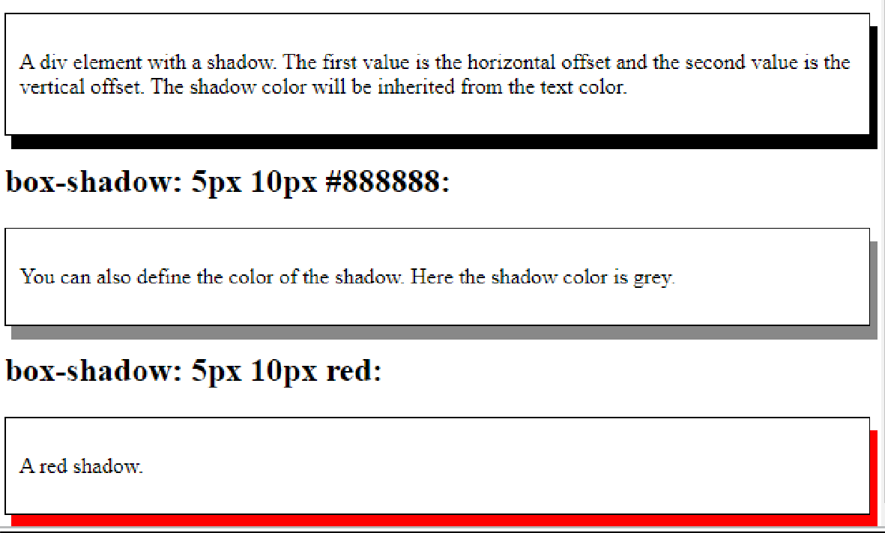
CSS box-shadow Property
#example2 { border: 1px solid;
padding: 10px;
box-shadow: 5px 10px #888888;
}
#example3 { border: 1px solid;
padding: 10px;
box-shadow: 5px 10px red;
} Check the below link for more examples on box shadow: https://www.w3schools.com/cssref/css3_pr_box-shadow.asp
V 2.0

Slide 39
CSS float Property
The float property specifies whether an element should float to the left, right, or not at all.
Note: Absolutely positioned elements ignore the float property!
Example: img {
float: right;
}
In this example the specified image should be at the right of it’s parent element or container,
whether it has any other elements with it or not.
Note: Elements next to a floating element will flow around it. To avoid this, use the clear property or the clearfix hack.
V 2.0

Slide 40
CSS float Property
Example 2:
img {
float: left;
}
p.clear { clear: left;
}
The clear property controls the flow next to floated elements.
The clear property specifies what should happen with the element that is next to a floating element, therefore, in the above example the element <p> will take another block to display rather than displaying beside the floating element.
V 2.0

Slide 41
CSS Position Property
The position property specifies the type of positioning method used for an element (static, relative, absolute, fixed, or sticky).
Note: The default of the position property is static.
CSS Syntax:
position: static|absolute|fixed|relative|sticky|initial|inherit;
static: Default value. Elements render in order, as they appear in the document flow.
absolute: The element is positioned relative to its first positioned (not static) ancestor element
fixed: The element is positioned relative to the browser window
V 2.0

Slide 42
CSS Position Property
CSS Syntax:
relative: The element is positioned relative to its normal position, so "left:20px" adds 20 pixels to the element's LEFT position
sticky: The element is positioned based on the user's scroll position, a sticky element toggles between relative and fixed, depending on the scroll position. It is positioned relative until a given offset position is met in the viewport - then it "sticks" in place (like position: fixed).
V 2.0

Slide 43
CSS Transform Property
The transform CSS property lets you rotate, scale, skew, or translate an element. It modifies the coordinate space of the CSS visual formatting model.
Example:
div.a {
transform: rotate(20deg);
}
div.b {
transform: skewY(20deg);
}
div.c {
transform: scaleY(1.5);
}
V 2.0

Slide 44
CSS Transform Property
CSS Syntax:
transform: transform-functions.
Note: transform-functions are rotate(), skewY(), scaleY(), etc.
V 2.0

Slide 45
Font Awesome
The font awesome is a place where you can get vector icons and social logos on your website.
To use the Font Awesome icons, add the following line inside the <head> section of your HTML page:
<link rel="stylesheet" href="https://cdnjs.cloudflare.com/ajax/libs/font- awesome/4.7.0/css/font-awesome.min.css">
Then you will be able to use <i> and <span> elements to insert the proper icon to your website.
To check more on font awesome you can use the following link: https://fontawesome.com/v5.15/how-to-use/on-the-web/referencing-icons/basic-use
V 2.0

Slide 46
Flexbox
Flexbox is a container used for laying out items in rows or columns.
Items inside the flexbox, flexes to fill additional space and shrink to fit into smaller spaces. The flex container becomes flexible by setting the display property to flex:
.flex-container { /* class of a parent element which is the container*/
display: flex;
}
Note: the container of the items called parent while the elements inside the container called child elements, therefore, you can control the elements inside the container to be aligned as rows or columns through the parent element.
V 2.0

Slide 47
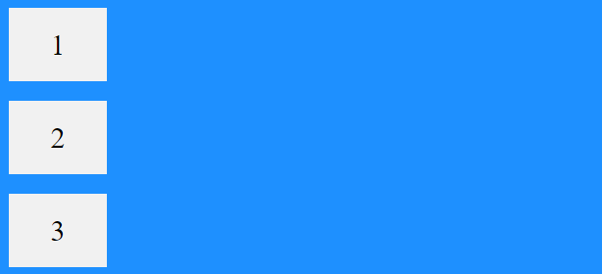
Flexbox
Example:
.flex-container { display: flex;
flex-direction: column;
background-color: DodgerBlue;
}
V 2.0

Slide 48

Flexbox
In the example above if we change the flex direction to row it will look like this:
V 2.0

Slide 49
CSS flex-grow Property
Flex grow property is one of the flex method that specifies how much the item will grow relative to the rest of the flexible items inside the same container.
Note: If the element is not a flexible item, the flex-grow property has no effect.
If there are many items in the flexbox and you want to make one wider or higher than other child elements inside the flex container(parent) you can do it with flex-grow property using the method nth-of-type() to indicate which element of the child elements you are going to apply the changes on.
V 2.0

Slide 50
CSS flex-grow Property
Example:
<style> #main { width: 350px; height: 100px;
border: 1px solid #c3c3c3; display: flex;
}
#main div:nth-of-type(1) {flex-grow: 1;}
#main div:nth-of-type(2) {flex-grow: 3;}
#main div:nth-of-type(3) {flex-grow: 1;}
#main div:nth-of-type(4) {flex-grow: 1;}
#main div:nth-of-type(5) {flex-grow: 1;}
</style>
In the example above, the id #main is the parent and the div’s are the child elements.
V 2.0

Slide 51
CSS flex-shrink Property
Flex-shrink property is the same as flex-grow but it shrinks the chosen child elements.
Example:
Let the second flex-item shrink three times more than the rest:
div:nth-of-type(2) { flex-shrink: 3;
}
V 2.0

Slide 52
CSS Grid Layout
The CSS Grid Layout Module offers a grid-based layout system, with rows and columns, making it easier to design web pages without having to use floats and positioning.
A Grid Layout must have a parent element with the display property set to grid or inline-grid. Direct child element(s) of the grid container automatically becomes grid items.
V 2.0

Slide 53
CSS Grid Layout
Example:
.grid-container { /*the class of the parent element*/ display: grid;
grid-template-columns: auto auto auto; /*auto refers to the number of column it will display the child elements*/
background-color: #2196F3; padding: 10px;
}
.grid-item { /*the class of the parent elements*/ background-color: rgba(255, 255, 255, 0.8);
border: 1px solid rgba(0, 0, 0, 0.8); padding: 20px;
font-size: 30px; text-align: center;
}
V 2.0

Slide 54
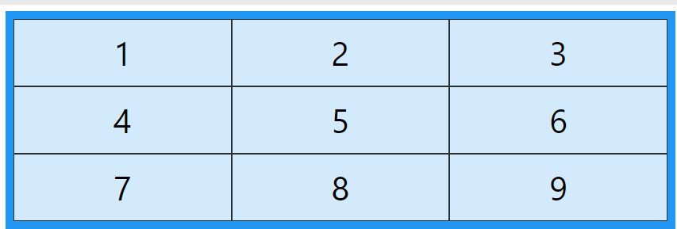
CSS Grid Layout
Check the output table below
We can use grid-column-gap:value, to make a gap between the column and the same for rows we can use grid-row-gap:value.
To read more about grid you can check the link below: https://developer.mozilla.org/en-US/docs/Web/CSS/grid-row
V 2.0

Slide 55
CSS calc() Function
The calc() CSS function lets you perform calculations when specifying CSS property values. It can be used anywhere a <length>, <frequency>, <angle>, <time>, <percentage>, <number>,
or <integer> is allowed.
CSS Syntax:
property : calc(expression)
Example:
width: calc(100% - 80px);
V 2.0

Slide 56
CSS calc() Function
Example:
div {
--a: 4em;
height: calc(var(--a) + 7px); background: #e53b2c;
}
In the above example we declared a local variable inside the div properties called –a and it was allowed to use this variable in the calc() so it’s replaced with 4em.
V 2.0

Slide 57
CSS calc() Function
The calc() function takes a single expression as its parameter, with the expression's result used as the value. And it also uses the normal operators.
Check the below link if you want to read more about operators: https://developer.mozilla.org/en- US/docs/Learn/JavaScript/First_steps/Math#operator_precedence
The amazing thing that we can include the CSS variable in the calc() method whether it’s global or local.
V 2.0

Slide 58
CSS Units
CSS has several different units for expressing a length.
Many CSS properties take "length" values, such as width, margin, padding, font-size, etc.
Length is a number followed by a length unit to determine the value of the above properties, such as 10px, 2em, etc.
Absolute Lengths
The absolute length units are fixed and a length expressed in any of the following, therefore it’s not recommended for use on screen, because screen sizes vary so much. However, they can be used if the output medium is known, such as for print layout.
cm -> centimeter
mm -> millimeters
in -> inch (1in = 96px = 2.54cm)
px -> pixels (1px = 1/96th of 1in)
V 2.0

Slide 59
CSS Units
em -> relative to the font-size of the exiting element.
Rem -> relative to the font size of the root element
Vw -> relative to 1% of the width of the viewport
Vh -> relative to 1% of the height of the viewport
Vmin -> relative to 1% of the viewport smaller dimension
Vmax -> relative to 1% of the viewport larger dimension
%
V 2.0

Slide 60
Icon Examples
<i class="fa fa-car fa-lg"></i>
<i class="fa fa-car fa-2x"></i>
<i class="fa fa-car fa-3x"></i>
<i class="fa fa-car fa-4x"></i>
<i class="fa fa-car fa-5x"></i>
V 2.0

Slide 61
CSS Nesting Selector: (&)
When using a nested style rule, one must be able to refer to the elements matched by the parent rule; that is, after all, the entire point of nesting.
To accomplish that, this specification defines a new selector, the nesting selector, written as an ASCII ampersand ‘&’.
When used in the selector of a nested style rule, the nesting selector represents the elements matched by the parent rule. When used in any other context, it represents nothing. (That is, it’s valid, but matches no elements.)
V 2.0

Slide 62
CSS Nesting Selector: (&)
Nesting allows the grouping of related style rules, like this:
.foo {
color: blue;
& > .bar { color: red; }
}
/* equivalent to
.foo { color: blue; }
.foo > .bar { color: red; }
*/
V 2.0

Slide 63
CSS The object-fit Property
The CSS object-fit property is used to specify how an <img> or <video> should be resized to fit its container.
This property tells the content to fill the container in a variety of ways; such as "preserve that aspect ratio" or "stretch up and take up as much space as possible“.
Example:
If we use object-fit: cover; the image keeps its aspect ratio and fills the given dimension. The image will be clipped to fit:
img {
width: 200px; height: 300px; object-fit: cover;
}
V 2.0

Slide 64
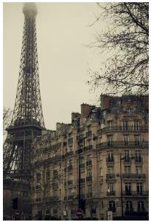
CSS The object-fit Property
However, if we don’t use object-fit property it will look like this:
V 2.0

Slide 65
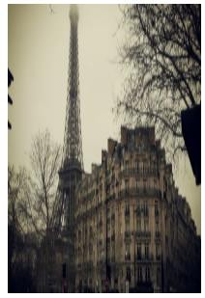
CSS The object-fit Property
img {
width: 200px; height: 300px;
}
V 2.0

Slide 66
CSS The object-fit Property
Here is the possible values for this property:
fill - This is default. The image is resized to fill the given dimension. If necessary, the image will be stretched or squished to fit
contain - The image keeps its aspect ratio, but is resized to fit within the given dimension
cover - The image keeps its aspect ratio and fills the given dimension. The image will be clipped to fit
none - The image is not resized
scale-down - the image is scaled down to the smallest version of none or contain
V 2.0

Slide 67
CSS Media Queries
Using media queries are a popular technique for delivering a tailored style sheet to desktops, laptops, tablets, and mobile phones (such as iPhone and Android phones).
Media queries allow you to specify one or more screen breakpoints where you can declare different styles at each breakpoint
Example:
@media screen and (min-width: 480px) { #leftsidebar {width: 200px; float: left;} #main {margin-left: 216px;}
}
It means that if the screen size is any size above 480px the elements with id #leftsidebar and #main will take these properties.
You can also use the (max-width: ..) and (min-width: ..) values to set a minimum width and a maximum width.
V 2.0

Slide 68
CSS Media Queries
Example2:
@media screen and (max-width: 900px) and (min-width: 600px) { div.example {
font-size: 50px; padding: 50px;
border: 8px solid black; background: yellow;
}
}
It means that any screen size between 600px and 900px, the div.example will take these specified properties.
V 2.0

Slide 69
Thank You!

