Slide 1

King County
House Pricing Analysis and Predictive Modeling
By Karen A. Amanya

Slide 2
Problem Statement
White Oak Realty is a real estate company based in Vancouver, Washington DC that would like to expand its business operations by venturing into other cities in Washington. As a junior data scientist at the company, I have been tasked with analysing house sales data in King County and building a model that would predict sale prices.
The product design team wants to start by purchasing existing houses in the area and remodelling them for re-sale as well as developing new houses and properties.
In order to achieve this they need to know;
1. What features affect house prices most?
2. Other underlying factors to focus on that might increase sale prices.

Slide 3
Business Value
The aim of this project is to help the firm make data driven decisions on their plans to expand their business operations into other parts of Washington. This project will provide insights to the sales and product design teams to help them better understand the real estate market in King County.
This project will also build pricing models that will help to best price houses based on their features which will maximize sale revenues and profits.

Slide 4
Methodology
This project will employ the ‘OSEMN’ data science process to source the data, perform exploratory data analysis, clean and prepare the data for model, fit regression models, Interpret results and draw conclusions that will be used to make recommendations to the firm.

Slide 5
Obtain Data
This project will use house data from King County,Washington that contains data about the features of the houses located in various parts of the county.
The dataset contains more that 20,000 observations of houses including their features such as the size, number of bedrooms and bathrooms and other features which will be used to draw useful insights.

Slide 6
2. Scrub
I performed initial cleaning of the dataset by following the following steps:
Investigating the datatypes of each column to ensure all numerical columns were stored as integers or floats and converting date columns to datetime objects.
Checking for missing / null values - I found that 3 columns (‘waterfront’, ‘view’ and ‘yr_renovated’ had null values). Using the column description file I found that the waterfront column represented binary variables and filled the null values with 0’s appropriately. I also chose to fill the null values in the view column with 0’s given that the values ranging from 0 to 5 represented the number of times a house was shown. 0 was the most frequent value and therefore replacing the null values with 0 would not distort the mean. Finally I chose to drop the yr_renovated column as it would not be essential for my analysis.

Slide 7
3. Checking for outliers - I used scatter plots to look for outliers in the various variables and handled them appropriately.
3. Explore
I proceeded to perform some EDA on the dataset to understand what the features represented and make observations on their relationship to price .

Slide 8
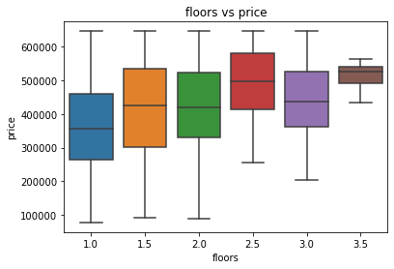
Visualizations of Features
The plot shows an increase in price as the number of floors increases.

Slide 9
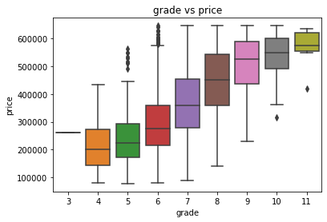
The plot shows that houses with a high grade also have high selling prices.

Slide 10
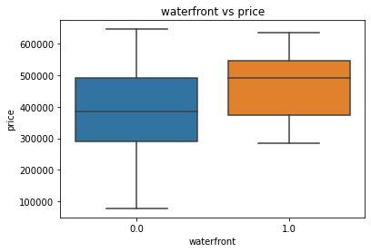
The plot shows that houses with a waterfront view sell at higher prices compared to those without this feature.

Slide 11
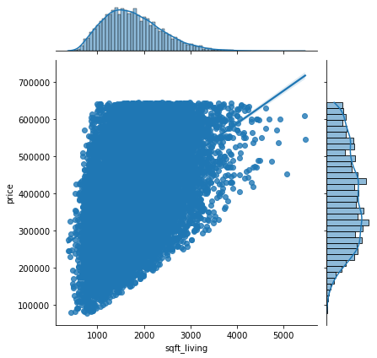
The jointplot shows a positive linear relationship between sqft_living and the house prices.

Slide 12
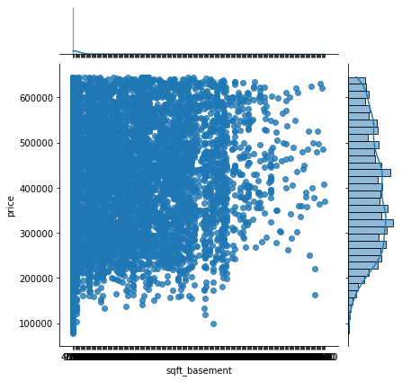
The plot shows no linear relationship between sqft_basement and the house selling price.

Slide 13
Checking for multicollinearity
I made use of a heatmap and correlation table to investigate multicollinearity between the different features in the dataset.
Both the heatmap and correlation table showed a high collinearity between sqft_above and sqft_living.
To minimize multicollinearity, I dropped sqft_above. The column contains information on the living space in the house excluding the basement.This should not negatively affect the model because 'sqft_living' also contains information about the size of the house excluding the basement and garage areas.

Slide 14
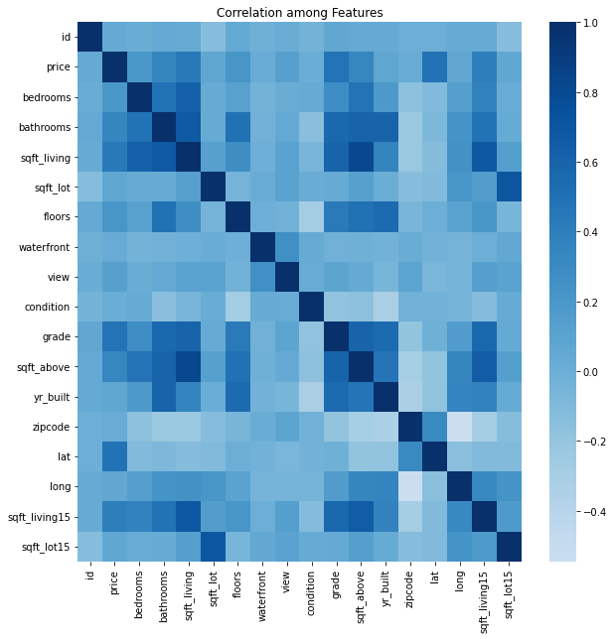

Slide 15
4. Model
Baseline model
I proceeded to build my first model which would serve as a simple baseline model with little manipulation done to the dataset.I plotted a second heatmap to visualize correlation of each feature against the price and used the features with the highest correlation as predictors for this model.Features used were 'grade', 'sqft_living', 'sqft_living15' and 'bathrooms'.
The model’s performance was not very good with an r-squared of 0.27 , explaining 27% of the variance.The model also had an RMSE score mean of 108055 and std of 1498 .The mean error can be interpreted to mean that the prices predicted using this model with be less or more by about $ 108,055.74 with a standard deviation of 1498.71.

Slide 16
B. Model 2
For the second model I first performed some modifications to the data to better prepare it before fitting the model.I followed the following steps;
Performing log transformations on the numerical variables.
Scaling the numerical variables to normalize their distributions.
One - hot encoding categorical variables.
The second model has performed significantly better than the baseline model. The r-squared score indicates that the model explains for 97.5 % of the variance. Even with a good score, the model used many features and poses a risk of overfitting which te final model will cater for.

Slide 17
C. Final Model
To cater for the risk of overfitting in the second model, this final model will further employ feature selection to reduce the number of predictors used to fit the model and hence build a model that will perform just as accurately on the test set as it did using the training data.
I performed feature selection to select the best features for the model by considering the p value of each feature. I ran a series of multiple models here with each round eliminating the feature with the highest p value that represented the lowest significance to the model and eventually ended up with the best features.
The most significant features according to this process were :

Slide 18
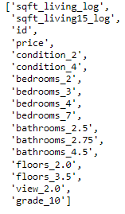

Slide 19
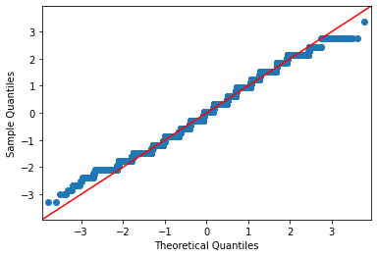
Checking for Normality
The plot shows a fairly linear distribution with a few outliers along the tails.

Slide 20
5. Interpret
Findings and Recommendations
Based on my findings,I made the following conclusions and subsequent recommendations based on the findings;
1. Bedrooms are bathrooms affect house sale prices - the findings show that houses with at least 4 bedrooms and two bathrooms sell at significantly higher prices than those with less. My recommendation would be to focus on acquiring houses with 4 or more bedrooms and at least 2 bathrooms.
2. The King County house grading system is key to a house's selling price. There is a clear linear relationship between the grade and price and as the grade went up so did the selling price. Although exact determinants of this grade are not clear in the study, it is very significant.My recommendation would be to look into the grading system and to choose houses with a grade of at least 7.

Slide 21
3. Waterfront feature - Houses without a waterfront sold at lower prices than those with one. My recommendation would be to acquire houses with a close proximity to a waterfront in order to maximize on the demand for this feature.
4. The overall living size area of the house i.e excluding the basement is very significant to the price. The study show a linear relationship between the size of the living space and price while the size of the basement played a very insignificant role to the houses' selling price. My recommendation would therefore be to acquire houses with a relatively larger living space as compared to the basement.

