Slide 1

pressure, atmospheric pressure, density, pressure head and forces on equilibrium
Presented by:
Asst. Comdt. P Kodanda Ram
Vetted By:
Commander Vivek Rathee

Slide 2
PRESSURE
Force actin per unit area
It is the normal force actin on a surface
Units are N/m2
Pressure = Force(F)
        Area(A)
3
Notes:
Pressure is the normal force per unit area exerted on a surface due to time rate of cane of momentum

Slide 3
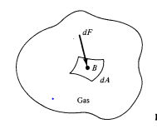

PRESSURE
4
Notes:
dA is incremental area
dF is incremental Force at point B

Slide 4
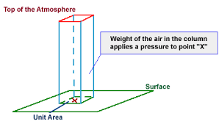
Atmospheric pressure
It is the force per unit area exerted against a surface by the weight of air above tat surface
Pressure at point X increases or decreases as weight of air in the column increases or decreases
8
Notes:
The actual pressure within the atmosphere differs and depends on location, temperature etc.
atmospheric pressure at mean sea level is 1.013X10^5 N/m2

Slide 5
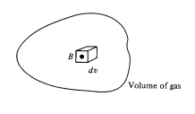


density
The density of a substance is the mass of tat substance per unit volume
8
Notes:
Density measured in Kg/m3

Slide 6

Pressure head
Pressure head is the height of the liquid column tat corresponds to a particular pressure exerted by the liquid column on the base of container
It is also known as STATIC PRESSURE HEAD or STATIC HEAD
ᴪ - Pressure head
ᵖ - Pressure
ᵟ- Specific Weight
15
Notes:
Flow control (RTS & CTS)
Error control Error free transmission(with ACK both + & -)

Slide 7
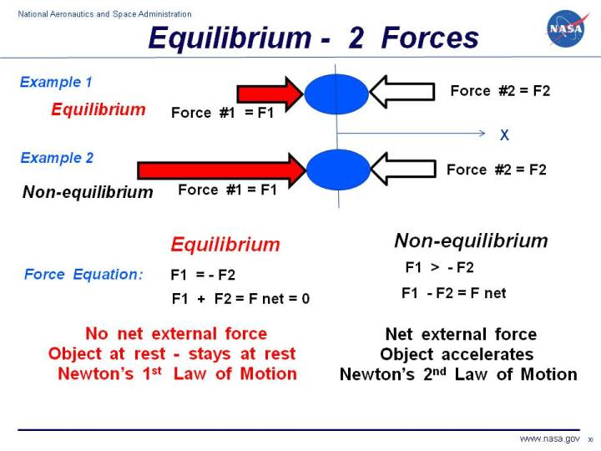
Forces at equilibrium
An object in equilibrium has sum of forces acting on it equals to zero

Slide 8
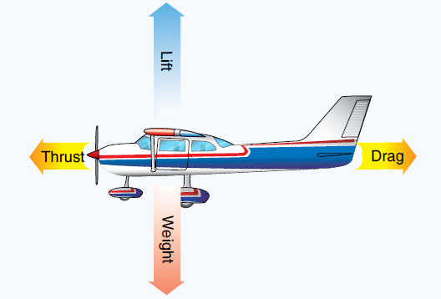
Forces on equilibrium
At equilibrium sum of Lift & Weight, thrust & drag will become zero

Slide 9

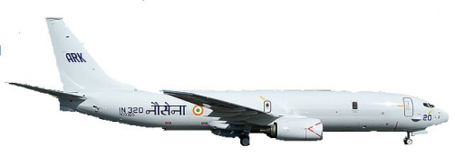

Thank You

