Slide 1


Topics covered- Fluid flow (types and approaches), Continuity equation and Bernoulli’s equation
Presented by:
SLt Manish Choudhary
Vetted By:
Commander. Vivek Ratee

Slide 2
Topics covered- Fluid flow (types and approaches), Continuity equation and Bernoulli’s equation
Vetted By:
Commander. Vivek Ratee
Vetted By:
Commander. Vivek Ratee
Prepared by:
Slt Manish Choudhary
Vetted by:
Cdr Vivek Rathee
Notes:
11/2/2020
2

Slide 3
Fluid- In physics, a fluid is a substance that continually deforms under an applied shear stress, or external force. Fluids are a phase of matter and include liquids, gases and plasmas
  There are two approach to study fluid-
    Lagrangian Approach- In this approach, a single fluid particle is taken and its behaviour is analysed at different sections (with respect to space)
    Eulerian Approach- In this approach, a certain section is taken in space and the behaviour of fluid particles passing through this section is analysed at a different instant. We mainly use this approach in Fluid Mechanics [With respect to Time].
Notes:
11/2/2020
3

Slide 4
There are Six different types of fluid flow-
Steady and Unsteady.
Uniform and Non-Uniform.
Laminar and Turbulent.
Compressible and In-compressible.
Rotational and Ir-rotational and.
One, Two, and Three -dimensional Fluid Flow.
Notes:
11/2/2020
4

Slide 5
There are Six different types of fluid flow-
Steady and Unsteady. The steady flow is defined as that type of flow in which the fluid characteristics like velocity, density, pressure, etc at a point do not change with the time. The Unsteady flow is defined as that type of flow in which the fluid characteristics like velocity, density, pressure, etc. at a point change respected to time.
Uniform and Non-Uniform. This uniform fluid flow is defined as the type of flow in which the velocity at any given time does not change with respect to space (i.e. length of direction of the flow), Whereas the Non-uniform flow is defined as, This non-uniform fluid flow is defined as the type of flow in which the velocity at any given time changes with respect to space (i.e. length of the direction of the flow).
Notes:
11/2/2020
5

Slide 6
Laminar and Turbulent. This laminar fluid flow is defined as the type of flow in which the fluid particles move along well-defined paths or streamline and all the streamlines are straight and parallel. Thus the particles move in laminas or layers gliding smoothly over the adjacent layer. This type of fluid is also called as streamline flow or viscous flow. This Turbulent fluid flow is defined as the type of flow in which the fluid particles move in a zig-zag way, the eddies formation takes place which is responsible for high energy loss.
Notes:
11/2/2020
6

Slide 7
Compressible and In-compressible. Compressible fluid flow is defined as the flow in which the density is not constant which means the density of the fluid changes from point to point. Incompressible fluid flow is defined as the flow in which the density is constant which means the density of the fluid does not change from point to point
Rotational and Ir-rotational. The rotational fluid flow is defined as the type of fluid flow in which the fluid particles while flowing along streamline and also rotate about there own axis. Whereas, The Ir-rotational fluid flow is defined as the type of fluid flow in which the fluid particles while flowing along streamline and do not rotate about there own axis
3/40
Notes:
I’ve been using CAVE
Picture like this
11/2/2020
7

Slide 8
One, Two, and Three -dimensional Fluid Flow. One dimensional flow is that type of flow in which the flow parameter such as velocity is a function of time and one space co-ordinate only, say x.
u=f(x), v=0 and w=0
Where u,v and w are velocity component in x,y and z directions respectively.
Two-dimensional fluid flow is the type of flow in which velocity is a function of time and two rectangular space co-ordinate say x,y.
u= f (x,y), v= f (x,y) and w= 0.
Three-dimensional fluid flow is the type of flow in which velocity is a function of time and three mutually perpendicular directions. The function of 3 space coordinates (x,y,z).
u= f (x,y,z), v= f (x,y,z) and w= f (x,y,z)
4/40
Notes:
11/2/2020
8

Slide 9
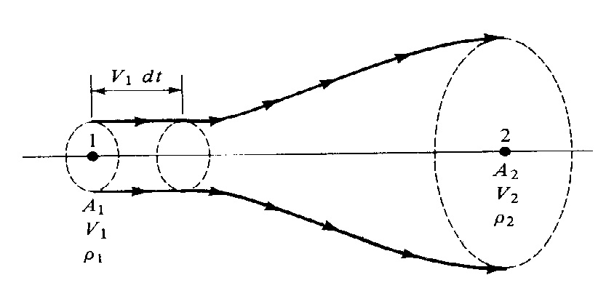
Continuity Equation.
Physical principle: Mass can neither be created nor destroyed
Fig. 1 Continuity equation
Notes:
Created using CG and HW, Believes to be real
In VRE and lot of potential for exploitation in Simulation & training domain
11/2/2020
9

Slide 10

Continuity Equation
Let A₁ be the cross-sectional area of the stream tube at point 1. Let V₁ be the flow velocity at point 1. Now, at a given instant in time, consider all the fluid elements that are momentarily in the plane of A_{1.} After a lapse of time dt, these same fluid elements have swept out a volume ( A₁V₁dt ) downstream of point 1. The mass of gas, dm, in this volume is equal to the density times the volume, i.e.,
This is the mass of gas that has swept through area A₁ during the time interval dt.
Therefore from above Eq. For area A_{1,}
Mass flow = dm/dt = m₁ = ρ₁A₁V₁ kg/s or slugs/s
Also, the mass flow through A₂, bounded by the same streamlines that go through the circumference of A₁, is obtained in the same fashion, as
$$dm=ρ_{1}\left(A_{1}V_{1}dt\right)$$
$$m_{2}=ρ_{2}A_{2}V_{2}$$
Notes:
Created using CG and HW, Believes to be real
In VRE and lot of potential for exploitation in Simulation & training domain
11/2/2020
10

Slide 11


Continuity Equation.
Since mass can be neither created nor destroyed, we have m1 = m2. Hence
(Eq. 1)
This is the continuity equation for steady flow. It is simple algebraic equation which relates the values of density, velocity, and area at one section of the stream tube to the same quantities at any other section.
Incompressible Flow- flow in which the density of the fluid elements is always constant. For incompressible flow ρ₁=ρ₂, hence
$$ρ_{1}A_{1}V_{1}=ρ_{2}A_{2}V_{2}$$
$$A_{1}V_{1}=A_{2}V_{2}$$
Notes:
Created using CG and HW, Believes to be real
In VRE and lot of potential for exploitation in Simulation & training domain
11/2/2020
11

Slide 12
Momentum Equation (Euler’s Equation).
The continuity equation, is only part of the story. For example, it says nothing about the pressure in the flow; yet, we know, just from intuition, that pressure is an important flow variable. Indeed, differences in pressure from one point to another in the flow create forces that act on the fluid elements and cause them to move. Hence, there must be some relation between pressure and velocity, and that relation will be derived in this section. Again, we first state a fundamental law of physics, namely, Newton's second law
Physical principle: Force = mass X acceleration
Notes:
Created using CG and HW, Believes to be real
In VRE and lot of potential for exploitation in Simulation & training domain
11/2/2020
12

Slide 13
Momentum Equation (Euler’s Equation).
To apply this principle to a flowing gas, consider an infinitesimally small fluid element moving along a streamline with velocity V, as shown in Figure 2. At some given instant, the element is located at point P. The element is moving in the x direction, where the x axis is oriented parallel to the streamline at point P. The y and z axes are mutually perpendicular to x. The fluid element is very small, infinitesimally small. However, looking at it through a magnifying glass, we see the picture shown at the upper right of Figure 2. Question: What is the force on this element? Physically, the force is a combination of three phenomena:
a). Pressure acting in a normal direction on all six faces of the element
b). Frictional shear acting tangentially on all six faces of the element
c). Gravity acting on the mass inside the element
Notes:
Created using CG and HW, Believes to be real
In VRE and lot of potential for exploitation in Simulation & training domain
11/2/2020
13

Slide 14
Bernoulli's Equation
(c) For a compressible flow, Eq. 2 must be used, with ρ treated as a variable. Bernoulli's equation must not be used for compressible flow.
(d) Remember that Eqs. 2 and 3 say that F = ma for a fluid flow. They are essentially Newton's second law applied to fluid dynamics.
Notes:
Created using CG and HW, Believes to be real
In VRE and lot of potential for exploitation in Simulation & training domain
11/2/2020
14

Slide 15
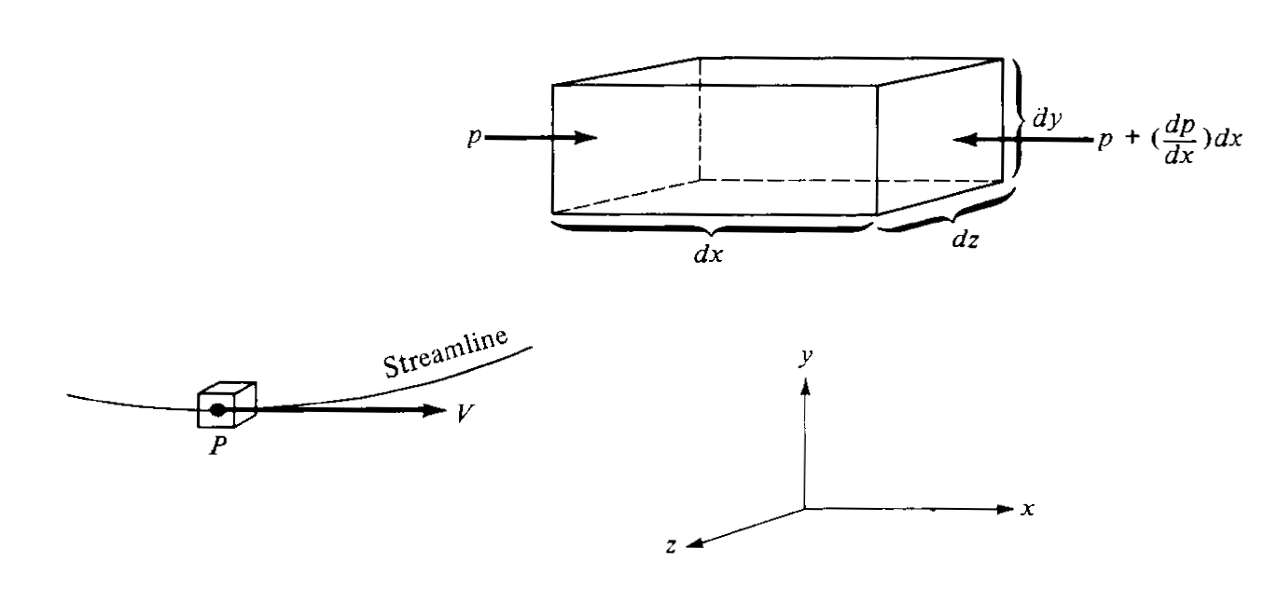
Momentum Equation (Euler’s Equation)
Fig. 2 Euler’s Equation
Notes:
Created using CG and HW, Believes to be real
In VRE and lot of potential for exploitation in Simulation & training domain
11/2/2020
15

Slide 16
Momentum Equation (Euler’s Equation) For the time being, we will ignore the presence of frictional forces; moreover, the gravity force is generally a small contribution to the total force. Therefore, we will assume that the only source of a force on the fluid element is pressure. To calculate this force, let the dimensions of the fluid element be dx, dy, and dz, as shown in Figure 2. Consider the left and right faces, which are perpendicular to the x axis. The pressure on the left face is p. The area of the left face is dydz, hence the force on the left face is . This force is in the positive x direction. Now recall that pressure varies from point to point in the flow. Hence, there is some change in pressure per unit length, symbolized by the derivative dp/dx. Thus, if we move away from the left face by a distance dx along the x axis, the change in pressure is . Consequently, the pressure on the right face is p+(dp/dx)dx. The area of the right face is also dydz, hence the force on the right face is [p+(dp/dx)dx](dydz). This force acts in the negative x direction, as shown in Figure 2.
Notes:
Created using CG and HW, Believes to be real
In VRE and lot of potential for exploitation in Simulation & training domain
11/2/2020
16

Slide 17


Momentum Equation (Euler’s Equation) The net force in the x direction, F, is the sum of the two:
or
Equation gives the force on the fluid element due to pressure. Because of the convenience of choosing the x axis in the flow direction, the pressures on the faces parallel to the streamlines do not affect the motion of the element along the streamline. The mass of the fluid element is the density ρ multiplied by the volume dxdydz:
Also, the acceleration a of the fluid element is, by definition of acceleration (rate of change of velocity), a = dV/dt. Noting that, also by definition, V = dx/dt, we can write-
$$F=pdydz−\left(p+\frac{dp}{dx}dx\right)dydz$$
$$F=\frac{−dp}{dx}×dx dv dz$$
$$m=ρ\left(dxdydz\right)$$
$$a=\frac{dV}{dt}=\frac{dV}{dx}\frac{dx}{dt}=\frac{dV}{dx}V$$
Notes:
Created using CG and HW, Believes to be real
In VRE and lot of potential for exploitation in Simulation & training domain
11/2/2020
17

Slide 18
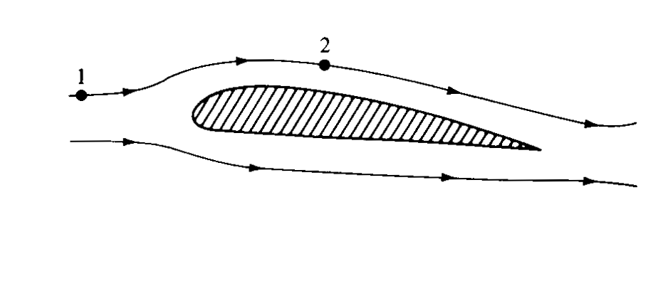


Momentum Equation (Euler’s Equation) Equations give the force, mass, and acceleration, respectively that go into Newton's second law F= ma
Eqn. 2
Equation 2 is Euler’s equation. Basically, it relates rate of change of momentum to the force; hence it can also be designated as the momentum equation.
$$\frac{−dp}{dx}\left(dxdydz\right)=ρ\left(dxdydz\right)V\frac{dV}{dx}$$
$$dp=−ρVdV$$
Fig. 3
Bernoulli’s Equation
Notes:
Created using CG and HW, Believes to be real
In VRE and lot of potential for exploitation in Simulation & training domain
11/2/2020
18

Slide 19





Bernoulli's Equation From momentum equation,
where ρ=constant. Integrating between points 1 and 2, we obtain
Eq. 3
Eqn 3, is called Bernoulli’s equation. Historically, Bernoulli's equation is one of the most fundamental equations in fluid mechanics. The following important points should be noted:
a) Equation 3 hold only for inviscid (frictionless), incompressible flow.
b) Equation 3 relate properties between different points along a streamline.
$$dp+ρVdV=0$$
$$\int_{p_{1}}^{p_{2}}{dp}+ρ\int_{V_{2}}^{V_{1}}{VdV}=0$$
$$\left(p_{2}−p_{1}\right)+ρ\left(\frac{V_{2}^{2}}{2}−\frac{V_{1}^{2}}{2}\right)=0$$
$$\left(p_{2}+\frac{{ρV}_{2}^{2}}{2}\right)=\left(p_{1}+\frac{V_{1}^{2}}{2}\right)$$
$$p+\frac{{ρV}^{2}}{2}=constantalongstramline$$
Notes:
Created using CG and HW, Believes to be real
In VRE and lot of potential for exploitation in Simulation & training domain
11/2/2020
19

Slide 20
Bernoulli's Equation.
For a compressible flow, Eq. 2 must be used, with ρ treated as a variable. Bernoulli's equation must not be used for compressible flow.
Remember that Eqs. 2 and 3 and 4 say that F = ma for a fluid flow. They are essentially Newton's second law applied to fluid dynamics.
Notes:
Created using CG and HW, Believes to be real
In VRE and lot of potential for exploitation in Simulation & training domain
11/2/2020
20

Slide 21

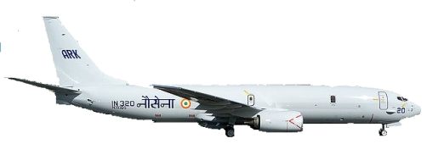

Thank You
Notes:
I HAVE NOW FINISHED WITH THE PRESENTATION SIR …
Any questions are welcome. THANK YOU
11/2/2020
21

