Slide 1

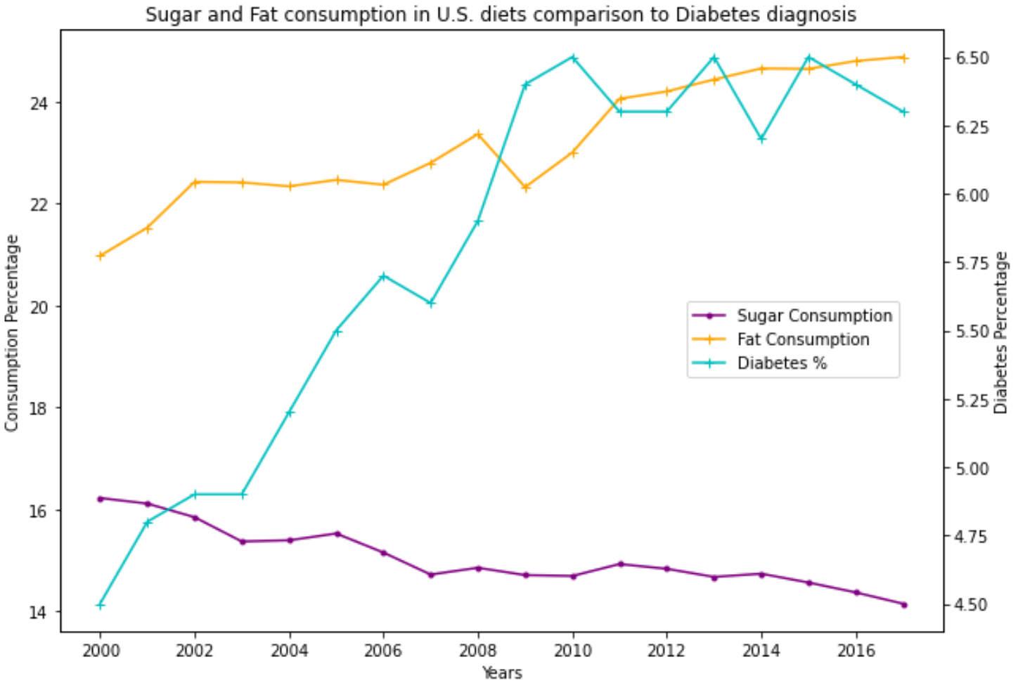
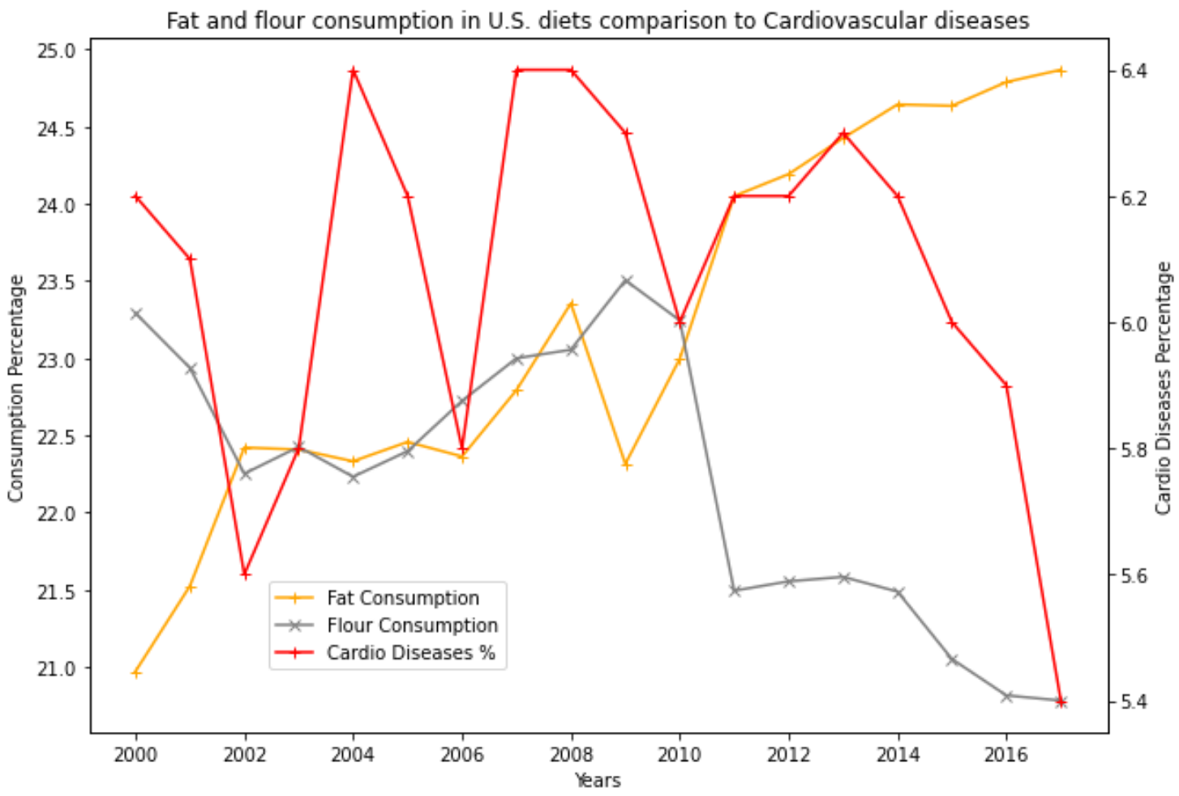
How have dietary habits in the U.S. affected chronic disease prevalence? Amar Agrawal
Whenever people consider healthy diets, the first thing they bring up is to check the number of calories consumed. While it gives us a general idea of how our diets look, it certainly is not a metric for how healthy people eat. This visualization will try to shed light on the fact that it is the type of foods we consume or the source of calories which matters while eating healthy. Specifically, this excerpt deals with how sugar/sweeteners, added fats/oils, flour and cereals in the U.S. diets contribute to chronic diseases like diabetes and cardiovascular issues. The graphs below depict an inverse relationship between diabetes diagnosis and sugar intake in U.S. diets. From the chart, we can observe that the percentage of fat consumed in diets increases the number of people affected by diabetes. Another graph depicts that flour intake in diets follows a somewhat similar trend to the decreasing cardiovascular disease trend. Much independent research linked refined grains lacking in fibre as causes for cardiovascular issues, as unlikely as it seems, and the graph above also hints at the same. Fat consumption does not seem to be related to the prevalence of cardiovascular diseases according to the data collected.
Data Sources:
https://www.ers.usda.gov/data-products/food-availability-per-capita-data-system/
https://gis.cdc.gov/grasp/diabetes/diabetesatlas-surveillance.html
https://www.cdc.gov/nchs/hus/data-finder.htm?year=2020-2021&table=Table%20HDPrv

