Slide 1
DHL Logistics Optimization Project
Complete SQL Queries, Results & Visual Analysis
Amarnath Chatterjee

Slide 2
Task 1: Data Cleaning & Preparation (SQL)
-- -----------------------------------------TASK 1.1 --------------------------------------------------------------------
SELECT Order_ID, COUNT(*) AS duplicate_count-- FROM orders-- GROUP BY Order_ID-- HAVING COUNT(*) > 1;-- SELECT Shipment_ID, COUNT(*) AS duplicate_count-- FROM shipments-- GROUP BY Shipment_ID-- HAVING COUNT(*) > 1;--
-----------------------------------------TASK 1.2 --------------------------------------------------
SELECT Shipment_ID, Route_ID, Delay_Hours-- FROM shipments-- WHERE Delay_Hours IS NULL;-- -- Find Average Delay per Route ---- -- SELECT Route_ID, AVG(Delay_Hours) AS avg_delay-- FROM shipments-- WHERE Delay_Hours IS NOT NULL-- GROUP BY Route_ID;-- -- -------- Replace NULL with Route-wise Average------------------------------------ UPDATE shipments s-- JOIN (-- SELECT Route_ID, AVG(Delay_Hours) AS avg_delay-- FROM shipments-- WHERE Delay_Hours IS NOT NULL-- GROUP BY Route_ID-- ) avg_table-- ON s.Route_ID = avg_table.Route_ID-- SET s.Delay_Hours = avg_table.avg_delay-- WHERE s.Delay_Hours IS NULL;-- SELECT COUNT(*) AS null_count-- FROM shipments-- WHERE Delay_Hours IS NULL;
-- --------------------------------TASK 1.3 -------------------------------------------------
SELECT * FROM orders;-- SELECT Order_Date-- FROM orders-- LIMIT 5;-- ALTER TABLE orders-- MODIFY Order_Date DATETIME;-- SELECT * FROM shipments;-- SELECT Pickup_Date, Delivery_Date-- FROM shipments-- LIMIT 5;--
----------------------TASK 1.4 -------------------------------------------
SELECT * FROM shipments;-- SELECT -- Shipment_ID,-- Pickup_Date,-- Delivery_Date,-- 'INVALID_DATE' AS status_flag-- FROM shipments-- WHERE Delivery_Date < Pickup_Date;-- ALTER TABLE shipments-- ADD COLUMN date_validation_status VARCHAR(20);-- UPDATE shipments-- SET date_validation_status = 'INVALID'-- WHERE Delivery_Date < Pickup_Date;-- UPDATE shipments-- SET date_validation_status = 'VALID'-- WHERE Delivery_Date >= Pickup_Date;-- SELECT Shipment_ID, Pickup_Date, Delivery_Date, date_validation_status-- FROM shipments-- WHERE date_validation_status = 'INVALID’;
--------------------------------------TASK 1.5 ---------------------------------------------------------------
SELECT s.Shipment_ID, s.Order_ID-- FROM shipments s-- LEFT JOIN orders o-- ON s.Order_ID = o.Order_ID-- WHERE o.Order_ID IS NULL;-- SELECT s.Shipment_ID, s.Route_ID-- FROM shipments s-- LEFT JOIN routes r-- ON s.Route_ID = r.Route_ID-- WHERE r.Route_ID IS NULL;-- SELECT s.Shipment_ID, s.Warehouse_ID-- FROM shipments s-- LEFT JOIN warehouses w-- ON s.Warehouse_ID = w.Warehouse_ID-- WHERE w.Warehouse_ID IS NULL;

Slide 3
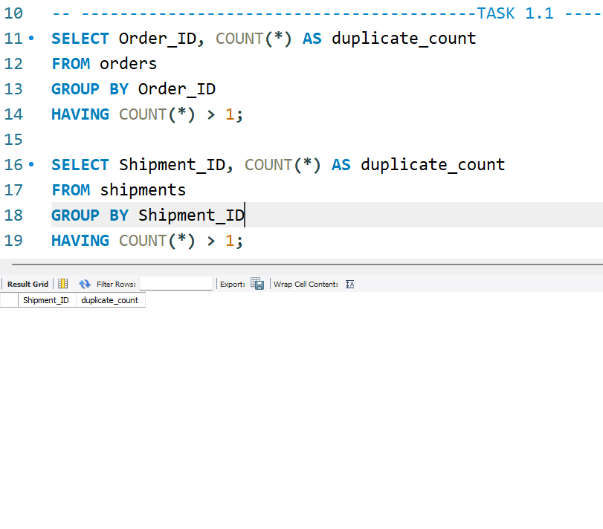
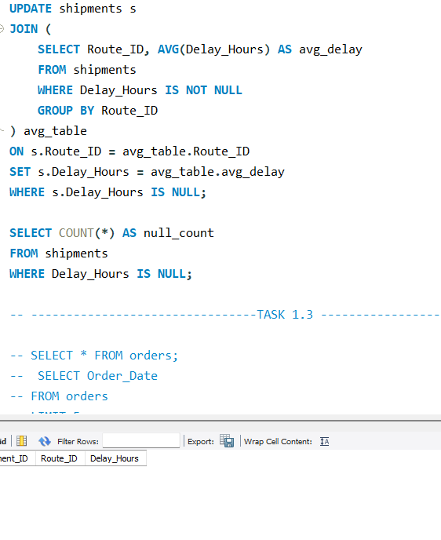
Screenshots TASK 1 :

Slide 4
Task 2: Delivery Delay Analysis (SQL)
Task 2.1: Calculate Delivery Delay (in Hours) for Each Shipment–
SELECT -- Shipment_ID,-- Pickup_Date,-- Delivery_Date,-- TIMESTAMPDIFF(HOUR, Pickup_Date, Delivery_Date) AS Delivery_Delay_Hours FROM shipments;
Task 2.2: Find Top 10 Delayed Routes (Based on Average Delay Hours)–
SELECT -- Route_ID,-- AVG(Delay_Hours) AS Avg_Delay_Hours-- FROM shipments-- GROUP BY Route_ID-- ORDER BY Avg_Delay_Hours DESC-- LIMIT 10;
-- Task 2.3: Rank Shipments by Delay within Each Warehouse
-- SELECT Shipment_ID, Warehouse_ID, Delay_Hours, RANK() OVER (-- PARTITION BY Warehouse_ID
ORDER BY Delay_Hours DESC-- ) AS Delay_Rank-- FROM shipments;-- Task 2.4: Identify Average Delay per Delivery_Type (Express vs Standard)-- SELECT -- o.Delivery_Type,-- AVG(s.Delay_Hours) AS Avg_Delay_Hours-- FROM shipments s-- JOIN orders o -- ON s.Order_ID = o.Order_ID-- GROUP BY o.Delivery_Type;

Slide 5
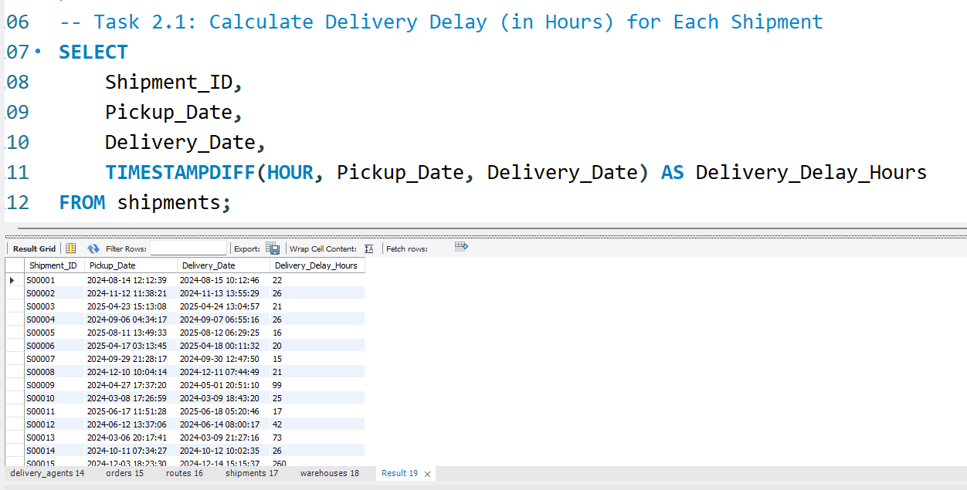
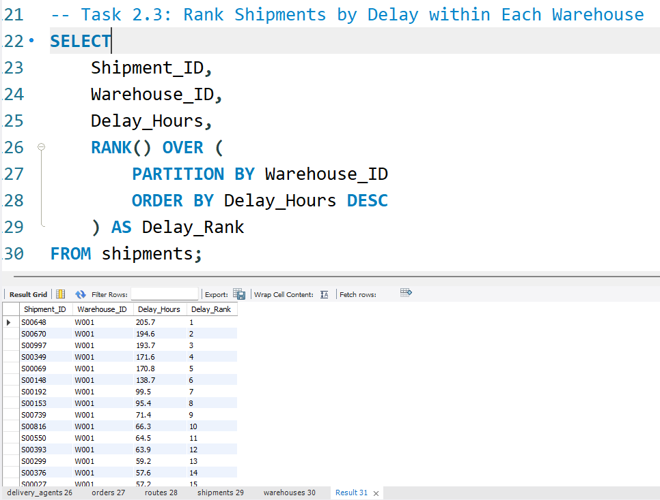
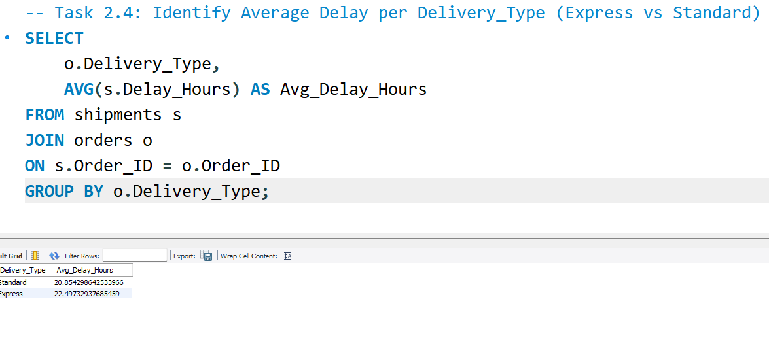
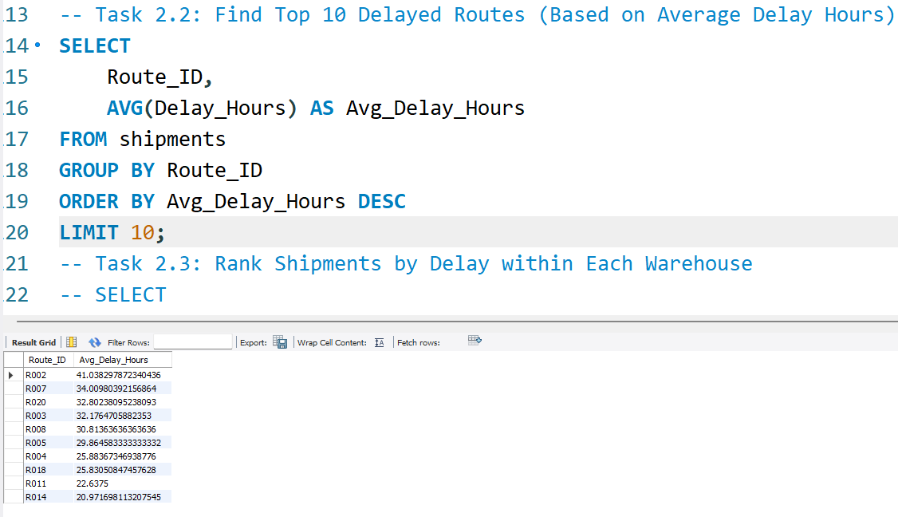
Screenshots Task 2 :

Slide 6
Task 2: Top Delayed Routes

Slide 7
Task 3: Route Optimization (SQL)
Avg Transit Time: AVG(TIMESTAMPDIFF(HOUR,...))
Efficiency Ratio: Distance_KM / Avg_Transit_Time_Hours
Worst Routes: ORDER BY efficiency_ratio ASC LIMIT 3
Delayed Routes >20% identified

Slide 8
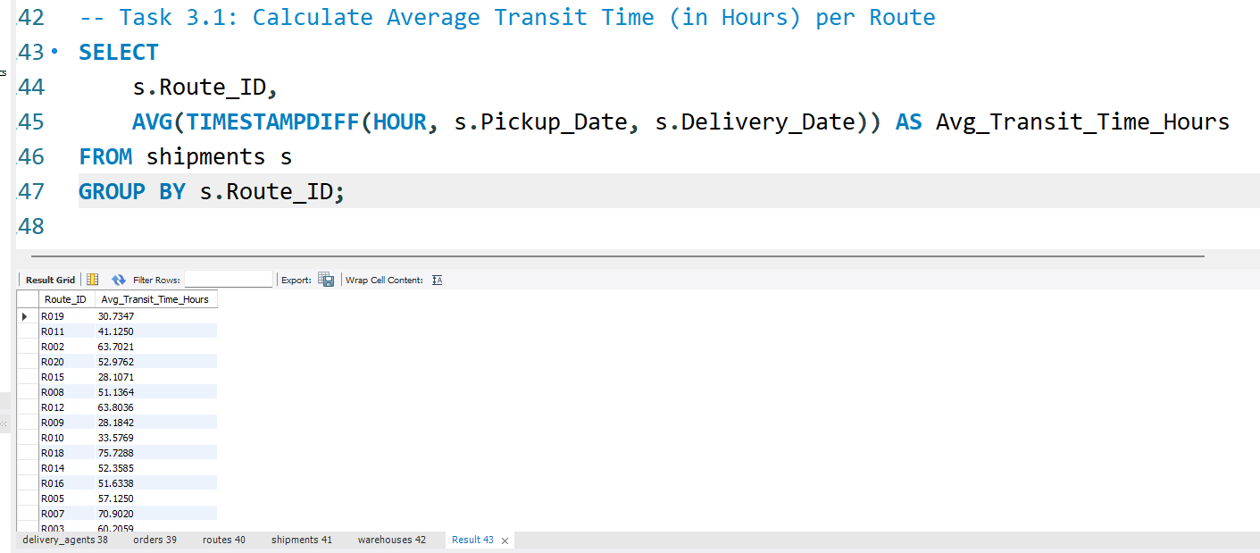
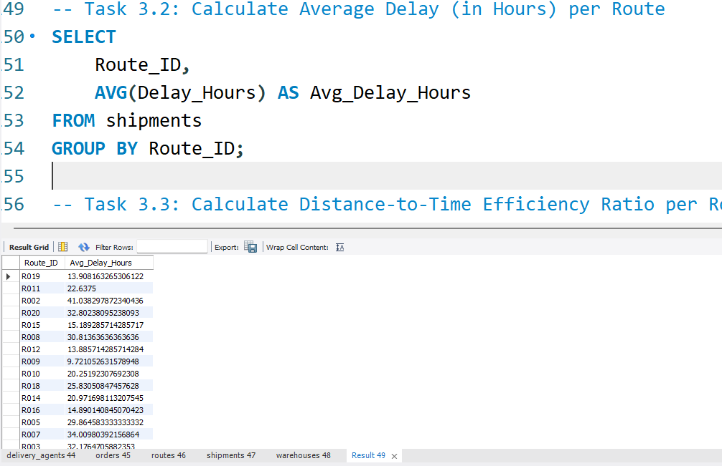
Task 3: Route Efficiency Comparison

Slide 9
Task 4: Warehouse Performance (SQL)
Top Delayed Warehouses: AVG(Delay_Hours)
Total vs Delayed Shipments
CTE used to compare with Global Avg Delay
Warehouse Ranking by On-Time %

Slide 10
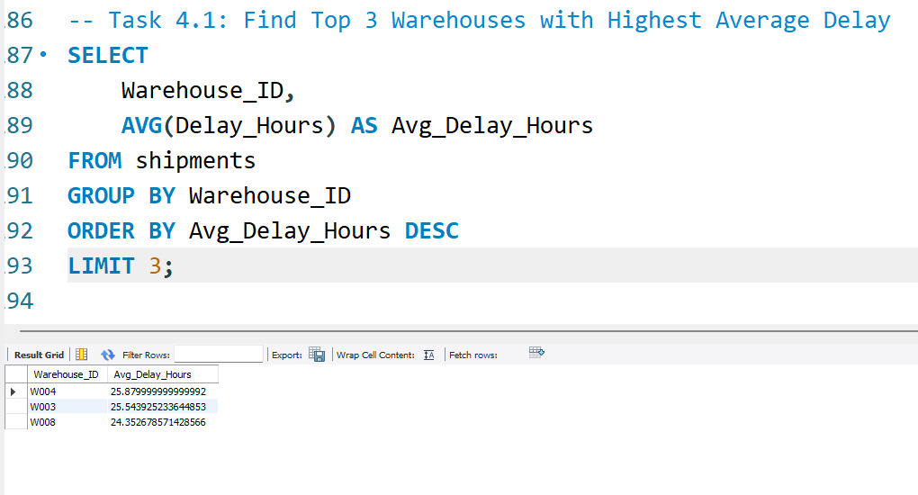
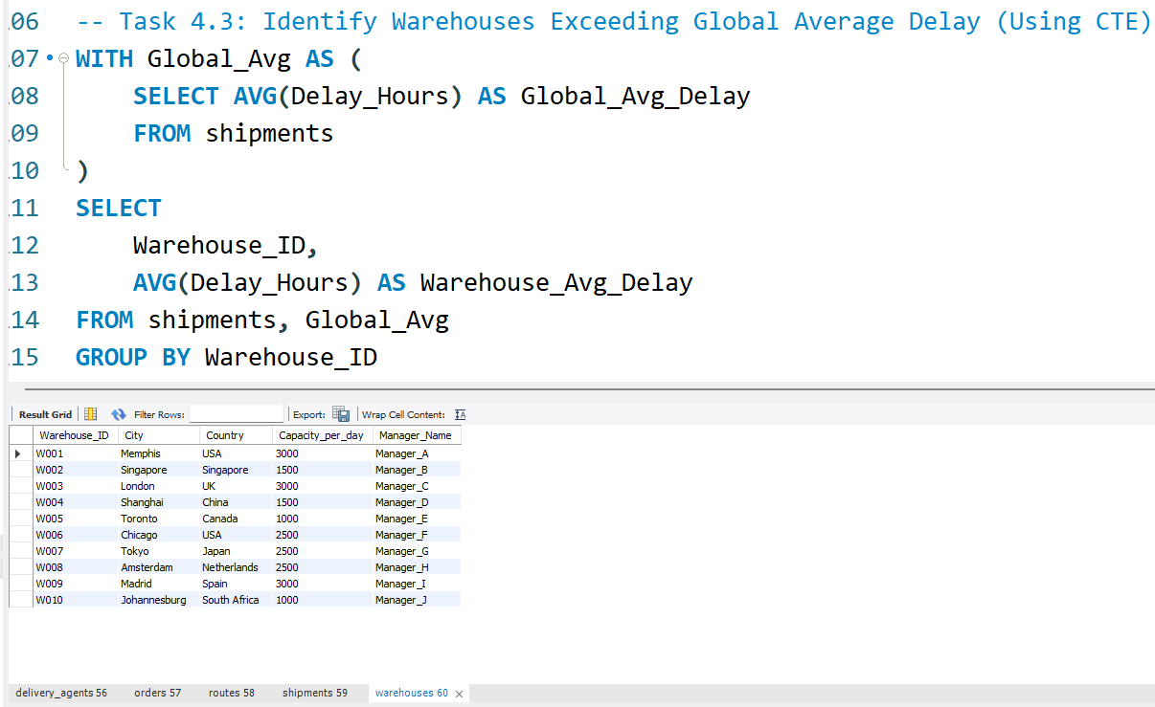
Screenshots Task 4 :

Slide 11
Task 4: Warehouse Delay

Slide 12
Task 5: Delivery Agent Performance (SQL)
On-Time % per Agent & Route
Agents Below 85% Identified
Top vs Bottom Agent Comparison
Training & Load Balancing Suggested

Slide 13
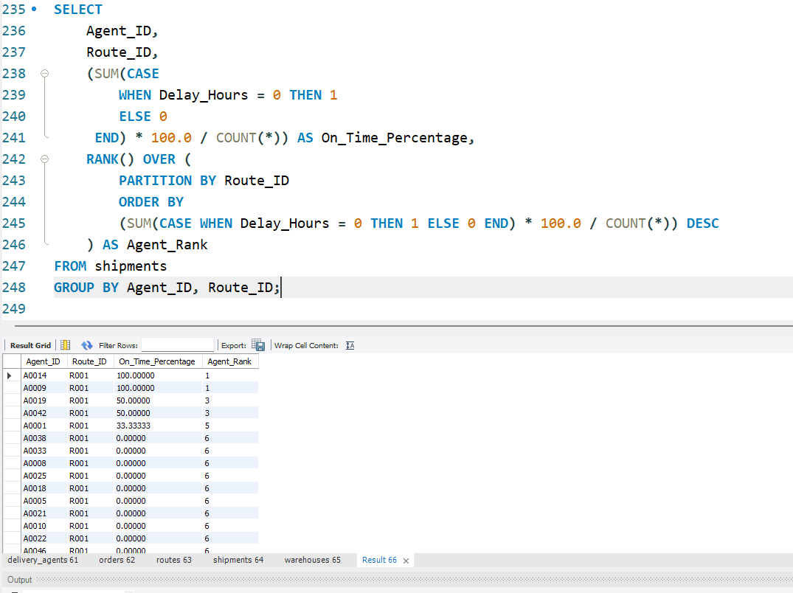
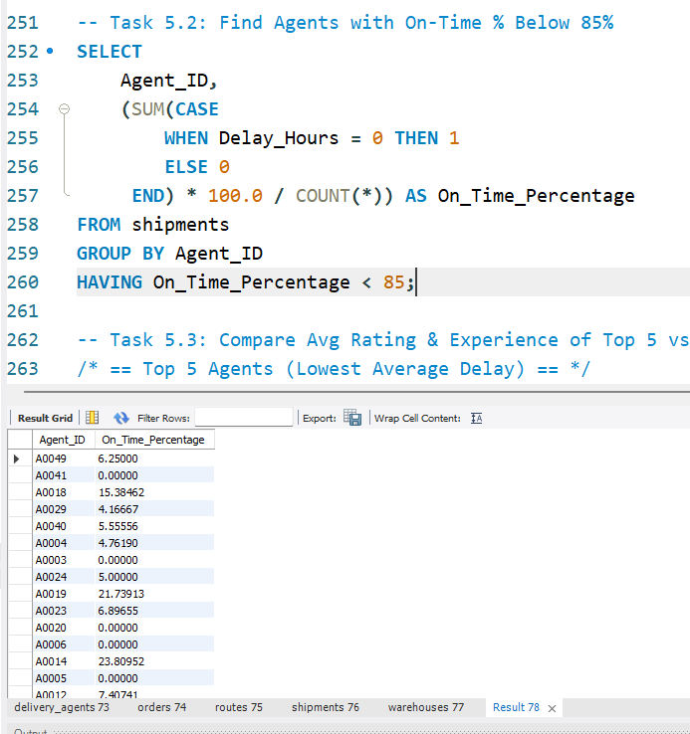
Screenshots:-

Slide 14
Task 6: Shipment Tracking Analytics
Latest Status per Shipment
Routes with Most In-Transit Shipments
High Delay Shipments (>120 hrs) Identified
Operational Bottlenecks Highlighted

Slide 15
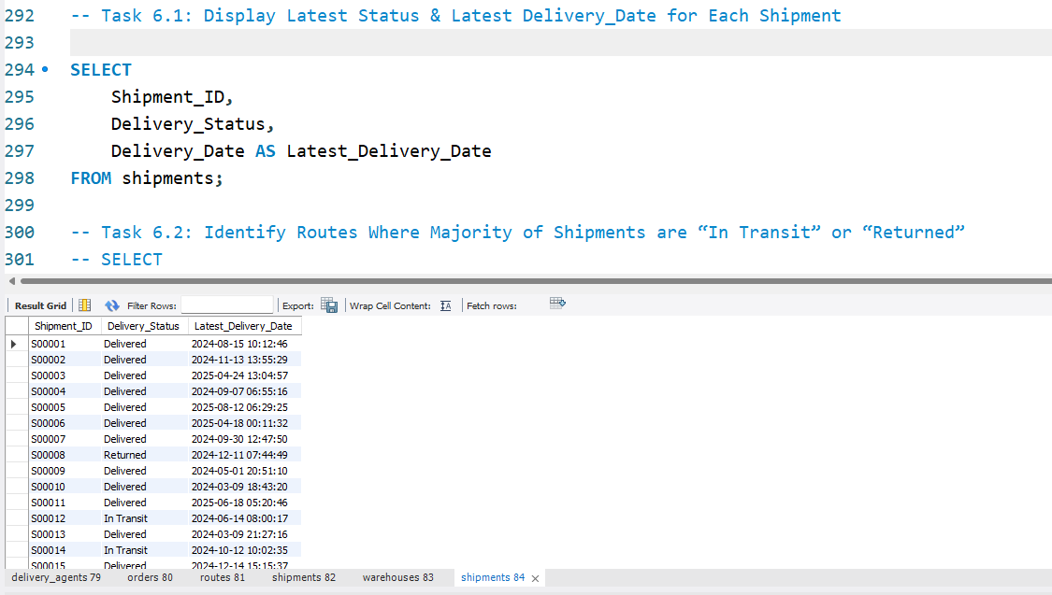
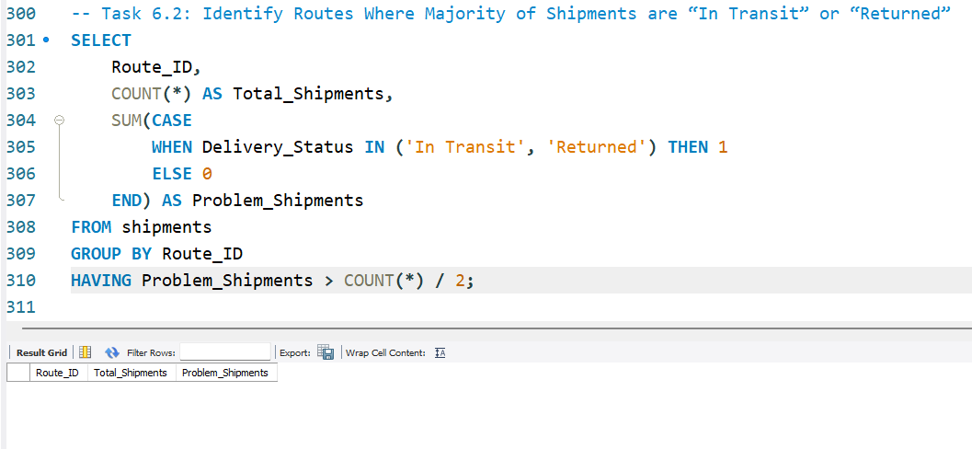
Screenshots:

Slide 16
Task 7: KPI Reporting
Avg Delay per Source Country
Overall On-Time Delivery %
Avg Delay per Route
Warehouse Utilization %

Slide 17
Key Insights & Business Recommendations
Certain routes need redesign & alternate hubs.
High-delay warehouses require capacity planning.
Agent training improves delivery performance.

Slide 18
Link For the Explanation:
https://drive.google.com/file/d/1cJyrHMSDteewQPYq7KI8nx32SZzx_d65/view?usp=sharing

