Slide 1

Contract API Testing
26 Th Feb 2021
AmarjeetY

Slide 2
What is contract testing?
Contract testing is a technique for testing an integration point by checking each application in isolation to ensure the messages it sends or receives conform to a shared understanding that is documented in a "contract".
When To use Contract Testing?
Contract testing is immediately applicable anywhere where you have two services that need to communicate - such as an API client and a web front-end. Although a single client and a single service is a common use case, contract testing really shines in microservices environment.

Slide 3
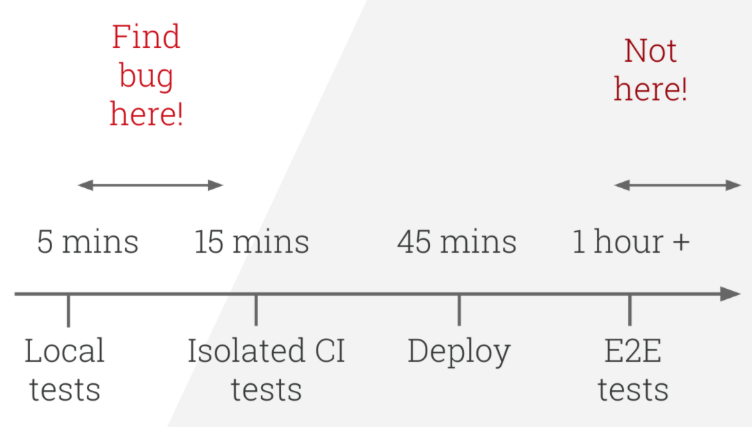
Why contract testing is important ?
Contracts can be tested in development stage rather than to wait for End to End test, as in development environments access to other services is not always possible.

Slide 4
How they differ from E2E tests ?
They run fast, because they don't need to talk to multiple systems.
They are easier to maintain: you don't need to understand the entire ecosystem to write your tests.
They are easy to debug and fix, because the problem is only ever in the component your testing - so you generally get a line number or a specific API endpoint that is failing.
They are repeatable.
They scale: Each component can be independently tested, build pipelines don't increase linearly / exponentially in time.
They uncover bugs locally, on developer machines: contract tests can and should run on developer machines prior to pushing code.

Slide 5
How Pact open source framework works ? (https://docs.pact.io/)
Note : Here consumer means requesting client which can be a web UI client or our contract tests. Provider means server which provides services to client. Example is a server running microservice.
Step 1:
API Request is send to Mock framework which generates contract in form of Json File.
Step 2:
API request is sent to provider by using data from contract Json.
Step 3:
Response from provider is compared with contract. All transactions are recorded in log file.

Slide 6
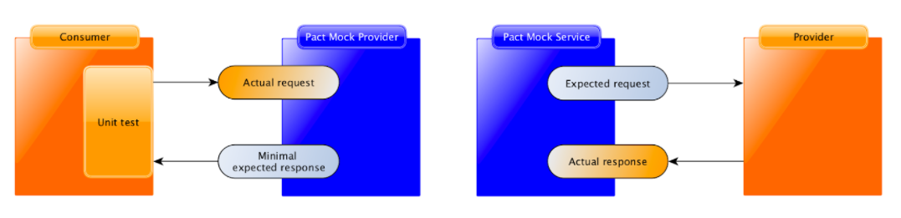
Pact Architecture diagram :

Slide 7
Why we should adapt contract testing?
Verifies complete response from provider including below:
- Response Code – Headers – Response Json Body
So that we don’t have to write separate tests to check each field
With shift left approach testers can generate contracts using mocks even before actual service us available. Once service is available and running testers can simply verify contracts previously created against actual service.
Developers and testers can use same mocking framework or testers can import mocks created by developers in other frameworks and simply format them in pact recognizable format.
BA’s can write contracts which can be directly imported in tests.

Slide 8
How to run attached demo ?
Install ISS on your pc using below link
https://www.howtogeek.com/112455/how-to-install-iis-8-on-windows-8/
Unzip and open in Visual Studio 2019. You can use free express edition of you don’t have licensed copy.
Build Solution. Run test “GenerateContract”
Make sure that contract json file is generated in below folder
C:/Pact-Testing-Files/pacts
Click IISExpress icon in toolbar. It will open new browser window. Close this browser window.
Open new browser window and copy /paste below URL.
http://localhost:60880/api/employee/1

Slide 9
How to run attached demo ( cont..) ?
You should see below in browser
{"id":1,"employeeName":"Developer","email":"developer@covea.co.uk","city":"Halifax"}
This indicates that local API server is running and ready to accept requests.
Run Test “VerifyContractWithRealService”
If test runs successfully check the log for this test in test explorer and make sure that you get messages seen in next slide :
Play with contract json and force tests to fail.
Update contract with your own service contract and test it against your service.

Slide 10
How to run attached demo ( cont..) ?
Verifying a pact between Service_Consumer and EmployeeList
Given Employee Details for Id '1'
A GET request to retrieve the employee 1 details
with GET /employee/1
returns a response which
has status code 200
has a matching body
includes headers
"Content-Type" which equals "application/json; charset=utf-8"
1 interaction, 0 failures

