Slide 1

RETAIL SALES CASE STUDY
Group 1
(ABADS B10)

Slide 2
Business Analysis and Hypothesis (Task 2)
Profile of people who respond vs. who don’t.
The DataFrame was split up into people who responded as responders (1) and people who did not respond as non_responders (0).
responders = marketing[marketing['Response'] == 1]
non_responders = marketing[marketing['Response'] == 0]
Two attributes “Year_Birth” & “Income” were taken for analysis to those who responded and those who didn’t.
Descriptive Statistics was done for the attributes as those who responded vs those who didn’t.

Slide 3
The minimum and maximum value for Year_Birth for the responders was 1969 and 1996. Similarly the minimum and maximum value for Year_Birth for the non-responders was 1968 and 1996. The minimum and maximum value for Income for the responders was $7500 and $105471. Similarly the minimum and maximum value for Income for the non-responders was $1730 and $666666 respectively.
Statistics for Year_Birth:
Responders:
count 334.000000
mean 1969.416168
std 12.398192
min 1943.000000
25% 1959.000000
50% 1971.000000
75% 1979.000000
max 1996.000000
Name: Year_Birth,
Non-Responders:
count 1906.000000
mean 1968.698846
std 11.910143
min 1893.000000
25% 1959.000000
50% 1970.000000
75% 1977.000000
max 1996.000000
Statistics for Income:
Responders:
count 333.000000
mean 60209.675676
std 23194.080987
min 7500.000000
25% 39763.000000
50% 64090.000000
75% 80589.000000
max 105471.000000
Non-Responders:
count 1883.000000
mean 50839.132767
std 25252.804747
min 1730.000000
25% 34421.000000
50% 50150.000000
75% 66308.000000
max 666666.000000

Slide 4
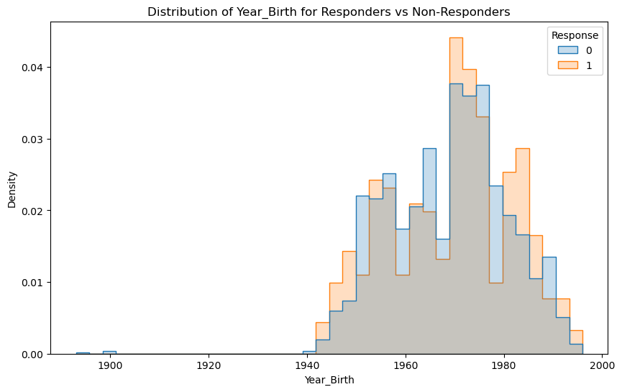
Distribution of Year_Birth for Responders vs Non-Responders
From the graph it can be concluded that people are responding to the campaign more than that of the Non-Responders.

Slide 5
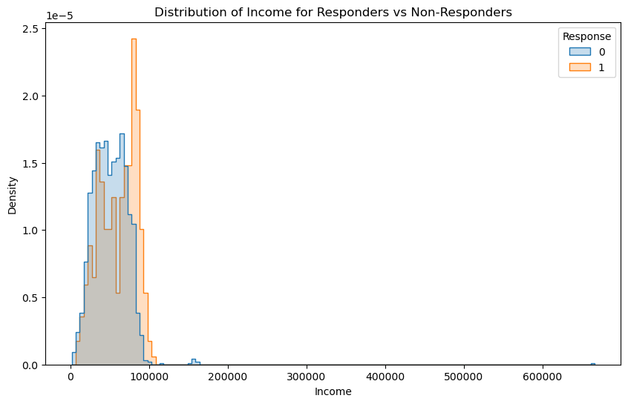
Distribution of Income for Responders Vs Non-Responders
From the graph it can be concluded that people with high income bracket are responding well to the campaign than the Non-Responders.

