Slide 1
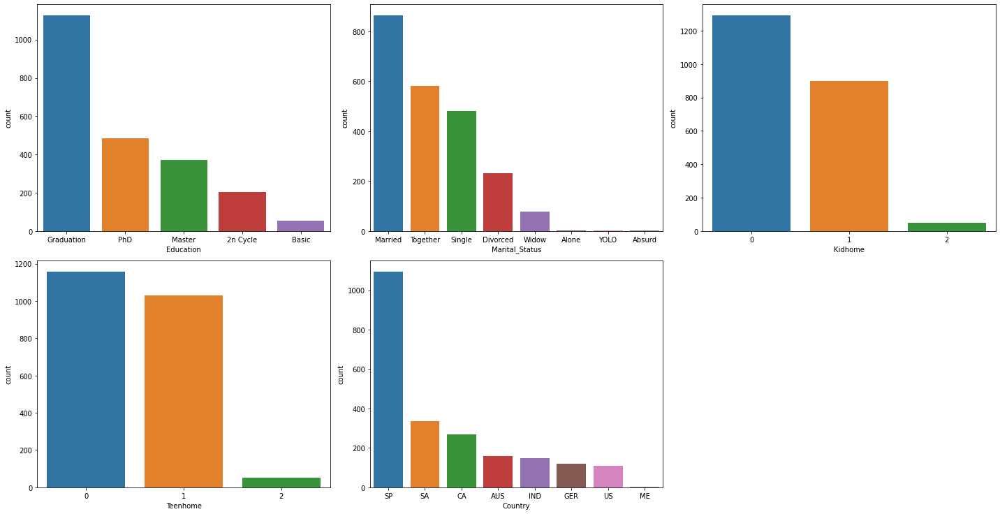
EDA Demographics

Slide 2
