Slide 1

Hypothesis Testing

Slide 2
Hypothesis 1: Customers who spend more on wines are more likely to respond positively to marketing campaigns promoting wine-related products.
Hypothesis 2: Customers who spend more on fruits are more likely to respond positively to health-focused marketing campaigns.
Hypothesis 3: There is no significant relationship between the amount spent on meat products and the response rates in marketing campaigns.
Hypothesis 4: Customers who spend more on fish products are more likely to respond positively to marketing campaigns promoting seafood specials or cooking classes.
Hypothesis 5: There is a positive correlation between the amount spent on sweets and the response rates in marketing campaigns targeting family-oriented or holiday-themed promotions.

Slide 3
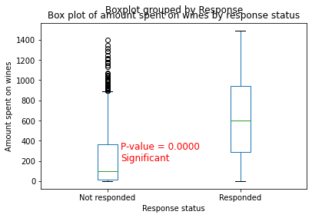
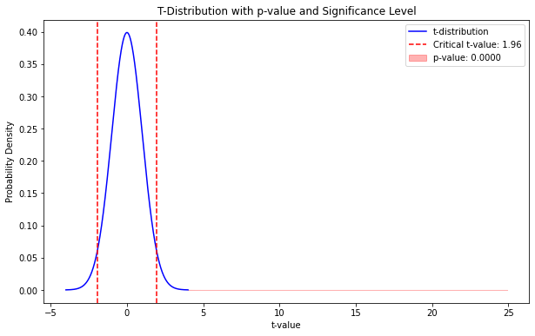
Hypothesis 1: Customers who spend more on wines are more likely to respond positively to marketing campaigns promoting wine-related products.
p value = 2.9561909421349646e-121 < significance value (0.05)
Reject the Null Hypothesis
The amount spent on wines significantly differs between customers who responded and those who did not respond to marketing campaigns.

Slide 4
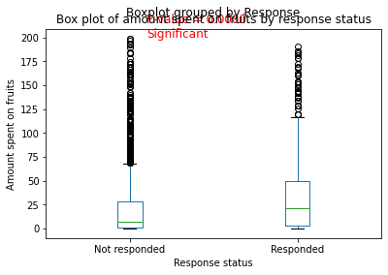
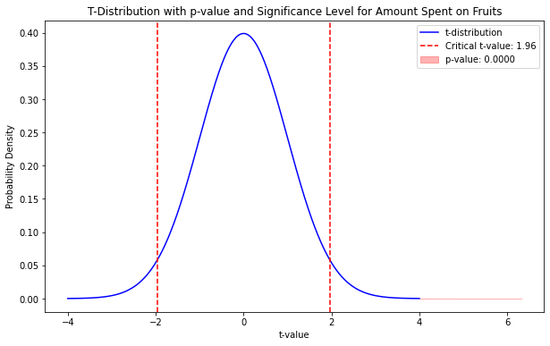
Hypothesis 2: Customers who spend more on fruits are more likely to respond positively to health-focused marketing campaigns.
the p value = 3.0950001315024603e-10 < 0.05
Reject the Null Hypothesis
The amount spent on fruits significantly differs between customers who responded and those who did not respond to marketing campaigns.

Slide 5
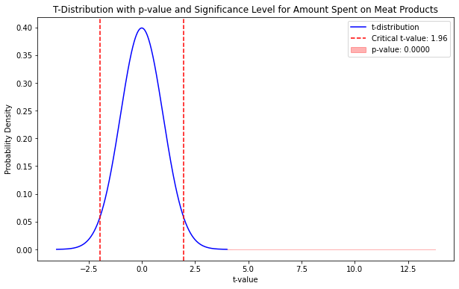
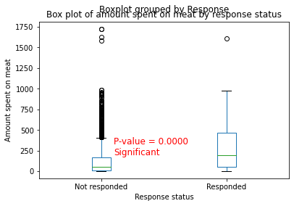
Hypothesis 3: There is no significant relationship between the amount spent on meat products and the response rates in marketing campaigns.
p value = 1.620540963756365e-41 < significance value (0.05)
Reject the Null Hypothesis
The amount spent on meat significantly differs between customers who responded and those who did not respond to marketing campaigns.

Slide 6
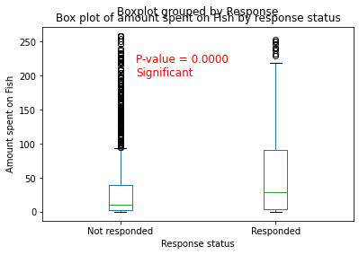
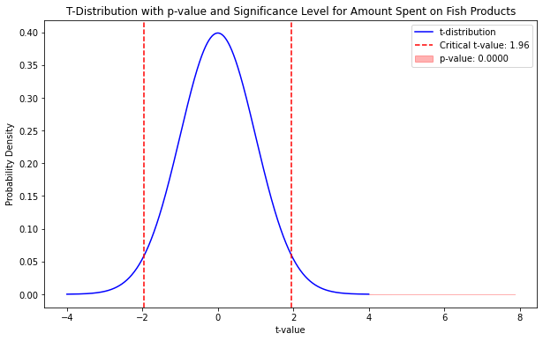
Hypothesis 4: Customers who spend more on fish products are more likely to respond positively to marketing campaigns promoting seafood specials or cooking classes.
p value = 5.351004838201368e-15 < significance value (0.05)
Reject the Null Hypothesis
The amount spent on wines significantly differs between customers who responded and those who did not respond to marketing campaigns.

Slide 7
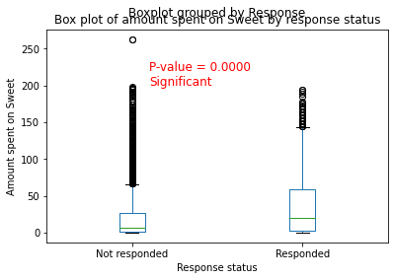
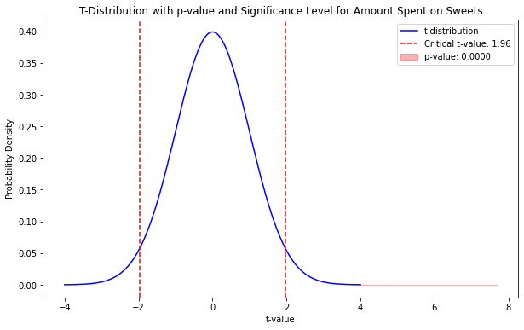
Hypothesis 5: There is a positive correlation between the amount spent on sweets and the response rates in marketing campaigns targeting family-oriented or holiday-themed promotions.
p value = 2.222422096548862e-14 < significance value (0.05)
Reject the Null Hypothesis
The amount spent on sweet significantly differs between customers who responded and those who did not respond to marketing campaigns.

