Slide 1
Problem Statement
Goal: Increase bank revenue through a cost-effective telemarketing campaign for term deposits.
Method: Analyze existing customer data to identify patterns and improve the positive response rate (subscriptions) for term deposits.
Focus: Customer demographics, campaign timing (temporal trends), and other relevant factors influencing campaign success.
Outcome: Recommendations for targeted marketing strategy improvements.

Slide 2
Business Understanding
Interest Income: Banks profit by lending out term deposit funds at higher interest rates than those paid to depositors, creating a net interest margin (NIM) that adds to revenue.
Liquidity Management: Term deposits offer stable funding, allowing banks to maintain liquidity for lending while managing deposit and loan maturities.
Cross-Selling Opportunities: Banks use term deposit relationships to offer additional financial products, boosting revenue through fee-based services and fostering customer loyalty.
Customer Retention: Competitive rates and flexible terms attract and retain term depositors, stabilizing funding and reducing reliance on short-term borrowing.
Risk Management: Term deposits provide a stable funding base, enhancing the bank's resilience to liquidity risks and market fluctuations.

Slide 3
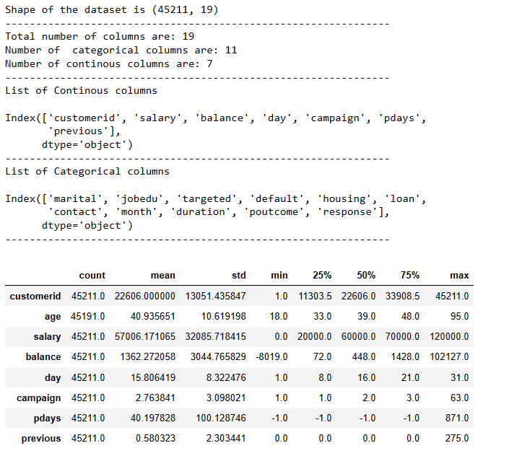
Data Understanding
Basic Info About Dataset
Column Operations need to be performed on RAW DATA 1) Convert age(folat64) ---> int64
2) Split (job_edu) ----> "job" , "education"
3) split(month) ----> month , year
4) convert all the data in "duration" to "minutes"
5) dropping customer id column

Slide 4
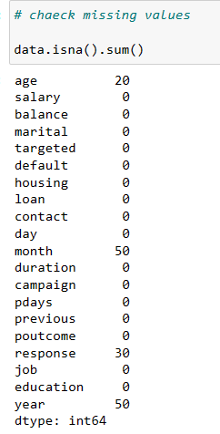
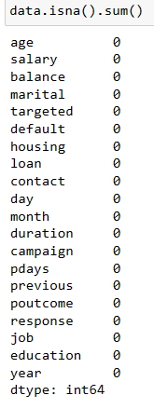
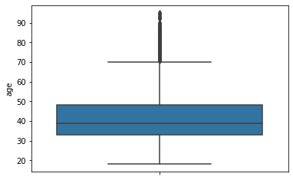
Handling Missing Values
BEFORE IMPUTATION
As we can see "age" and "response" have missing values here
In order to impute the missing values we need to check two aspect
Check the data type of the column that has missing values (here "age" is an int and "response" is an object)
2) Check if the column with missing value has any outliers (specifically continuous dtype) if “YES” impute with median, If “NO” then impute it with mean.
3) For categorical data impute with median.
AFTER IMPUTATION

Slide 5
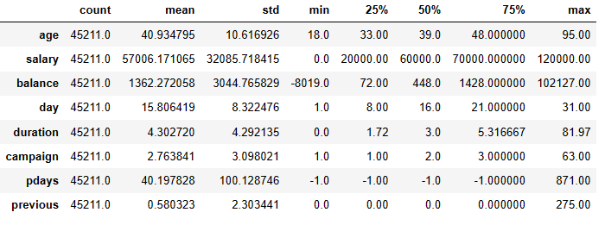
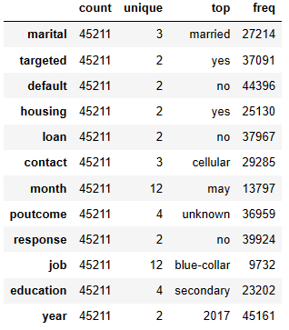
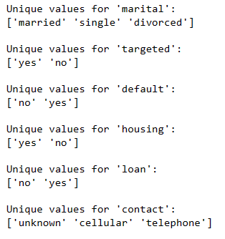
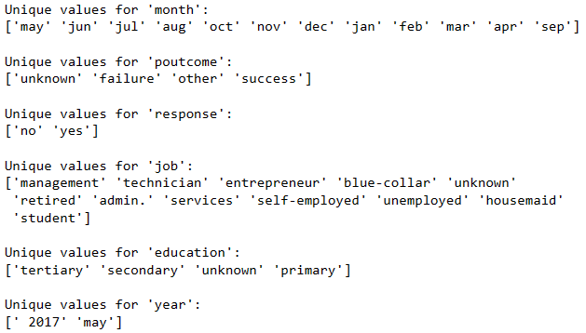
Descriptive Statistics
Continuous Variables
Categorical variables
Note: 5 point summary(Plotly) is present in Jupyter notebook (cell 14)
Unique values of categorical variables

Slide 6
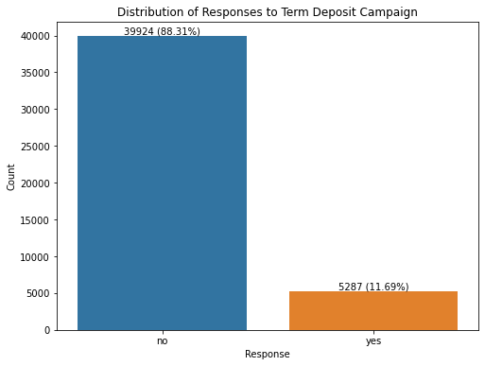
Target Variable Distribution
So the distribution of target variable is unbalanced. We need to perform SMOTE (oversampling if we want to make predictive model)

Slide 7
Exploratory Data Analysis

Slide 8
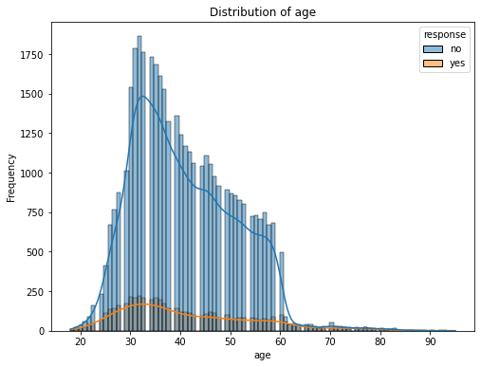
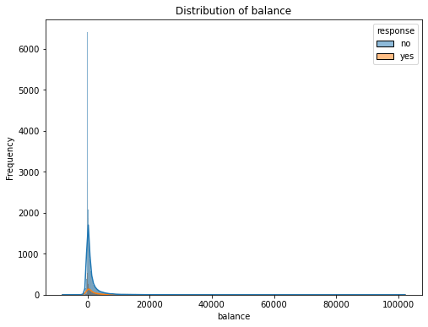
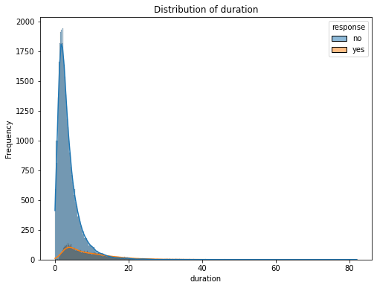
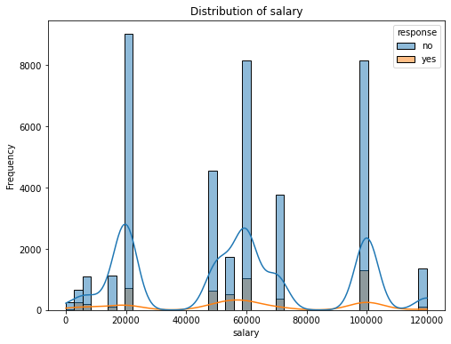
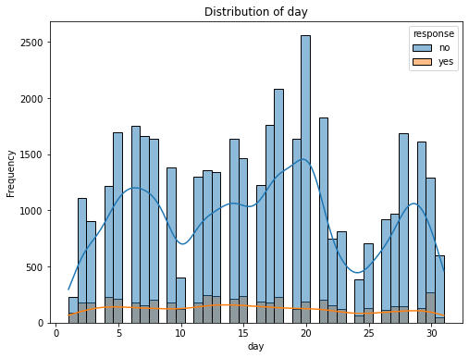
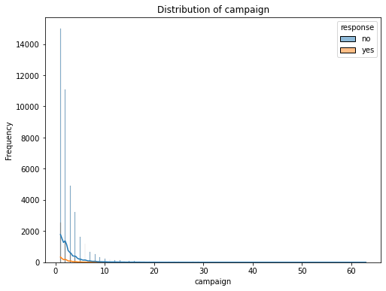
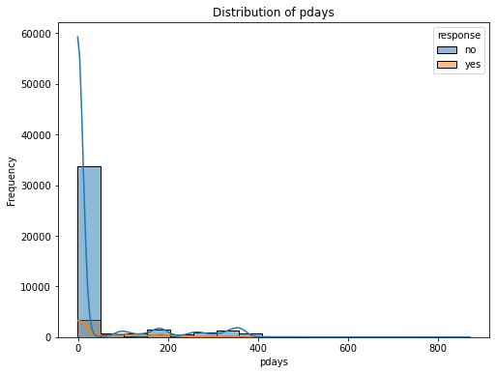
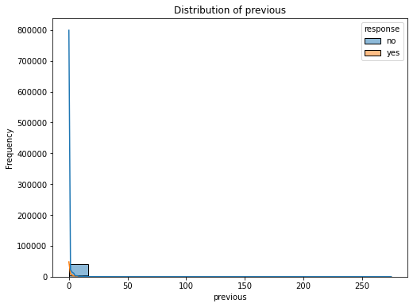
Continuous variable vs Response

Slide 9
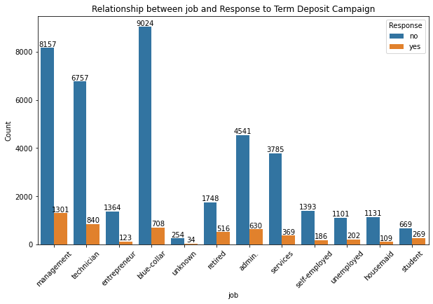
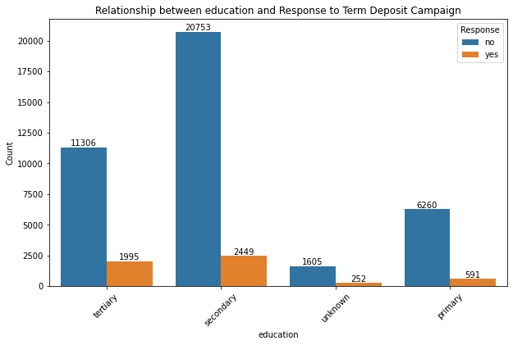
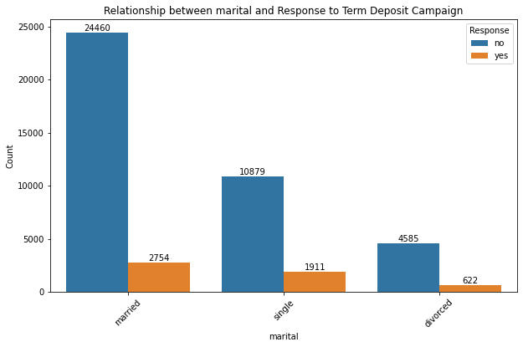
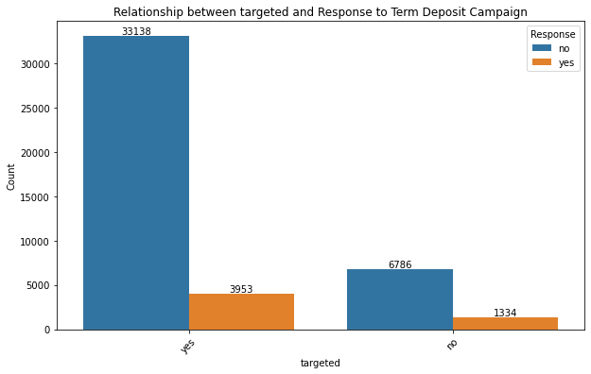
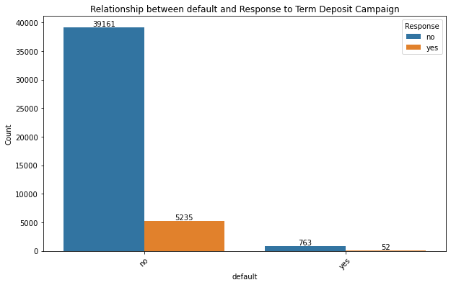
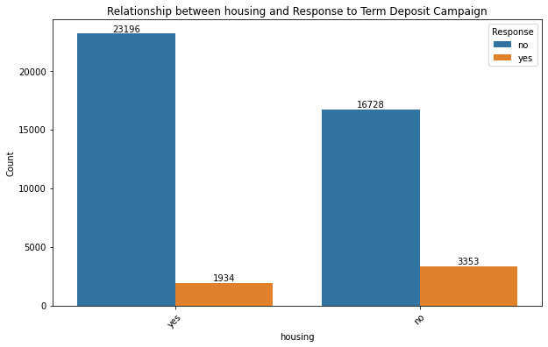
Categorical variable vs Response

Slide 10
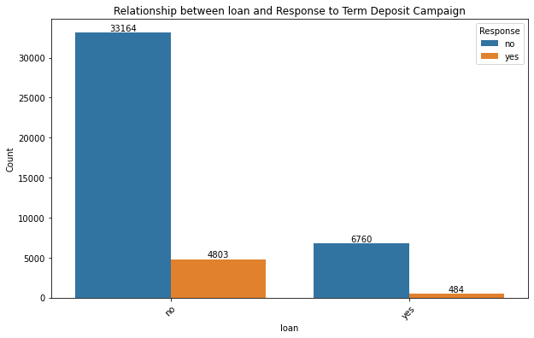
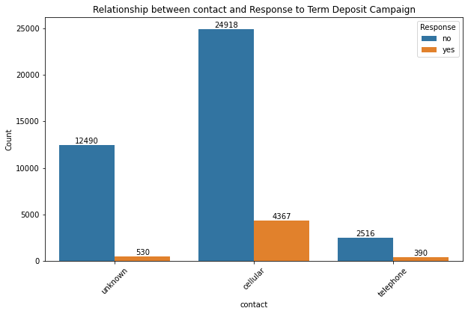
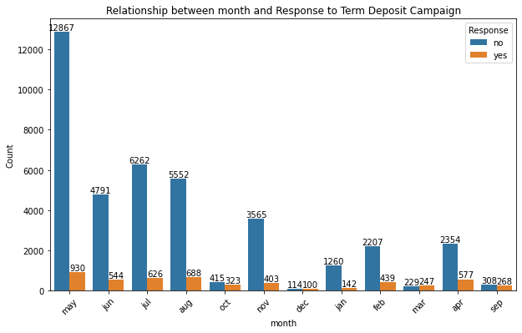
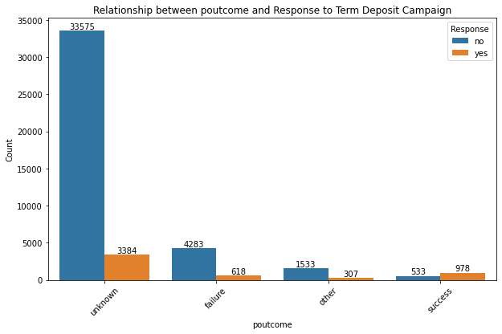

Slide 11
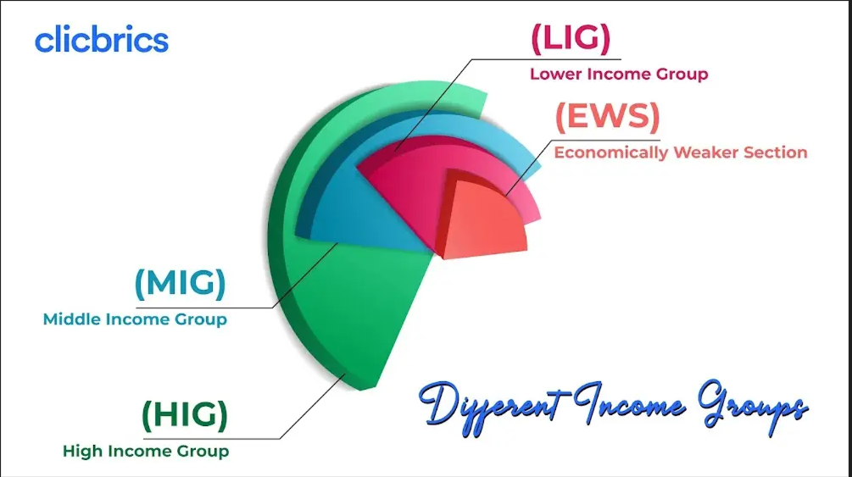
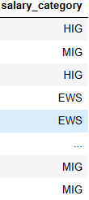
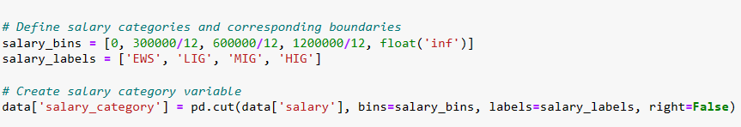
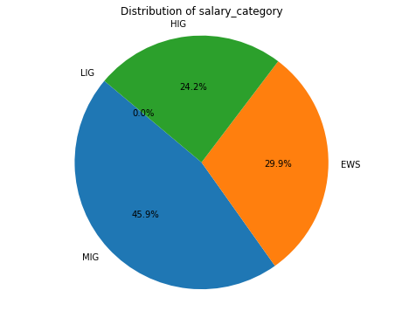
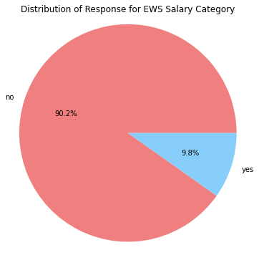
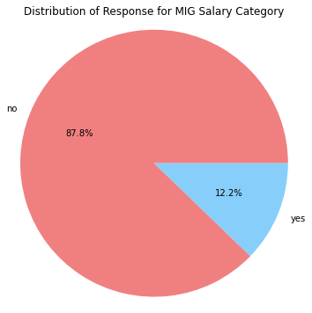
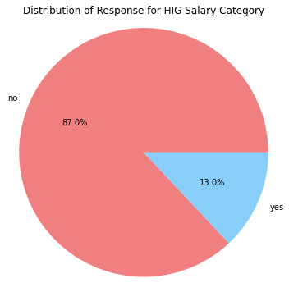
Creating Derived variable (salary category)
Output
Code
Distribution of salary category vs Response (YES /NO)
Note : MIG and HIG category are more likely to say “YES”

Slide 12
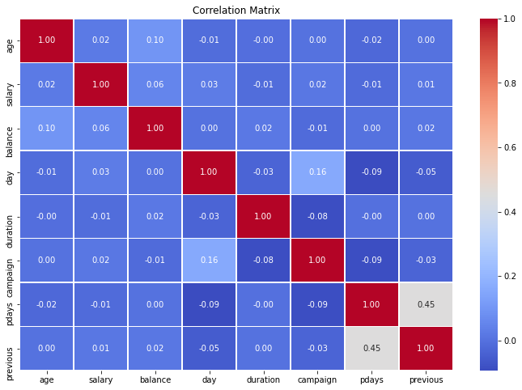
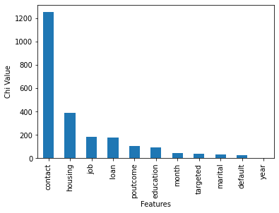
Correlation Between Independent Variables
If we look at correlation matrix there is no strong correlation between independent variables hence there is no issue of multi-collinearity.
Out of all the categorical features contact is having the most importance

Slide 13
What is the distribution of categorical variables
Refer cell 22 from Jupyter notebook
How does Categorical variables contribute to “YES” as response
Check Jupyter notebook code block for the result (cell 48)

Slide 14
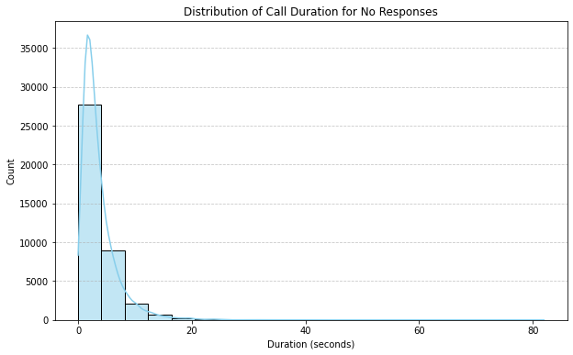
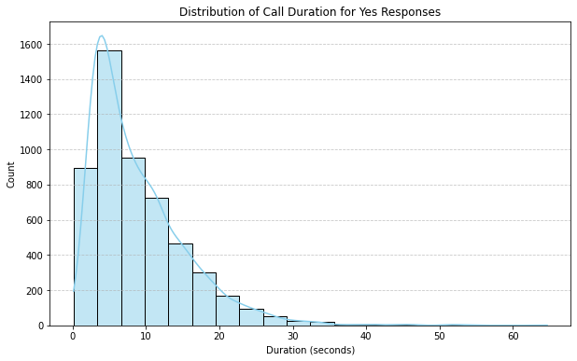
How does duration effect the response as “YES”
For response “NO” Maximum number of calls are near to zero minutes
For response “YES” Maximum number of calls last up to 5-8 minutes

Slide 15
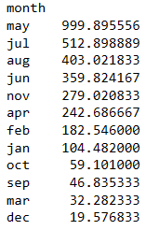
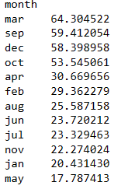
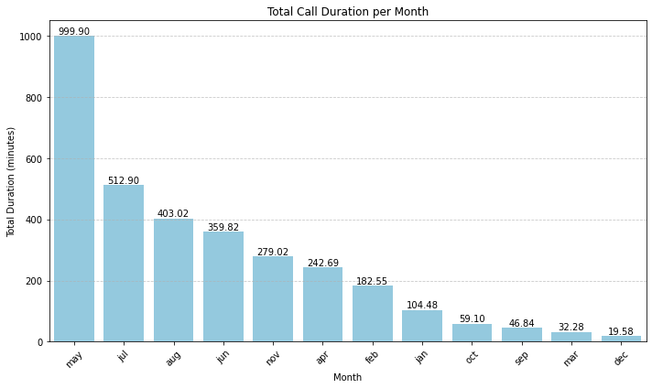
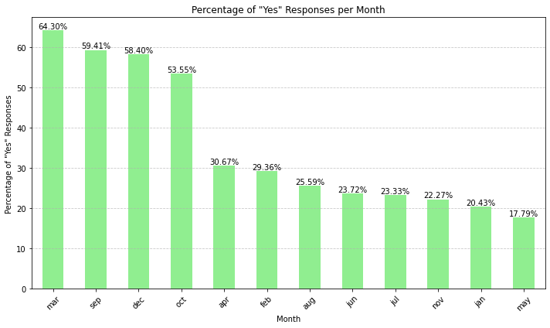
Call Duration /Month/ Response as “YES”
“Summation” of “call duration” according to month in “HOURS”
Percentage of “RESPONSE” as “YES” w.r.t “Month”
The conversion rate is higher for month of march even though the total duration of call was less for that particular month

Slide 16
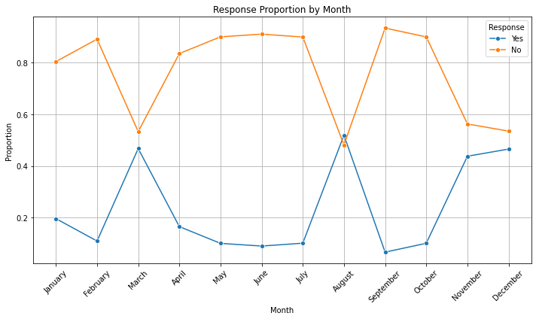
Response Proportion by month
March, August, November and December are months with peaks

Slide 17
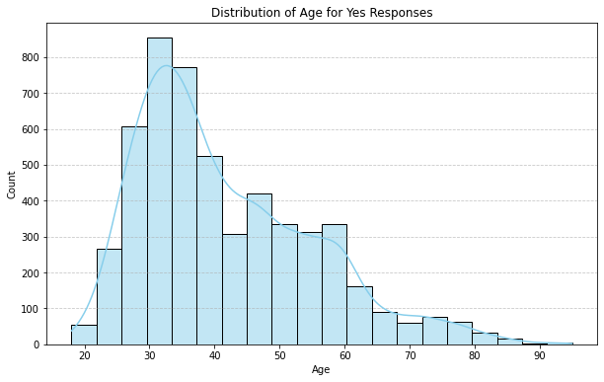
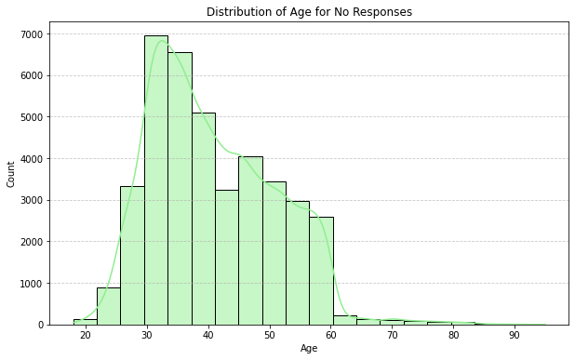
Age Vs Responses
Almost same distribution can be seen for age but after age 60 we have some significant response as “YES” but for “NO” the line is almost flat i.e. after 60 the probability of response to be as “YES” is more as compared to “NO”.
Most of the data for “YES” lies with range of (25 – 60 age), so our target audience is with age of 25 - 60

Slide 18
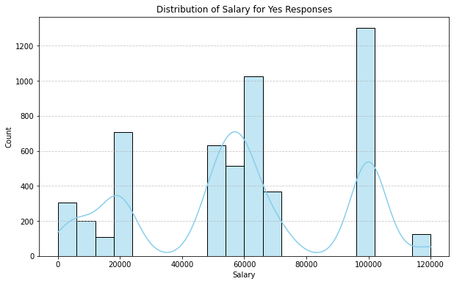
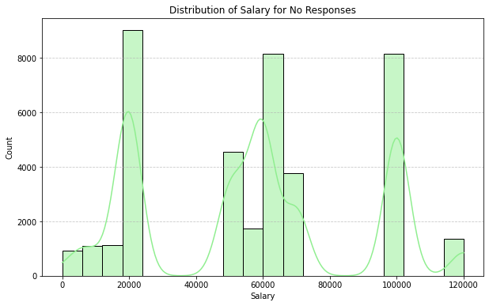
Salary vs Responses
For both the graphs we can see that the distribution has three modes (trimodal), so the potential customers whose have high conversion response as “YES” can be grouped into 3 categories.
 | Group 1 | Group 2 | Group 3
Salary Range/month | 0 - 20,000 | 50,000 – 70,000 | 1 lac - 1.2 lac

Slide 19
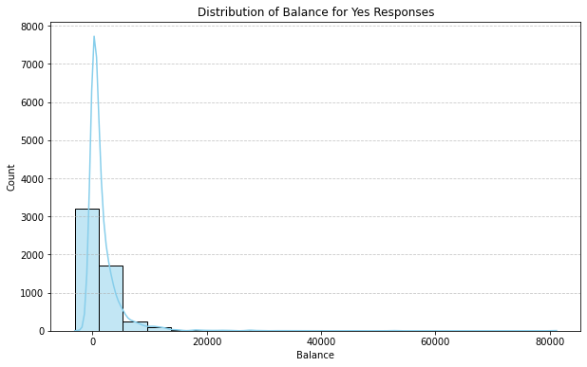
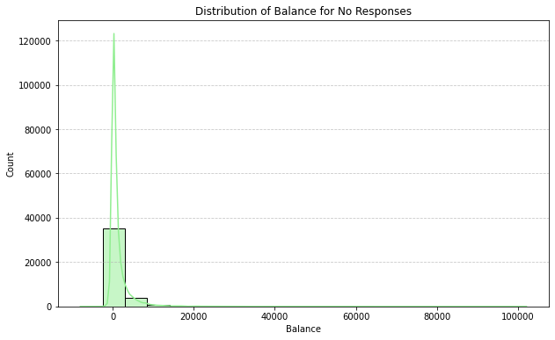
Balance vs Responses
If we look at the graph for “YES” it has a larger body as compared to “NO” which makes yes i.e people with some amount of balance left in their account can invest. People who have almost zero balance has “NO” as their responses.

Slide 20
Traits of Potential Customers whose probability of saying “Yes” for term deposit
Income Group
High Income Group (HIG)
And
Middle Income Group (MIG)
 | Group 1 | Group 2 | Group 3
Salary Range/month | 0 - 20,000 | 50,000 – 70,000 | 1 lac - 1.2 lac
Age
25 - 60
Best Mode of Contact
Cellular
Job Type
Management, Technician, blue-collar, admin, retired, services
Education
Secondary and Tertiary
Marital Status
Married and Single
Housing Loan No

