Slide 1
A superstition is a belief in supernatural causality – that one event leads to another without anything physically linking the two events.
Logically, they are irrational and sometimes funny, but some people believe in them a great deal – and some people change their normal behaviour to fit in with them – for example, Triskaidekaphobia is the fear of the number 13. A sufferer may be too terrified to leave the house on that date, believing only bad things would happen.

Slide 2
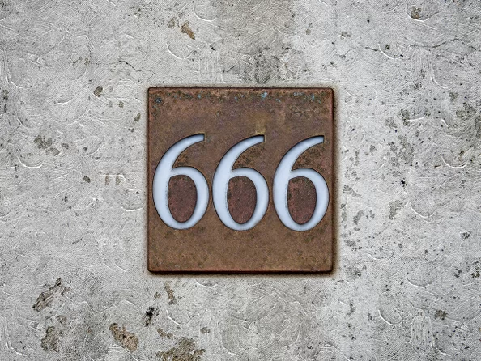
666 - The mark of Satan

Slide 3
Three sixes in a row give some people the chills. It's a superstition that harks back to the Bible. In the Book of Revelation, 666 is given as the number of the "beast," and is often interpreted as the mark of Satan and a sign of the end times.

Slide 4
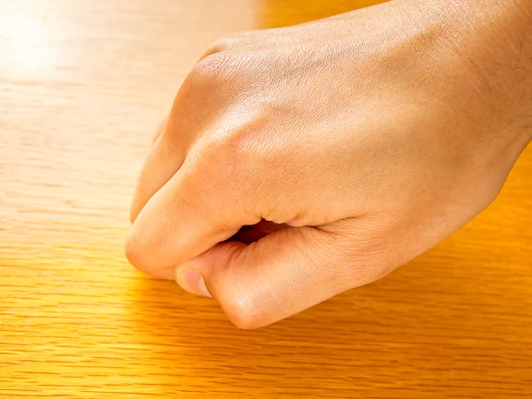
Knock on wood

Slide 5
This phrase is almost like a verbal talisman, designed to ward off bad luck after tempting fate: "Breaking that mirror didn't bring me any trouble, knock on wood."
The fixation on wood may come from old myths about good spirits in trees or from an association with the Christian cross.

Slide 6
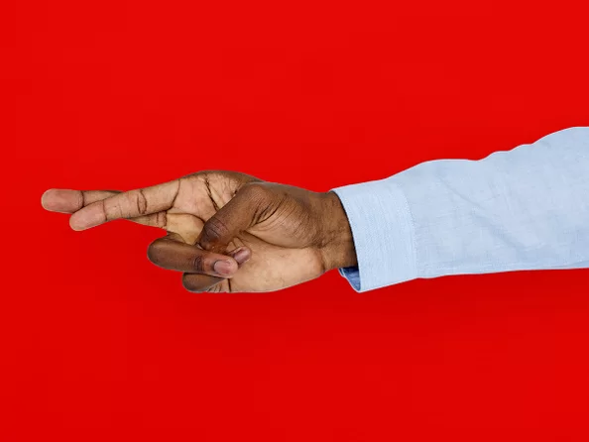
Cross your fingers

Slide 7
Those wishing for luck will often cross one finger over another, a gesture that's said to date back to early Christianity. The story goes that two people used to cross index fingers when making a wish, a symbol of support from a friend to the person making the wish. (Anything associated with the shape of the Christian cross was thought to be good luck.) The tradition gradually became something people could do on their own; these days, just saying "fingers crossed" is enough to get the message, well, across.

Slide 8
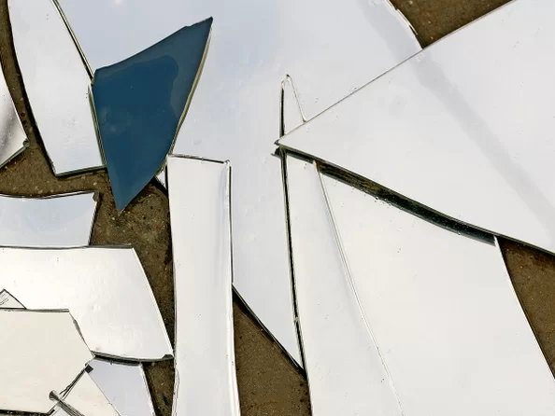
Don’t break a mirror

Slide 9
According to folklore, breaking a mirror is a surefire way to doom yourself to seven years of bad luck. The superstition seems to arise from the belief that mirrors don't just reflect your image; they hold bits of your soul. That belief led people in the old days of the American South to cover mirrors in a house when someone died, lest their soul be trapped inside.

